Slide 1
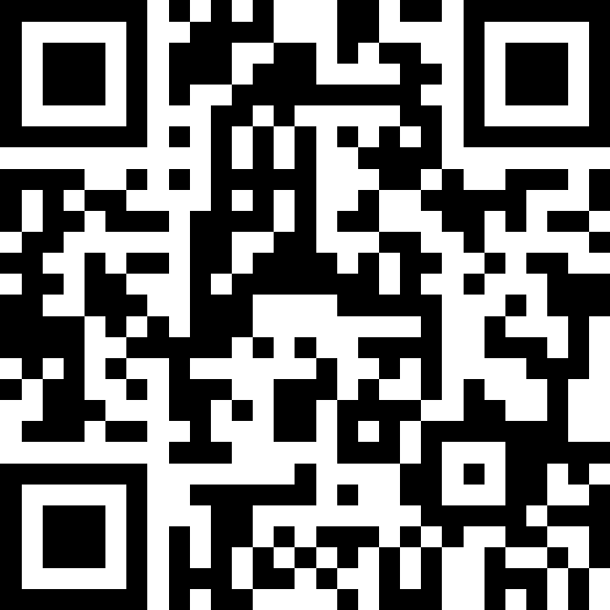
Stacks & Queues
BEFORE WE START
Slido vote & chat with neighbors:
Best place for cheap eats on the Ave? on Campus?

Slide 2
Lecture Outline
Announcements
Review: ADTs, Stacks & Queues
Queue Manipulation
Stack Manipulation
  Problem Solving

Slide 3
Announcements
Quizzes
  Quiz 0 was yesterday
  Feedback releasing sometime before Quiz 1 (May 7th)
  Metacognition: How did it go? Was your studying and preparation effective?
Creative Project 1 releasing Today
  Focus on ArrayLists
  Due Thursday, April 23rd by 11:59pm PT
Resub 0 opened yesterday, due Tuesday, April 21st by 11:59pm PT
  Eligible Assignment: C0
Viewing feedback in Ed
  Having difficulty finding it? Don’t know how to see your grade? Go to IPL or ask your section TA! This feedback is super important! Don’t miss out on it!

Slide 4
Lecture Outline
Announcements
Review: Stacks & Queues
Queue Manipulation
Stack Manipulation
  Problem Solving

Slide 5

(PCM) Stacks & Queues
PCM focused on these new data structures!
Some collections are constrained, only use optimized (but limited) operations
  Stack: retrieves elements in reverse order as added
  Queue: retrieves elements in same order as added
Why optimize? Think dedicated tool instead of a Swiss Army knife
push
pop, peek
top | 3
 | 2
bottom | 1
front |  | back
1 | 2 | 3
remove, peek
add
queue
stack

Slide 6
(PCM) Abstract Data Types
Abstract Data Type (ADT): A specification of a collection of data and the operations that can be performed on it.
  Describes what a collection does, not how it does it (not implementation!)
  Think of it as an ✨idea ✨ of a data type
We don't know exactly how a stack or queue is implemented, and we don't need to!
  Only need to understand high-level idea of what a collection does
  Stack: retrieves elements in reverse order as added.
  Queue: retrieves elements in same order as added.

Slide 7
Wait, ADT? Interfaces?
Abstract Data Type (ADT): A description of the idea of a data structure including what operations are available on it and how those operations should behave. For example, the English explanation of what a list should be.
Interface: Java construct that lets programmers specify what methods a class should have. For example the List interface in java.
Implementation: Concrete code that meets the specified interface. For example, the ArrayList and LinkedList classes that implement the List interface.

Slide 8



(PCM) Stacks
Stack: A collection based on the principle of adding elements and retrieving them in the opposite order.
  Last-In, First-Out ("LIFO")
  Elements are stored in order of insertion.
    We do not think of them as having indexes.
  Client can only add/remove/examine the last element added (the "top")
Basic Stack operations:
push: Add an element to the top
pop: Remove the top element
peek: Examine the top element
top
push
pop
bottom

Slide 9
Stacks in Computer Science
Programming languages and compilers:
  method calls are placed onto a stack (call↔push, return ↔ pop)
  compilers use stacks to evaluate expressions
Operating Systems:
  Call stacks → memory stack for processes’ data
Matching up related pairs of things:
  find out whether a string is a palindrome
  examine a file to see if its braces { } match
  convert "infix" expressions to pre/postfix
Sophisticated algorithms:
  searching through a maze with "backtracking”
  many programs use an "undo stack" of previous operations

Slide 10
(PCM) Programming with Stacks
Stack<E>() | constructs a new stack with elements of type E
push(value) | places given value on top of stack
pop() | removes top value from stack and returns it; throws EmptyStackException if stack is empty
peek() | returns top value from stack without removing it; throws EmptyStackException if stack is empty
size() | returns number of elements in stack
isEmpty() | returns true if stack has no elements
"c"
"b"
"a"
  Stack<String> s = new Stack<String>();
  s.push("a");
  s.push("b");
  s.push("c");
  System.out.println(s.pop());
  Stack has other methods that we will ask you not to use 😬

Slide 11
(PCM) Queue
Queue: Retrieves elements in the order they were added.
  First-In, First-Out ("FIFO")
  Elements are stored in order of insertion but don't have indexes.
  Client can only add to the end of the queue, and can only examine/remove the front of the queue.
Basic Queue operations:
  add (enqueue): Add an element to the back.
  remove (dequeue): Remove the front element.
  peek: Examine the front element.
remove
front
back
add

Slide 12
Queues in Computer Science
Operating systems:
  Queue of print jobs to send to the printer
  Queue of programs / processes to be run
  Queue of network data packets to send
Computer Architecture
  Miss status/handling register (MSHR) queue
  Instruction fetch queue
  Issue queue
  Instruction pipeline in general!
Programming:
  Modeling a line of customers or clients
  Storing a queue of computations to be performed in order
Real world examples:
  People on an escalator or waiting in a line
  Cars at a gas station (or on an assembly line)

Slide 13
(PCM) Programming with Queues
add(value) | places given value at back of queue
remove() | removes value from front of queue and returns it; throws a NoSuchElementException if queue is empty
peek() | returns front value from queue without removing it; returns null if queue is empty
size() | returns number of elements in queue
isEmpty() | returns true if queue has no elements
front
back
42
-3
17
  Queue<Integer> q = new LinkedList<Integer>();
  q.add(42);
  q.add(-3);
  q.add(17);
  System.out.println(q.remove());
  🚨 IMPORTANT: When constructing a queue you must use a new LinkedList object instead of a new Queue object. (More on that with Interfaces.)

Slide 14
Lecture Outline
Announcements
Review: Stacks & Queues
Queue Manipulation
Stack Manipulation
  Problem Solving

Slide 15
Lecture Outline
Announcements
Review: Stacks & Queues
Queue Manipulation
Stack Manipulation
  Problem Solving

Slide 16

What does this method return?
// numbers: bottom [1, 2, 3, 4, 5] top
public static int sum(Stack<Integer> numbers) {
int total = 0;
for (int i = 0; i < numbers.size(); i++) {
int number = numbers.pop();
total += number;
numbers.push(number);
}
return total;
}
A) 0
B) 5
C) 12
D) 15
E) 25
F) Error /
Exception

Slide 17
What does this method return?
// numbers: bottom [1, 2, 3, 4, 5] top
public static int sum(Stack<Integer> numbers) {
int total = 0;
for (int i = 0; i < numbers.size(); i++) {
int number = numbers.pop();
total += number;
numbers.push(number);
}
return total;
}
A) 0
B) 5
C) 12
D) 15
E) 25
F) Error /
Exception

Slide 18
What does this method return?
// numbers: bottom [1, 2, 3, 4, 5] top
public static int sum(Stack<Integer> numbers) {
Queue<Integer> q = new LinkedList<>();
int total = 0;
for (int i = 0; i < numbers.size(); i++) {
int number = numbers.pop();
total += number;
q.add(number);
}
return total;
}
A) 0
B) 5
C) 12
D) 15
E) 25
F) Error /
Exception

Slide 19
What does this method return?
// numbers: bottom [1, 2, 3, 4, 5] top
public static int sum(Stack<Integer> numbers) {
Queue<Integer> q = new LinkedList<>();
int total = 0;
for (int i = 0; i < numbers.size(); i++) {
int number = numbers.pop();
total += number;
q.add(number);
}
return total;
}
A) 0
B) 5
C) 12
D) 15
E) 25
F) Error /
Exception

Slide 20
Lecture Outline
Announcements
Review: Stacks & Queues
Queue Manipulation
Stack Manipulation
  Problem Solving

Slide 21
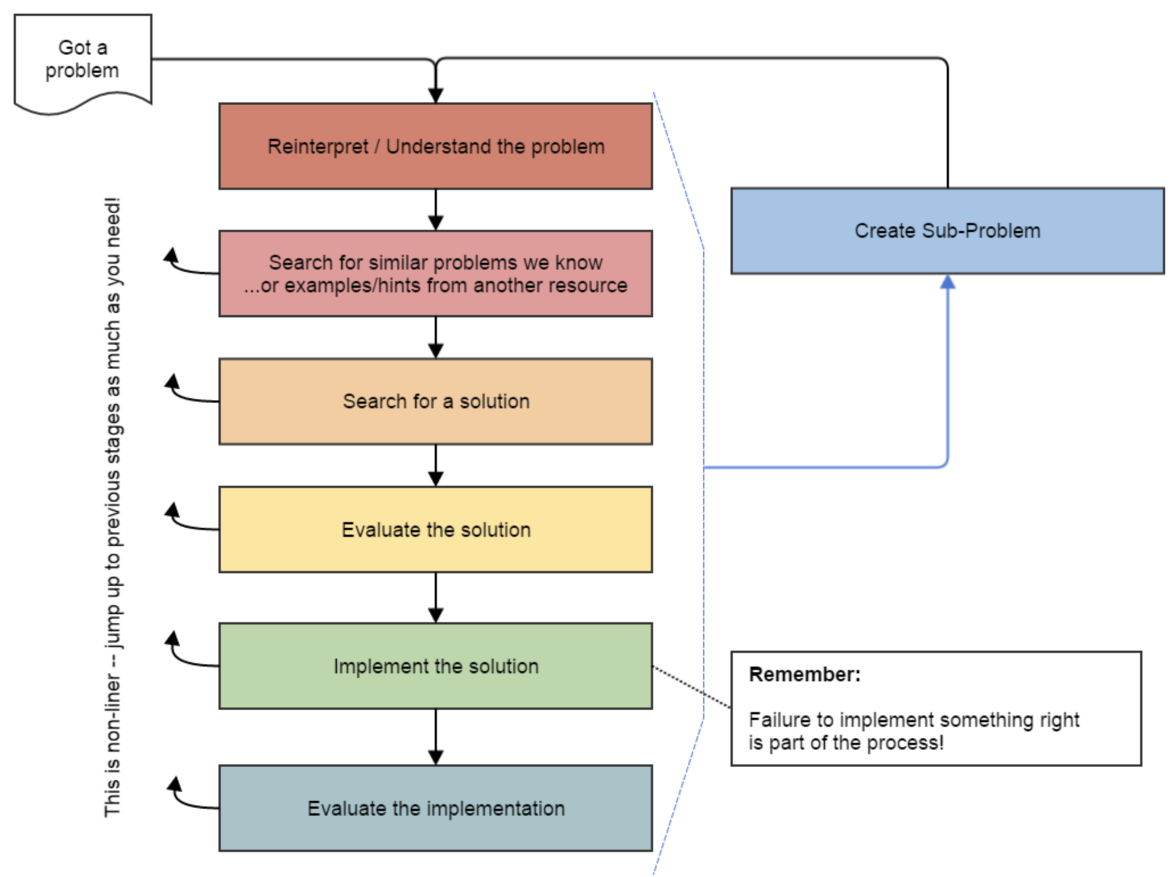
Problem Solving
On their own, Stacks & Queues are
quite simple with practice
(few methods, simple model)
Some of the problems we ask are
complex because the tools you have
to solve them are restrictive
  sum(Stack) is hard with a Queue as
  the auxiliary structure
We challenge you on purpose here
to practice problem solving
Source: Oleson, Ko (2016) - Programming, Problem Solving, and Self-Awareness: Effects of Explicit Guidance

Slide 22
Common Problem-Solving Strategies
Analogy – Is this similar to a problem you’ve seen?
  sum(Stack) is probably a lot like sum(Queue), start there!
Brainstorming – Consider steps to solve problem before writing code
  Try to do an example “by hand” → outline steps
Solve Sub-Problems – Is there a smaller part of the problem to solve?
  Move to queue first
Debugging – Does your solution behave correctly on the example input.
  Test on input from specification
  Test edge cases (“What if the Stack is empty?”)
Iterative Development – Can we start by solving a different problem that is easier?
  Just looping over a queue and printing elements

Slide 23
Common Stack & Queue Patterns
Stack → Queue and Queue → Stack
  We give you helper methods for this on problems
Reverse a Stack with a S→Q + Q→S
“Cycling” a queue: Inspect each element by repeatedly removing and adding to back size times
  Careful: Watch your loop bounds when queue’s size changes
A “splitting” loop that moves some values to the Stack and others to the Queue

