Slide 1
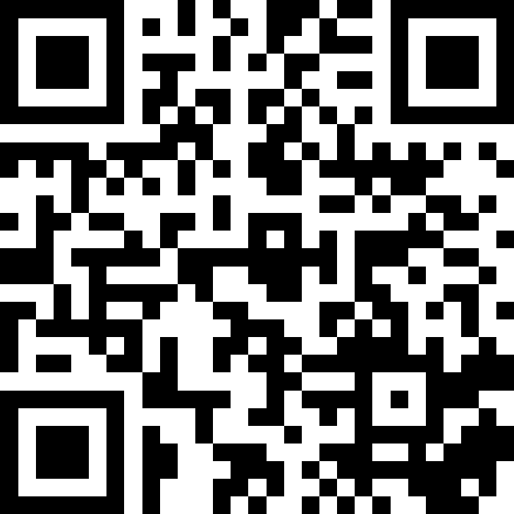
ArrayList Applications
BEFORE WE START
Slido vote & chat with neighbors: What is your favorite part of spring?
Music: 122 26sp Lecture Jams🎧

Slide 2
Lecture Outline (1/6)
Announcements
moveRight
compareToList
topN
addAll
ArrayList Extended Application

Slide 3
Announcements/Reminders
First quiz in section tomorrow, Apr 16th
Practice Quiz 0 released!
Programming Assignment 0 (P0) due tomorrow!
Creative Assignment 1 (C1) out Friday!
Focused on ArrayLists
Due next Thursday, Apr 23rd by 11:59pm PT
Reminder: Section participation in 11+ sections → Extra resub!
No need to do anything; TAs will track on Gradescope

Slide 4
Lecture Outline (2/6)
Announcements
moveRight
compareToList
topN
addAll
ArrayList Extended Application

Slide 5
ArrayList Methods
Method | Description
add(type element) | Adds element to the end of the ArrayList
add(int index, type element) | Adds element to the specified index in the ArrayList
size() | Returns the number of elements in the ArrayList
contains(type element) | Returns true if element is contained in the ArrayList, false otherwise
get(int index) | Returns the element at index in the ArrayList
remove(int index) | Removes the element at index from the ArrayList and returns the removed element.
indexOf(type element) | Returns the index of element in the ArrayList; returns -1 if the element doesn’t exist in the ArrayList
set(int index, type element) | Sets the element at index to the given element and returns the old value

Slide 6
moveRight
Write a method called moveRight that accepts an ArrayList of integers list and an int n and moves the element at index n one space to the right in list.
For example, if list contains [8, 4, 13, -7] and our method is called with moveRight(list, 2), after the method call list would contain [8, 4, -7, 13].
8
4
13
-7
0
1
2
3
moveRight(list, 2)
8
4
-7
13
0
1
2
3

Slide 7
What ArrayList methods (and in what order) could we use to implement the moveRight method?
A) list.remove(n); list.add(n);
B) int element = list.remove(n);
list.add(n, element);
C) list.add(n);
list.remove(n-1);
D) int element = list.remove(n);
list.add(n+1, element);

Slide 8
What ArrayList methods (and in what order) could we use to implement the moveRight method?
A) list.remove(n); list.add(n);
B) int element = list.remove(n);
list.add(n, element);
C) list.add(n);
list.remove(n-1);
D) int element = list.remove(n);
list.add(n+1, element);

Slide 9
moveRight
Write a method called moveRight that accepts a List of integers list and an int n and moves the element at index n one space to the right in list.
For example, if list contains [8, 4, 13, -7] and our method is called with moveRight(list, 2), after the method call list would contain [8, 4, -7, 13].
8
4
13
-7
0
1
2
3
moveRight(list, 2)
8
4
-7
13
13
0
1
2
3

Slide 10
Edge Cases! (And Testing)
When writing a method, especially one that takes input of some kind (e.g., parameters, user input, a Scanner with input) it’s good to think carefully about what assumptions you can make (or cannot make) about this input.
Edge case: A scenario that is uncommon but possible, especially at the “edge” of a parameter’s valid range.
❓ What happens if the user passes a negative number to moveRight?
❓ What happens if the user passes a number larger than the length of the list to moveRight?
More testing tips on the course website’s Resources page!

Slide 11
Lecture Outline (3/6)
Announcements
moveRight
compareToList
topN
addAll
ArrayList Extended Application

Slide 12
compareToList
Write a method called compareToList that accepts two ArrayLists of integers list1 and list2 as parameters and compares the elements of the two lists, printing out the locations of common elements in each of the ArrayLists.
For example, if list1 contained [5, 6, 7, 8] and list2 contained [7, 5, 9, 0, 2], a call to compareToList(list1, list2) would produce output such as:
- 5 (list1 at 0, list2 at 1)
- 7 (list1 at 2, list2 at 0)

Slide 13
Spend 1 min on your own thinking about how you would implement this method! (focus on pseudocode)
Write a method called compareToList that accepts two ArrayLists of integers list1 and list2 as parameters and compares the elements of the two lists, printing out the locations of common elements in each of the ArrayLists.
For example, if list1 contained [5, 6, 7, 8] and list2 contained [7, 5, 9, 0, 2], a call to compareToList(list1, list2) would produce output such as:
- 5 (list1 at 0, list2 at 1)
- 7 (list1 at 2, list2 at 0)

Slide 14
Spend 2 min discussing about how you would implement this method with a neighbor! (focus on pseudocode)
Write a method called compareToList that accepts two ArrayLists of integers list1 and list2 as parameters and compares the elements of the two lists, printing out the locations of common elements in each of the ArrayLists.
For example, if list1 contained [5, 6, 7, 8] and list2 contained [7, 5, 9, 0, 2], a call to compareToList(list1, list2) would produce output such as:
- 5 (list1 at 0, list2 at 1)
- 7 (list1 at 2, list2 at 0)

Slide 15
Lecture Outline (4/6)
Announcements
moveRight
compareToList
topN
addAll
ArrayList Extended Application

Slide 16

topN
Write a method called topN that accepts an ArrayList of characters list and an int n and returns a new ArrayList of characters that contains the first n elements of list.
For example, if list contained ['m', 'a', 't', 'i', 'l', 'd', 'a'], a call to topN(list, 4) would return an ArrayList containing [‘m', ‘a', ‘t', ‘i']

Slide 17
Lecture Outline (5/6)
Announcements
moveRight
compareToList
topN
addAll
ArrayList Extended Application

Slide 18



addAll
Write a method called addAll that accepts two ArrayLists of Characters, list1 and list2 , and an integer location as parameters and inserts all of the elements from list2 into list1 at the specified location.

Slide 19
Lecture Outline (6/6)
Announcements
moveRight
compareToList
topN
addAll
ArrayList Extended Application

Slide 20
Bakery Favorites
We will write a program called BakeryFavorites.java that manages a list of favorite bakeries for a user (using an ArrayList) and allows the user to perform various different operations on their stored list of favorite bakeries.
Key skills used:
User Interaction (UI) loop
Iterative development strategies
Functional decomposition
Practice with ArrayList methods!

Slide 21
Bakery Favorites: Operations
Load a list of favorites in from a file provided by the user.
Compare the stored list of favorites to another list of favorites provided by the user in another file.
Report the top n favorites according to the list, where the user can specify n.
Move a specific favorite down in the list.
Add a list of favorites in a user-provided file to the stored list of favorites at a specified location.
Save the current list of favorites to a file provided by the user.

Slide 22
Bakery Favorites: Development Strategy
Set up the main scaffold code
Menu loop
Develop each operation, one at a time
You’ll see a similar development strategy in Creative Project 1’s specification — we recommend you follow it!

Slide 23
Bakery Favorites: Operations
Load a list of favorites in from a file provided by the user.
Compare the stored list of favorites to another list of favorites provided by the user in another file.
Report the top n favorites according to the list, where the user can specify n.
Move a specific favorite down in the list.
Add a list of favorites in a user-provided file to the stored list of favorites at a specified location.
Save the current list of favorites to a file provided by the user.
ALREADY DONE!

