Slide 1
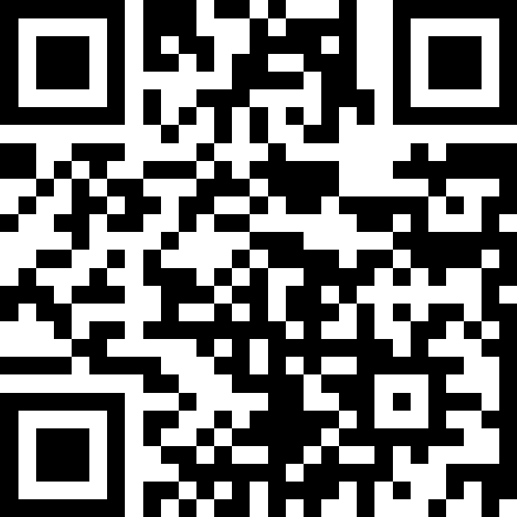
File I/O
BEFORE WE START
Slido input & discuss with neighbors:
What’s the last show you watched?
Music: 122 26sp Lecture Jams🎧

Slide 2
Lecture Outline (1/4)
Announcements/Reminders
  Review Java
Review Scanners for User Input
Scanners for Files
  Token-based, Line-based, and Hybrid processing
Example

Slide 3
Announcements (1/2)
The IPL is open!
  MGH 334, schedule is on the course website; staffed by our awesome TAs!
  Open 12:30 to 9:30pm most weekdays, but check the schedule…
Creative Project 0 due Thursday, April 9th at 11:59pm PT
  Make sure to complete the “Final Submission” slide and submit!
  Submit as many times as you’d like—we will only grade the latest submission made before the deadline
Just joined CSE 122? That’s okay; look at Ed & course website and catch up!
  Freaking out that C0 is due tomorrow? It’s ok! Resubmission cycles allow you to submit it later.
Elba OH Update: Mondays 2:30–3:30pm & Thursdays 3:30–4:30pm
Quiz dates:
Quiz 0: April 16th Quiz 1: May 7th Quiz 2: May 26th

Slide 4
Announcements (2/2)
CSE 390HA Honors Seminar
  Weekly seminar, Tuesdays at 3:30pm
  No homework! Just show up and chat.
  Talk about sociotechnical topics in computing, different every quarter!
    Technology & the Environment
    Anonymity & Privacy in Tech
    Warfare Technology
    Real-life Effects of Software Bugs
    Sign up via this Google Form by end-of-week!

Slide 5
Reminders: Review Java Syntax
Java Tutorial reviews all the relevant programming features you should familiar with (even if you don’t know them in Java).
  Printing and comments
  Variables, types, expressions
  Conditionals (if/else if/ else)
  Loops (for and while)
  Strings
  Methods
  Arrays & 2D arrays
Recordings of both sessions are now available on the course website in the course calendar!

Slide 6
Lecture Outline (2/4)
Announcements/Reminders
  Review Java
Review Scanners for User Input
Scanners for Files
  Token-based, Line-based, and Hybrid processing
Example

Slide 7
(Review) Scanner for User Input
Scanner is defined in the java.util package
import java.util.*;
Scanner console = new Scanner(System.in);
Scanner Methods | Description
nextInt() | Reads the next token from the user as an int and returns it
nextDouble() | Reads the next token from the user as a double and returns it
next() | Reads the next token from the user as a String and returns it
nextLine() | Reads an entire line from the user as a String and returns it
hasNextInt() | Returns true if the next token can be read as an int, false otherwise
hasNextDouble() | Returns true if the next token can be read as a double, false otherwise
hasNext() | Returns true if there is another token of input to be read in, false otherwise
hasNextLine() | Returns true if there is another line of input to be read in, false otherwise

Slide 8
Lecture Outline (3/4)
Announcements/Reminders
  Review Java
Review Scanners for User Input
Scanners for Files
  Token-based, Line-based, and Hybrid processing
Example

Slide 9
(PCM) Tokens
Tokens are units of input (as defined by the Scanner) that are separated by whitespace (spaces, tabs, new lines)

Slide 10
How many tokens are in the following line? (1/8)
“Hello world !” my-name is Elba
A) Four
B) Five
C) Six
D) Seven
Notes:
public class Temperatures {
public static void main(String[] args) {
int[] nums = {1, 4, 4, 8, 13};
int totalDiff = 0;
for (int i = 1; i <= nums.length-1; i++) {
totalDiff += (nums[i] - nums[i - 1]);
}
System.out.println("Total Diff = " + totalDiff);
}
}

Slide 11
How many tokens are in the following line? (2/8)
“Hello world !” my-name is Elba
A) Four
B) Five
C) Six
D) Seven
Notes:
public class Temperatures {
public static void main(String[] args) {
int[] nums = {1, 4, 4, 8, 13};
int totalDiff = 0;
for (int i = 1; i <= nums.length-1; i++) {
totalDiff += (nums[i] - nums[i - 1]);
}
System.out.println("Total Diff = " + totalDiff);
}
}

Slide 12
How many tokens are in the following line? (3/8)
“Hello world !” my-name is Elba
A) Four
B) Five
C) Six
D) Seven
Notes:
public class Temperatures {
public static void main(String[] args) {
int[] nums = {1, 4, 4, 8, 13};
int totalDiff = 0;
for (int i = 1; i <= nums.length-1; i++) {
totalDiff += (nums[i] - nums[i - 1]);
}
System.out.println("Total Diff = " + totalDiff);
}
}

Slide 13
How many tokens are in the following line? (4/8)
“Hello world !” my-name is Elba
A) Four
B) Five
C) Six
D) Seven
Notes:
public class Temperatures {
public static void main(String[] args) {
int[] nums = {1, 4, 4, 8, 13};
int totalDiff = 0;
for (int i = 1; i <= nums.length-1; i++) {
totalDiff += (nums[i] - nums[i - 1]);
}
System.out.println("Total Diff = " + totalDiff);
}
}

Slide 14
How many tokens are in the following line? (5/8)
“Hello world !” my-name is Elba
A) Four
B) Five
C) Six
D) Seven
Notes:
public class Temperatures {
public static void main(String[] args) {
int[] nums = {1, 4, 4, 8, 13};
int totalDiff = 0;
for (int i = 1; i <= nums.length-1; i++) {
totalDiff += (nums[i] - nums[i - 1]);
}
System.out.println("Total Diff = " + totalDiff);
}
}

Slide 15
How many tokens are in the following line? (6/8)
“Hello world !” my-name is Elba
A) Four
B) Five
C) Six
D) Seven
Notes:
public class Temperatures {
public static void main(String[] args) {
int[] nums = {1, 4, 4, 8, 13};
int totalDiff = 0;
for (int i = 1; i <= nums.length-1; i++) {
totalDiff += (nums[i] - nums[i - 1]);
}
System.out.println("Total Diff = " + totalDiff);
}
}

Slide 16
How many tokens are in the following line? (7/8)
“Hello world !” my-name is Elba
A) Four
B) Five
C) Six
D) Seven
Notes:
public class Temperatures {
public static void main(String[] args) {
int[] nums = {1, 4, 4, 8, 13};
int totalDiff = 0;
for (int i = 1; i <= nums.length-1; i++) {
totalDiff += (nums[i] - nums[i - 1]);
}
System.out.println("Total Diff = " + totalDiff);
}
}

Slide 17
How many tokens are in the following line? (8/8)
“Hello world !” my-name is Elba
A) Four
B) Five
C) Six
D) Seven
Notes:
public class Temperatures {
public static void main(String[] args) {
int[] nums = {1, 4, 4, 8, 13};
int totalDiff = 0;
for (int i = 1; i <= nums.length-1; i++) {
totalDiff += (nums[i] - nums[i - 1]);
}
System.out.println("Total Diff = " + totalDiff);
}
}

Slide 18
(PCM) Scanner for File I/O
Scanner is defined in the java.util package
import java.util.*;
File file = new File("Example.txt");
Scanner fileScan = new Scanner(file);
File is defined in the java.io package
import java.io.*;
Scanner Methods | Description
nextInt() | Reads the next token as an int and returns it
nextDouble() | Reads the next token as a double and returns it
next() | Reads the next token as a String and returns it
nextLine() | Reads an entire line as a String and returns it
hasNextInt() | Returns true if the next token can be read as an int, false otherwise
hasNextDouble() | Returns true if the next token can be read as a double, false otherwise
hasNext() | Returns true if there is another token of input to be read in, false otherwise
hasNextLine() | Returns true if there is another line of input to be read in, false otherwise

Slide 19
(PCM) Checked Exceptions
If you try to compile a program working with file scanners, you may encounter this error message:
  error: unreported exception FileNotFoundException; must be caught or declared to be thrown
To resolve this, you need to include throws FileNotFoundException at the end of the header of any method containing file Scanner creation code, or any method that calls that method!
  This is like signing a waiver and telling Java—"Hey, I hereby promise to not get mad at you when you bug and crash my program if I give you a file that doesn't actually exist."

Slide 20
(PCM) Typical Line Processing Pattern
while (scan.hasNextLine()) {
String nextLine = scan.nextLine();
// do something with nextLine
}

Slide 21
(PCM) Typical Token Processing Pattern (1/2)
while (scan.hasNext______()) {
_______ nextToken = scan.next_______();
// do something with nextToken
}

Slide 22
(PCM) Typical Token Processing Pattern (2/2)
while (scan.hasNext______()) {
_______ nextToken = scan.next_______();
// do something with nextToken
}
Avoid mixing line- and token-based processing!

Slide 23
(PCM) Typical Hybrid Pattern (1/2)
while (fileScan.hasNextLine()) {
String line = fileScan.nextLine();
Scanner lineScan = new Scanner(line);
while (lineScan.hasNext__()) {
__ nextToken = lineScan.next__();
// do something with nextToken
}
}

Slide 24
(PCM) Typical Hybrid Pattern (2/2)
while (fileScan.hasNextLine()) {
String line = fileScan.nextLine();
Scanner lineScan = new Scanner(line);
while (lineScan.hasNext__()) {
__ nextToken = lineScan.next__();
// do something with nextToken
}
}
Line-by-line and then token-by-token to do something

Slide 25
(PCM) Scanners with Strings (not files!) (1/7)
String str = "A quick, brown fox";
Scanner stringScan = new Scanner(str);
while (stringScan.hasNext____()) {
____ nextToken = stringScan.next____();
// do something with nextToken
}

Slide 26
(PCM) Scanners with Strings (not files!) (2/7)
String str = "A quick, brown fox";
Scanner stringScan = new Scanner(str);
while (stringScan.hasNext()) {
String nextToken = stringScan.next();
System.out.println(nextToken);
}

Slide 27
(PCM) Scanners with Strings (not files!) (3/7)
String str = "A quick, brown fox";
Scanner stringScan = new Scanner(str);
while (stringScan.hasNext()) {
String nextToken = stringScan.next();
System.out.println(nextToken);
}

Slide 28
(PCM) Scanners with Strings (not files!) (4/7)
String str = "A quick, brown fox";
Scanner stringScan = new Scanner(str);
while (stringScan.hasNext()) {
String nextToken = stringScan.next();
System.out.println(nextToken);
}
A

Slide 29
(PCM) Scanners with Strings (not files!) (5/7)
String str = "A quick, brown fox";
Scanner stringScan = new Scanner(str);
while (stringScan.hasNext()) {
String nextToken = stringScan.next();
System.out.println(nextToken);
}
quick,

Slide 30
(PCM) Scanners with Strings (not files!) (6/7)
String str = "A quick, brown fox";
Scanner stringScan = new Scanner(str);
while (stringScan.hasNext()) {
String nextToken = stringScan.next();
System.out.println(nextToken);
}
brown

Slide 31
(PCM) Scanners with Strings (not files!) (7/7)
String str = "A quick, brown fox";
Scanner stringScan = new Scanner(str);
while (stringScan.hasNext()) {
String nextToken = stringScan.next();
System.out.println(nextToken);
}
fox

Slide 32
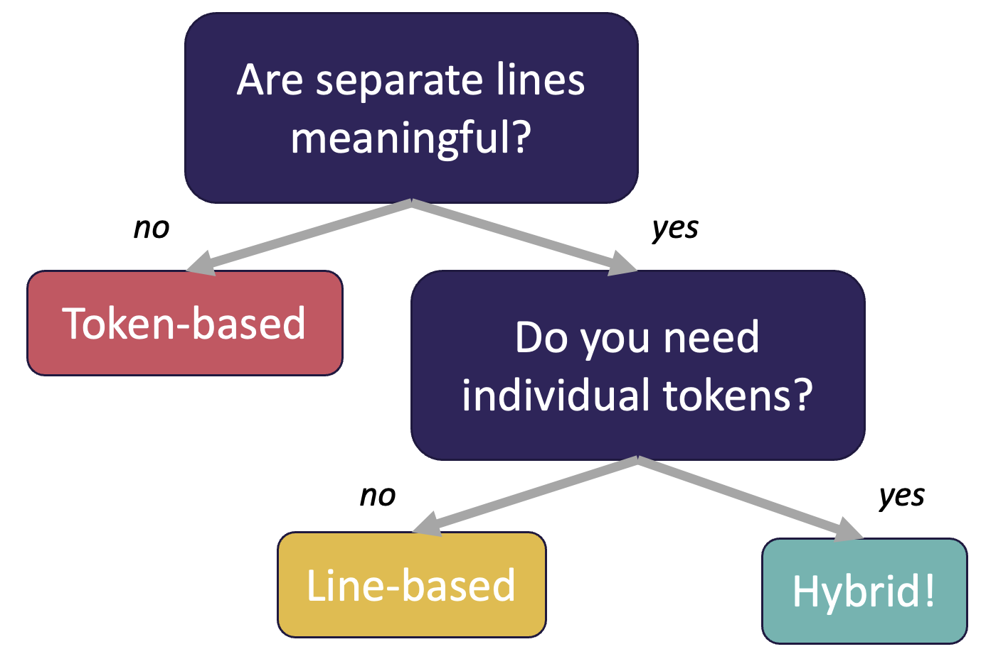
(PCM) Token vs. Line vs. Hybrid?
We now know 3 different ways to use Files!
  Line
  Token
  Hybrid
Although this gives us flexibility – it can sometimes get confusing
Feel free to use the following diagram to help!

Slide 33
Think: What is the output of this Java method?
File f = new File("Example.txt");
Scanner fileScan = new Scanner(f);
while (fileScan.hasNextLine()) {
String line = fileScan.nextLine();
Scanner lineScan = new Scanner(line);
while (lineScan.hasNext()) {
System.out.print(lineScan.next() + ", ");
}
System.out.println();
}
A) One, Two, Three,
B) One,
Two,
Three,
C) One, Two,
Three,
D) Error / Exception
Example.txt:
One Two
Three
Notes:
public class Temperatures {
public static void main(String[] args) {
int[] nums = {1, 4, 4, 8, 13};
int totalDiff = 0;
for (int i = 1; i <= nums.length-1; i++) {
totalDiff += (nums[i] - nums[i - 1]);
}
System.out.println("Total Diff = " + totalDiff);
}
}

Slide 34
Pair: What is the output of this Java method?
File f = new File("Example.txt");
Scanner fileScan = new Scanner(f);
while (fileScan.hasNextLine()) {
String line = fileScan.nextLine();
Scanner lineScan = new Scanner(line);
while (lineScan.hasNext()) {
System.out.print(lineScan.next() + ", ");
}
System.out.println();
}
A) One, Two, Three,
B) One,
Two,
Three,
C) One, Two,
Three,
D) Error / Exception
Example.txt:
One Two
Three
Notes:
public class Temperatures {
public static void main(String[] args) {
int[] nums = {1, 4, 4, 8, 13};
int totalDiff = 0;
for (int i = 1; i <= nums.length-1; i++) {
totalDiff += (nums[i] - nums[i - 1]);
}
System.out.println("Total Diff = " + totalDiff);
}
}

Slide 35
Initial Letter Count by Line (1/2)
Initial Letter Count
  Token-based processing!
Letter Count
  Line-based processing!
Task: Initial Letter Count by Line
  What kind of processing?

Slide 36
Initial Letter Count by Line (2/2)
Initial Letter Count
  Token-based processing!
Letter Count
  Line-based processing!
Task: Initial Letter Count by Line
  What kind of processing?
  Hybrid processing! Each line, and then each token per line.

Slide 37
Lecture Outline (4/4)
Announcements/Reminders
  Review Java
Review Scanners for User Input
Scanners for Files
  Token-based, Line-based, and Hybrid processing
Example

Slide 38
Movie Ratings (1/2)
In this program, we'll be examining and printing data from a file of IMDb ratings for popular U.S. movies. This will happen through 3 major user-entered commands:
(F)ind movie, (A)dd a rating, and (P)rint ratings.
small.tsv
5
Title Average Total
Pride_&_Prejudice 7.8 323647
Barbie 6.9 455488
Oppenheimer 8.4 588723
Poor_Things 8.5 20542
Spider-Man:_Across_the_Spider-Verse 8.6 329200

Slide 39
Movie Ratings (2/2)
Welcome to the CSE 122 Movie Rating Program!
Loaded 5 movies from small.tsv!
Menu: (F)ind movie, (A)dd rating, (P)rint ratings, (Q)uit
Enter your choice: F
What's the name of the movie? Pride_&_Prejudice
Movie Pride_&_Prejudice found!
Average Rating: 7.8
Total Ratings: 323647
Menu: (F)ind movie, (A)dd rating, (P)rint ratings, (Q)uit
Enter your choice: A
What movie would you like to add your rating to? Pride_&_Prejudice
And what rating would you like to give? 100000
Menu: (F)ind movie, (A)dd rating, (P)rint ratings, (Q)uit
Enter your choice: f
What's the name of the movie? Pride_&_Prejudice
Movie Pride_&_Prejudice found!
Average Rating: 8.1
Total Ratings: 323648
Menu: (F)ind movie, (A)dd rating, (P)rint ratings, (Q)uit
Enter your choice: P
5
Title Average Total
Pride_&_Prejudice 7.8 323647
Barbie 6.9 455488
Oppenheimer 8.4 588723
Poor_Things 8.5 20542
Spider-Man:_Across_the_Spider-Verse 8.6 329200
Menu: (F)ind movie, (A)dd rating, (P)rint ratings, (Q)uit
Enter your choice: q
Thank you for using this program! Bye!
small.tsv
5
Title Average Total
Pride_&_Prejudice 7.8 323647
Barbie 6.9 455488
Oppenheimer 8.4 588723
Poor_Things 8.5 20542
Spider-Man:_Across_the_Spider-Verse 8.6 329200

Slide 40
Movie Ratings: Development Strategy
Fill in the main method with a loop that calls a method to read the data in from the .tsv file and allows the user to select between the different options (find, add, print, quit). I was nice and did this for you 😇
Implement a method to load the movie rating data from the file and populate the appropriate arrays.
Implement a method that allows users to find the rating for a movie.
Implement a method that allows users to add a rating for a movie.
Implement a method that allows users to print the movie rating data. I was nice and did this for you 😇

