Slide 1
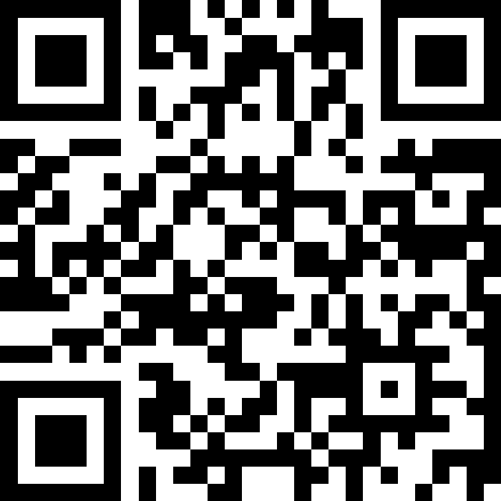
Putting It All Together
(Review)
BEFORE WE START
Slido Vote & Talk with your neighbors:
What songs should we put on our CSE 122 26sp final exam grading playlist?

Slide 2
Lecture Outline (1/4)
Announcements
Exam Logistics
Review
How to Study
  Mind Maps

Slide 3
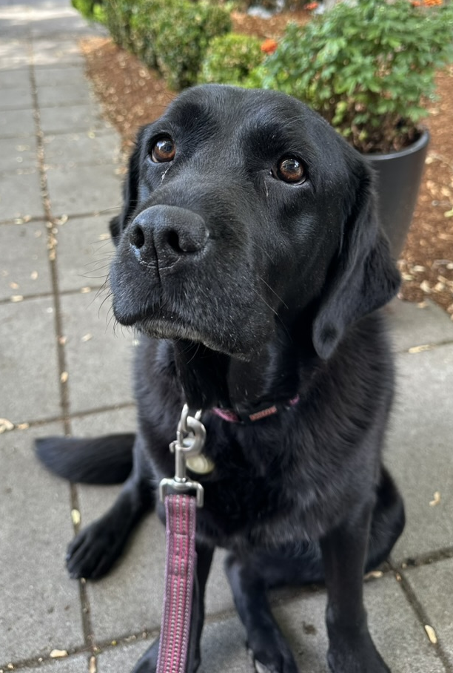
Announcements
Last couple sessions of classes!
  Quick overview of class today; Victory lap + AMA on Friday
Creative Project 3 (C3) currently out
  Due tomorrow, Thursday, June 4th by 11:59pm PT
Resubmission Cycle 7 (R7) opens tomorrow
  Due Tue, Jun 9th by 11:59pm PT; open to all previous assignments
Resubmission Cycle 8 (participation bonus) opens soon
  More info being sent directly to those who qualified!
Provide feedback by June 7th
  Course evaluations:
  Section A: https://uw.iasystem.org/survey/324556
  TA evaluations: https://tinyurl.com/cse12x-sp26-ta-evals
IPL/Office Hours ending this Friday!
Come meet Gigi on Monday, June 8th at 1:30pm

Slide 4
Announcements
Final Exam Review: Monday, Jun 8th 4:30 – 7:00pm in BAG 131
  Led by TAs
  First half: time to work on practice exam with TAs in room
  Second half: TAs going over exam, giving tips
  Likely recorded, we’ll update if this isn’t the case!
Final Exam: Tuesday, Jun 9th 2:30 – 4:20pm in KNE 120
  Preliminary details are up on the course website!
  Seating chart will be posted soon!
  Already up:
    Final Exam Study Guide
    Past & Practice Exams

Slide 5
Lecture Outline (2/4)
Announcements
Exam Logistics
Review
How to Study
  Mind Maps

Slide 6
Exam Format
6 questions in total, each will receive one ESN grade
  Some questions might have sub-parts
  Reminder: Quiz and Exam grades are all mixed into the same bucket
General format
  3 Questions: Mix of Conceptual, Mechanical/Tracing, Debugging Problems
  3 Questions: Programming Problems
See sections for the last 2 weeks for practice handwriting problems

Slide 7
Exam Logistics
Most important bits
Tuesday June 9th from 2:30 – 4:20pm in KNE 120
Seat assignments to be posted on the course website
Don’t cheat
  Only have the exam open during the time (don’t start early; don’t work after)
  No electronic devices
You can bring one 8.5x11 inch (or A4) paper with notes (front and back)
  Will also provide a reference sheet (see course website)
Questions? Raise hand or as on sli.do (cse122)

Slide 8
Lecture Outline (3/4)
Announcements
Exam Logistics
Review
How to Study
  Mind Maps

Slide 9
Review So Far
CS Concepts
Problem Solving
Functional Decomposition
Debugging
Testing
Third Party Libraries*
Java Language
File I/O
Iterators and For-each Loops
Exceptions
Reference Semantics
JUnit*
Data Structures
ADTs
Lists
Stacks
Queues
Sets
Maps
Java Collections
Arrays / 2D Arrays
ArrayList
LinkedList
Stack
TreeSet / TreeMap
HashSet / HashMap
Interfaces for Collections
Object Oriented
Instance variables
Instance methods
Interfaces
Abstraction
Encapsulation
Client/Implementer

Slide 10
Review Resources
Pre-Class Materials + Lectures
Section Handouts
Quizzes
Your Notes!
  Helpful for contextualizing what you learned
Practice final exams

Slide 11
Lecture Outline (3/4)
Announcements
Exam Logistics
Review
How to Study
  Mind Maps

Slide 12
Study Strategies
Study Early and Often
Stay Healthy
Study Like you Test
Connect Problems: How is one problem similar/different to another?
Mixed Practice vs. Massed Practice
Embrace Difficulty
Reference Sheet: Iterative Refining

Slide 13
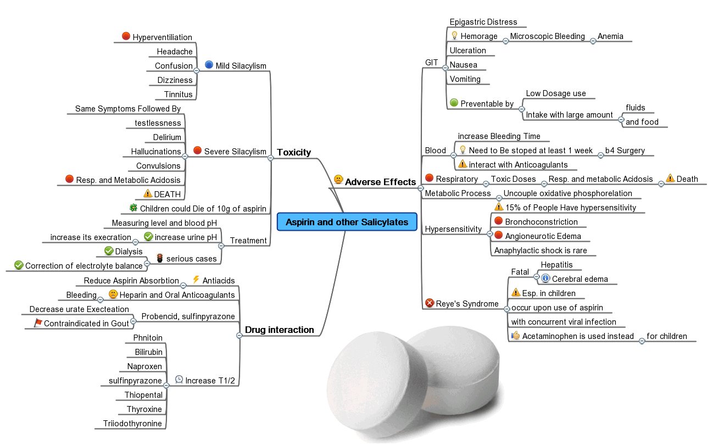
Mind Maps
One of the most important parts of learning is relating concepts to each other
  Almost all learning is contextual: based on relating one thing to another
  Transfer is challenging!
Mind Maps empower you to write out how topics relate to each other. Concretizing relations.
Can be incredibly helpful when reviewing and can be a great resource for looking back at this class

Slide 14
Name:
TA Name(s): ____________________________________
Some Fun: Draw your TA(s) teaching section this quarter!

