Slide 1
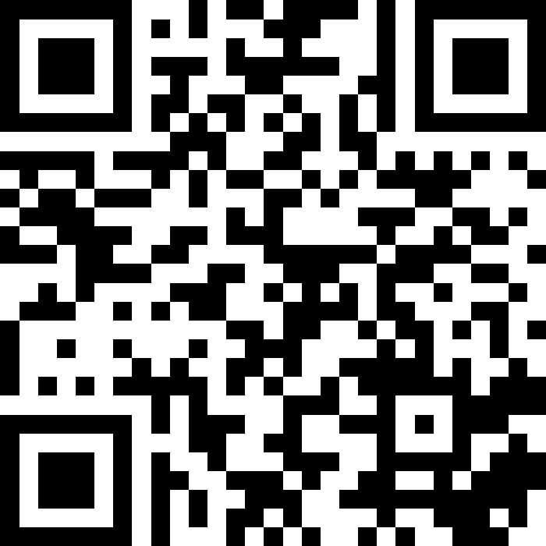
JUnit Testing
BEFORE WE START
Slido vote & chat with neighbors: What is your favorite bug (insect or otherwise) and why?
Music: 122 26sp Lecture Jams🎧

Slide 2
Lecture Outline
Announcements
Importance of Testing
JUnit
Testing Tips

Slide 3
Announcements
Tomorrow (Thursday, May 28): Programming Assignment 3 (P3) due!
Resubmission 5 extended deadline!
  Now due tonight, 11:59 PM
Resubmission 6 opens tomorrow
Creative Project 3 (C3) will be released Friday, May 29
Final Exam: Tuesday, June 9th 2:30-4:20 PM
  KNE 120 (here)
JUnit “virtual section” for today’s content, linked from this Ed module

Slide 4
Lecture Outline
Announcements
Importance of Testing
JUnit
Testing Tips

Slide 5


Importance of Testing
Software, written by people, controls more and more of our day-to-day lives.
Bugs (just like the ones we all write) are just as easy to write in this software.
Stakes can be quite high so bugs
can have catastrophic effects
Source: Hackaday
The Horizon IT System for The UK Post Office
Source: Fujitsu.com

Slide 6

Importance of Testing
“The Horizon scandal, described as ‘the most widespread miscarriage of justice in UK history’, resulted in more than 700 post office operators being prosecuted between 1999 and 2015 for theft, fraud and false accounting because of faulty accounting software installed in the late 1990s… Some spent time in prison, and the scandal has been linked to four suicides.”
Source: The Guardian

Slide 7
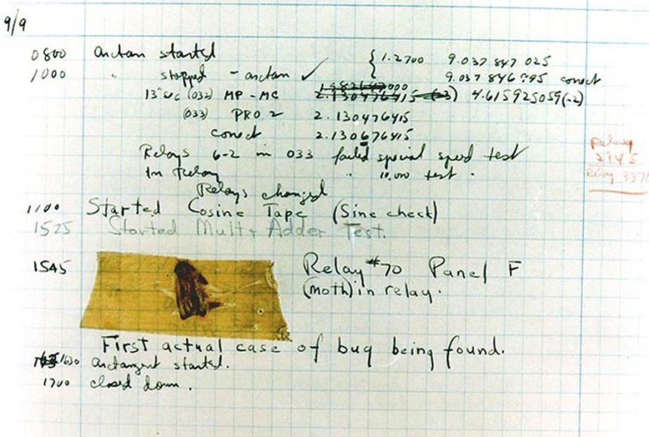

Fun Aside – what was the first computer bug?
1947 Harvard “computers” find moth trapped in the Mark II

Slide 8
Bugs you’ve experienced
Can you think of a bug(s) you’ve experienced or heard of that have had serious effects?
If you can’t, can you think of any absurd bugs you’ve seen?

Slide 9
Lecture Outline
Announcements
Importance of Testing
JUnit
Testing Tips

Slide 10

Using a Testing Framework
Unit Test – a method that compares what your code does against what you expect it to do
Testing Framework – a library of code that gives you special tags and key words for your unit tests so that you can click the “test” button instead of the “run” button and you get a list of tests with info like green check mark passes or error messages
Like a music tuner! Technology specifically built to compare what your instrument sounds like against what it’s expected to sound like

Slide 11
Writing a Unit Test
Break your code into cases, what should occur in each case?
public static int max(int x, int y) {
if (x > y) {
return x;
} else {
return y;
}
}
Specification Testing (based on the spec) vs. Clear-box Testing (based on how you know your implementation works)
  Specification Testing you can do before writing your solution! (Test Driven Development)
  Clear-box Testing you do after you've written your solution.
// Returns the maximum of two integers.
public static int max(int x, int y) {

Slide 12
In-Class: Remix – Courses Taught

Slide 13
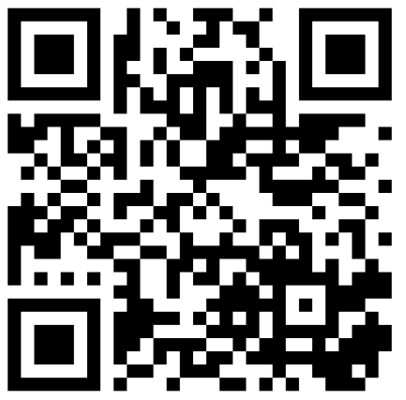
What test cases can you test for the coursesTaught method?
Spend 1 minute brainstorming specification testing
Then 1 minute brainstorming clear-box testing

Slide 14
JUnit Basics
JUnit – a unit testing framework for the Java language
  import statements to give you access to JUnit method annotations and assertion methods!
Method Annotations
  @Test
  @DisplayName
  …
Assertion Methods
  assertEquals
  assertTrue
  assertFalse
  …
import org.junit.jupiter.api.*;
import static org.junit.jupiter.api.Assertions.*;
import java.util.*;
public class ArrayListTest {
@Test
@DisplayName(“Add works alongside Get")
public void testAddAndGet() {
List<String> list = new ArrayList<>();
list.add(“Nicolae");
list.add(“Isis");
list.add(“Shreyank");
assertEquals(“Isis", list.get(1));
}
}

Slide 15
JUnit Testing
import org.junit.jupiter.api.*;
import static org.junit.jupiter.api.Assertions.*;
import java.util.*;
public class ArrayListTest {
@Test
@DisplayName(“Add works alongside Get")
public void testAddAndGet() {
List<String> list = new ArrayList<>();
list.add(“Nicolae");
list.add(“Isis");
list.add(“Shreyank");
assertEquals(“Isis", list.get(1));
}
}

Slide 16
JUnit Testing
import org.junit.jupiter.api.*;
import static org.junit.jupiter.api.Assertions.*;
import java.util.*;
public class ArrayListTest {
@Test
@DisplayName(“Add works alongside Get")
public void testAddAndGet() {
List<String> list = new ArrayList<>();
list.add(“Nicolae");
list.add(“Isis");
list.add(“Shreyank");
assertEquals(“Isis", list.get(1)); // TRUE!!
}
}

Slide 17
JUnit Testing
import org.junit.jupiter.api.*;
import static org.junit.jupiter.api.Assertions.*;
import java.util.*;
public class ArrayListTest {
@Test
@DisplayName(“Add works alongside Get")
public void testAddAndGet() {
List<String> list = new ArrayList<>();
list.add(“Nicolae");
list.add(“Isis");
list.add(“Shreyank");
assertEquals(“Isis", list.get(1));
assertEquals(“Nicolae", list.get(2));
}
}

Slide 18
JUnit Testing
import org.junit.jupiter.api.*;
import static org.junit.jupiter.api.Assertions.*;
import java.util.*;
public class ArrayListTest {
@Test
@DisplayName(“Add works alongside Get")
public void testAddAndGet() {
List<String> list = new ArrayList<>();
list.add(“Nicolae");
list.add(“Isis");
list.add(“Shreyank");
assertEquals(“Isis", list.get(1));
assertEquals(“Nicolae", list.get(2)); // FALSE!!
}
}

Slide 19
JUnit Testing
import org.junit.jupiter.api.*;
import static org.junit.jupiter.api.Assertions.*;
import java.util.*;
public class ArrayListTest {
@Test
@DisplayName(“Add works alongside Get")
public void testAddAndGet() {
List<String> list = new ArrayList<>();
list.add(“Nicolae");
list.add(“Isis");
list.add(“Shreyank");
assertEquals(“Isis", list.get(1));
assertEquals(“Shreyank", list.get(2));
}
}

Slide 20
JUnit Testing
import org.junit.jupiter.api.*;
import static org.junit.jupiter.api.Assertions.*;
import java.util.*;
public class ArrayListTest {
@Test
@DisplayName(“Add works alongside Get")
public void testAddAndGet() {
List<String> list = new ArrayList<>();
list.add(“Nicolae");
list.add(“Isis");
list.add(“Shreyank");
assertEquals(“Isis", list.get(1));
assertEquals(“Shreyank", list.get(2)); // TRUE!!!
}
}

Slide 21
JUnit Testing
import org.junit.jupiter.api.*;
import static org.junit.jupiter.api.Assertions.*;
import java.util.*;
public class ArrayListTest {
@Test
@DisplayName(“Add works alongside Get")
public void testAddAndGet() {
List<String> list = new ArrayList<>();
list.add(“Nicolae");
list.add(“Isis");
list.add(“Shreyank");
assertEquals(“Isis", list.get(1));
assertEquals(“Shreyank", list.get(2));
assertTrue(list.size() == 3);
}
}

Slide 22
JUnit Testing
import org.junit.jupiter.api.*;
import static org.junit.jupiter.api.Assertions.*;
import java.util.*;
public class ArrayListTest {
@Test
@DisplayName(“Add works alongside Get")
public void testAddAndGet() {
List<String> list = new ArrayList<>();
list.add(“Nicolae");
list.add(“Isis");
list.add(“Shreyank");
assertEquals(“Isis", list.get(1));
assertEquals(“Shreyank", list.get(2));
assertTrue(list.size() == 3); // TRUE!!
}
}

Slide 23
In-Class: Remix – Courses Taught (Testing time!)

Slide 24
Lecture Outline
Announcements
Importance of Testing
JUnit
Testing Tips

Slide 25
Testing Tips
Write many tests for each method
  Test that your method does what you want it to do
  Test combinations of your method being used with other methods
Use assertEquals(expected, actual, message) to provide a description of what case that line is testing
Testing code is just code. Use good coding practices (e.g., helper methods to reduce redundancy) to help you write code.
  It can take time, but if you do it well, developing your solution can be a breeze!

Slide 26

How Many Test Cases Is Enough?
In general, more diverse tests –> more confidence!
Test a wide variety of different cases
  Think about boundary or "edge" cases in particular,
  where the behavior should change
  Empty objects, null, negative numbers
Try to think adversarially and try to break your own code with tests, how do you “user-proof” your code?
public static int max(int x, int y) {
if (x > y) {
return x;
} else {
return y;
}
}
=

