Slide 1

Advanced OOP
BEFORE WE START
Slido vote & chat with neighbors:
What is your favorite warm drink?

Slide 2
Lecture Outline (1/4)
Announcements
Recap
Equals
Bigger Example

Slide 3
Announcements
Creative Project 2 will be released later today!
  Focused on OOP
  Due Thursday, May 21st by 11:59pm PT
Resubmission Cycle 4 (R4) out soon, too
  Due Tuesday, May 19th by 11:59pm PT
  Eligible assignments: C1, P1
Quiz 2 on Tuesday, May 26th—coming up fast!
  Topics: Nested Collections, Objects, and Interfaces
  Expect Quiz 1 grades day(s) before Quiz 2

Slide 4
Lecture Outline (2/4)
Announcements
Recap
Equals
Bigger Example

Slide 5
Constructor Syntax
public ShoppingCart(int initialCapacity) {
items = new HashSet<>();
capacity = initialCapacity;
}
All fields should be initialized in the constructor(s)!
If we write any constructors, Java no longer provides one for us.

Slide 6
Multiple Constructors
Java allows you to define more than 1 constructor for a class!
When you call new ShoppingCart(…), Java chooses the constructor that matches your arguments.

Slide 7
this keyword
The this keyword refers to the current object in a method or constructor.
You can use it to refer to an object’s fields:
this.capacity, this.items
You can use it to refer to an object’s instance methods:
this.setCapacity(newCapacity)
Also, you can use it to call one constructor from another:
this(3)

Slide 8
private
The private keyword is an access modifier (like public)
Fields declared private cannot be accessed by any code outside of the class.
We always want to encapsulate our objects’ fields by declaring them private.

Slide 9
Encapsulation
While users can still access and modify our ShoppingCart’s fields with the instance methods we defined, we have control of how they do so.
Example: Can only accept a capacity with a positive value
Another Example: Can swap out our underlying implementation to use queues instead!

Slide 10
Lecture Outline (3/4)
Announcements
Recap
Equals
Bigger Example
For next quarter…

Slide 11
Equals
The equals() method returns true if the given parameter is considered equal to this object, and false otherwise.
  Used by lots of library methods! e.g. contains, remove for specific elements, etc.
Let’s do it!
Each class has one provided by Java, but it checks for reference equality. (Thanks?)
If you want equals to check for value equality, you need to write this method yourself.

Slide 12
Opening Up A New World!
With an equals() method defined, we can now create new data structures of our ShoppingCart object, including those in the List interface.
Using equals(), we can now check whether a List contains an object directly!
Elba:This is a draft TODO slide I made after Lecture12

Slide 13
Object
By taking a parameter of type Object, the equals method can be passed any type of object.
More to come in CSE 123 on the Java mechanisms that make this work!
We can use the instanceof keyword in Java to determine if the parameter is actually a ShoppingCart

Slide 14
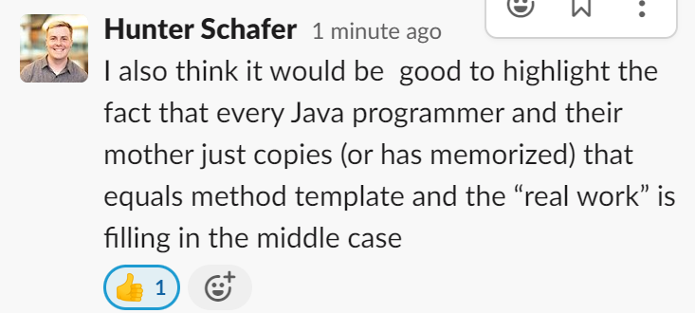
ShoppingCart’s equals()
public boolean equals(Object o) {
if (this == o) {
return true;
} else if (o instanceof ShoppingCart) {
ShoppingCart other = (ShoppingCart) o;
return other.capacity == this.capacity;
} else {
return false;
}
}

Slide 15
Almost there…
This is actually still an imperfect implementation because we would also need to write a hashCode() method for our object to work with HashSet, HashMap, etc. but more to come on that in CSE 331 and beyond ☺

Slide 16
Lecture Outline (4/4)
Announcements
Recap
Equals
Bigger Example

Slide 17
Student class
Write a Student class that you can construct by saying:
new Student(1234567, "Cornbear")
where the first parameter is their student number and the second parameter is their name. Your Student class should also implement the following methods:
getName() returns the student's name
getStudentNumber() returns the student's number
setName(String newName) sets the student’s name to the given newname
toString() returns a String representation of the student formatted as "name (studentNumber)"
equals(Object other) that returns true if the given parameter is considered equal to this object

Slide 18

Student class
A cautionary tale:
What if we added a field to the Student class:
private boolean isLocalStudent;
Yikes—You are the designer now. Think carefully about what assumptions you are making!
Also…
Why shouldn’t we include a setStudentNumber method?

Slide 19
Course class
Write a Course class that represents a course at UW. Implement the following methods and constructors:
Constructors
Write a constructor so that you can construct a Course by saying new Course(23213, "CSE 122", 4) where the first parameter is the course's SLN, the second parameter is the code for the course, and the third parameter is the number of credits.
Write another constructor so that you can construct a Course by saying new Course(23239, "CSE 122", 4, enrollment) where the first parameter is the course's SLN, the second parameter is the code for the course, the third parameter is the number of credits, and the fourth parameter is a Student[] containing a Student for each student enrolled in the course.

Slide 20
Course class
Instance Methods
getSLN() returns the course's SLN
getCourseCode() returns the course's code
getCredits() returns the number of credits for the course
getRoster() returns a copy of the course's roster

Slide 21
Course class
Instance Methods
updateRoster(Student[] students) replaces the current roster with the content of the given students
addStudent(Student s) adds the given student to the roster if they are not already on it
dropStudent(Student s) removes the given student from the roster if they are on it
checkStudentEnrolled(Student s) returns true if the given student is on the current roster, and false otherwise

