Slide 1
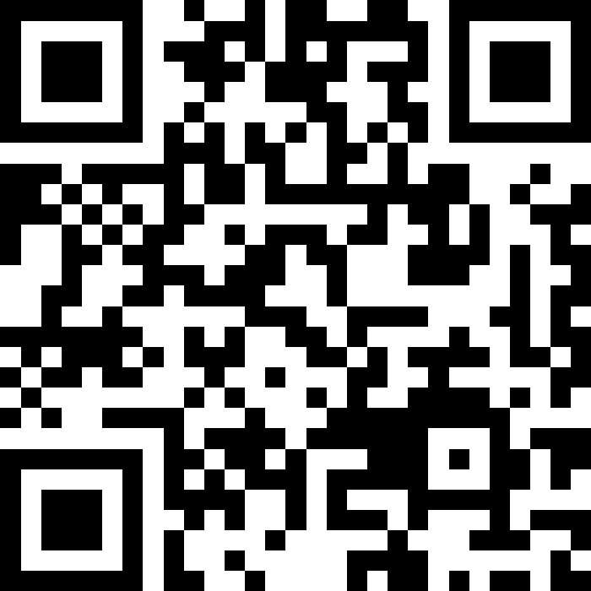
Java Review & Functional Decomposition
BEFORE WE START
Talk to your neighbors:
What’s your favorite guilty pleasure food?
Music: 122 26sp Lecture Jams🎧
David
William
Dani
Rohan
Andrew
Ava
Shreyank
Nicole
Caleb
Neha
Wesley
Isis
Colin
Naomi
Hanna
Blake P.
Cole
Blake R.
Carson
Sushma
Connor
Mahima
Nicolae
Ivory
Yang
Cady
Diya

Slide 2
Lecture Outline
Announcements/Reminders
Review Java
Code Quality
Functional Decomposition
First Assignment
Grading

Slide 3
Announcements
Hope you had fun in your first quiz section yesterday!
Creative Project 0 (C0) releasing later today; due Thursday, April 9th
Focused on Java Review + Functional Decomposition
Java Review Session on Monday, April 6th
2:30 – 3:30pm in JHN 102
Will be recorded!
IPL will also open on Monday, April 6th!
Elba Office Hours posted
Tuesdays 3pm – 4pm CSE 438
Thursdays 3:30pm – 4:30pm CSE 438
Viewable on the Staff page of the course website

Slide 4
Reminders
Fill out the Introductory Survey
⭐ Complete the pre-class material (PCM) for next Wednesday (see calendar)
Will be posted after class today
Attend quiz section on Tuesday!

Slide 5
Section Credit
Students receive "section credit" for a quiz section by attending and engaging in the quiz section's class and activities.
Section credit is logged and tracked by TAs on behalf of students.
Students will be able track and verify their participation credits on Gradescope.
Section 0 will be a freebie!

Slide 6
Section Credit
Students can earn one extra resubmission at the end of the quarter by participating in 11+ sections throughout 26Sp!
Missing a quiz section will not count against you, but attending section can help you earn that extra resubmission to use at the end of the quarter.

Slide 7
Lecture Outline
Announcements/Reminders
Review Java
Functional Decomposition
Code Quality
First Assignment
Grading

Slide 8
Reminders: Review Java Syntax
Java Tutorial reviews all the relevant programming features you should familiar with (even if you don’t know them in Java).
Printing and comments
Variables, types, expressions
Conditionals (if/else if/ else)
Loops (for and while)
Strings
Methods
Arrays
2D arrays

Slide 9
In-Class Activities
Goal: Get you actively participating in your learning
Typical Activity
Question is posed
Think (1 min): Think about the question on your own
Pair (2 min): Talk with your neighbor to discuss question
If you arrive at different conclusions, discuss your logic and figure out why you differ!
If you arrived at the same conclusion, discuss why the other answers might be wrong!
Share (1 min): We discuss the conclusions as a class
During each of the Think and Pair stages, you will respond to the question via a sli.do poll
Not worth any points, just here to help you learn! 😉

Slide 10
What is the output of this Java program?
public class Demo { public static void main(String[] args) { int[] nums = {1, 4, 4, 8, 13}; int totalDiff = 0; for (int i = 1; i <= nums.length; i++) { totalDiff += (nums[i] - nums[i - 1]); } System.out.println("Total Diff = " + totalDiff); } }
Total Diff = 12
Total Diff = 10
Total Diff = 9
Exception!
Notes:
public class Temperatures {
public static void main(String[] args) {
int[] nums = {1, 4, 4, 8, 13};
int totalDiff = 0;
for (int i = 1; i <= nums.length-1; i++) {
totalDiff += (nums[i] - nums[i - 1]);
}
System.out.println("Total Diff = " + totalDiff);
}
}

Slide 11
What is the output of this Java program?
public class Demo { public static void main(String[] args) { int[] nums = {1, 4, 4, 8, 13}; int totalDiff = 0; for (int i = 1; i <= nums.length; i++) { totalDiff += (nums[i] - nums[i - 1]); } System.out.println("Total Diff = " + totalDiff); } }
Total Diff = 12
Total Diff = 10
Total Diff = 9
Exception!

Slide 12
Lecture Outline
Announcements/Reminders
Review Java
Code Quality
Functional Decomposition
First Assignment
Grading

Slide 13
Code Quality
“Programs are meant to be read by humans and only incidentally for computers to execute.” – Abelson & Sussman, SICP
Code is about communication. Writing code with good code quality is important to communicate effectively.
Different organizations have different standards for code quality.
Doesn’t mean any one standard is wrong! (e.g., APA, MLA, Chicago, IEEE, ...)
Consistency is very helpful within a group project
See our Code Quality Guide for the standards we will all use in CSE 122

Slide 14
CSE 122 Code Quality
Examples relevant for this week
Naming conventions
Descriptive variable names
Indentation
Long lines
Spacing
Good method decomposition
Writing documentation

Slide 15
What does this code do? How could you improve the quality of this code? No Slido poll!
public static int l(String a,char b){ int j=-1;for(int a1=0;a1<a.length();a1 ++) { if (a.charAt(a1) == b) { j = a1; } } if(j==-1){return -1;} else { return j;} }

Slide 16
What does this code do? How could you improve the quality of this code? (No Slido poll)
public static int l(String a, char b) { int j=-1; for(int a1=0;a1<a.length();a1 ++) { if (a.charAt(a1) == b) { j = a1; } } if(j==-1) { return -1; } else { return j; } }

Slide 17
Lecture Outline
Announcements/Reminders
Review Java
Code Quality
Functional Decomposition
First Assignment
Grading

Slide 18
Functional Decomposition
Functional decomposition is the process of breaking down a complex problem or system into parts that are easier to conceive, understand, program, and maintain.
Wet
Mix butter and sugar
Beat in eggs & vanilla
Dry
Mix in flour, baking soda, and chocolate chips
Place
Make cookie-sized balls of dough
Place evenly on baking sheet
Bake
Bake at 350 degrees Fahrenheit for 10 minutes
Let cool after
“Bake the cookies”

Slide 19
Functional Decomposition
In our code, functional decomposition often means breaking a task into smaller methods (also called functions).
Example: Bingo
Set up populated game card
Roll and call a new number
Mark your card if the number called is present
Check card for bingo

Slide 20
Avoid Trivial Methods
Introduce methods to decompose a complex problem, not just for the sake of adding a method.
Bad example: Good Example:
Rule of thumb: A method should do at least two steps
Ask yourself: Does adding this method make my code easier to understand?
public static void printMessage(String message) { System.out.println(message);
System.out.println(); }
public static void sToQ(Stack<String> s, Queue<String> q) {
while (!s.isEmpty()) {
q.add(s.pop());;
} }

Slide 21
Lecture Outline
Announcements/Reminders
Review Java
Functional Decomposition
Code Quality
First Assignment
Grading

Slide 22
Creative Project 0
Released today, due next Thursday (Apr 9) at 11:59pm PT on Ed
Can hit the "Submit" button multiple times – we will grade the last submission made before the initial deadline.
Build good habits: Don’t “shotgun debug”
While you can resubmit this assignment, it's important to meet due date to get as much feedback as possible.
Focused on reviewing Java concepts and Functional Decomposition
See Grading Rubric to know what to expect
IPL opens Monday!

