Slide 1
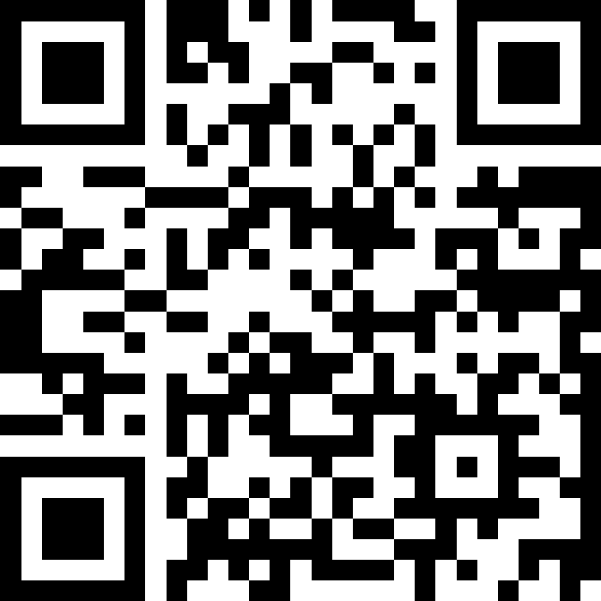
Introduction to Objects
BEFORE WE START
Talk to your neighbors:
Respond on sli.do!
Instructor:
Brett Wortzman
TAs:
Archit
Blake P.
Blake R.
Cady
Carson
Cole
Connor
Daniel
David
Hanna
Isis
Jun
Landon
Michelle
Naomi
Neha
Nicole
Rio
Rohan
Shreyank
Somya
Sreshta
Suyash
Trisha
Wesley
Yash
Music: 🎷CSE 122 26au Lecture Tunes 🎵

Slide 2
Lecture Outline
Announcements
Review: OOP
Abstraction
Building a Shopping Cart

Slide 3
Announcements
CQ1 has begun
  Sign up early– slots fill!
  Same-day changes not allowed; email Brett if an emergency
CQ0 grades out; PQ0 grades coming next week

Slide 4
Mid-Quarter Feedback
Good things!
  PCM/Lecture/Section triad
  TAs
  IPL
  AI policy

Slide 5
Mid-Quarter Feedback
Areas for improvement
  Computer Quiz length
    Already working on it– see note in CQ0 grade post
  More practice quizzes
    Unlikely to get more than 1/quiz this quarter, but will build over time
    Make sure to use them well!
  Gradebook
    On the way

Slide 6
Mid-Quarter Feedback
Mixed results
  Pace of lecture
    Also amount of review/recap
  Quiz/Practice alignment
  Spec clarity

Slide 7
Lecture Outline
Announcements
Review: OOP
Abstraction
Building a Shopping Cart

Slide 8
(PCM) Object Oriented Programming (OOP)
Procedural programming: Programs that perform their behavior as a series of steps to be carried out
  Classes that do things
Object-oriented programming (OOP): Programs that perform their behavior as interactions between objects
  Classes that represent things
  We’re going to start writing our own objects!

Slide 9
(PCM) Classes & Objects
Classes can define the template for an object
  📰 Like the blueprint for a house!
  “What does it mean to be this thing?”
Objects are the actual instances of the class
  🏠 Like the actual house built from the blueprint!
  “It is an example of this thing!”
We create a new instance of a class with the new keyword
e.g., Scanner console = new Scanner(System.in);

Slide 10
(PCM) Object State & Behavior
Objects can tie related state and behavior together
State is defined by the object’s fields (aka instance variables)
  Scanner’s state may include what it’s scanning, where it is in the input, etc.
Behavior is defined by the object’s instance methods
  Scanner’s behavior includes “getting the next token and returning it as an int”, “returning whether there is a next token or not”, etc.
  …Next time!

Slide 11
(PCM) Object Class Syntax
public class MyObject {
// fields (or instance variables)
type1 fieldName1;
type2 fieldName2;
...
// instance methods
public returnType methodName(...) {
...
}
...
}

Slide 12
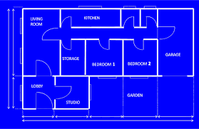






(PCM) Instance Variables
Fields are also referred to as instance variables
Fields are defined in a class, where each instance of the class has their own copy of the fields
  Hence instance variable! It’s a variable tied to a specific instance of the class!

Slide 13






(PCM) Instance Methods
Instance methods are defined in a class
Calling an instance method on a particular instance of the class will have effects only on that instance
More on these later…

Slide 14
Lecture Outline
Announcements
Review: OOP
Abstraction
Building a Shopping Cart

Slide 15
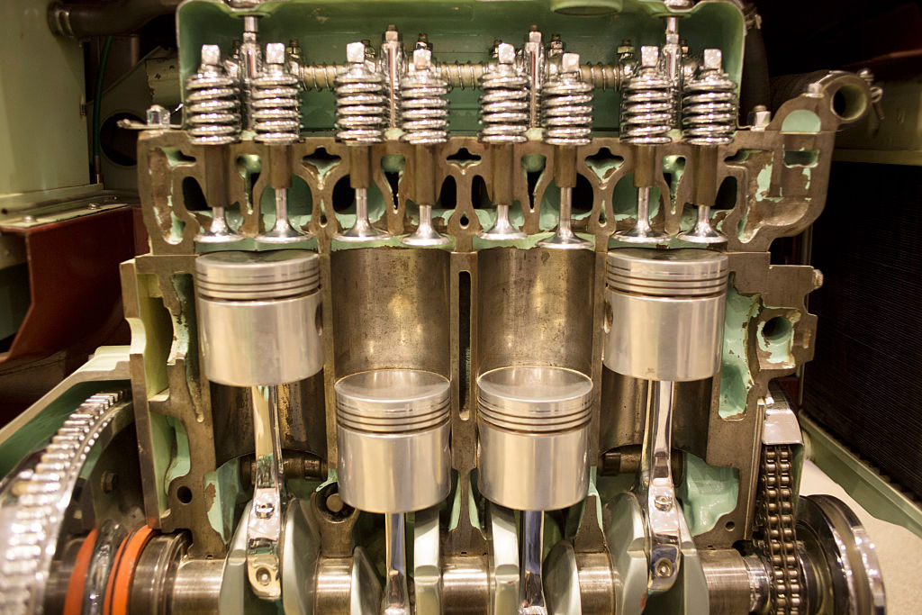

Slide 16
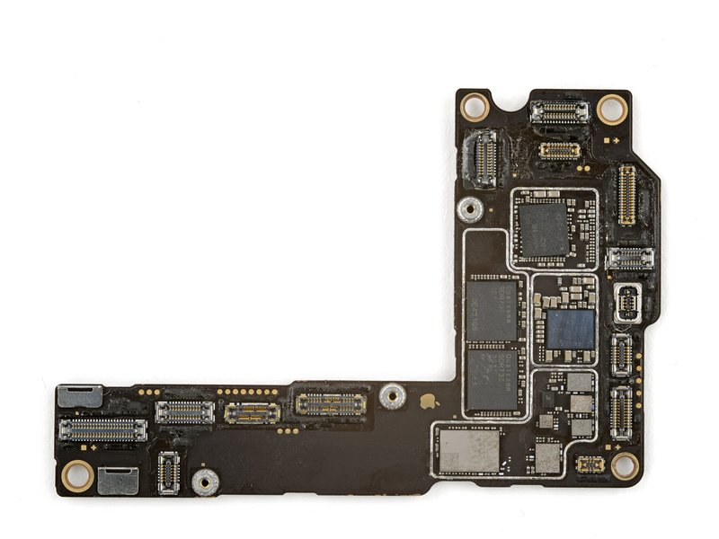

Slide 17
Abstraction
The separation of ideas from details, meaning that we can use something without knowing exactly how it works.
You were able use the Scanner class without understanding how it works internally!

Slide 18
Client v. Implementor
We have been the clients of many objects this quarter!
Now we will become the implementors of our own objects!

Slide 19
Lecture Outline
Announcements
Review: OOP
Abstraction
Building a Shopping Cart

