Slide 1

Nested Collections
BEFORE WE START
Talk to your neighbors:
What book are you reading right now?
Respond on sli.do!
Instructor:
Brett Wortzman
TAs:
Archit
Blake P.
Blake R.
Cady
Carson
Cole
Connor
Daniel
David
Hanna
Isis
Jun
Landon
Michelle
Naomi
Neha
Nicole
Rio
Rohan
Shreyank
Somya
Sreshta
Suyash
Trisha
Wesley
Yash
Music: 🎷CSE 122 26au Lecture Tunes 🎵

Slide 2
Agenda
Announcements
Review: Nested Collections
Practice: mostFrequentStart
Practice: Social Network

Slide 3
Announcements
P1 due tomorrow (Oct. 29)
  Code quality and reflection not graded on project, but will impact computer quiz
    You should take these seriously now
CQ1 scheduling open; begins Friday, Oct. 30
  Sign up early– slots fill!
  Same-day changes not allowed; email Brett if an emergency
Working on grades for CQ0 and PQ0
  Hoping to publish CQ0 grades tomorrow, but can’t commit yet
Working on unified gradebook; will announce once ready

Slide 4
Agenda
Announcements
Review: Nested Collections
Practice: mostFrequentStart
Practice: Social Network

Slide 5
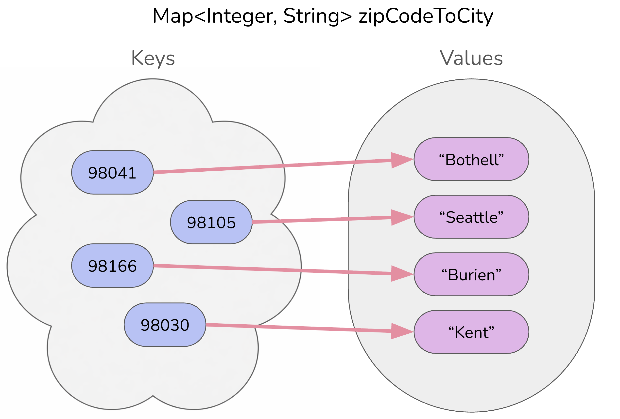
Reminder: Map ADT
Data structure to map keys to values
  Keys can be any* type; Keys must be unique
  Values can be any type
Example: Mapping ticker to stock price in P0
Operations
  put(key, value): Associate key to value
    Overwrites existing keys
  get(key): Get value for key
  remove(key): Remove key/value pair
Same as Python’s dict

Slide 6
(PCM) Nested Collections
The values inside a collection can be any type, including other collections
Examples:
  Queue: Students in the IPL by group
    Queue<Set<String>>
  Map: Section ➔ Set of students in that section
    Map<String, Set<String>
  Map: Recipe ➔ List of ingredients in that recipe
    Map<String, List<String>
    Or even Map<String, Map<String, Double>> to track amounts!

Slide 7
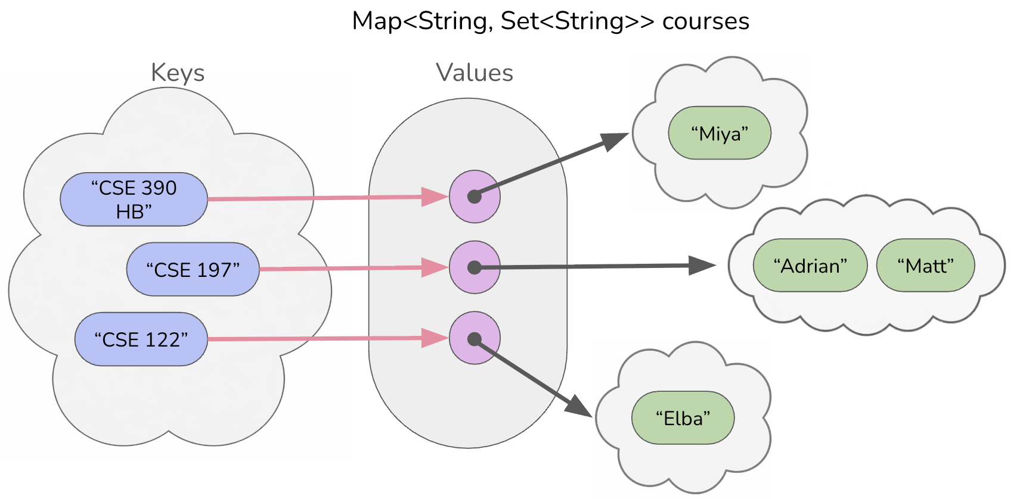
(PCM) Nested Collections

Slide 8
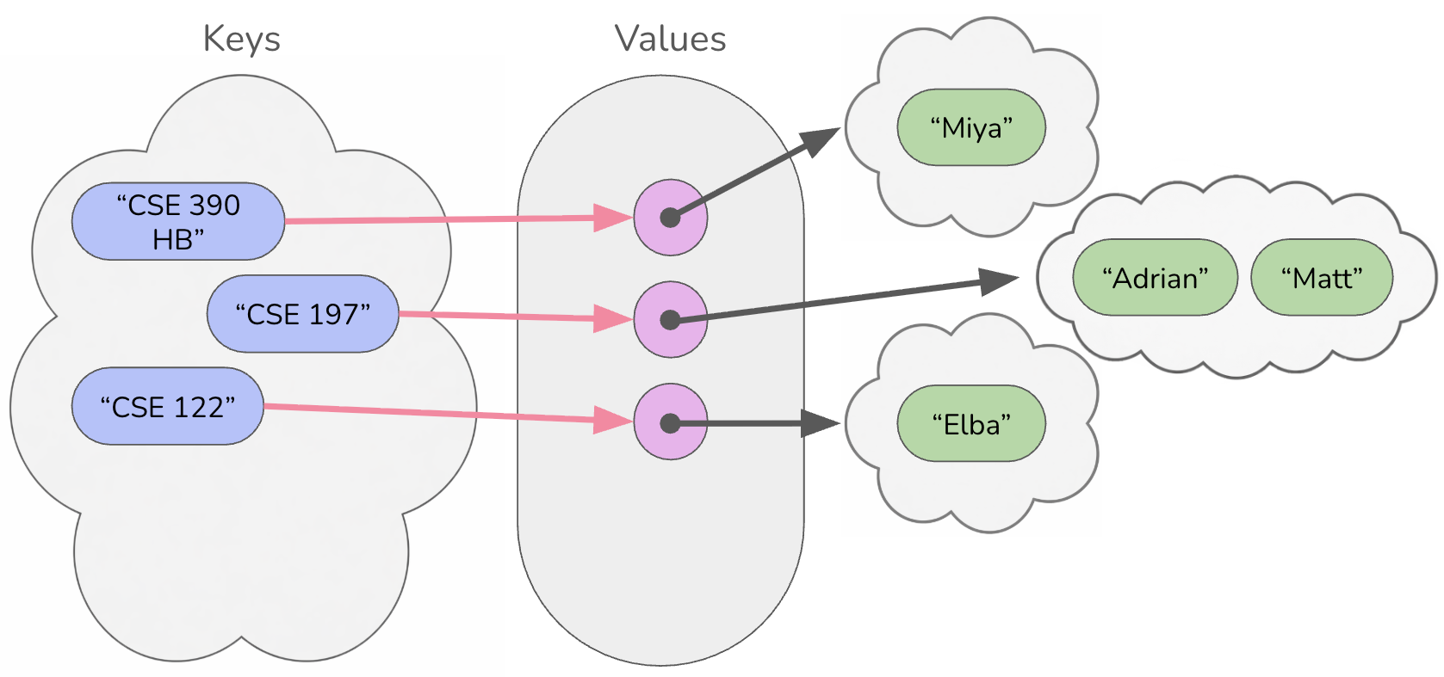

(PCM) Updating Nested Collections
courses.put("CSE 123",
new HashSet<String>());
courses.get("CSE 123").add("James");
Set<String> cse123 = courses.get("CSE 123");
cse123.add("Gigi");
The “value” inside the Map is a reference
to the data structure!
  Think carefully about number of references to a particular object
cse123
“CSE 123”
“James”
“Gigi”

Slide 9

What would be stored in map after executing the following code?
map: {"KeyA"=[1, 2], "KeyB"=[3], "KeyC"=[4, 5, 6]}
Set<Integer> nums = map.get("KeyA");
nums.add(7);
map.put("KeyB", nums);
map.get("KeyA").add(8);
map.get("KeyB").add(9);
{"KeyA"=[1, 2], "KeyB"=[1, 2, 7], "KeyC"=[4, 5, 6]}
{"KeyA"=[1, 2, 8], "KeyB"=[1, 2, 7, 9], "KeyC"=[4, 5, 6]}
{"KeyA"=[1, 2, 7, 8], "KeyB"=[1, 2, 7, 9], "KeyC"=[4, 5, 6]}
{"KeyA"=[1, 2, 7, 8, 9], "KeyB"=[1, 2, 7, 8, 9], "KeyC"=[4, 5, 6]}

Slide 10
What would be stored in map after executing the following code?
map: {"KeyA"=[1, 2], "KeyB"=[3], "KeyC"=[4, 5, 6]}
Set<Integer> nums = map.get("KeyA");
nums.add(7);
map.put("KeyB", nums);
map.get("KeyA").add(8);
map.get("KeyB").add(9);
{"KeyA"=[1, 2], "KeyB"=[1, 2, 7], "KeyC"=[4, 5, 6]}
{"KeyA"=[1, 2, 8], "KeyB"=[1, 2, 7, 9], "KeyC"=[4, 5, 6]}
{"KeyA"=[1, 2, 7, 8], "KeyB"=[1, 2, 7, 9], "KeyC"=[4, 5, 6]}
{"KeyA"=[1, 2, 7, 8, 9], "KeyB"=[1, 2, 7, 8, 9], "KeyC"=[4, 5, 6]}

Slide 11
What would be stored in map after executing the following code?
nums
map: {"KeyA"=[1, 2], "KeyB"=[3], "KeyC"=[4, 5, 6]}
[1, 2]
[1, 2, 7, 8]
KeyA:
[1, 2, 7]
Set<Integer> nums = map.get("KeyA");
nums.add(7);
map.put("KeyB", nums);
map.get("KeyA").add(8);
map.get("KeyB").add(9);
[1, 2, 7, 8, 9]
KeyB:
[3]
KeyC:
[4, 5, 6]
{"KeyA"=[1, 2], "KeyB"=[1, 2, 7], "KeyC"=[4, 5, 6]}
{"KeyA"=[1, 2, 8], "KeyB"=[1, 2, 7, 9], "KeyC"=[4, 5, 6]}
{"KeyA"=[1, 2, 7, 8], "KeyB"=[1, 2, 7, 9], "KeyC"=[4, 5, 6]}
{"KeyA"=[1, 2, 7, 8, 9], "KeyB"=[1, 2, 7, 8, 9], "KeyC"=[4, 5, 6]}

Slide 12
Agenda
Announcements
Review: Nested Collections
Practice: mostFrequentStart
Practice: Social Network

Slide 13
mostFrequentStart
Write a method called mostFrequentStart that takes a Set of words and does the following steps:
Organizes words into “word families” based on which letter they start with
Selects the largest “word family” as defined as the family with the most words in it
Updates the Set of words to only have words from the selected family
Returns the starting letter of the largest word family

Slide 14
mostFrequentStart
For example, if the Set words stored the values:
["hello", "goodbye", "library", "literary", "little", "repel"]
The word families produced would be:
'h' -> 1 word ("hello")
'g' -> 1 word ("goodbye")
'l' -> 3 words ("library", "literary", "little")
'r' -> 1 word ("repel")
Since 'l' has the largest word family, we modify the Set to only contain Strings starting with 'l' and finally return 'l'.

Slide 15
Agenda
Announcements
Review: Nested Collections
Practice: mostFrequentStart
Practice: Social Network

Slide 16
Social Network
Write methods to complete our implementation of a simple social network program. You should complete the following methods:
  addUser: adds a new user to the network with no friends (😢)
  addFriend: adds a friend to a user (friendships are not symmetric)
  removeUser: removes a user from the network and all friends lists
  getAllFriendsOf: returns a Set of all the given user's friends and all users who are friends with the given user

