Slide 1
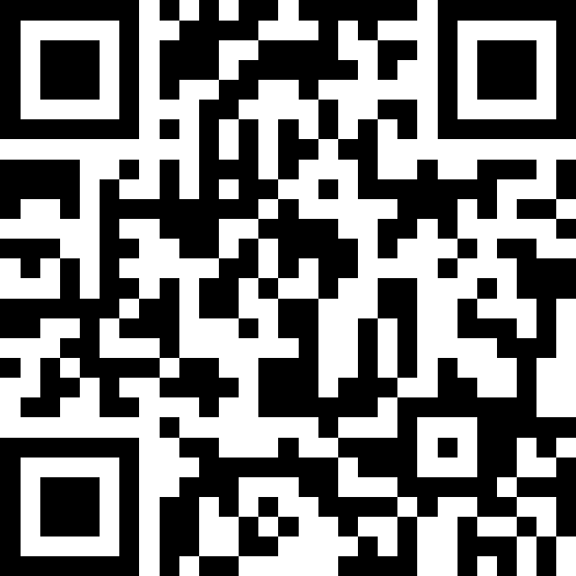
Maps
BEFORE WE START
Talk to your neighbors:
What was your last YouTube/Wikipedia/Google/ChatGPT rabbit hole?
Respond on sli.do!
Instructor:
Brett Wortzman
TAs:
Archit
Blake P.
Blake R.
Cady
Carson
Cole
Connor
Daniel
David
Hanna
Isis
Jun
Landon
Michelle
Naomi
Neha
Nicole
Rio
Rohan
Shreyank
Somya
Sreshta
Suyash
Trisha
Wesley
Yash
Music: 🎷CSE 122 26au Lecture Tunes 🎵

Slide 2
Lecture Outline
Announcements
Review: Maps
Practice: joinRosters
Practice: mostFrequentStart

Slide 3
Announcements/Reminders
P1 out tonight; due Thursday, Oct. 29
PQ0 on Tuesday, Oct. 27 in section
  Policies posted on Ed
  Will cover material through Lesson 5 (up to stacks)
CQ1 will begin Friday, Oct. 30
  Scheduling will open early next week
Reminder: you may not discuss the computer quiz with other students until the quiz window is closed

Slide 4
Lecture Outline
Announcements
Review: Maps
Practice: joinRosters
Practice: mostFrequentStart

Slide 5
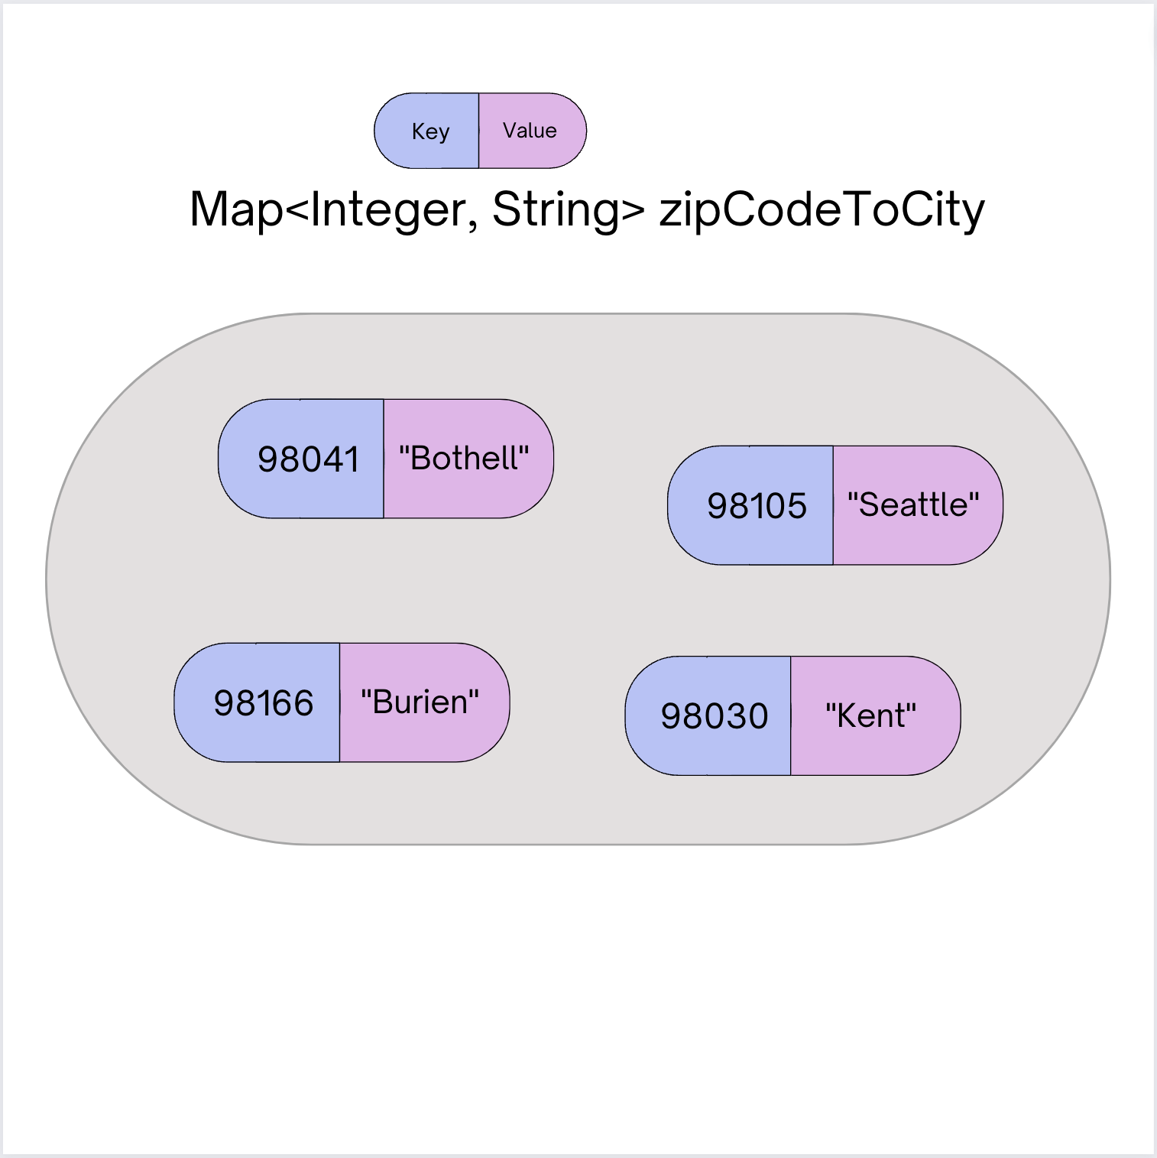
(PCM) Maps (ADT)
Data structure to map keys to values
  Keys can be any type; Keys must be unique
  Values can be any type
Key operations:
  put(key, value): Associate key to value
    🚨 Overwrites existing keys 🚨
  get(key): Get value for key
  remove(key): Remove key/value pair

Slide 6
(PCM) Maps in Java
Map is an interface in Java
  In java.util package, like List, Queue, Stack, Set
Two implementations: HashMap and TreeMap
  HashMap: Very fast! Implemented using a hash table
    Keys are stored in an unpredictable order
  TreeMap: Pretty fast! Implemented using a binary search tree
    Keys are stored in sorted order

Slide 7
(PCM) Map Methods
Methods | Description
put(key, value) | adds a mapping from the given key to the given value; if the key already exists, replaces its value with the given one
get(key) | returns the value mapped to the given key (null if not found)
containsKey(key) | returns true if the map contains a mapping for the given key
remove(key) | removes any existing mapping for the given key
keySet() | returns a set of all keys in the map
values() | returns a collection of all values in the map
clear() | removes all key/value pairs from the map
size() | returns the number of key/value pairs in the map
isEmpty() | returns true if the map's size is 0
toString() | returns a string such as "{a=90, d=60, c=70}"

Slide 8
Select the method calls required to modify the given map m as follows:
Assume m’s contents are
98030="Kent"
98178="Seattle"
98166="Burien"
98041="Bothell"
We want to modify m so that its contents are
98030="Kent"
98178="Tukwila"
98166="Burien"
98041="Bothell"
98101="Seattle"
98126="Seattle"
m.put(98178, "Tukwila");
m.remove(98178);
m.put(98126, "Seattle");
m.get(98178, "Seattle");
m.put(98101, "Seattle");

Slide 9
Select the method calls required to modify the given map m as follows:
Assume m’s contents are
98030="Kent"
98178="Seattle"
98166="Burien"
98041="Bothell"
We want to modify m so that its contents are
98030="Kent"
98178="Tukwila"
98166="Burien"
98041="Bothell"
98101="Seattle"
98126="Seattle"
m.put(98178, "Tukwila");
m.remove(98178);
m.put(98126, "Seattle");
m.get(98178, "Seattle");
m.put(98101, "Seattle");

Slide 10
Lecture Outline
Announcements
Review: Maps
Practice: joinRosters
Practice: mostFrequentStart

Slide 11
joinRosters
Write a method joinRosters that combines a Map from student name to quiz section, and a Map from TA name to quiz section and prints all pairs of students/TAs.
For example, if studentSections stores the following map:
{Alan=AD, Jerry=BE, Yueying=BG, Sharon=BE, Steven=BE, Zewditu=AF}
And taSections stores the following map
{Blake=AF, Dani=BG, Naomi=BE, Wesley=AD}
AD: Alan - Wesley
AF: Zewditu – Blake
BE: Jerry – Naomi
BE: Sharon - Naomi BE: Steven - Naomi BG: Yueying – Dani

Slide 12
Lecture Outline
Announcements
Review: Maps
Practice: joinRosters
Practice: mostFrequentStart

Slide 13
mostFrequentStart
Write a method called mostFrequentStart that takes a Set of words and does the following steps:
Organizes words into “word families” based on which letter they start with
Selects the largest “word family” as defined as the family with the most words in it
Returns the starting letter of the largest word family (and if time, should update the Set of words to only have words from the selected family).

Slide 14
mostFrequentStart
For example, if the Set words stored the values
["hello", "goodbye", "library", "literary", "little", "repel"]
The word families produced would be
'h' -> 1 word ("hello")
'g' -> 1 word ("goodbye")
'l' -> 3 words ("library", "literary", "little")
'r' -> 1 word ("repel")
Since 'l' has the largest word family, we return 'l' and modify the Set to only contain Strings starting with 'l'.

