Slide 1

Stacks
BEFORE WE START
Talk to your neighbors:
How do you relax after a stressful day/week?
Respond on sli.do!
Instructor:
Brett Wortzman
TAs:
Archit
Blake P.
Blake R.
Cady
Carson
Cole
Connor
Daniel
David
Hanna
Isis
Jun
Landon
Michelle
Naomi
Neha
Nicole
Rio
Rohan
Shreyank
Somya
Sreshta
Suyash
Trisha
Wesley
Yash
Music: 🎷CSE 122 26au Lecture Tunes 🎵

Slide 2
Lecture Outline
Announcements
Review: Stacks
Review: Exceptions
Stack Programming Example
Data Structure Choice
Commenting/Implementation Details

Slide 3
Announcements
P0 now past due
  Congratulations!!
  Start early, ask questions, test your code often
CQ0 now running
  Be sure to schedule if you haven’t– spots are filling fast!
P1 will release next Friday, October 23
PQ0 Tuesday, October 27 (in section)

Slide 4
Metacognition
Metacognition: asking questions about your solution process.
Examples:
  While debugging: explain to yourself why you’re making this change to your program.
  Before running your program: make an explicit prediction of what you expect to see.
  When coding: be aware when you’re not making progress, so you can take a break or try a different strategy.
  When designing:
    Explain the tradeoffs with using a different data structure or algorithm.
    If one or more requirements change, how would the solution change as a result?
    Reflect on how you ruled out alternative ideas along the way to a solution.
  When studying: what is the relationship of this topic to other ideas in the course?
  After finishing: consider what went well and didn’t, and what you should change or continue next time

Slide 5
Lecture Outline
Announcements
Review: Stacks
Review: Exceptions
Stack Programming Example
Data Structure Choice
Commenting/Implementation Details

Slide 6



(PCM) Stacks
Stack: A collection based on the principle of adding elements and retrieving them in the opposite order.
  Last-In, First-Out ("LIFO")
  Elements are stored in order of insertion.
    We do not think of them as having indexes.
  Client can only add/remove/examine the last element added (the "top")
Basic Stack operations:
push: Add an element to the top
pop: Remove the top element
peek: Examine the top element
top
push
pop
bottom

Slide 7
Stacks in Computer Science
Programming languages and compilers:
  method calls are placed onto a stack (call↔push, return ↔ pop)
  compilers use stacks to evaluate expressions
Operating Systems:
  Call stacks → memory stack for processes’ data
Matching up related pairs of things:
  find out whether a string is a palindrome
  examine a file to see if its braces { } match
  convert "infix" expressions to pre/postfix
Sophisticated algorithms:
  searching through a maze with "backtracking”
  many programs use an "undo stack" of previous operations

Slide 8
(PCM) Programming with Stacks
Stack<E>() | constructs a new stack with elements of type E
push(value) | places given value on top of stack
pop() | removes top value from stack and returns it; throws EmptyStackException if stack is empty
peek() | returns top value from stack without removing it; throws EmptyStackException if stack is empty
size() | returns number of elements in stack
isEmpty() | returns true if stack has no elements
"c"
"b"
"a"
  Stack<String> s = new Stack<String>();
  s.push("a");
  s.push("b");
  s.push("c");
  System.out.println(s.pop());
  Stack has other methods that we will ask you not to use 😬

Slide 9
Lecture Outline
Announcements
Review: Stacks
Review: Exceptions
Stack Programming Example
Data Structure Choice
Commenting/Implementation Details

Slide 10
Exceptions
Sometimes we want to limit someone’s input into our method to “valid” options we define
  Previously printed out “hey don’t do that” messages which isn’t great…
Allow us to “fail fast” and immediately halt execution
No longer need to wrap code in conditionals
Can include custom error messages about what went wrong
if (/* invalid input */) {
throw new IllegalArgumentException("Error Message");
}

Slide 11
Lecture Outline
Announcements
Review: Stacks
Review: Exceptions
Stack Programming Example
Data Structure Choice
Commenting/Implementation Details

Slide 12
Lecture Outline
Announcements
Review: Stacks
Review: Exceptions
Stack Programming Example
Data Structure Choice
Commenting/Implementation Details

Slide 13
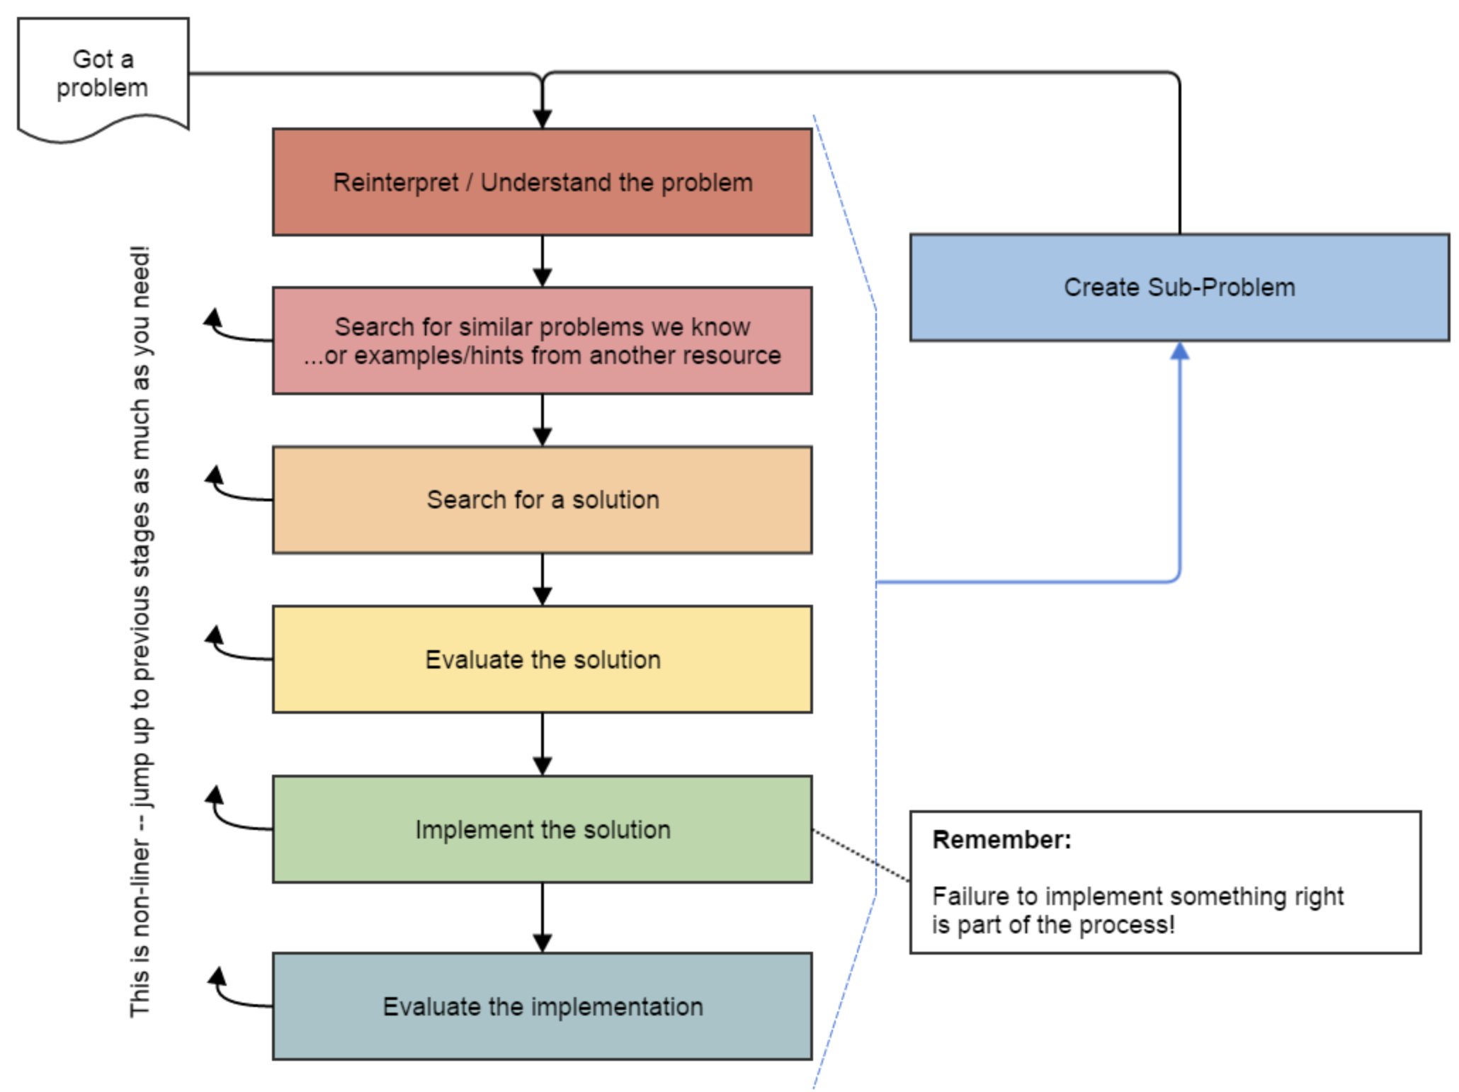
Data Structure Choice
Many problems are made easier or
harder based on the data structures
used
When given the choice, think carefully
  Don’t always choose a list
Sometimes you won’t be given the
choice
  Learn to work within constraints
Source: Oleson, Ko (2016) - Programming, Problem Solving, and Self-Awareness: Effects of Explicit Guidance

Slide 14
Lecture Outline
Announcements
Review: Stacks
Review: Exceptions
Stack Programming Example
Data Structure Choice
Commenting/Implementation Details

Slide 15
Commenting/Implementation Details
In CSE 122, we use header comments as general documentation
  Describing what the client needs to know about the program/method
See the Commenting Guide for example and guidelines
Should avoid providing implementation details
  Things that are not relevant to the client’s understanding
  The “how” instead of the “what”
  Note: this is not universal, but it is a 122 expectation

Slide 16
Implementation Details
// B: Uses a for-loop to go from 0 up to but not including numCount and
// puts the running sums in an ArrayList.
// For example, if numCount is 4, the list will contain [0, 1, 3, 6].
// R: sums - the list of sums being returned
// P: numCount - the number of terms to sum
public static List<Integer> sumNumbers(int numCount) {
List<Integer> sums = new ArrayList<>();
int total = 0;
for (int i = 0; i < numCount; i++) {
total += i;
sums.add(total);
}
return sums;
}

Slide 17
Implementation Details
// B: Puts the running sums from 0 up to but not including numCount in a list.
// For example, if numCount is 4, the list will contain [0, 1, 3, 6].
// R: the list of running sums
// P: numCount - the number of terms to sum
public static List<Integer> sumNumbers(int numCount) {
List<Integer> sums = new ArrayList<>();
int total = 0;
for (int i = 0; i < numCount; i++) {
total += i;
sums.add(total);
}
return sums;
}

