Slide 1
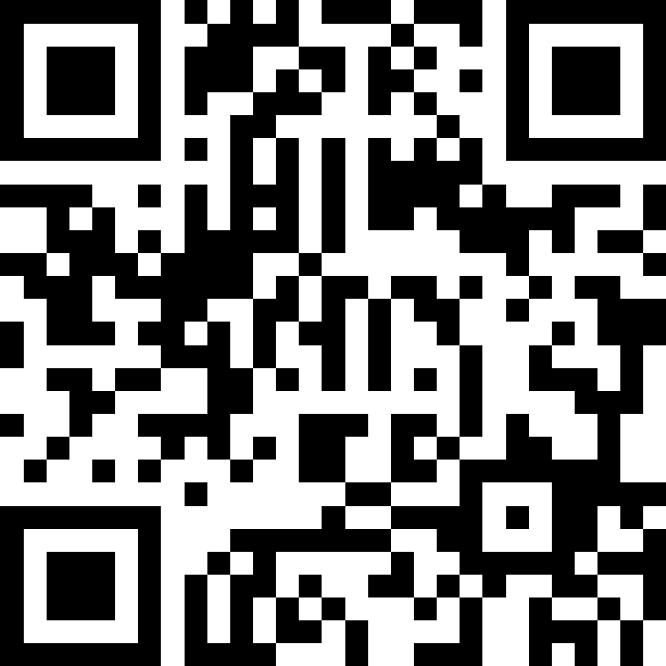
Queues
BEFORE WE START
Talk to your neighbors:
What is your favorite place to eat on the Ave?
Respond on sli.do!
Instructor:
Brett Wortzman
TAs:
Archit
Blake P.
Blake R.
Cady
Carson
Cole
Connor
Daniel
David
Hanna
Isis
Jun
Landon
Michelle
Naomi
Neha
Nicole
Rio
Rohan
Shreyank
Somya
Sreshta
Suyash
Trisha
Wesley
Yash
Music: 🎷CSE 122 26au Lecture Tunes 🎵

Slide 2
Lecture Outline
Announcements
Review: ADTs; Queues
Programming Practice
Commenting/Implementation Details

Slide 3
Announcements
Programming Project 0 (P0) due tomorrow by 11:59pm
Computer Quiz 0 now available for scheduling
  Will run Friday 10/16 through Friday 10/23
  See policies and procedures on Ed
Paper Quiz 0 coming up on Tuesday, October 27 (in section)
  More details soon, but like computer quizzes except on paper
Brett’s Office Hours posted
  Mon 12:30-1:30, Thur 12:00-1:00 (except 11/5 and 12/10)

Slide 4
Lecture Outline
Announcements
Review: ADTs; Queues
Programming Practice
Commenting/Implementation Details

Slide 5
(PCM) Abstract Data Types
Abstract Data Type (ADT): A specification of a collection of data and the operations that can be performed on it.
  Describes what a collection does, not how it does it (not implementation!)
  Think of it as an ✨idea ✨ of a data type
We don't know exactly how a list or queue is implemented, and we don't need to!
  Only need to understand high-level idea of what a collection does
  List: ordered collection, access any element by index, add/remove anywhere
  Queue: ordered collection, only add to back/remove from from

Slide 6
Wait, ADT? Interfaces?
Abstract Data Type (ADT): A description of the idea of a data structure including what operations are available on it and how those operations should behave.
  The concept of a list.
Interface: Java construct that lets programmers specify what methods a class should have.
  The List interface in Java.
Implementation: Concrete code that meets the specified interface.
  The ArrayList and LinkedList classes that implement the List interface.

Slide 7
(PCM) Queues
Queue: Retrieves elements in First-In, First-Out ("FIFO") order
  Client can only add to the end of the queue, and can only examine/remove the front of the queue.
  Elements are stored in order of insertion but don't have indexes.
Basic Queue operations:
  add (enqueue): Add an element to the back.
  remove (dequeue): Remove the front element.
  peek: Examine the front element.
  Java allows certain other operations, but you should not use them in 122!

Slide 8
(PCM) Programming with Queues
add(value) | places given value at back of queue
remove() | removes value from front of queue and returns it; throws a NoSuchElementException if queue is empty
peek() | returns front value from queue without removing it; returns null if queue is empty
size() | returns number of elements in queue
isEmpty() | returns true if queue has no elements
front
back
42
-3
17
  Queue<Integer> q = new LinkedList<Integer>();
  q.add(42);
  q.add(-3);
  q.add(17);
  System.out.println(q.remove());
  🚨 IMPORTANT: When constructing a queue you must use a new LinkedList object instead of a new Queue object. (More on that with Interfaces.)

Slide 9
Queues in Computer Science
Operating systems:
  Queue of print jobs to send to the printer
  Queue of programs / processes to be run
  Queue of network data packets to send
Computer Architecture
  Miss status/handling register (MSHR) queue
  Instruction fetch queue
  Issue queue
  Instruction pipeline in general!
Programming:
  Modeling a line of customers or clients
  Storing a queue of computations to be performed in order
Real world examples:
  People on an escalator or waiting in a line
  Cars at a gas station (or on an assembly line)

Slide 10
But Why?
Lists can do everything queues can and more.
So why use a queue?
Similar questions:
  Why not always use double instead of int?
  Why not always use String instead of char?
  Why not always use while instead of for?
Makes the intent clearer
Avoids unintended operations
Can have efficiency benefits

Slide 11
Lecture Outline
Announcements
Review: ADTs; Queues
Programming Practice
Commenting/Implementation Details

Slide 12
Lecture Outline
Announcements
Review: ADTs; Queues
Programming Practice
Commenting/Implementation Details

Slide 13
Commenting/Implementation Details
In CSE 122, we use header comments as general documentation
  Describing what the client needs to know about the program/method
See the Commenting Guide for example and guidelines
Should avoid providing implementation details
  Things that are not relevant to the client’s understanding
  The “how” instead of the “what”
  Note: this is not universal, but it is a 122 expectation

Slide 14
Implementation Details
// B: Uses a for-loop to go from 0 up to but not including numCount and
// puts the running sums in an ArrayList.
// For example, if numCount is 4, the list will contain [0, 1, 3, 6].
// R: sums - the list of sums being returned
// P: numCount - the number of terms to sum
public static List<Integer> sumNumbers(int numCount) {
List<Integer> sums = new ArrayList<>();
int total = 0;
for (int i = 0; i < numCount; i++) {
total += i;
sums.add(total);
}
return sums;
}

Slide 15
Implementation Details
// B: Puts the running sums from 0 up to but not including numCount in a list.
// For example, if numCount is 4, the list will contain [0, 1, 3, 6].
// R: the list of running sums
// P: numCount - the number of terms to sum
public static List<Integer> sumNumbers(int numCount) {
List<Integer> sums = new ArrayList<>();
int total = 0;
for (int i = 0; i < numCount; i++) {
total += i;
sums.add(total);
}
return sums;
}

