Slide 1

File I/O
BEFORE WE START
Talk to your neighbors:
What is your current TV/Youtube/video obsession?
Respond on sli.do!
Instructor:
Brett Wortzman
TAs:
Archit
Blake P.
Blake R.
Cady
Carson
Cole
Connor
Daniel
David
Hanna
Isis
Jun
Landon
Michelle
Naomi
Neha
Nicole
Rio
Rohan
Shreyank
Somya
Sreshta
Suyash
Trisha
Wesley
Yash
Music: 🎷CSE 122 26au Lecture Tunes 🎵

Slide 2
Lecture Outline
Announcements/Reminders
PCM Review
Code Tracing
Programming Example
File output with PrintStream

Slide 3
Announcements
The IPL is open!
  Schedule will be on the course website
Materials and recordings from Java Review posted
Programming Project 0 out Friday, Oct. 9, due next Thursday, Oct. 15
Computer Quiz 0 window begins Friday, Oct. 16
  See assignment and quiz dates on course calendar
Just joined CSE 122? Welcome!
  All materials on course website
  Canvas not published– this is expected
Reminder: Complete PCM before class
  Due by 11:59pm for participation credit

Slide 4
Lecture Outline
Announcements/Reminders
PCM Review
Code Tracing
Programming Example
File output with PrintStream

Slide 5
(Review) Scanner for User Input
Scanner is defined in the java.util package
import java.util.*;
Scanner console = new Scanner(System.in);
Scanner Methods | Description
nextInt() | Reads the next token from the user as an int and returns it
nextDouble() | Reads the next token from the user as a double and returns it
next() | Reads the next token from the user as a String and returns it
nextLine() | Reads an entire line from the user as a String and returns it
hasNextInt() | Returns true if the next token can be read as an int, false otherwise
hasNextDouble() | Returns true if the next token can be read as a double, false otherwise
hasNext() | Returns true if there is another token of input to be read in, false otherwise
hasNextLine() | Returns true if there is another line of input to be read in, false otherwise

Slide 6
(PCM) Scanner for File I/O
Scanner is defined in the java.util package
import java.util.*;
File file = new File("Example.txt");
Scanner fileScan = new Scanner(file);
File is defined in the java.io package
import java.io.*;
Scanner Methods | Description
nextInt() | Reads the next token as an int and returns it
nextDouble() | Reads the next token as a double and returns it
next() | Reads the next token as a String and returns it
nextLine() | Reads an entire line as a String and returns it
hasNextInt() | Returns true if the next token can be read as an int, false otherwise
hasNextDouble() | Returns true if the next token can be read as a double, false otherwise
hasNext() | Returns true if there is another token of input to be read in, false otherwise
hasNextLine() | Returns true if there is another line of input to be read in, false otherwise

Slide 7
(PCM) Checked Exceptions
New possible problem: the input file doesn’t exist
This is such a big deal, Java makes you acknowledge it:
error: unreported exception FileNotFoundException; must be caught or declared to be thrown
Fix this error by declaring the exception:
public static void fileMethod() throws FileNotFoundException {
...
}
This does not prevent the error, just makes the compiler happy!

Slide 8
(PCM) Token-Based Processing Pattern
while (scan.hasNext______()) {
_______ nextToken = scan.next_______();
// do something with nextToken
}

Slide 9
(PCM) Line-Based Processing Pattern
while (scan.hasNextLine()) {
String nextLine = scan.nextLine();
// do something with nextLine
}

Slide 10
(PCM) Hybrid Processing Pattern
while (fileScan.hasNextLine()) {
String line = fileScan.nextLine();
Scanner lineScan = new Scanner(line);
while (lineScan.hasNext__()) {
__ nextToken = lineScan.next__();
// do something with nextToken
}
}

Slide 11
(PCM) Hybrid Processing Pattern
while (fileScan.hasNextLine()) {
String line = fileScan.nextLine();
Scanner lineScan = new Scanner(line);
while (lineScan.hasNext__()) {
__ nextToken = lineScan.next__();
// do something with nextToken
}
}
Line-by-line and then token-by-token to do something

Slide 12
(PCM) Scanners with Strings
String str = "A quick, brown fox";
Scanner stringScan = new Scanner(str);
while (stringScan.hasNext()) {
String nextToken = stringScan.next();
System.out.println(nextToken);
}

Slide 13
(PCM) Scanners with Strings
String str = "A quick, brown fox";
Scanner stringScan = new Scanner(str);
while (stringScan.hasNext()) {
String nextToken = stringScan.next();
System.out.println(nextToken);
}

Slide 14
(PCM) Scanners with Strings
String str = "A quick, brown fox";
Scanner stringScan = new Scanner(str);
while (stringScan.hasNext()) {
String nextToken = stringScan.next();
System.out.println(nextToken);
}
A

Slide 15
(PCM) Scanners with Strings
String str = "A quick, brown fox";
Scanner stringScan = new Scanner(str);
while (stringScan.hasNext()) {
String nextToken = stringScan.next();
System.out.println(nextToken);
}
quick,

Slide 16
(PCM) Scanners with Strings
String str = "A quick, brown fox";
Scanner stringScan = new Scanner(str);
while (stringScan.hasNext()) {
String nextToken = stringScan.next();
System.out.println(nextToken);
}
brown

Slide 17
(PCM) Scanners with Strings
String str = "A quick, brown fox";
Scanner stringScan = new Scanner(str);
while (stringScan.hasNext()) {
String nextToken = stringScan.next();
System.out.println(nextToken);
}
fox

Slide 18
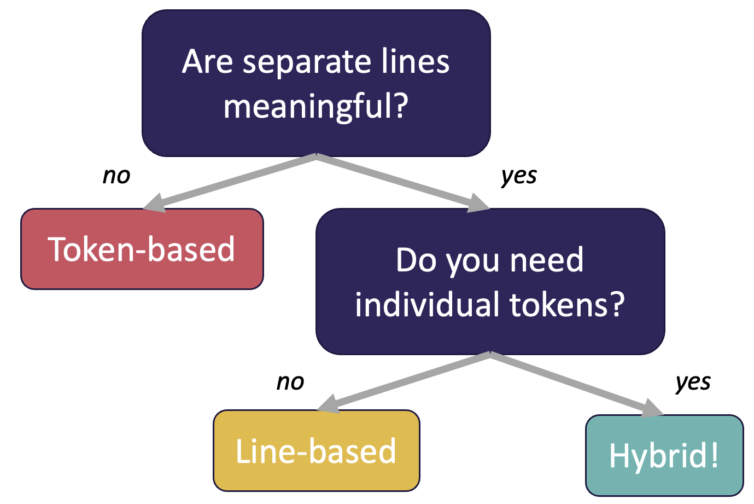
Token-based vs. Line-based vs. Hybrid

Slide 19
Lecture Outline
Announcements/Reminders
PCM Review
Code Tracing Practice
Programming Practice
File output with PrintStream

Slide 20

What is the output of this Java code?
File f = new File("Example.txt");
Scanner fileScan = new Scanner(f);
while (fileScan.hasNext()) {
String word = fileScan.next();
System.out.println("W: " + word + ", ");
}
A) W: One, W: Two,
W: Three,
B) W: One,
W: Two,
W: Three,
C) W: One, Two,
W: Three,
D) Exception
Example.txt:
One Two
Three
Notes:
public class Temperatures {
public static void main(String[] args) {
int[] nums = {1, 4, 4, 8, 13};
int totalDiff = 0;
for (int i = 1; i <= nums.length-1; i++) {
totalDiff += (nums[i] - nums[i - 1]);
}
System.out.println("Total Diff = " + totalDiff);
}
}

Slide 21
What is the output of this Java code?
File f = new File("Example.txt");
Scanner fileScan = new Scanner(f);
while (fileScan.hasNext()) {
String word = fileScan.next();
System.out.println("W: " + word + ", ");
}
A) W: One, W: Two,
W: Three,
B) W: One,
W: Two,
W: Three,
C) W: One, Two,
W: Three,
D) Exception
Example.txt:
One Two
Three
Notes:
public class Temperatures {
public static void main(String[] args) {
int[] nums = {1, 4, 4, 8, 13};
int totalDiff = 0;
for (int i = 1; i <= nums.length-1; i++) {
totalDiff += (nums[i] - nums[i - 1]);
}
System.out.println("Total Diff = " + totalDiff);
}
}

Slide 22
What is the output of this Java code?
File f = new File("Example.txt");
Scanner fileScan = new Scanner(f);
while (fileScan.hasNextLine()) {
String line = fileScan.nextLine();
Scanner lineScan = new Scanner(line);
while (lineScan.hasNext()) {
String word = lineScan.next()
System.out.print("W: " + word + ", ");
}
System.out.println();
}
A) W: One, W: Two,
W: Three,
B) W: One,
W: Two,
W: Three,
C) W: One, Two,
W: Three,
D) Exception
Example.txt:
One Two
Three
Notes:
public class Temperatures {
public static void main(String[] args) {
int[] nums = {1, 4, 4, 8, 13};
int totalDiff = 0;
for (int i = 1; i <= nums.length-1; i++) {
totalDiff += (nums[i] - nums[i - 1]);
}
System.out.println("Total Diff = " + totalDiff);
}
}

Slide 23
What is the output of this Java code?
File f = new File("Example.txt");
Scanner fileScan = new Scanner(f);
while (fileScan.hasNextLine()) {
String line = fileScan.nextLine();
Scanner lineScan = new Scanner(line);
while (lineScan.hasNext()) {
String word = lineScan.next()
System.out.print("W: " + word + ", ");
}
System.out.println();
}
File f = new File("Example.txt");
Scanner fileScan = new Scanner(f);
while (fileScan.hasNextLine()) {
String line = fileScan.nextLine();
Scanner lineScan = new Scanner(line);
while (lineScan.hasNext()) {
String word = lineScan.next()
System.out.print("W: " + word + ", ");
}
System.out.println();
}
A) W: One, W: Two,
W: Three,
B) W: One,
W: Two,
W: Three,
C) W: One, Two,
W: Three,
D) Exception
Example.txt:
One Two
Three
Notes:
public class Temperatures {
public static void main(String[] args) {
int[] nums = {1, 4, 4, 8, 13};
int totalDiff = 0;
for (int i = 1; i <= nums.length-1; i++) {
totalDiff += (nums[i] - nums[i - 1]);
}
System.out.println("Total Diff = " + totalDiff);
}
}

Slide 24
Lecture Outline
Announcements/Reminders
PCM Review
Code Tracing Practice
Programming Practice
File output with PrintStream

Slide 25
Initial Letter Counts
Three tasks:
Count words that start with a letter
Count lines that start with a letter
Find the line with the most words that start with a letter

Slide 26
Initial Letter Counts
Token-based
Three tasks:
Count words that start with a letter
Count lines that start with a letter
Find the line with the most words that start with a letter
Line-based
Hybrid

Slide 27
Lecture Outline
Announcements/Reminders
PCM Review
Code Tracing Practice
Programming Practice
File output with PrintStream

Slide 28
PrintStreams for output
PrintStream is defined in the java.io package
import java.io.*;
File outputFile = new File("out.txt");
PrintStream output = new PrintStream(outputFile);
PrintStream Methods | Description
print(…) | Prints the given value to the set output location.
println(…) | Prints the given value to the set output location, and then terminates the line.
System.out.print("Hello, world! ");
System.out.println("#1 Bee Movie fan!");
output.print("Hello, world! ");
output.println("#1 Bee Movie fan!");
Hello, world! #1 Bee Movie fan!

