Slide 1

Java Review;
Functional Decomposition
BEFORE WE START
Talk to your neighbors:
What is your favorite handheld food?
Respond on sli.do!
Instructor:
Brett Wortzman
TAs:
Archit
Blake P.
Blake R.
Cady
Carson
Cole
Connor
Daniel
David
Hanna
Isis
Jun
Landon
Michelle
Naomi
Neha
Nicole
Rio
Rohan
Shreyank
Somya
Sreshta
Suyash
Trisha
Wesley
Yash
Music: 🎷CSE 122 26au Lecture Tunes 🎵

Slide 2
Lecture Outline
Announcements/Reminders
Assignments/Grading
Java Review
Functional Decomposition

Slide 3
Announcements/Reminders
Hope you had fun in your first quiz section yesterday!
Review the syllabus
Fill out the Introductory Survey
Java Review Session on Monday, October 5th
  12:30 – 1:20pm in ARC 147; 2:30 – 3:20pm in SAV 260
  Will be recorded!
IPL will open on Monday, October 5th

Slide 4

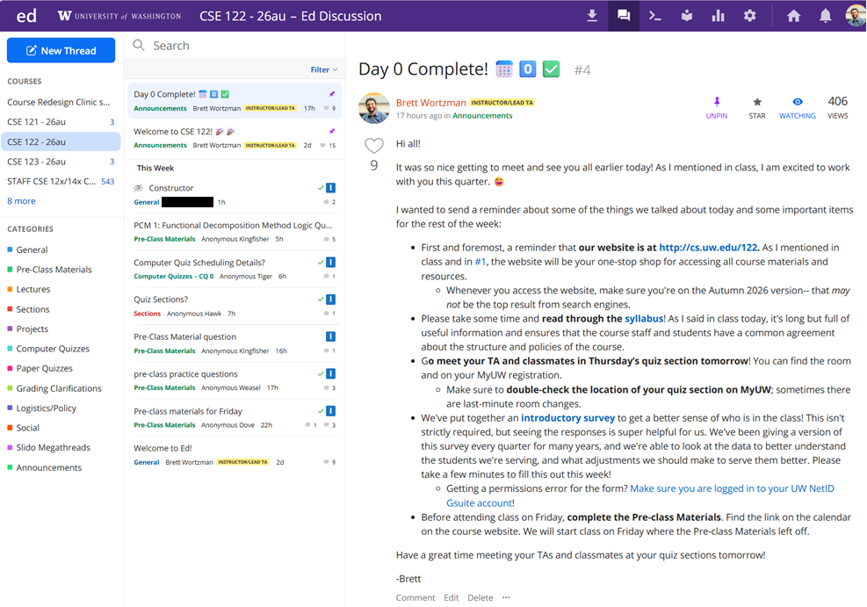
Ed
Our online learning platform
Lessons, materials
Discussion board, announcements
Also, where we’ll code and submit work!
Notes:
James

Slide 5





Other Course Tools
sli.do
Ask questions in class
Live activities (ungraded)
No account needed
Canvas
Panopto lecture recordings
(also linked from website)
Some grades*
My Digital Hand
Queueing in IPL
Gradescope
Paper quiz grading
Visual Studio Code (optional)
Offline IDE
Notes:
James

Slide 6
Help Us Improve!
This is a relatively new course, and we’ve made lots of changes this quarter!
We are always looking for feedback on how to improve the class for you and for future students! Thank you in advance for your patience and understanding as we develop everything. ☺
  We really value your feedback!
  Let us know what’s working and what isn’t working for you
  Something that went well in another course? Tell us about it!
Post on the discussion board (can be public/private).
  Note: Anonymous here is anonymous to other students, not to the staff.
Submit feedback via the Anonymous Feedback Tool (linked under “Course Tools” on the website)

Slide 7
Lecture Outline
Announcements/Reminders
Assignments/Grading
Java Review
Functional Decomposition

Slide 8

Course Components
PRE-CLASS MATERIALS
x18ish
PROGRAMMING PROJECTS
x4
COMPUTER QUIZZES
x4
Introduce new concepts/ideas
Readings, sample problems
Due before lecture
Structured assignments
Applying & implementing course concepts
AI and collaboration allowed
45 minutes on computer
Expand on and connect to projects
Scheduled outside of class
LECTURES
x20
Expand on new concepts
Apply and practice
In person, recorded 🎥
PAPER QUIZZES
x4
PARTICIPATION
x1
45 minutes on paper
3 in quiz section, 1 on exam day
Complete PCMs, participate in section
SECTIONS
x16
Review concepts
More apply and practice
Get TA advice
In person, not recorded 🚫🎥🚫
CODE QUALITY
x3*
Write code well
Assessed throughout quarter
Lessons
Graded Components
Notes:
James

Slide 9

Collaboration and AI Policy
You may collaborate with others and/or use AI freely for general questions, explanations, examples, and ungraded work
On Programming Projects, you may collaborate with others and/or use AI freely
  All collaboration and AI usage must be documented
One Computer Quizzes and Paper Quizzes, you may not collaborate with others or use AI, and you will be restricted to limited resources
AI for Support and Growth

Slide 10
Assessment
Why assessment?
Our goal: you gain proficiency of the concepts and skills we teach
We assess your proficiency by asking you to apply these concepts and skills on tasks
By necessity, we are assessing your work as a proxy for proficiency

Slide 11
Grading Scheme
Grades should reflect proficiency in course objectives.
All assignments, quizzes, and exams are graded with an “E/S/N” grade:
E (Excellent)
S (Satisfactory)
N (Not Yet)
[U (Unassessable)]

Slide 12
Graded Course Components
Category | ESN Grades Per | Grading Notes
 | 1 | Autograded based on requirements in assignment
 | 4 | 4 problems, 1 grade per problem Manually graded (with possible automated testing)
 | 4 | 4 problems, 1 grade per problem Manually graded
 | 3 | 3 dimensions, 1 grade per dimension Assessed on computer quizzes Aggregated throughout quarter
 | 1 | Complete PCMs, participate in section At least 26/32 ➔ E At least 22/32 ➔ S
PROGRAMMING PROJECTS
COMPUTER QUIZZES
PAPER QUIZZES
CODE QUALITY
PARTICIPATION
See syllabus for more details
Notes:
James

Slide 13
Assignment Grades
Category | Count | ESN Grades Per | Total ESN Grades
 | 4 | 1 | 4
 | 4 | 4 | 16
 | 4 | 4 | 16
 | 1 | 3 | 3
 | 1 | 1 | 1
Total |  |  | 40
PROGRAMMING PROJECTS
COMPUTER QUIZZES
PAPER QUIZZES
CODE QUALITY
PARTICIPATION
See syllabus for more details

Slide 14
Course Grades
We provide a “minimum grade guarantee” for translating to a numeric grade, but not a direct formula.
Minimum Grade | Requirements
Total ESN available | 40
3.5 | 32 Es AND 3 additional S+
3.0 | 24 Es AND 8 additional S+
2.5 | 16 Es AND 13 additional S+
2.0 | 8 Es AND 18 additional S+
1.5 | 18 S+
0.7 | 10 S+
S+ = S or E
See syllabus for more details

Slide 15
Lecture Outline
Announcements/Reminders
Assignments/Grading
Java Review
Functional Decomposition

Slide 16
Reminders: Review Java Syntax
Java Tutorial reviews all the relevant programming features you should familiar with (even if you don’t know them in Java).
  Printing and comments
  Variables, types, expressions
  Conditionals (if/else if/ else)
  Loops (for and while)
  Strings
  Methods
  Arrays
  2D arrays

Slide 17

In-Class Activities
Goal: Get you actively participating in your learning
Typical Activity
  Question is posed
  Think (1 min): Think about the question on your own
  Pair (2 min): Talk with your neighbor to discuss question
    If you arrive at different conclusions, discuss your logic and figure out why you differ!
    If you arrived at the same conclusion, discuss why the other answers might be wrong!
  Share (1 min): We discuss the conclusions as a class
During each of the Think and Pair stages, you will respond to the question via a sli.do poll
  Not worth any points, just here to help you learn! 😉

Slide 18
What is the output of this Java program?
public class Demo {
public static void main(String[] args) {
int[] nums = {1, 4, 4, 8, 13};
int totalDiff = 0;
for (int i = 1; i <= nums.length; i++) {
totalDiff += (nums[i] - nums[i - 1]);
}
System.out.println("Total Diff = " + totalDiff);
}
}
Total Diff = 12
Total Diff = 10
Total Diff = 9
Exception!
Notes:
public class Temperatures {
public static void main(String[] args) {
int[] nums = {1, 4, 4, 8, 13};
int totalDiff = 0;
for (int i = 1; i <= nums.length-1; i++) {
totalDiff += (nums[i] - nums[i - 1]);
}
System.out.println("Total Diff = " + totalDiff);
}
}

Slide 19
What is the output of this Java program?
public class Demo {
public static void main(String[] args) {
int[] nums = {1, 4, 4, 8, 13};
int totalDiff = 0;
for (int i = 1; i <= nums.length; i++) {
totalDiff += (nums[i] - nums[i - 1]);
}
System.out.println("Total Diff = " + totalDiff);
}
}
Total Diff = 12
Total Diff = 10
Total Diff = 9
Exception!

Slide 20
Lecture Outline
Announcements/Reminders
Assignments/Grading
Java Review
Functional Decomposition

Slide 21

Functional Decomposition
Functional decomposition is the process of breaking down a complex problem or system into parts that are easier to conceive, understand, program, and maintain.
Wet
Mix butter and sugar
Beat in eggs & vanilla
Dry
Mix in flour, baking soda, and chocolate chips
Place
Make cookie-sized balls of dough
Place evenly on baking sheet
Bake
Bake at 350 degrees Fahrenheit for 10 minutes
Let cool after
“Bake the cookies”

Slide 22
Functional Decomposition
We should use methods to:
  Reduce redundancy
  Increase reusability
  Generalize functionality
  Improve readability
  Abstract away details
  …
We should not use methods to:
  Give new names to existing methods
  “Shorten” code

Slide 23
Functional Decomposition
In our code, functional decomposition often means breaking a task into smaller methods (also called functions).
Example: Bingo
  Set up populated game card
  Roll and call a new number
  Mark your card if the number called is present
  Check card for bingo

Slide 24
Avoid Trivial Methods
Introduce methods to decompose a complex problem, not just for the sake of adding a method.
Bad example: Good Example:
Rule of thumb: A method should do at least two steps
  Ask yourself: Does adding this method make my code easier to understand?
public static void printMessage(String message) {
System.out.println(message);
System.out.println();
}
public static String prompt(Scanner input, String prompt) {
System.out.print(prompt);
String response = input.nextLine();
return response;
}

