Slide 1

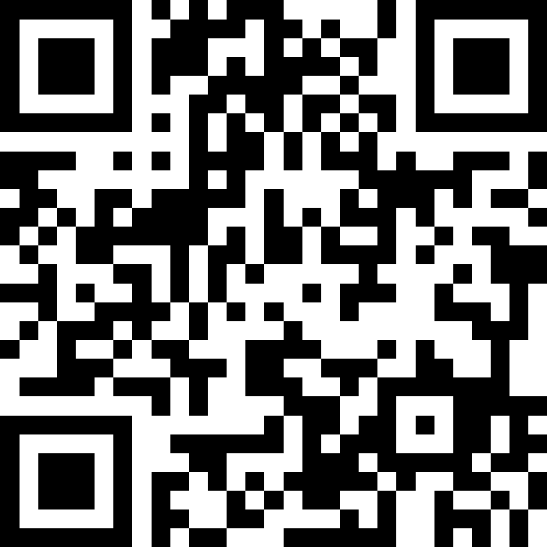
Welcome!
BEFORE WE START
Talk to your neighbors:
Introduce yourself to your neighbor!
What is your name? Year? Major? What did you do over summer break?
Instructor:
Brett Wortzman
TAs:
Archit
Blake P.
Blake R.
Cady
Carson
Cole
Connor
Daniel
David
Hanna
Isis
Jun
Landon
Michelle
Naomi
Neha
Nicole
Rio
Rohan
Shreyank
Somya
Sreshta
Suyash
Trisha
Wesley
Yash

Slide 2
Lecture Outline
Introductions
About this Course
  Making the Most of this Class
  Community and Culture
  Course Components & Tools
Intro/Review Java

Slide 3
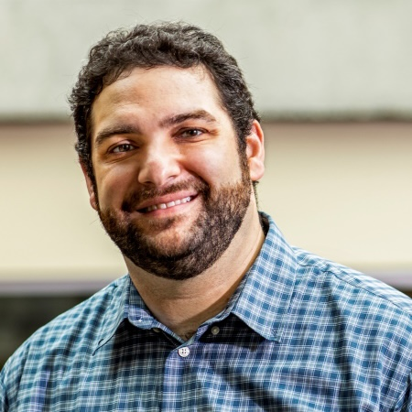
Hi, I’m Brett! (he/him)
Associate Teaching Professor
Frequent intro CS instructor
Also interested in CS education/pedagogy
Previously:
  trained CS teachers (and still!)
  developed CS curriculum (and still!)
  taught high school CS
  worked as a software engineering
Non-CS hobbies: board games/RPGs, officiating football, announcing robotics competitions
Notes:
Brett

Slide 4
Students
Currently 418 students registered for the course!
Strength in numbers
  With 418 students, if you’re confused about something, we guarantee someone else is too! Ask questions in Slido or in class 🗣️
  Students come from all different backgrounds, majors, & interests in future career goals.
Focus on us trying to help you build community
  Meet others in the class to form study groups or have people you can work with.

Slide 5
Lecture Outline
Introductions
About this Course
  Making the Most of this Class
  Community and Culture
  Course Components & Tools
Intro/Review Java

Slide 6
What is this Class?
CSE 121 – Computer Programming I
or Other Programming Experience
CSE 122 – Computer Programming II
  Print statements
  Data types (int, String, boolean)
  Methods / Functions
    Parameters
    Returns
  Control structures
    Loops
    Conditionals
  Arrays & 2D arrays
  Computational Thinking
  (language agnostic)
  Decomposing large problems into smaller, manageable subproblems
  File I/O
  Using data structures
    List
    Stacks / Queues
    Sets
    Maps
  Object Oriented Programming
    Interfaces

Slide 7
Prerequisite Knowledge
Students entering CSE 122 are coming from many of different backgrounds
  UW: CSE 121 or other intro programming course
  Community College: Intro Programming Course
  High School Programming Course (e.g., UWHS, AP CS, IB CS, etc.)
  Self-taught or other previous experience
Importantly: CSE 122 is in Java, but we do not expect prior experience in Java! Do expect knowing the list of CSE 121 topics in some language.
  Students who do not have experience in Java will be focusing on practicing the programming skills you know in a new language!
  You will find the Java Tutorial very helpful!
If you want to know if this class is the right fit for you, take the Allen School Self-Placement Test

Slide 8
Other Similar Courses
Course | Good choice if…
CSE 121 | You’ve never programmed before AND You are, or want to be in a major such as CS, CE, ECE, Info, etc. that requires Java programming
CSE 122 (this is us!) | You’ve done some programming (roughly one course worth) in any programming language AND You are, or want to be in a major such as CS, CE, ECE, Info, etc. that requires Java programming
CSE 123 | You’ve taken CSE 122 (or equivalent) AND You are, or want to be in a major such as CS, CE, ECE, Info, etc. that requires Java programming
CSE 143 | You took CSE 142 (at UW, through UWHS, or at community college) OR You took AP CS A (or similar) and feel confident in all the material
CSE 143X | You have programmed quite a bit before, but not in Java OR You have lots of extra time to put into learning and tend to pick things up quickly
CSE 160 | You’ve never programmed before AND You’re interested in data science and analysis OR You’d rather learn Python than Java* OR You are, or want to be in a major such as Physics, Bio, Stat, etc. where your primary goal is analyzing data through programming (rather than building software)
Also see: guided self-placement and CSE page on introductory courses for more info.
Notes:
Brett

Slide 9
Lecture Outline
Introductions
About this Course
  Making the Most of this Class
  Community and Culture
  Course Components & Tools
Intro/Review Java

Slide 10
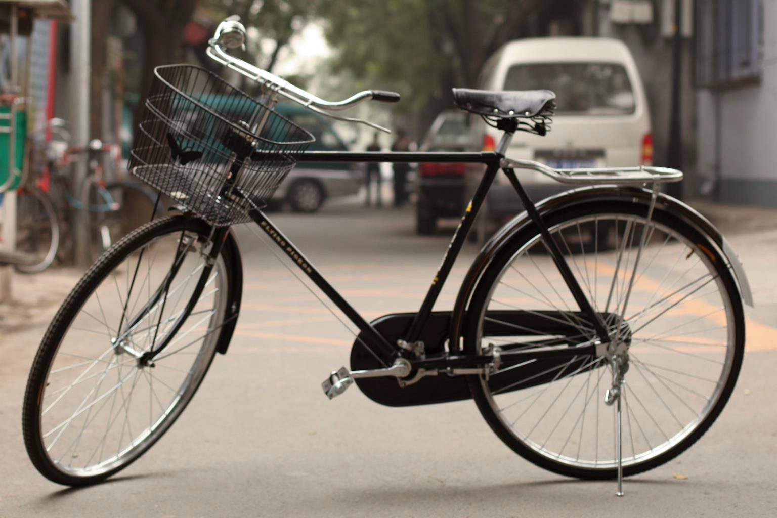
How did you learn how to ride a bike?
Notes:
Brett

Slide 11

Digression: My Pandemic Hobby
Amigurumi: Japanese art of creating crocheted or knitted stuffed toys
Notes:
Brett
I learned to crochet! I bought a kit, read the instructions, and watched a bunch of videos. This is what I was supposed to make.

Slide 12
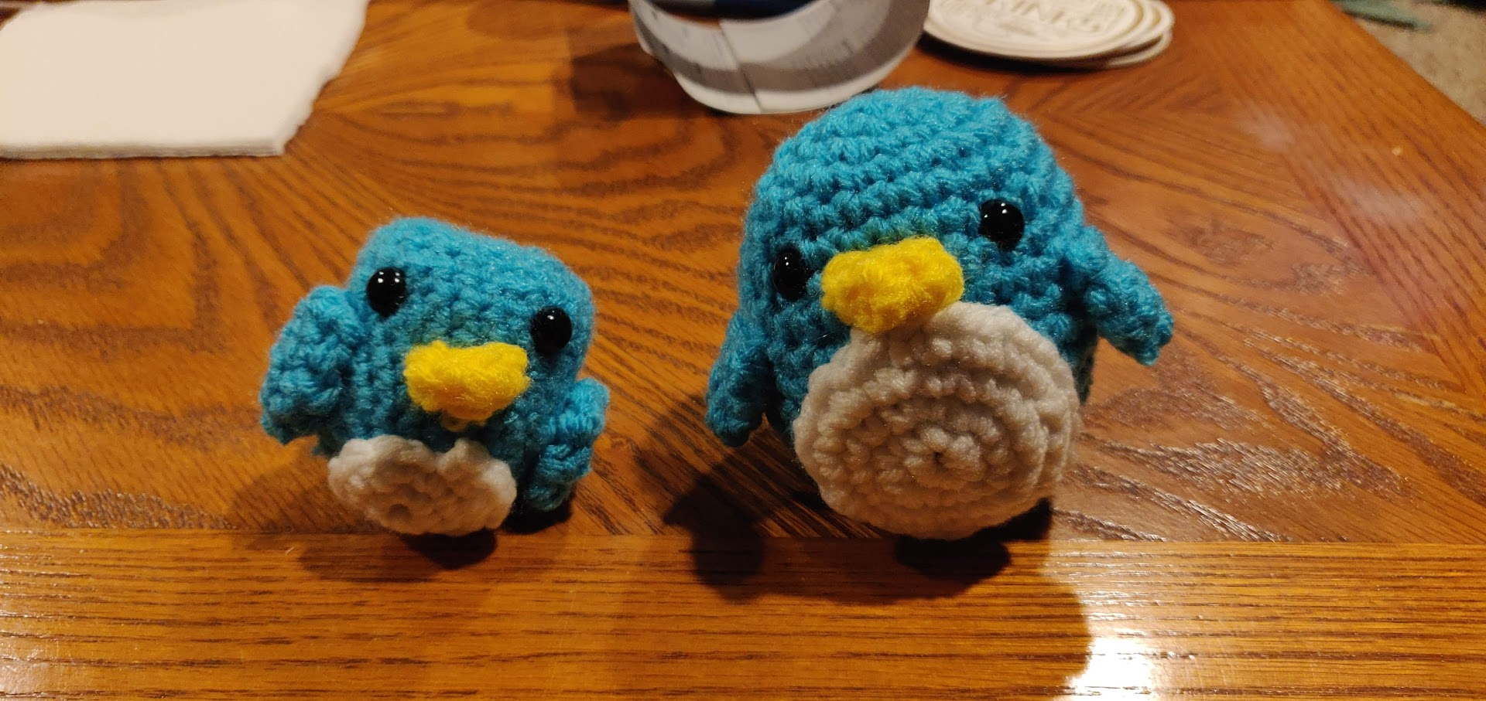
Digression: My Pandemic Hobby
Amigurumi: Japanese art of creating crocheted or knitted stuffed toys
Notes:
Brett
This is what I actually made!
Except that wasn’t my first penguin– it was my second…

Slide 13
Digression: My Pandemic Hobby
Amigurumi: Japanese art of creating crocheted or knitted stuffed toys
Notes:
Brett
THIS was my first penguin.
I did everything “right”: followed instructions, looked for resources, paid attention. But I still made mistakes.
We don’t learn by watching, listening, or reading; we learn by DOING! And we almost always make mistakes along the way. Don’t expect to just show up to class, watch and listen, and get things exactly right the first time. Plan to engage, practice, and make mistakes.

Slide 14
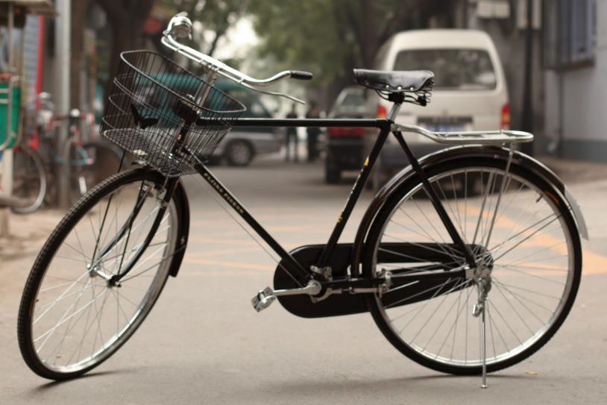
How Learning Works
Learning requires active participation in the process.
It’s not as simple as sitting and listening to someone talk at you!
Requires deliberate practice in learning by doing
Benefits from collaborative learning
Does not work well if you cram everything!
Notes:
Brett

Slide 15
Learning and AI: Our Philosophy
AI amplifies the skills of the AI user
We cannot teach an introductory programming course without acknowledging the existence of AI tools.
We strongly believe in the value of learning the fundamentals of programming.
The ability to understand and modify code is more important than ever.
AI use is permitted on some assignments. AI use is not required.

Slide 16

Course Components
PRE-CLASS MATERIALS
x18ish
Introduce new concepts/ideas
Readings, sample problems
Due before lecture
LECTURES
x20
Expand on new concepts
Apply and practice
In person, recorded 🎥
SECTIONS
x16
Review concepts
More apply and practice
Get TA advice
In person, not recorded 🚫🎥🚫
Lessons
Graded Components
Notes:
James

Slide 17
Pre-Class Materials
PRE-CLASS MATERIALS
PCMs are a core element of the course
Prepare for each lecture with readings & practice problems
Should take ~30 minutes per lecture (why we don’t have Monday lectures!)
Class will start with a brief recap, then pick off where we left off
Notes:
James

Slide 18
Pre-Class Materials
PRE-CLASS MATERIALS
PCMs are a core element of the course
Prepare for each lecture with readings & practice problems
Should take ~30 minutes per lecture (why we don’t have Monday lectures!)
Class will start with a brief recap, then pick off where we left off
This means…
We can spend lecture diving deeper, answering questions, and think-pair-share
You can ask about pre-lecture material in class or section!
Notes:
James

Slide 19
Pre-Class Materials
PRE-CLASS MATERIALS
PCMs are a core element of the course
Prepare for each lecture with readings & practice problems
Should take ~30 minutes per lecture (why we don’t have Monday lectures!)
Class will start with a brief recap, then pick off where we left off
This means…
We can spend lecture diving deeper, answering questions, and think-pair-share
You can ask about pre-lecture material in class or section!
Pre-class materials are part of your participation grade, which means…
It’s okay if you find them challenging – that means you’re learning!
But you should do them, and we will assume you’ve done them
Notes:
James

Slide 20
Consistent and Active Participation
ATTENDANCE
Attendance is not graded, but it’s strongly encouraged!
Lectures and sections are not going to be just us talking at you!
Instead: live in-class coding, debugging, think-pair-share, and problem—solving
Spending ~1-2 hours each day over Tuesday - Friday is much more effective than cramming before the assignment is due!
Notes:
Brett

Slide 21
Consistent and Active Participation
ATTENDANCE
Attendance is not graded, but it’s strongly encouraged!
Lectures and sections are not going to be just us talking at you!
Instead: live in-class coding, debugging, think-pair-share, and problem—solving
Spending ~1-2 hours each day over Tuesday - Friday is much more effective than cramming before the assignment is due!
Catching up:
All lectures are recorded on Panopto; slides are on our website.
Section materials are on Ed, but section will not be recorded
Notes:
Brett

Slide 22
Learning in CSE 122: Live Support Systems
Programming is hard! We want to give you collaborative support!
Introductory Programming Lab (TA Office Hours) – starting Week 2
many hours/week (and highly rated in the class!)
Face-to-face help from TAs on any course questions
Instructor Office Hours – starting this week!
Great for things from lecture, personal questions, or just saying hi

Slide 23
Learning in CSE 122: Async Support Systems
Ed Board
Best for content and logistics questions – 400+ of you!!
Encourage public posts, except for things about your graded work
Answer other students’ questions – great way to learn!
Email
Best for personal circumstances and/or private questions
Unsure? Feel free to email Brett
May politely ask you to post on Ed instead!
For emails, please use your UW email (protecting student privacy!)

Slide 24
Lecture Outline
Introductions
About this Course
  Making the Most of this Class
  Community and Culture
  Course Components & Tools
Intro/Review Java

Slide 25
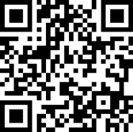
Think-Pair-Share: Inclusive Environments
CSE 122 will have many think-pair-share activities. Let’s practice! Today’s think:
What was an experience you had that made you feel welcome or included in a learning environment?
Think on your own, in silence for about ~ 30 seconds
Pair with your neighbor about it (and introduce yourself!!)
Share in sli.do & in class (I’ll take a few volunteers from both)

Slide 26
Think-Pair-Share: Exclusive Environments
CSE 122 will have many think-pair-share activities. Let’s practice! Today’s think:
What was an experience you had that made you feel unwelcome or excluded in a learning environment?
Think on your own, in silence for about ~ 30 seconds
Pair with your neighbor about it (and introduce yourself!!)
Share in sli.do & in class (I’ll take a few volunteers from both)

Slide 27
The CSE 122 Community
ABOUT US
OUR GOALS
Currently ~418 students enrolled!
  Only some are CSE majors
  Wide range of backgrounds, interests, and goals
  Everyone is new to programming
Foster an inclusive and supportive environment for all students to thrive by:
  being respectful
  being kind and understanding
  being honest
  being ourselves

Slide 28
The World Around Us
College is challenging and CSE 122 isn’t your only class.
Life is unpredictable and things happen.
We can’t leave the impacts of the world around us at the classroom door.
OUR POLICIES
SUPPORT
Our course policies are designed for flexibility:
  Asynchronous help
  Lecture recordings
We’re here to support you as a student and as a person.
Please reach out if you’re struggling or have circumstances that require extra support.

Slide 29
Help Us Improve!
This is a relatively new course, and we’ve made lots of changes this quarter!
We are always looking for feedback on how to improve the class for you and for future students! Thank you in advance for your patience and understanding as we develop everything. ☺
  We really value your feedback!
  Let us know what’s working and what isn’t working for you
  Something that went well in another course? Tell us about it!
Post on the discussion board (can be public/private).
  Note: Anonymous here is anonymous to other students, not to the staff.
Submit feedback via the Anonymous Feedback Tool (linked under “Course Tools” on the website)

Slide 30
Lecture Outline
Introductions
About this Course
  Making the Most of this Class
  Community and Culture
  Course Components & Tools
Intro/Review Java

Slide 31
Course Components
PRE-CLASS MATERIALS
x18ish
PROGRAMMING PROJECTS
x4
COMPUTER QUIZZES
x4
Introduce new concepts/ideas
Readings, sample problems
Due before lecture
Structured assignments
Programming in Java
Applying & implementing course concepts
45 minutes on computer
Expand on and connect to projects
Scheduled outside of class
LECTURES
x20
Expand on new concepts
Apply and practice
In person, recorded 🎥
PAPER QUIZZES
x4
PARTICIPATION
x1
45 minutes on paper
3 in quiz section, 1 on exam day
Complete PCMs, participate in section
SECTIONS
x16
Review concepts
More apply and practice
Get TA advice
In person, not recorded 🚫🎥🚫
CODE QUALITY
x3
Write code well
Assessed throughout quarter
Lessons
Graded Components
Notes:
James

Slide 32
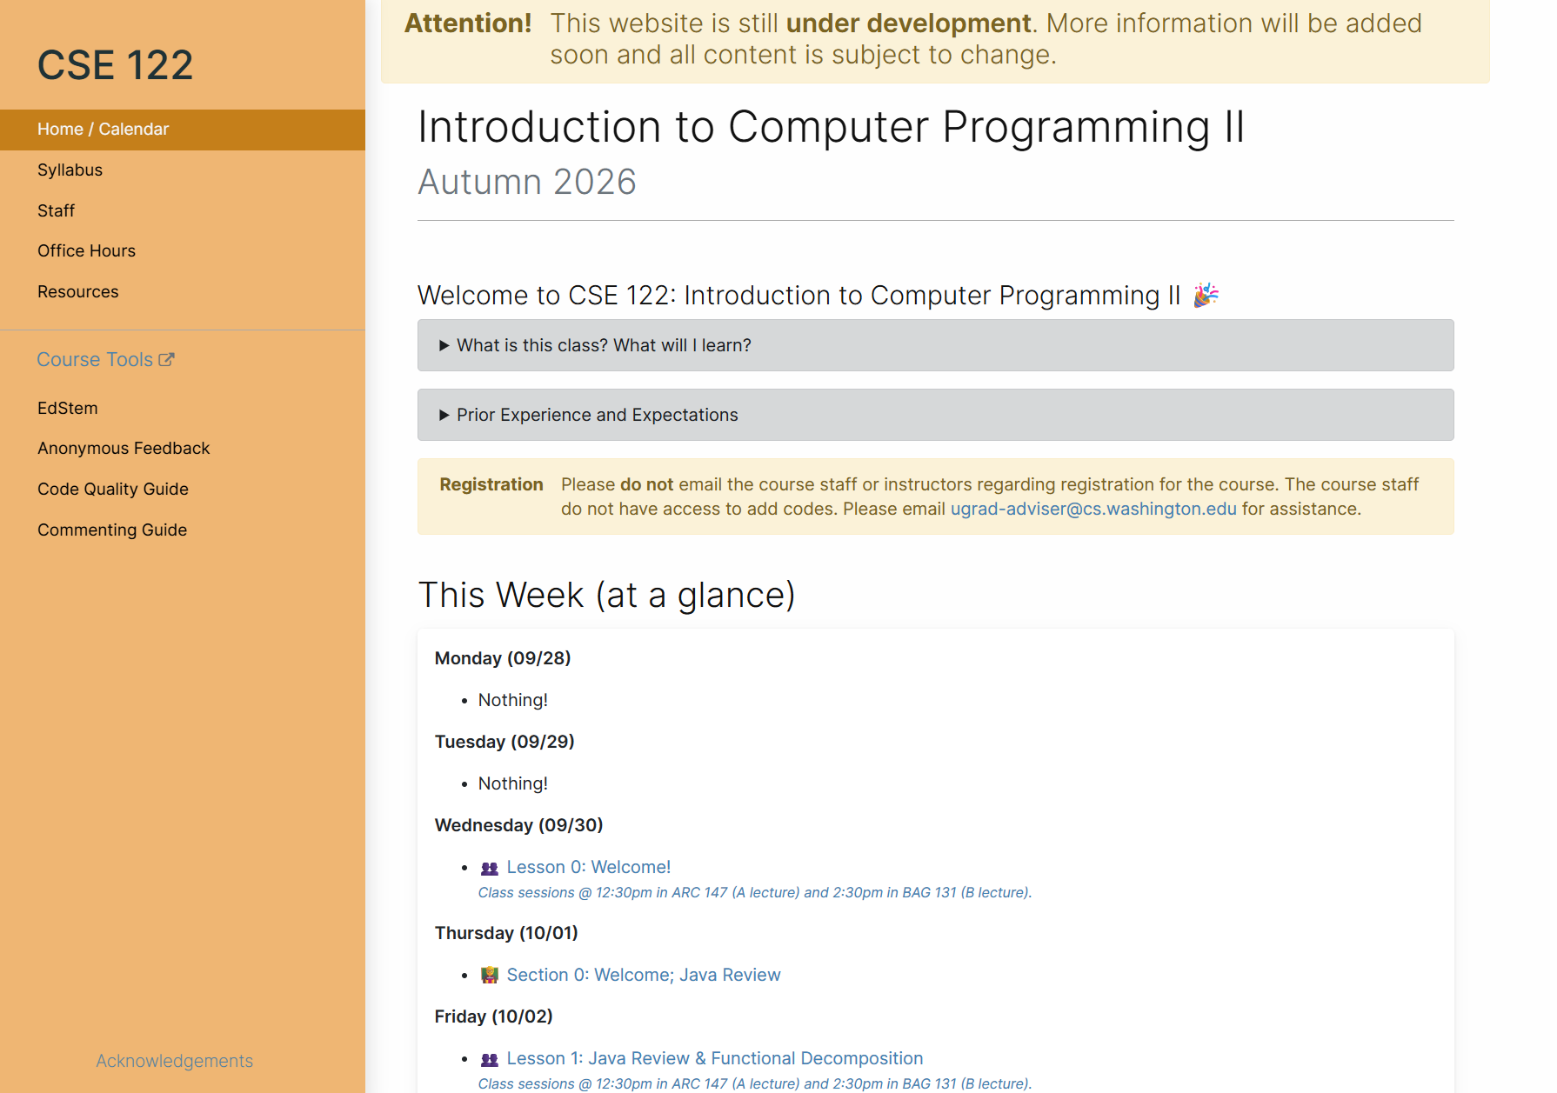
Course Website
cs.uw.edu/122
Primary source of course information (not Canvas)
Calendar will contain links to (almost) all resources
Please review syllabus ASAP
Let’s go on a website tour :)

Slide 33
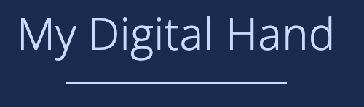




Other Course Tools
My Digital Hand
Queueing in office hours
VSCode (Optional)
Develop offline
Visual debugger
Ed
Community & Information
  Discussion Board
  (please ask & answer!; anonymous option)
  Chat
  Announcements
Pre-Class Materials / Section Handouts
Assignments
  Online IDE
  Submit assignments
  View Feedback
Canvas
Lecture recordings
Computer quiz scheduling
Sli.do
In-class activities
(ungraded)
No account needed

Slide 34
Lecture Outline
Introductions
About this Course
  Making the Most of this Class
  Community and Culture
  Course Components & Tools
Intro/Review Java

Slide 35
Hello World
Java Specifics
  Every program needs a class
  Runnable programs need a main method (signature must exactly match)
  System.out.println to print
  "Hello world" is a String
Running on EdStem
  Run runs your program
  Mark submits and runs autograder
    Submit as many times as you like
    “Shotgun submission” = Unhelpful habit
  Solution shows solution (if applicable)
public class HelloWorld {
public static void main(String[] args) {
System.out.println("Hello world");
}
}

Slide 36
Review Java Syntax
Java Tutorial reviews all the relevant programming features you should familiar with (even if you don’t know them in Java).
  Printing and comments
  Variables, types, expressions
  Conditionals (if/else if/ else)
  Loops (for and while)
  Strings
  Methods
  Arrays & 2D Arrays

Slide 37
“Homework” for Next Time
Fill out the introductory survey
Go meet your TA and classmates in Thursday’s quiz section
⭐️ Complete the pre-class material for Friday (see calendar)
Check over syllabus details

