Slide 1

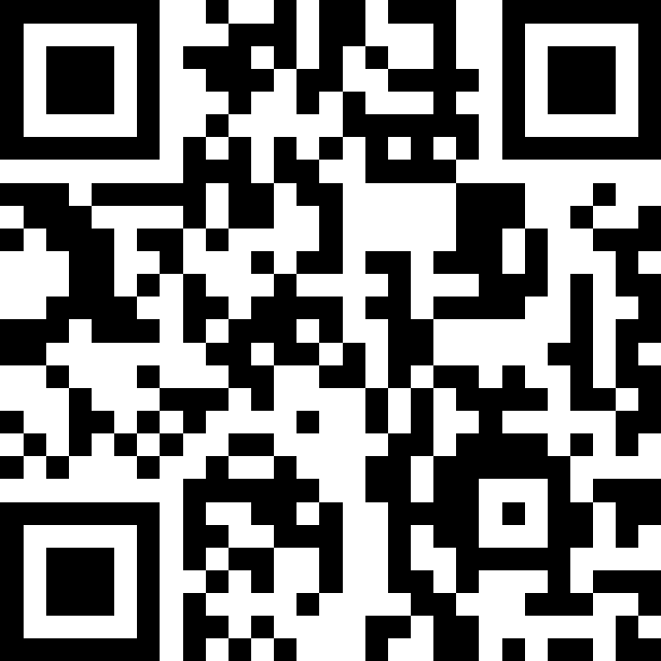
Welcome!
BEFORE WE START
Talk to your neighbors:
Introduce yourself to your neighbor!
What is your name? Major? What did you do over winter break?
Music: 122 25wi Lecture Tunes 🏂
Instructors:
Elba Garza
TAs:
Anya
Ashley
Cady
Caleb
Carson
Chaafen
Colin
Connor
Dalton
Daniel Ryan
Diya
Elizabeth
Hannah
Harshitha
Ivory
Izak
Jack
Jacob
Ken
Kuhu
Kyle
Leo
Logan
Maggie
Mahima
Marcus
Minh
Nicole
Nicole
Niyati
Sai
Steven
Yang
Zach

Slide 2
Lecture Outline
Introductions
About this Course
  Course Components & Tools
  Grading
  Policies
  Making the Most of this Class
Intro/Review Java

Slide 3
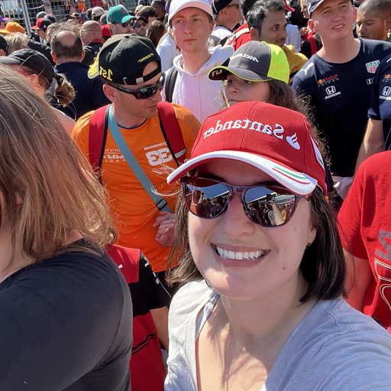
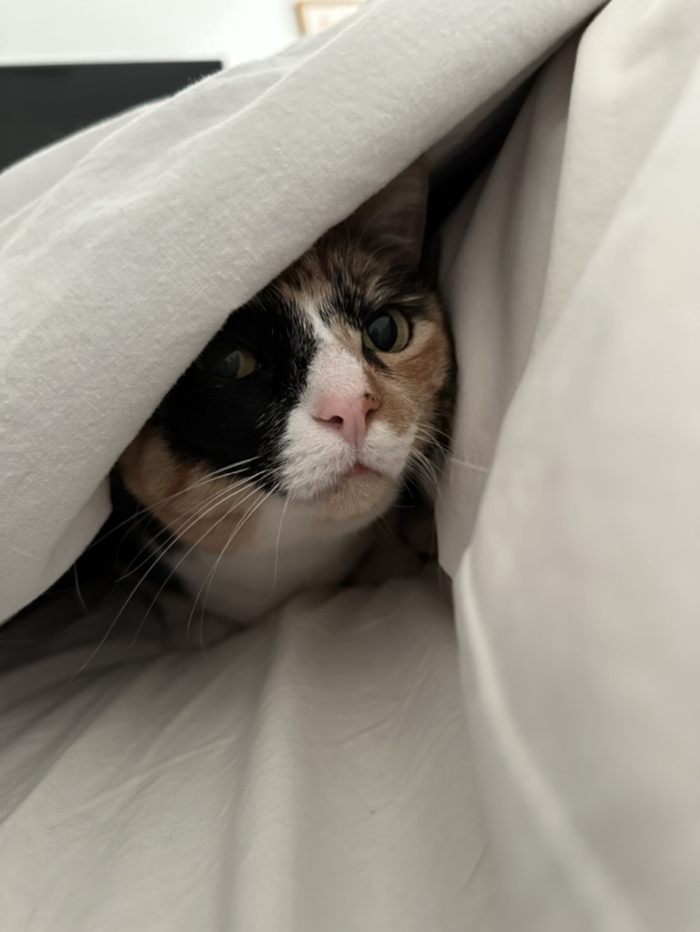
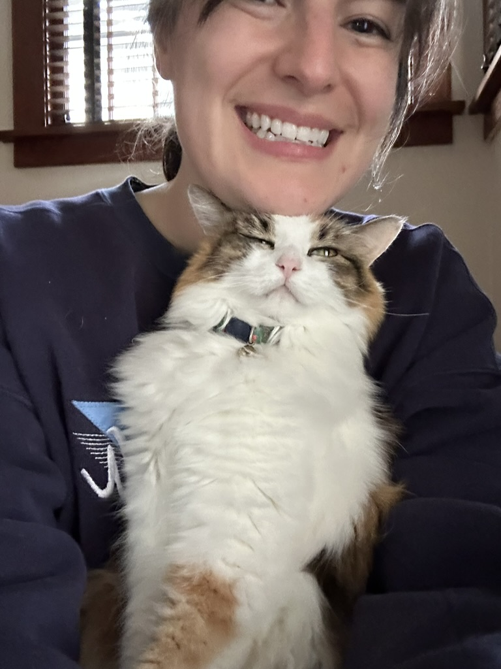
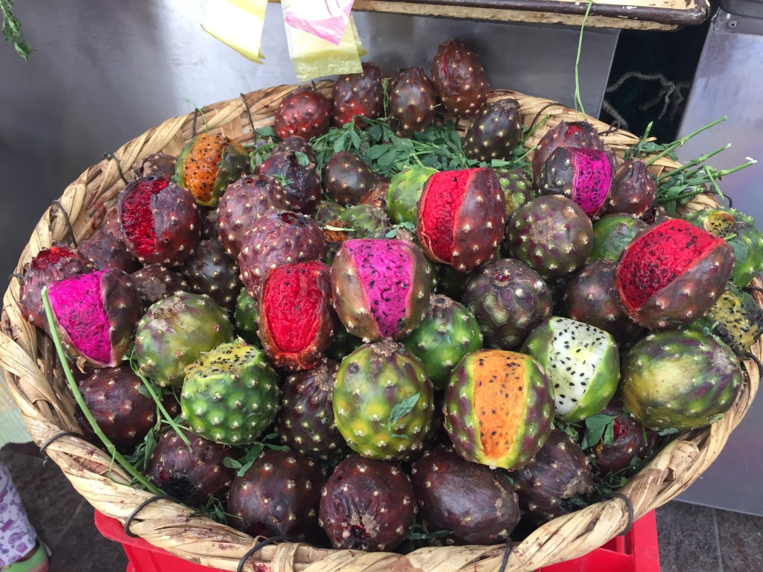
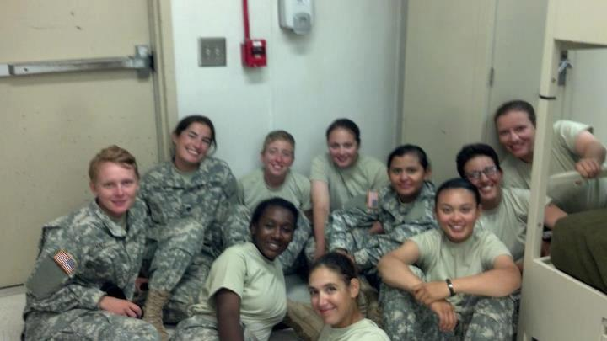
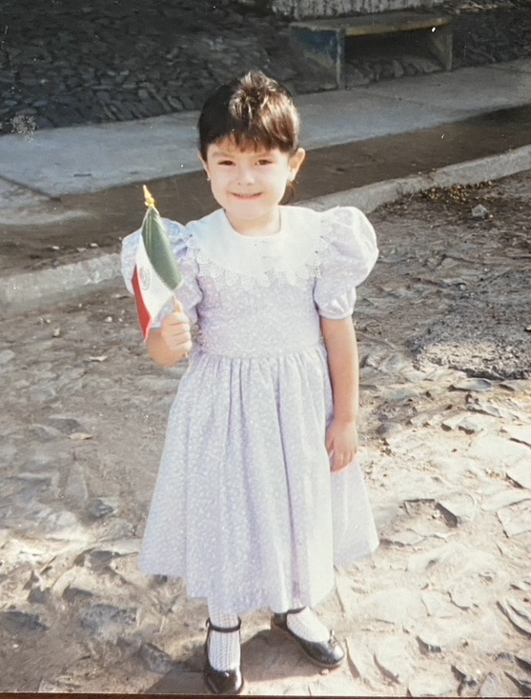
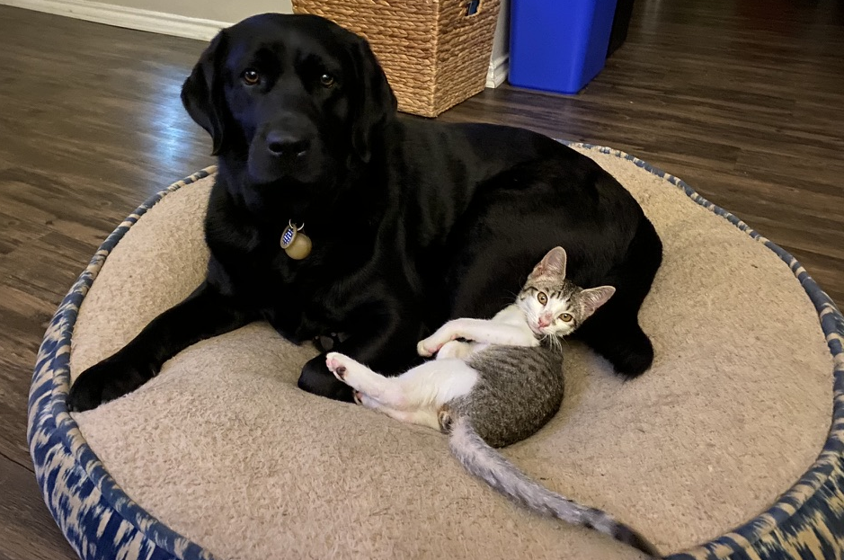
Course Staff
Instructor: Elba Garza
Call me: Elba
      Professor Garza
Teaching Assistants: 36 Fantastic TAs!
  Available in section, office hours, and discussion board
  Invaluable source of information & help in this course
We’re excited to get to know you!
  Our goal is to help you succeed ☺

Slide 4
Students
Currently 595 students registered for the course!
Strength in numbers
  With 595 students, if you’re confused about something, we guarantee someone else is too! Ask questions in Slido or in class 😉
  Students come from all different backgrounds & majors & interests in future career goals.
Focus on us trying to help you build community
  Meet others in the class to form study groups or have people you can work with.

Slide 5
CSE 12x Behavioral Expectations

Slide 6
What is this Class?
CSE 121 – Computer Programming I
or Other Programming Experience
CSE 122 – Computer Programming II
  Print statements
  Data types (int, String, boolean)
  Methods / Functions
    Parameters
    Returns
  Control structures
    Loops
    Conditionals
  Arrays & 2D arrays
  Computational Thinking
  (language agnostic)
  Decomposing large problems into smaller, manageable, subproblems
  File I/O
  Using data structures
    List
    Stacks / Queues
    Sets
    Maps
  Object Oriented Programming
    Interfaces

Slide 7
Prerequisite Knowledge
Students entering CSE 122 are coming from many of different backgrounds
  UW: CSE 121 or other intro programming course
  Community College: Intro Programming Course
  High School Programming Course (e.g., UWHS, AP CS, IB CS, etc.)
  Self-taught or other previous experience
Importantly: CSE 122 is in Java, but we do not expect prior experience in Java! Do expect knowing the list of CSE 121 topics in some language.
  Students who do not have experience in Java will be focusing on practicing the programming skills you know in a new language!
  You will find the Java Tutorial and Creative Project 0 very helpful!
If you want to know if this class is the right fit for you, take the Allen School Self-Placement Test

Slide 8
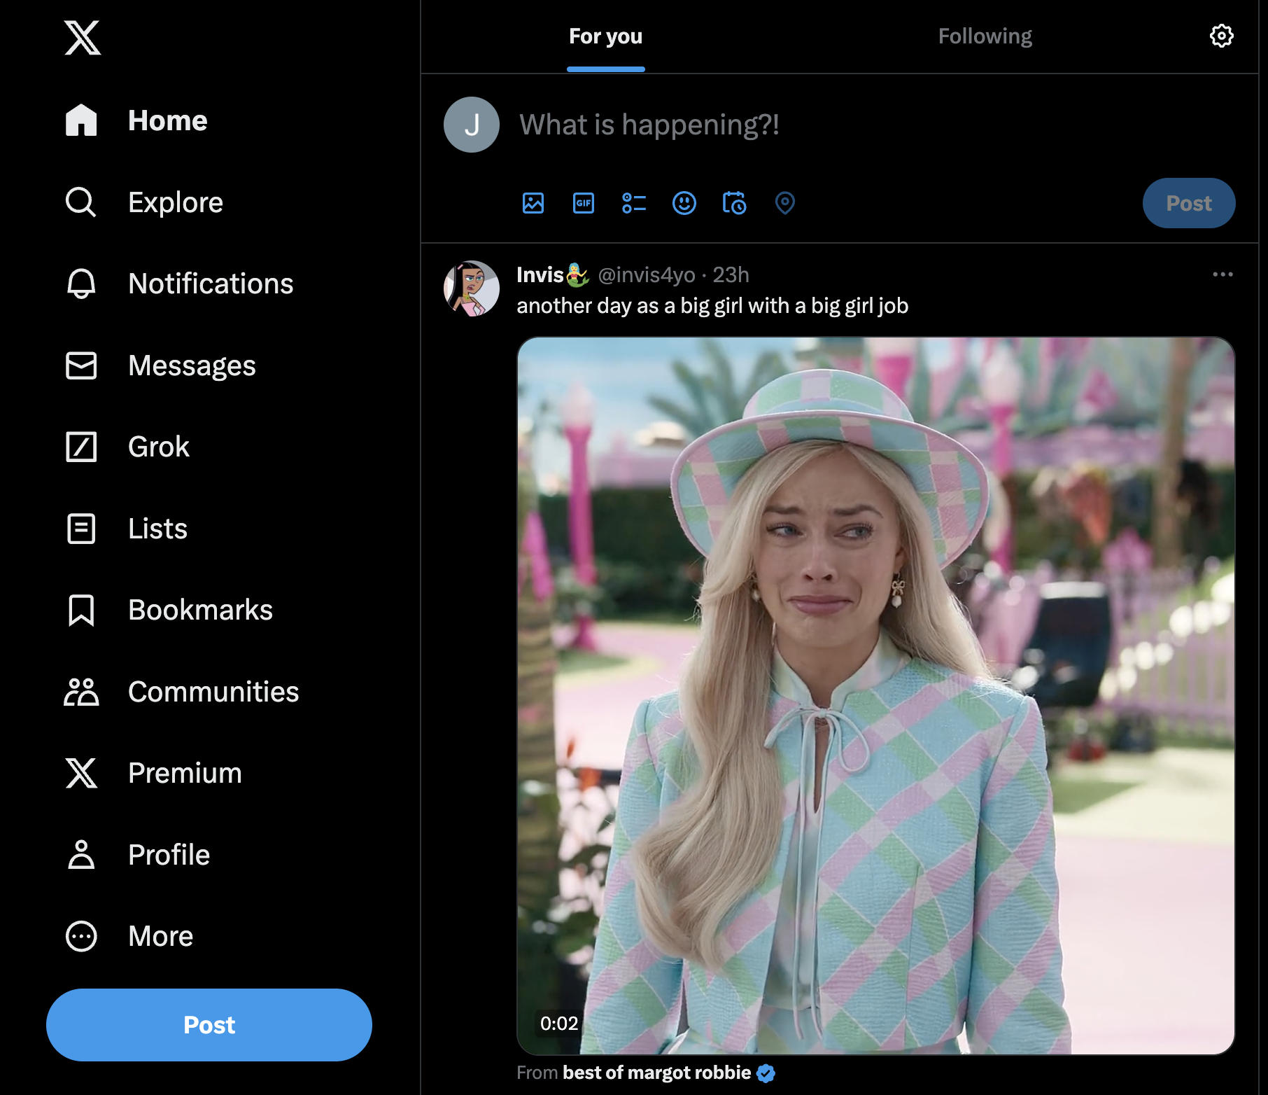
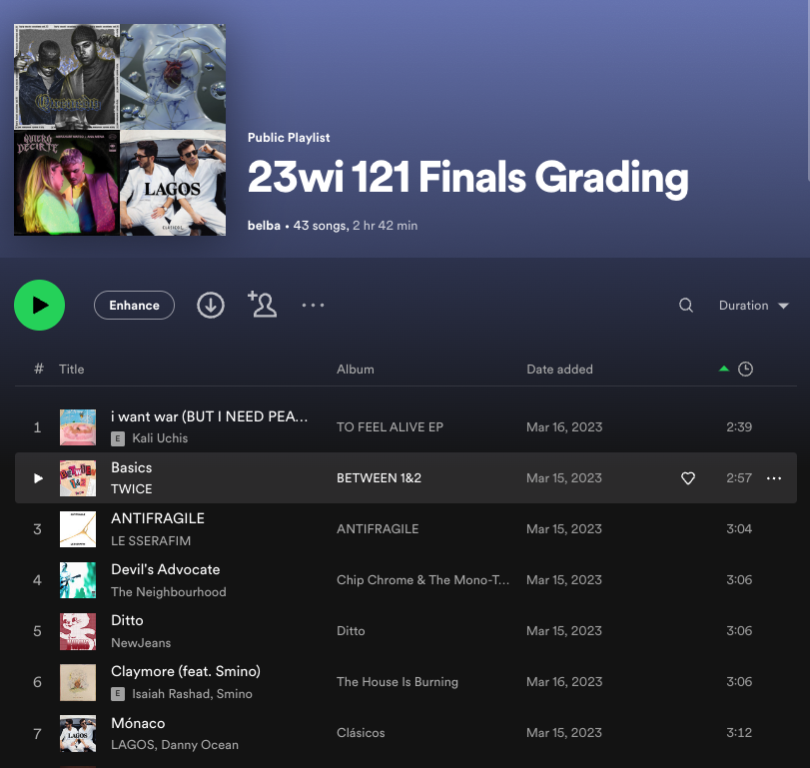
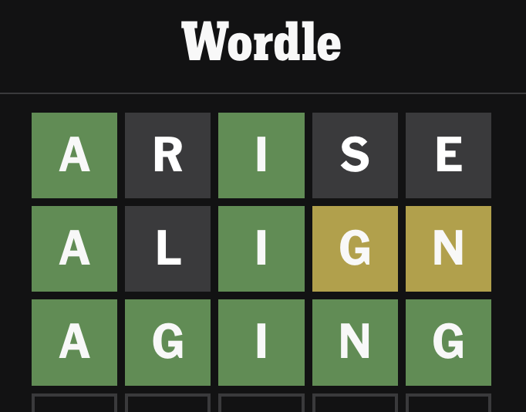
Why 122? (1/2)
1. Build a strong foundation of data structures that will let you tackle the biggest problems in computing
122 Data Structures

Slide 9
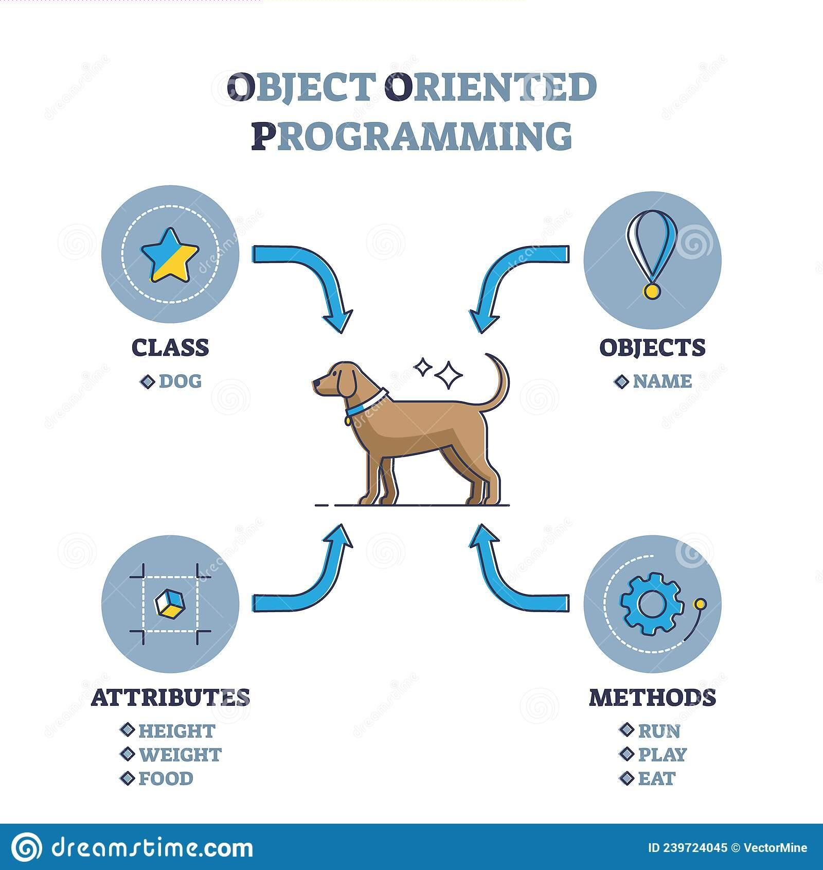
Why 122? (2/2)
2. Learn an important structural pattern for representing objects in code to make our code more reusable and maintainable and easier to understand.
Java is designed around this idea of objects. We haven’t been leveraging that yet!
Used in almost every real-world software project.

Slide 10
Lecture Outline
Introductions
About this Course
  Course Components & Tools
  Grading
  Policies
  Making the Most of this Class
Intro/Review Java

Slide 11
Course Components
Meetings
LECTURES
(x20)
SECTIONS
(x19)
We’re here!
Introduce concepts, practice
ideas, discuss applications.
Pre-class materials to prepare for
class each day. Due before class.
Recorded 🎥
Held in person
More practice, reviews, applications
TA advice, how to be an effective student
Preparation for quizzes / exams
Incentives to attend this quarter!
🚨 Not Recorded! 🚨
Assessments
PROGRAMMING ASSIGNMENTS
(x4)
CREATIVE PROJECTS
(x4)
QUIZZES
(x3)
EXAM
(x1)
Structured assignments
Programming in Java
Applying & implementing course concepts
More open-ended assignments
Explore new ideas and applications
Taken in quiz section
45 minutes on paper
Culminating exam
Date/Time TBD

Slide 12
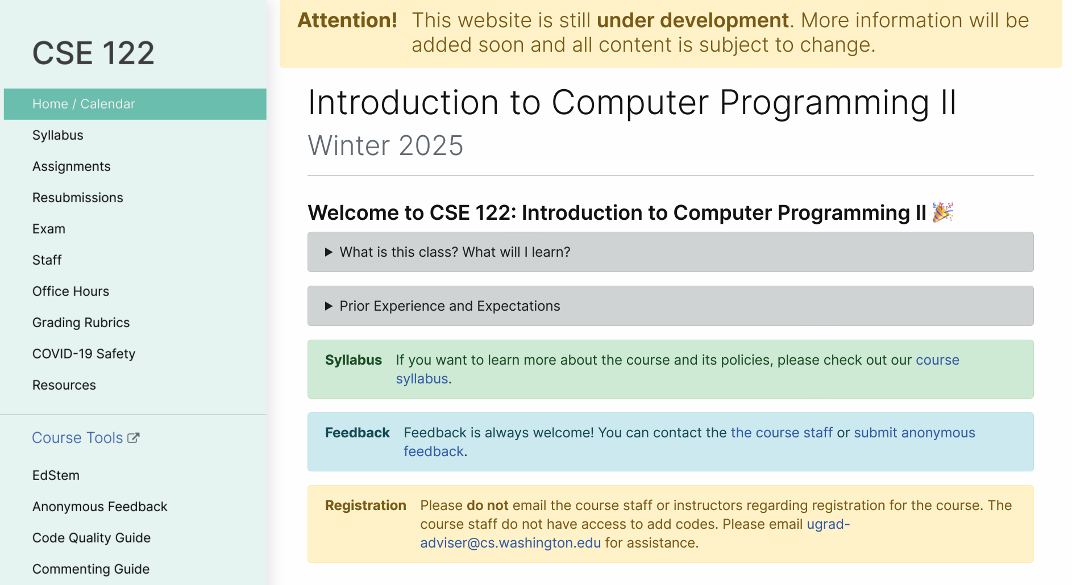
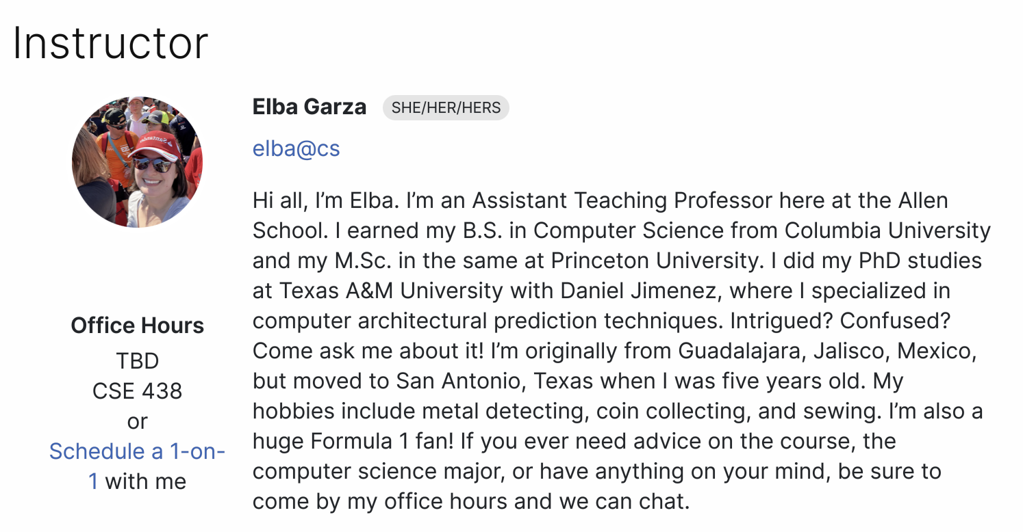
Course Website (1/2)
cs.uw.edu/122
Get to know the course staff
Contains most course info – check frequently!
Announcements, Calendar, Lecture Slides, Office Hours schedule, Staff Bios, Important Links

Slide 13
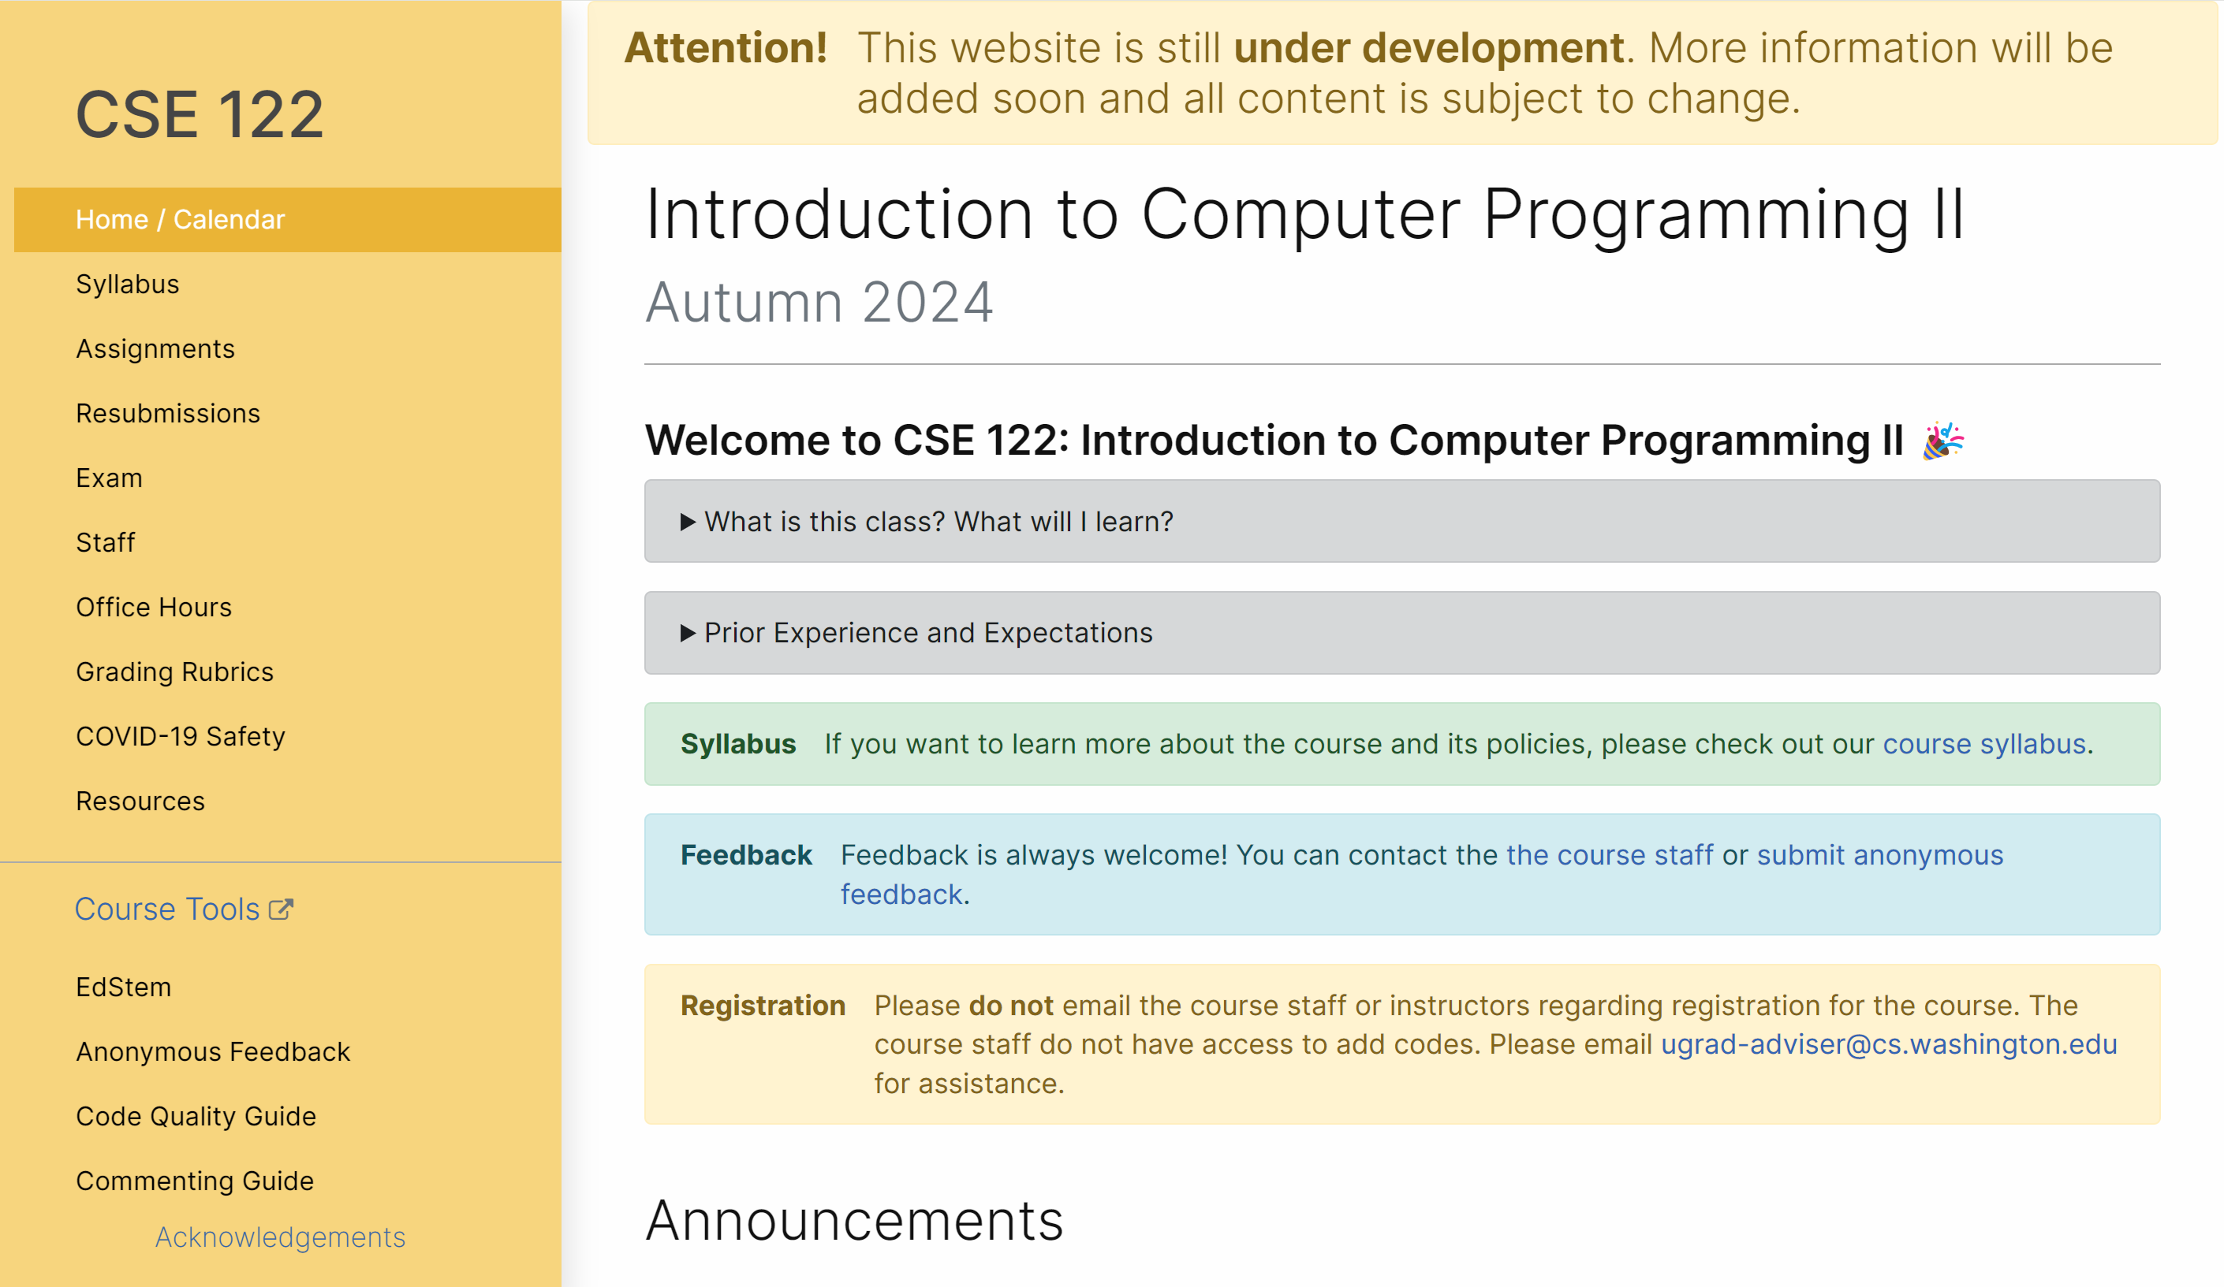
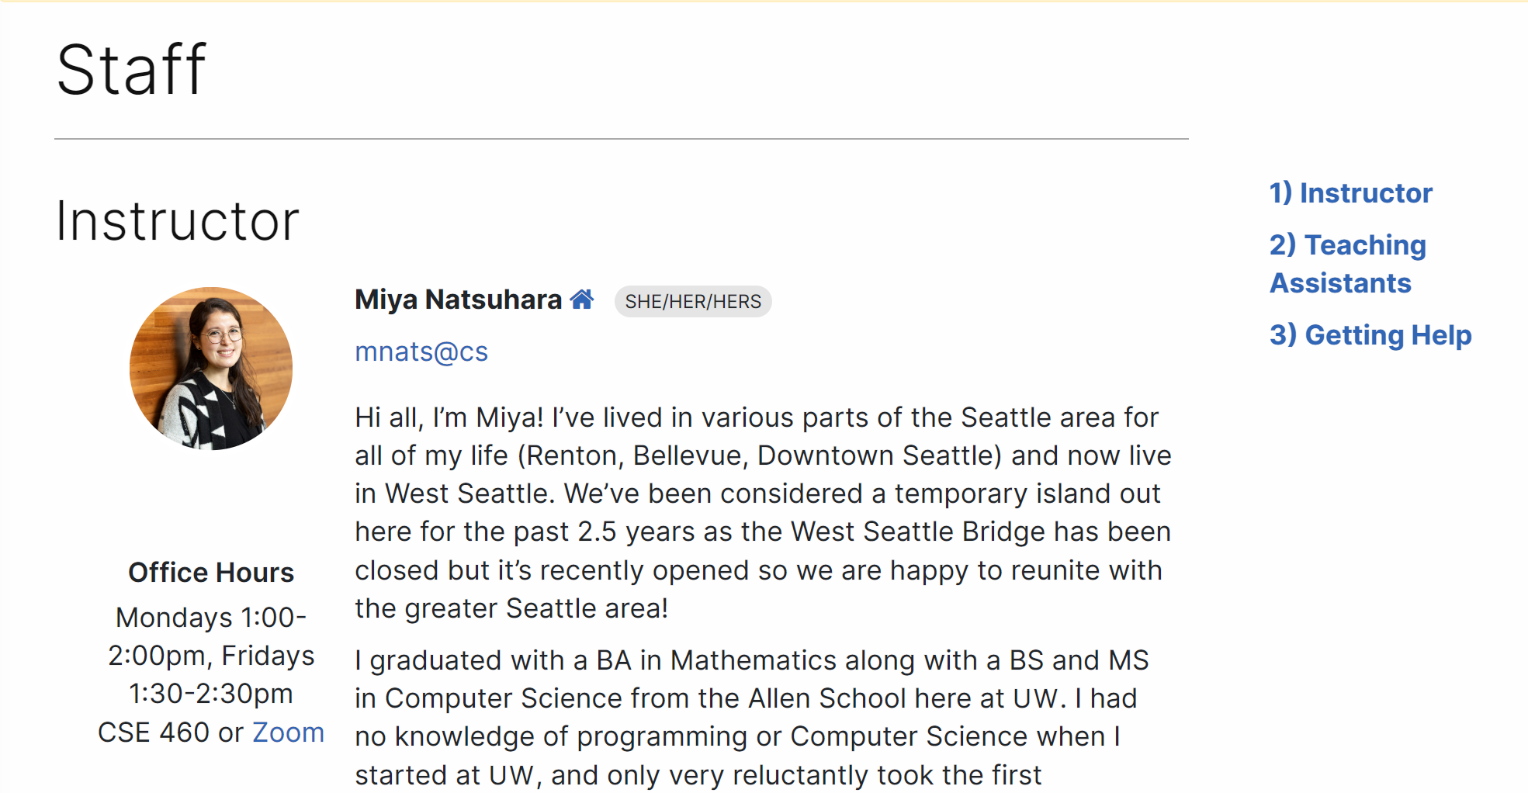
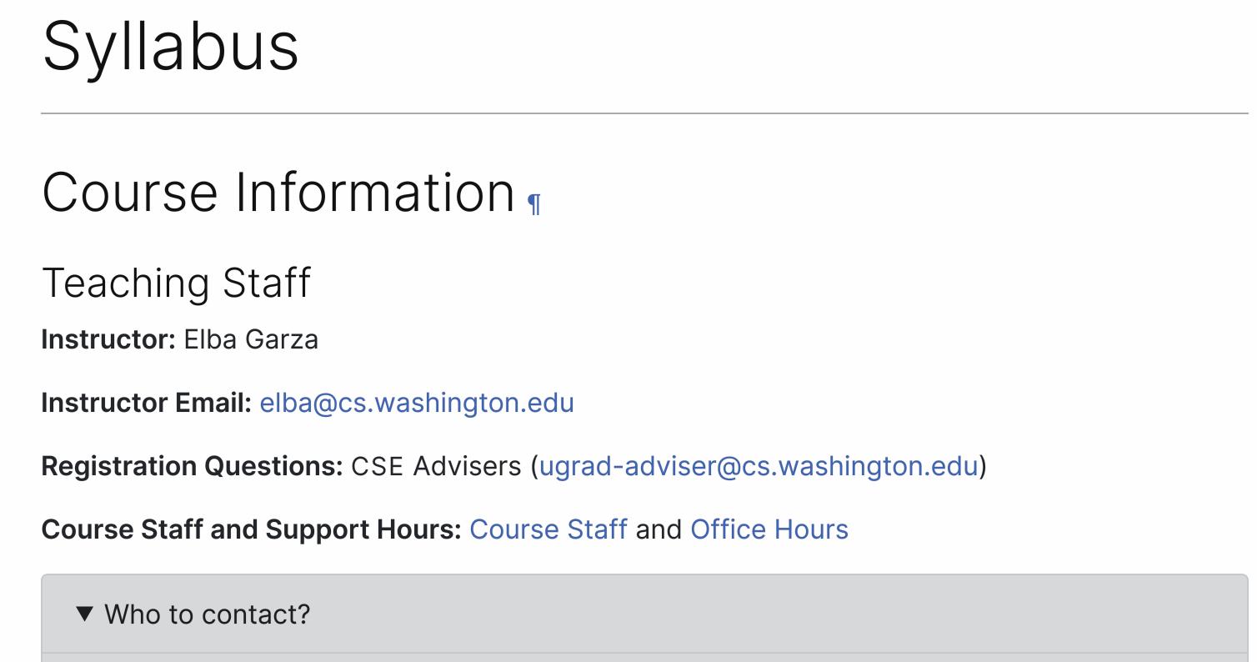
Course Website (2/2)
cs.uw.edu/122
Please familiarize yourself with the course syllabus this week!
Contains most course info – check frequently!
Announcements, Calendar, Lecture Slides, Office Hours schedule, Staff Bios, Important Links

Slide 14
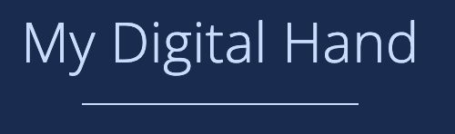




Other Course Tools
My Digital Hand
Queueing in office hours
VSCode (Optional)
Develop offline
Visual debugger
Ed
Community & Information
  Discussion Board
  (please ask & answer!; anonymous option)
  Chat
  Announcements
Pre-Class Materials / Section Handouts
Assignments
  Online IDE
  Submit assignments
  View Feedback
Canvas
Lecture recordings
Sli.do
In-class activities
(ungraded)
No account needed

Slide 15
Lecture Outline
Introductions
About this Course
  Course Components & Tools
  Grading
  Policies
  Making the Most of this Class
Intro/Review Java

Slide 16
Graded Course Components
Your grade will consist of the following categories:
Each mark is graded on the scale:
  E(xcellent)
  S(atisfafactory)
  N(ot yet)
Category | # | Marks per | Total Marks
Programming Assignments | 4 | 4 (Behavior, Concepts, Quality, Testing/Reflection) | 16
Creative Projects | 4 | 1 | 4
Quizzes | 3 | 3 (3 questions) | 9
Exam | 1 | 6 (6 questions) | 6

Slide 17
Course Grades
In assigning course grades, we’ll use a bucket system:
  Marks earned place in an initial bucket, additional S+ marks improve grade.
  Must meet all requirements of a bucket for initial placement.
  These are minimum GPA guarantees – grade can always be higher than minimum promise. 😄
Minimum Grade | Required S+, of which… | Required E
3.5 | 30 | 27
3.0 | 27 | 22
2.5 | 24 | 17
2.0 | 21 | 0
1.5 | 14 | 0
0.7 | 8 | 0
S+ indicates S or E

Slide 18
Lecture Outline
Introductions
About this Course
  Course Components & Tools
  Grading
  Policies
  Making the Most of this Class
Intro/Review Java

Slide 19
Resubmissions
Learning is a challenging process that takes time, it doesn’t always happen on your first try.
Each week, one previous Programming Assignment or Creative Project can be resubmitted
  Must be accompanied by write up explaining changes
  Grade on resubmission replaces original grade.
  An assignment can be resubmitted in the 3 cycles after feedback has been published
  Tip: Resubmit as early as possible
See syllabus for more details

Slide 20
Collaboration
These concepts are challenging—we strongly encourage discussion + collaboration!
  Don’t attempt to gain credit for something you didn’t do
  In general, share ideas and work together, but don’t copy work. Never show someone else your code or solution write up.
  For any ungraded work (e.g., pre-class materials) there is no concern about academic misconduct! You should be collaborating on those without reservation.
  On graded assignments you should still collaborate, but the code you write should be of your own creation.
  Be aware of and avoid use of Forbidden Features in submitted work
  Always cite the help you receive on graded work
Read full policy in Syllabus

Slide 21
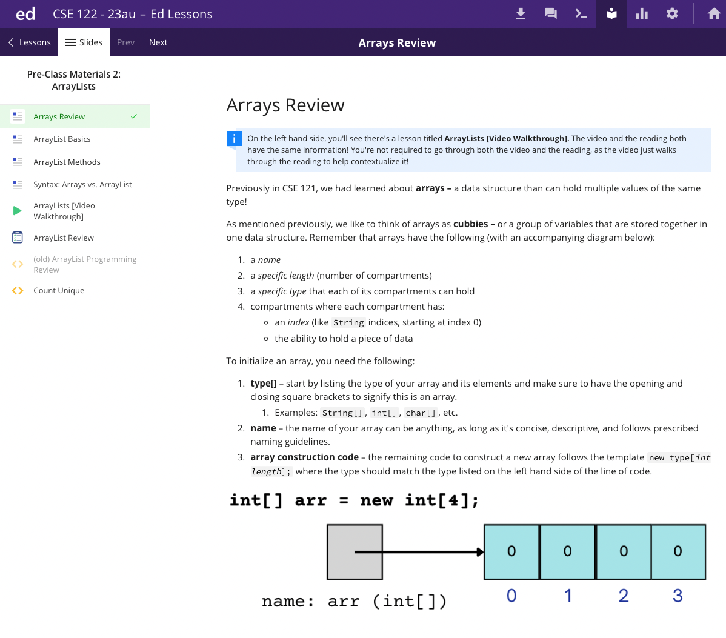
Textbook
Pre-class Materials
All required readings are available free on Ed!
Should be finished before class (not graded)
Optional Textbook
Building Java Programs by Reges and Stepp (5th Edition)
Not required but does add another perspective. Will reference relevant chapters.
Advice: only purchase if you learn best with a textbook, otherwise not recommended.

Slide 22
Lecture Outline
Introductions
About this Course
  Course Components & Tools
  Grading
  Policies
  Making the Most of this Class
Intro/Review Java

Slide 23
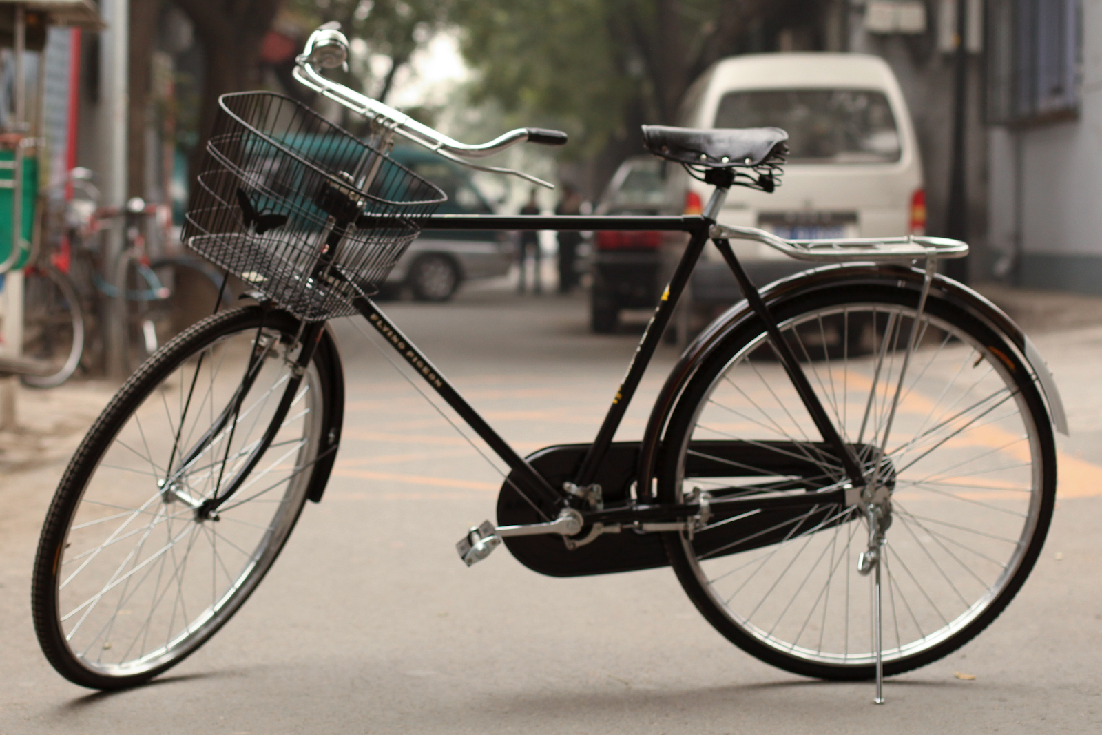
How Learning Works
Learning requires active participation in the process. It’s not as simple as sitting and listening to someone talk at you.
  Requires deliberate practice in learning by doing
  Benefits from collaborative learning
Hybrid classroom model
  Asks you to do some preparation before class in the form
  of readings and practice problems.
    Should take ~30 minutes a day
  Class will start with brief recap, then pick up
  where the reading and practice problems leave off.
  Attendance isn’t graded, but showing up and trying
  is the first step in succeeding in the class!
Pre-class materials are ungraded, but…
  It’s okay if you find them challenging! That means
  you are learning!

Slide 24
Metacognition
Metacognition: asking questions about your solution process.
Examples:
  While debugging: explain to yourself why you’re making this change to your program.
  Before running your program: make an explicit prediction of what you expect to see.
  When coding: be aware when you’re not making progress, so you can take a break or try a different strategy.
  When designing:
    Explain the tradeoffs with using a different data structure or algorithm.
    If one or more requirements change, how would the solution change as a result?
    Reflect on how you ruled out alternative ideas along the way to a solution.
  When studying: what is the relationship of this topic to other ideas in the course?

Slide 25
Getting Help
Discussion Board
  Feel free to make a public or private post on Ed
  We encourage you to answer other peoples’ questions! A great way to learn
Introductory Programming Lab (Office Hours)
  TAs can help you face to face in office hours, and look at your code
  You can go to the IPL with any course questions, not just assignments
Section
  Work through related problems, get to know your TA who is here to support you
Your Peers
  We encourage you to form study groups! Discord or Ed are great places to do that
Email
  We prefer that all content and logistic questions go on the Ed discussion board (even if you make them private). 593 of you >>> 37 of us!
  For serious personal circumstances, you can email Elba directly. It never hurts to email us, but if it’s a common logistic question, we may politely ask you to post on the discussion board instead.

Slide 26
Help Us Improve!
This is a relatively new course! We are always looking for feedback on how to improve the class for you and for future students! Thank you in advance for your patience and understanding as we develop everything. ☺
  We really value your feedback!
  Let us know what’s working and what isn’t working for you
  Something that went well in another course? Tell us about it!
Post on the discussion board (can be public/private).
  Note: Anonymous here is anonymous to other students, not to the staff.
Submit feedback via the Anonymous Feedback Tool (linked under “Course Tools” on the website)

Slide 27
The World Around CSE 122
Our goal is to give you a great CSE 122 experience
  But CSE 122 does not exist in a vacuum – there’s a lot going on in the world right now that can impact your education
We’ve designed course policies for maximum flexibility: ability to resubmit assignments and drop low letter grades in quizzes
  But we cannot cover every individual situation
Please reach out if you need accommodations of any kind to deal with these unfamiliar situations

Slide 28
Lecture Outline
Introductions
About this Course
  Course Components & Tools
  Grading
  Policies
  Making the Most of this Class
Intro/Review Java

Slide 29
Hello World
Java Specifics
  Every program needs a class
  Runnable programs need a main method (signature must exactly match)
  System.out.println to print
  "Hello world" is a String
Running on Ed
  Run runs your program
  Mark submits and runs autograder
    Submit as many times as you like
    “Shotgun submission” = Unhelpful habit
  Solution shows solution (if applicable)
public class HelloWorld {
public static void main(String[] args) {
System.out.println("Hello world");
}
}

Slide 30
Review Java Syntax
Java Tutorial reviews all the relevant programming features you should familiar with (even if you don’t know them in Java).
  Printing and comments
  Variables, types, expressions
  Conditionals (if/else if/ else)
  Loops (for and while)
  Strings
  Methods
  Arrays & 2D Arrays

Slide 31
“Homework” for Next Time
First assignment will be released Friday, but there are some things to do in the meantime.
TODO this week
  Fill out the introductory survey
  Go meet your TA and classmates in Thursday’s quiz section
  ⭐️ Complete the pre-class material for Friday (see calendar)
  Check over syllabus details

