Slide 1
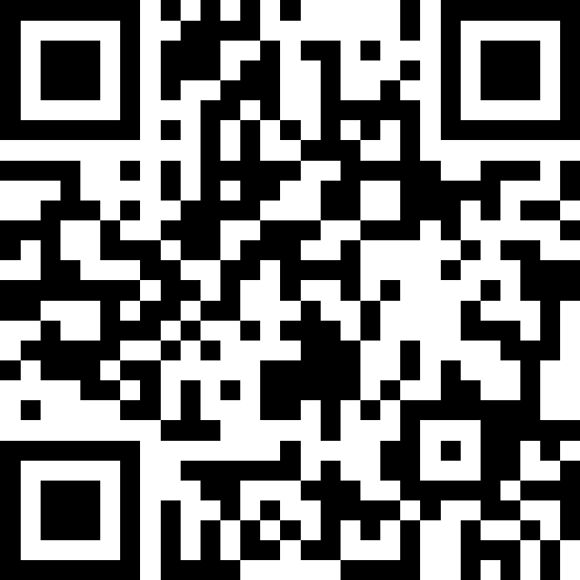
Putting It All Together (Review)
BEFORE WE START
Slido chat & talk with neighbors:
What’s the first thing you’ll do after finals are over? (Sleep is obvious…)

Slide 2
Lecture Outline
Announcements
Exam Logistics
Review
How to Study
Mind Maps

Slide 3
Announcements
Last few sessions of classes!
Quick overview of class today!
Victory lap + AMA on Friday
Creative Project 3 (C3) currently out
Due Friday, June 6th by 11:59 PM
Resubmission Cycle 7 (R7) opens tomorrow, Thurs June 5
Due Tuesday, June 10th by 11:59 PM
Open to all previous assignments
R8 info coming soon!
Provide feedback!
Course evaluations have been send to your UW emails
TA evaluations in section tomorrow

Slide 4
Announcements
Final Exam Review: Monday, June 9 from 2:30-5:00 PM, JHN 102
Led by TAs
First half: time to work on practice exam with TAs in room
Second half: TAs going over exam, giving tips
Likely recorded, we’ll update if this isn’t the case!
Final Exam: Tuesday, June 10 from 2:30-4:30 PM
Preliminary details are up on the course website!
Seating chart will be posted soon!
Already up:
Final Exam Study Guide/Resource Bank Document
Past & Practice Exams

Slide 5
Lecture Outline
Announcements
Exam Logistics
Review
How to Study
Mind Maps

Slide 6
Exam Format
6 questions in total, each will receive one ESN grade
Some questions might have sub-parts
Reminder: Quiz and Exam grades are all mixed into the same bucket
General format
3 Questions: Mix of Conceptual, Mechanical/Tracing, Debugging Problems
3 Questions: Programming Problems
See sections for the last 2 weeks for practice handwriting problems
See your quizzes too!

Slide 7
Exam Logistics
Most important bits:
Tuesday June 10 from 2:30 – 4:20 PM
Seat assignments will be posted soon!
Don’t cheat
Only have the exam open during the time (don’t start early; don’t work after)
No electronic devices
You can bring one 8.5x11 inch (or A4) paper with notes, front and back
Will also provide a reference sheet (see course website)
Questions? Raise hand or as on sli.do (cse122)

Slide 8
Review So Far
CS Concepts
Problem Solving
Functional Decomposition
Debugging
Testing
Third Party Libraries*
Java Language
File I/O
Iterators and For-each Loops
Exceptions
Reference Semantics
JUnit*
Data Structures
ADTs
Lists
Stacks
Queues
Sets
Maps
Java Collections
Arrays / 2D Arrays
ArrayList
LinkedList
Stack
TreeSet / TreeMap
HashSet / HashMap
Interfaces for Collections
Object Oriented
Instance variables
Instance methods
Interfaces
Abstraction
Encapsulation
Client/Implementer

Slide 9
Review Resources
Pre-Class Materials + Lectures
Section Handouts
Quizzes so Far
Your Notes!
Helpful for contextualizing what you learned
Practice final exams
Practice it

Slide 10
Lecture Outline
Announcements
Exam Logistics
Review
How to Study
Mind Maps

Slide 11
Study Strategies
Study Early and Often
Stay Healthy
Embrace Difficulty!
You don’t need to be perfect
Connect Problems: How is one problem similar/different to another?
Mix up the problem order!
Study Like you Test

Slide 12
Study Strategies
Reference Sheet: Iterative Refining
Don’t stay stuck on a problem
Draw things out!
Key words
Exceptions
Auxiliary structures
“Unique”, “Ordered”, etc

Slide 13
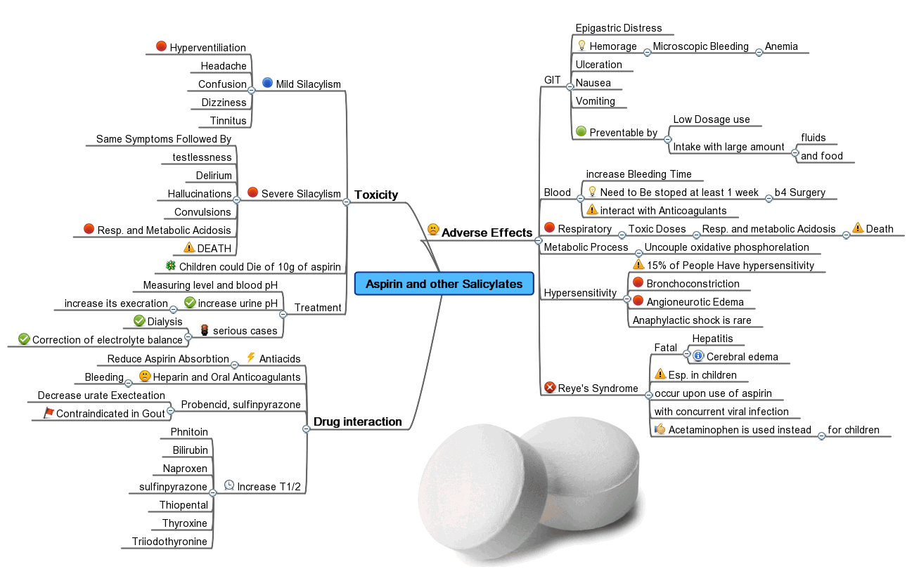
Mind Maps
One of the most important parts of learning is relating concepts to each other
Almost all learning is contextual: based on relating one thing to another
Transfer is challenging!
Mind Maps empower you to write out how topics relate to each other. Concretizing relations.
Can be incredibly helpful when reviewing and can be a great resource for looking back at this class

Slide 14
Lecture Outline
Announcements
Exam Logistics
Review
How to Study
Mind Maps

