Slide 1
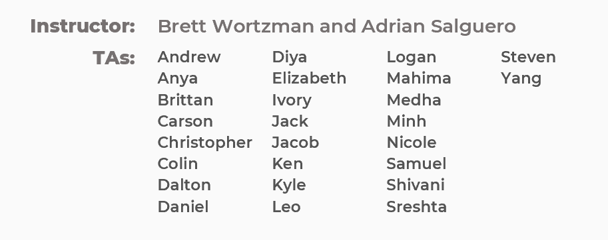
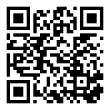
Advanced OOP
BEFORE WE START
Talk to your neighbors:
What is your favorite cold summer drink? 🍹

Slide 2
Lecture Outline
Announcements
Constructors (cont.)
Equals
Bigger Example
For next quarter…

Slide 3
Announcements
Creative Project 2 (C2) releasing later tonight
  Focused on OOP!
  Due FRIDAY May 23rd
  Go to Next Tuesday’s Section!
    Bookshelf Problem
Resubmission Cycle 4 (R4) out; due Tuesday, May 20th by 11:59 PM
  Eligible Assignments: C1, P1
Quiz 2 on May 27th—coming up fast!
  Topics: Nested Collections, Objects, Interfaces

Slide 4
Lecture Outline
Announcements
Constructors (cont.)
This
Equals
Bigger Example
For next quarter…

Slide 5
Constructor Syntax
public Point(int initialX, int initialY) {
x = initialX;
y = initialY;
}
All fields should be initialized in the constructor(s)!
If we write any constructors, Java no longer provides one for us.

Slide 6
Constructor Syntax
private int x;
private int y;
public Point(int x, int y) {
x = x;
y = y;
}

Slide 7
Lecture Outline
Announcements
Constructors (cont.)
This
Equals
Bigger Example
For next quarter…

Slide 8
this keyword
The this keyword refers to the current object in a method or constructor.
You can use it to refer to an object’s fields:
this.x, this.y
You can use it to refer to an object’s instance methods:
this.setX(newX)
Also, you can use it to call one constructor from another:
this(0, 0)

Slide 9
Lecture Outline
Announcements
Constructors (cont.)
this
Equals
Bigger Example
For next quarter…

Slide 10
Equals
The equals() method returns true if the given parameter is considered equal to this object, and false otherwise.
  Used by lots of library methods! e.g. contains, remove for specific elements, etc.
Each class has one provided by Java, but it checks for reference equality. (Thanks?)
If you want equals to check for value equality, you need to write this method yourself.

Slide 11
Object
By taking a parameter of type Object, the equals method can be passed any type of object.
More to come in CSE 123 on the Java mechanisms that make this work!
We can use the instanceof keyword in Java to determine if the parameter is actually a Point

Slide 12
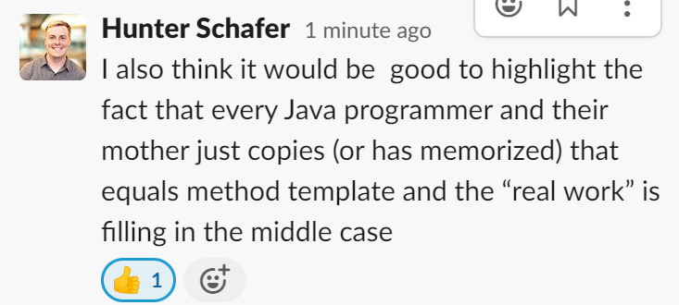
Point’s equals()
public boolean equals(Object o) {
if (this == o) {
return true;
} else if (o instanceof Point) {
Point other = (Point) o;
return other.x == this.x && other.y == this.y;
} else {
false;
}
}

Slide 13
Almost there…
This is actually still an imperfect implementation because we would also need to write a hashCode() method for our object to work with HashSet, HashMap, etc. but more to come on that in CSE 331 and beyond ☺

Slide 14
Lecture Outline
Announcements
Constructors (cont.)
this
Equals
Bigger Example
For next quarter…

Slide 15
Student class
Write a Student class that you can construct by saying:
new Student(1234567, "Cornbear")
where the first parameter is their student number and the second parameter is their name. Your Student class should also implement the following methods:
getName() returns the student's name
getStudentNumber() returns the student's number
setName(String newName) sets the student’s name to the given newname
toString() returns a String representation of the student formatted as "name (studentNumber)"
equals(Object other) that returns true if the given parameter is considered equal to this object

Slide 16
Student class
What if we added a field to the Student class:
private boolean isTraditionalStudent;
Yikes—You are the designer now. Think carefully about what assumptions you are making!
Also…
Why shouldn’t we include a setStudentNumber method?

Slide 17
Course class
Write a Course class that represents a course at UW. Implement the following methods and constructors:
Constructors
Write a constructor so that you can construct a Course by saying new Course(23213, "CSE 122", 4) where the first parameter is the course's SLN, the second parameter is the code for the course, and the third parameter is the number of credits.
Write another constructor so that you can construct a Course by saying new Course(23239, "CSE 122", 4, enrollment) where the first parameter is the course's SLN, the second parameter is the code for the course, the third parameter is the number of credits, and the fourth parameter is a Student[] containing a Student for each student enrolled in the course.

Slide 18
Course class
Instance Methods
updateRoster(Student[] students) replaces the current roster with the content of the given students
addStudent(Student s) adds the given student to the roster if they are not already on it
dropStudent(Student s) removes the given student from the roster if they are on it
checkStudentEnrolled(Student s) returns true if the given student is on the current roster, and false otherwise
getSLN() returns the course's SLN
getCourseCode() returns the course's code
getCredits() returns the number of credits for the course
getRoster() returns a copy of the course's roster

Slide 19
Course class
Instance Methods
updateRoster(Student[] students) replaces the current roster with the content of the given students
addStudent(Student s) adds the given student to the roster if they are not already on it
dropStudent(Student s) removes the given student from the roster if they are on it
checkStudentEnrolled(Student s) returns true if the given student is on the current roster, and false otherwise
…

Slide 20
Lecture Outline
Announcements
Constructors (cont.)
This
Equals
Bigger Example
For next quarter…

Slide 21
If you want to…
Learn more about programming techniques
  Recursion!
Learn about even more fundamental data structures!
  And implement your own data structures
Gain a stronger understanding of efficiency
Pursue a software-intensive major and/or career
Consider taking…
CSE 123
CSE 163 and courses in the Data Science Minor & Option
CSE 123 offered 25sp (Brunelle), 25su (Yin)

Slide 22
If you want to…
Do something with data science
  The world is run on decisions made from data. Data science requires processing large amounts of data collected to help people make decisions.
Learn the programming concepts, libraries, and tools that make up the modern data science ecosystem.
  Data programming = The programming that supports data science
Consider taking…
CSE 163 and other courses in the Data Science Minor & Option
CSE 163 and courses in the Data Science Minor & Option
CSE 163 offered 25sp (Lin)

Slide 23
If you want to…
Build a website or web app
  Either the frontend (what visitors see in their browser) or the backend (what runs on the server to compute data)
Learn the fundamentals of a number of web technologies that make it easier for you to learn more on your own
Consider taking…
CSE 154, INFO 343, or INFO 344
CSE 154 likely offered 25su (???)

