Slide 1

Introduction to Objects
BEFORE WE START
Chat with neighbors:
What are your favorite places to
study on/near campus?
Music: 122 25sp Lecture Tunes 🌸

Slide 2
Lecture Outline
Announcements
OOP Review
Example
Abstraction

Slide 3
Announcements
Programming Assignment 2 (P2) out
  Due Thursday, May 15th by 11:59 PM
  Which means… no assignment releasing tonight!
Quiz 0 grades released last night!
  Check out & use results to calibrate how/what to study over the weekend.
  Read Ed announcement for note about Problem 3
Quiz 1 on Tuesday, May 13th in your registered quiz section
  Practice Quiz out tonight
Resubmission Cycle 3 (R3) out
  Due Tuesday, May 13th by 11:59 PM
  Eligible assignments: P0, C1, P1

Slide 4
Lecture Outline
Announcements
OOP Review
Example
Abstraction

Slide 5
Object Oriented Programming (OOP)
Procedural programming: Programs that perform their behavior as a series of steps to be carried out
  Classes that do things
Object-oriented programming (OOP): Programs that perform their behavior as interactions between objects
  Classes that represent things
  We’re going to start writing our own objects!

Slide 6
Classes & Objects
Classes can define the template for an object
  📰 Like the blueprint for a house!
  “What does it mean to be this thing?”
Objects are the actual instances of the class
  🏠 Like the actual house built from the blueprint!
  “It is an example of this thing!”
We create a new instance of a class with the new keyword
e.g., Scanner console = new Scanner(System.in);

Slide 7
State & Behavior
Objects can tie related state and behavior together
State is defined by the object’s fields or instance variables
  Scanner’s state may include what it’s scanning, where it is in the input, etc.
Behavior is defined by the object’s instance methods
  Scanner’s behavior includes “getting the next token and returning it as an int”, “returning whether there is a next token or not”, etc.

Slide 8
Syntax
public class MyObject {
// fields (or instance variables)
type1 fieldName1;
type2 fieldName2;
...
// instance methods
public returnType methodName(...) {
...
}
}

Slide 9
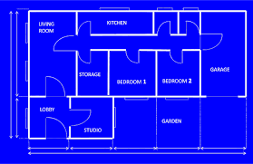






Instance Variables
Fields are also referred to as instance variables
Fields are defined in a class
Each instance of the class has their own copy of the fields
  Hence instance variable! It’s a variable tied to a specific instance of the class!

Slide 10






Instance Methods
Instance methods are defined in a class
Calling an instance method on a particular instance of the class will have effects only on that instance

Slide 11
Lecture Outline
Announcements
OOP Review
Example
Abstraction

Slide 12
Representing a Coordinate Point
How would we do this given what we knew last week?
Maybe int x, int y?
Maybe int[]?

Slide 13
Representing a point
int x, int y
Easy to mix up x, y
Just two random ints floating around – easy to make mistakes!
int[]
Not really what an array is for
Again, just two ints – just have to “trust” that we’ll remember to treat it like a point
Let’s make a class instead!

Slide 14
Instance Methods
Instance methods are defined in a class
Calling an instance method on a particular instance of the class will have effects on that instance

Slide 15
Instance Methods
Instance methods are defined in a class
Calling an instance method on a particular instance of the class will have effects only on that instance

Slide 16
Lecture Outline
Announcements
OOP Review
Example
Abstraction

Slide 17
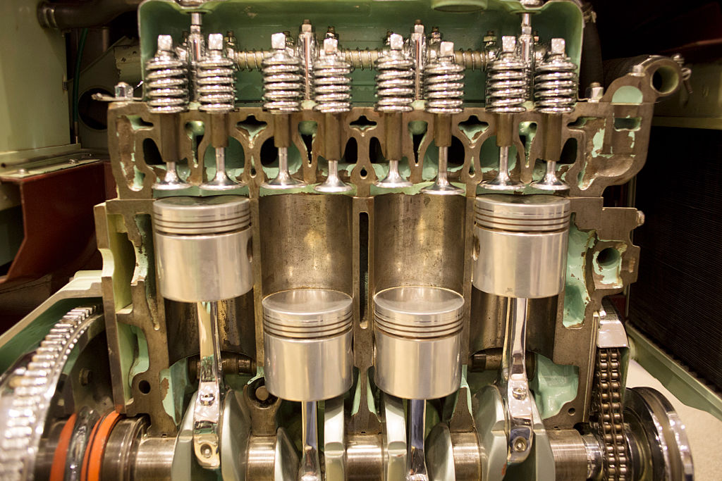

Slide 18
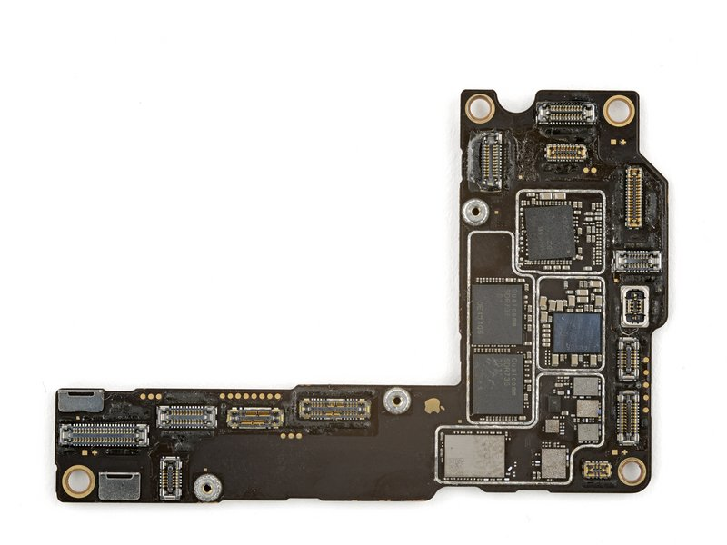

Slide 19
Abstraction
The separation of ideas from details, meaning that we can use something without knowing exactly how it works.
You were able use the Scanner class without understanding how it works internally!

Slide 20
Client v. Implementor
We have been the clients of many objects this quarter!
Now we will become the implementors of our own objects!

