Slide 1

Nested Collections
BEFORE WE START
Chat with neighbors:
What is your favorite animal?
Music: 122 25sp Lecture Tunes 🌸

Slide 2
Agenda
Announcements
Review/Finish: mostFrequentStart
Recap: Nested Collections
Practice: Social Network

Slide 3
Announcements
Programming Assignment 2 (P2) was released on Friday!
  Seriously, start early! This assignment is much more involved…
  Due May 15th by 11:59 PM
  Go to section tomorrow!!
Quiz 1 on May 13th in your registered Quiz Section
  Topics: (Reference Semantics), Stacks and Queues, Sets, Maps
  Practice Quiz 1 available tomorrow or Friday
Quiz 0 grades to be released today or tomorrow!
Tomorrow, Resubmission Cycle 3 (R3) form out, due May 13th by 11:59 PM
  Available assignments: P0, C1, P1
  Reminder: to use a resubmission cycle you need to
    (1) submit your work (big blue "Submit" button on Ed)
    AND (2) fill out the resubmission form (linked from Ed + course calendar)

Slide 4
Agenda
Announcements
Review/Finish: mostFrequentStart
Recap: Nested Collections
Practice: Social Network

Slide 5
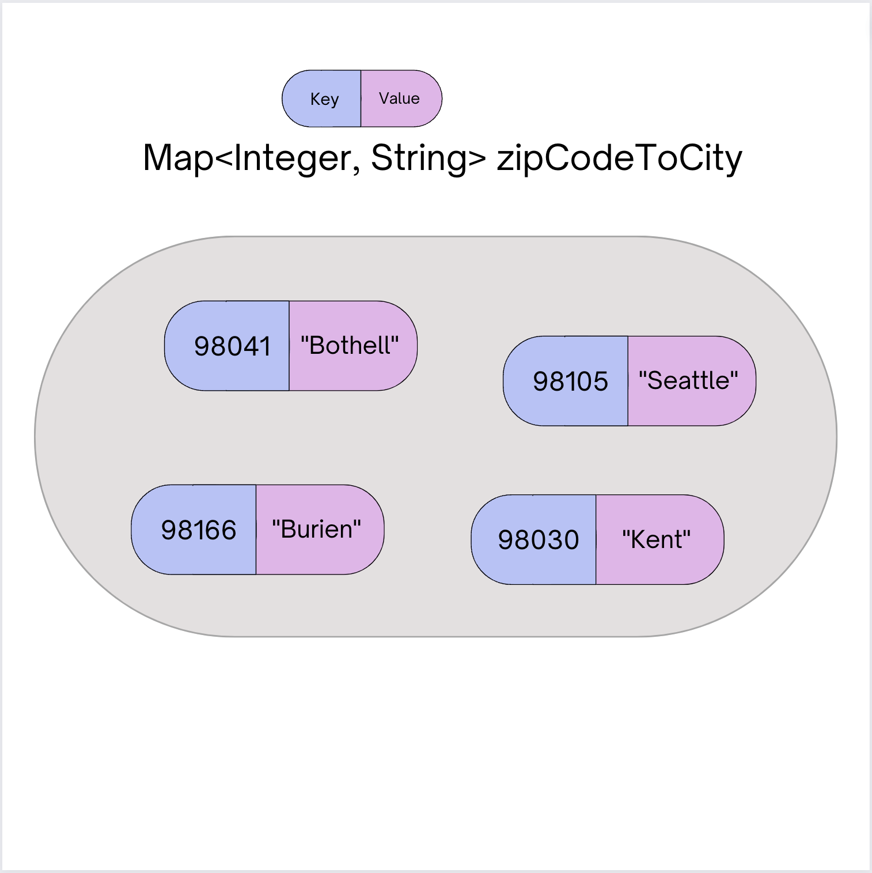
Map ADT
Data structure to map keys to values
  Keys can be any* type; Keys must be unique
  Values can be any type
Example: Mapping ticker to stock price in P0
Operations
  put(key, value): Associate key to value
    Overwrites duplicate keys
  get(key): Get value for key
  remove(key): Remove key/value pair
Same as Python’s dict

Slide 6
mostFrequentStart
Write a method called mostFrequentStart that takes a Set of words and does the following steps:
Organizes words into “word families” based on which letter they start with
Selects the largest “word family” as defined as the family with the most words in it
Returns the starting letter of the largest word family (and should update the Set of words to only have words from the selected family).

Slide 7
mostFrequentStart
For example, if the Set words stored the values:
["hello", "goodbye", "library", "literary", "little", "repel"]
The word families produced would be:
'h' -> 1 word ("hello")
'g' -> 1 word ("goodbye")
'l' -> 3 words ("library", "literary", "little")
'r' -> 1 word ("repel")
Since 'l' has the largest word family, we return 3 and modify the Set to only contain Strings starting with 'l'.

Slide 8
Agenda
Announcements
Review/Finish: mostFrequentStart
Recap: Nested Collections
Practice: Social Network

Slide 9
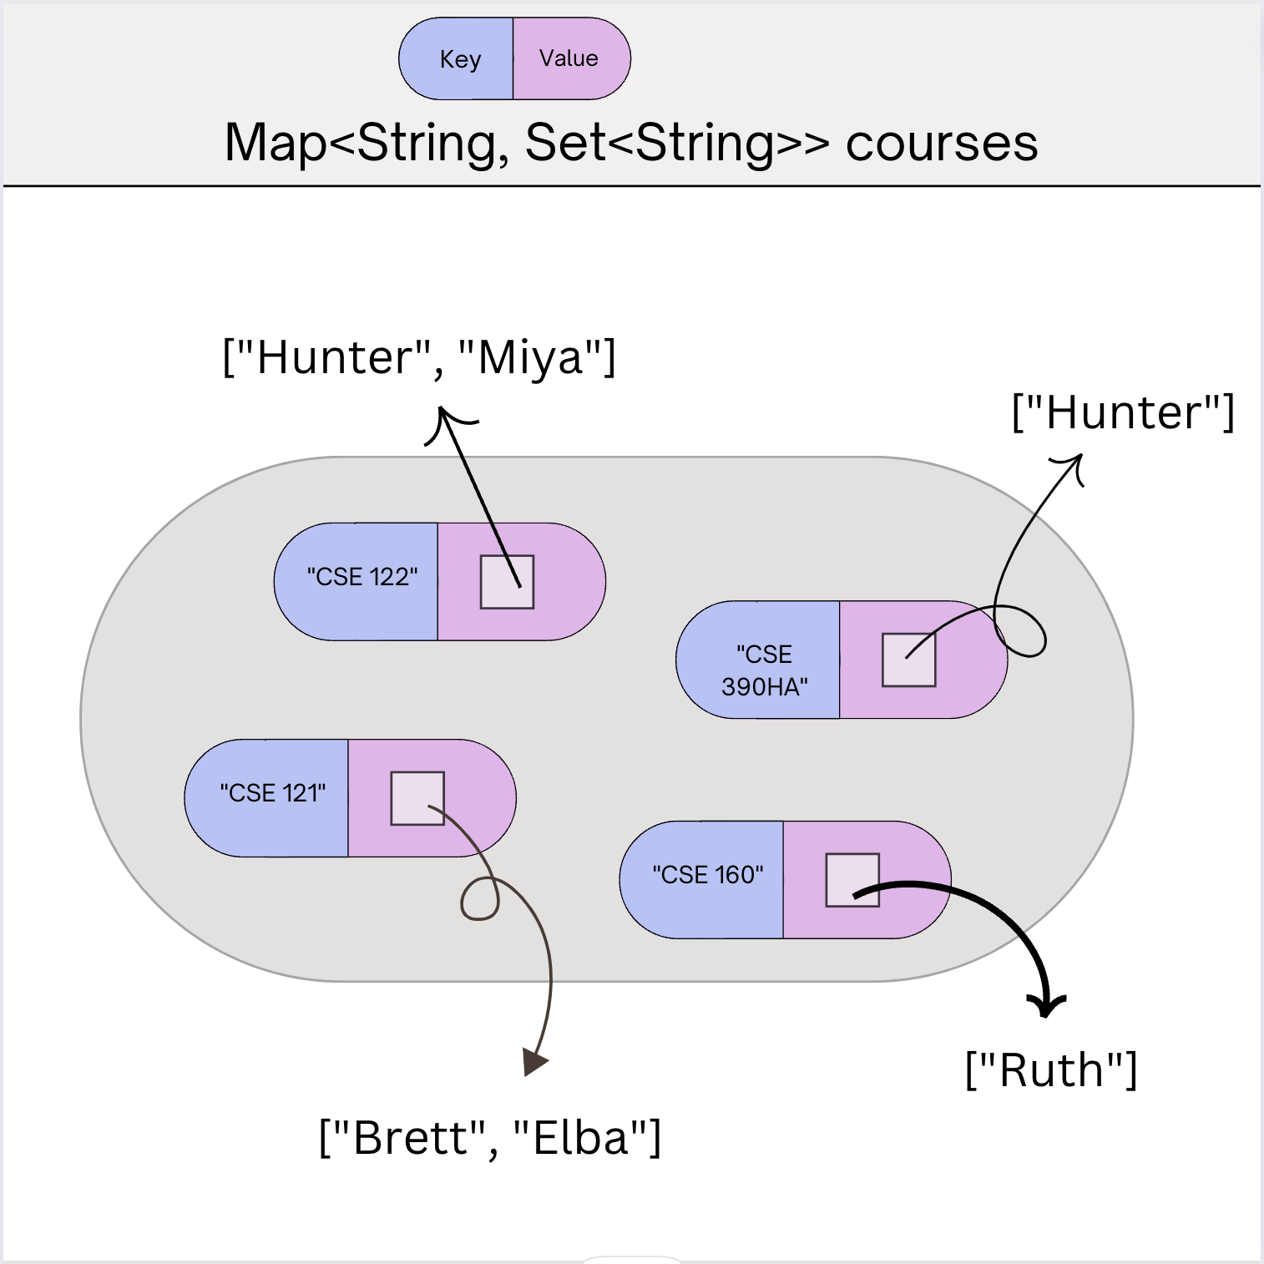
Nested Collections
The values inside a Map can be any type, including data structures
Common examples:
  Mapping: Section ➔ Set of students in that section
  Mapping: Recipe ➔ Set of ingredients in that recipe
    Or even Map<String, Map<String, Double>> for units!

Slide 10
Updating Nested Collections
The “value” inside the Map is a reference
to the data structure!
  Think carefully about number of references
  to a particular object
cse123
“CSE 123”
[ “Nathan” ]
[ “Nathan”, “Joe” ]
[ ]
courses.put("CSE 123", new HashSet<String>());
courses.get("CSE 123").add("Nathan");
Set<String> cse123 = courses.get("CSE 123");
cse123.add("Joe");

Slide 11
Suppose map had the following items. What would its items be after running this code?
map: {”KeyA"=[1, 2], ”KeyB"=[3], ”KeyC"=[4, 5, 6]}
Set<Integer> nums = map.get("KeyA");
nums.add(7);
map.put("KeyB", nums);
map.get("KeyA").add(8);
map.get("KeyB").add(9);
{"KeyA"=[1, 2], "KeyB"=[1, 2, 7], "KeyC"=[4, 5, 6]}
{"KeyA"=[1, 2, 8], "KeyB"=[1, 2, 7, 9], "KeyC"=[4, 5, 6]}
{"KeyA"=[1, 2, 7, 8], "KeyB"=[1, 2, 7, 9], "KeyC"=[4, 5, 6]}
{"KeyA"=[1, 2, 7, 8, 9], "KeyB"=[1, 2, 7, 8, 9], "KeyC"=[4, 5, 6]}

Slide 12
Suppose map had the following items. What would its items be after running this code?
nums
map: {”KeyA"=[1, 2], ”KeyB"=[3], ”KeyC"=[4, 5, 6]}
[1, 2]
[1, 2, 7, 8]
KeyA:
[1, 2, 7]
Set<Integer> nums = map.get("KeyA");
nums.add(7);
map.put("KeyB", nums);
map.get("KeyA").add(8);
map.get("KeyB").add(9);
[1, 2, 7, 8, 9]
KeyB:
[3]
KeyC:
[4, 5, 6]
{"KeyA"=[1, 2], "KeyB"=[1, 2, 7], "KeyC"=[4, 5, 6]}
{"KeyA"=[1, 2, 8], "KeyB"=[1, 2, 7, 9], "KeyC"=[4, 5, 6]}
{"KeyA"=[1, 2, 7, 8], "KeyB"=[1, 2, 7, 9], "KeyC"=[4, 5, 6]}
{"KeyA"=[1, 2, 7, 8, 9], "KeyB"=[1, 2, 7, 8, 9], "KeyC"=[4, 5, 6]}

Slide 13
Agenda
Announcements
Review/Finish: mostFrequentStart
Recap: Nested Collections
Practice: Social Network

