Slide 1
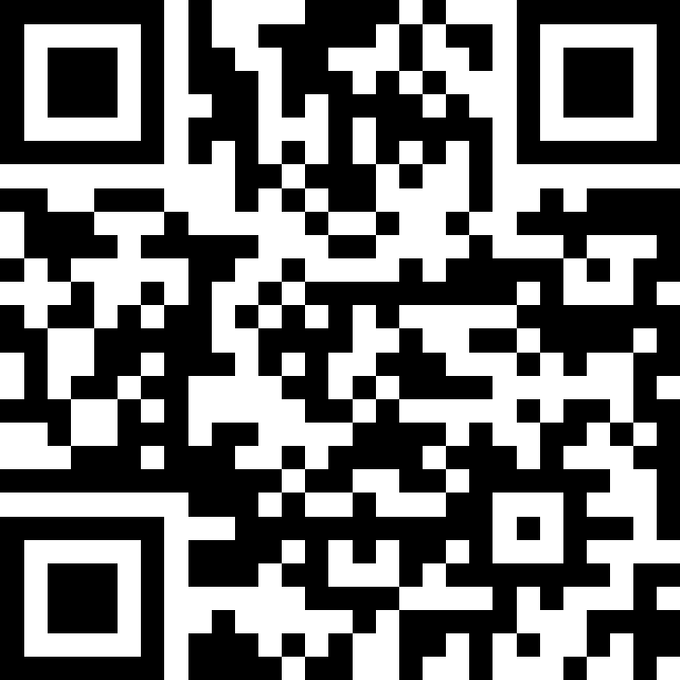
Stacks & Queues Practice
BEFORE WE START
Slido vote & chat with neighbors:
What food could you only eat happily for the rest of your life?

Slide 2
Lecture Outline
Announcements
Quick Recap
copyStack Review
Exceptions
Structured Example: spliceStack

Slide 3
Announcements
Creative Project 1 was due yesterday, how’d it go?
Programming Assignment 1 releasing later tonight
    Focusing on Stacks and Queues!
Resubmission Cycle 1 form posted!
    Due October 21st by 11:59pm PT
    Eligible assignments: C0, P0

Slide 4
Lecture Outline
Announcements
Quick Recap
copyStack Review
Exceptions
Structured Example: spliceStack

Slide 5
Stacks & Queues
Some collections are constrained, only use optimized operations
  Stack: retrieves elements in reverse order as added
  Queue: retrieves elements in same order as added
push
pop
top | 3
 | 2
bottom | 1
front |  | back
1 | 2 | 3
👀 peek
remove
add
queue
👀 peek
stack

Slide 6
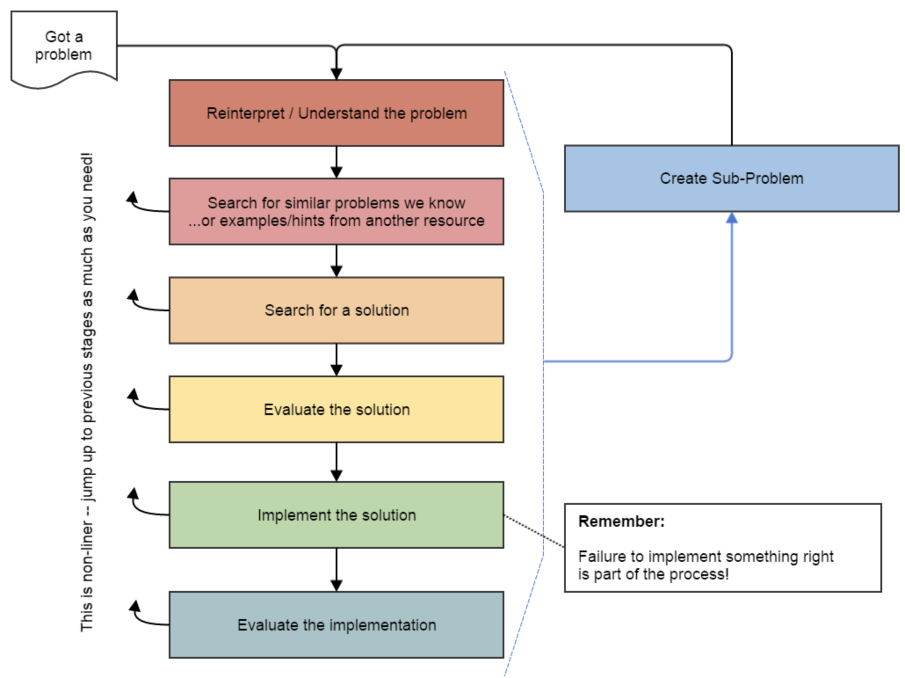
Fundamental Data Structures ➔ Problem Solving
On their own, Stacks & Queues are
quite simple with practice
(few methods, simple model)
Some of the problems we ask are
complex because the tools you have
to solve them are restrictive
  sum(Stack) is hard with a Queue as
  the auxiliary structure
We challenge you on purpose here
to practice problem solving
Source: Oleson, Ko (2016) - Programming, Problem Solving, and Self-Awareness: Effects of Explicit Guidance

Slide 7
Common Problem-Solving Strategies
Analogy – Is this similar to a problem you’ve seen?
  sum(Stack) is probably a lot like sum(Queue), start there!
Brainstorming – Consider steps to solve problem before writing code
  Try to do an example “by hand” → outline steps
Solve Sub-Problems – Is there a smaller part of the problem to solve?
  Move to queue first
Debugging – Does your solution behave correctly on the example input.
  Test on input from specification
  Test edge cases (“What if the Stack is empty?”)
Iterative Development – Can we start by solving a different problem that is easier?
  Just looping over a queue and printing elements

Slide 8
Metacognition
Metacognition: asking questions about your solution process.
Examples:
  While debugging: explain to yourself why you’re making this change to your program.
  Before running your program: make an explicit prediction of what you expect to see.
  When coding: be aware when you’re not making progress, so you can take a break or try a different strategy.
  When designing:
    Explain the tradeoffs with using a different data structure or algorithm.
    If one or more requirements change, how would the solution change as a result?
    Reflect on how you ruled out alternative ideas along the way to a solution.
  When studying: what is the relationship of this topic to other ideas in the course?

Slide 9
Common Stack & Queue Patterns
Stack → Queue and Queue → Stack
  We give you helper methods for these on problems
Reverse a Stack with a S→Q move & then a Q→S move
“Cycling” a queue: Inspect each element by repeatedly removing and adding to back a total of size times
  Careful: Watch your loop bounds when a queue’s size changes
A ”splitting” loop that moves some values to the Stack and others to the Queue

Slide 10
Lecture Outline
Announcements
Quick Recap
copyStack Review
Exceptions
Structured Example: spliceStack

Slide 11
copyStack
Write a method copyStack that takes a stack, s, of integers as a parameter and returns a copy, s2, of the original stack (i.e., a new stack with the same values as the original, stored in the same order as the original).
Your method should create the new stack and fill it up with the same values that are stored in the original stack. It is not acceptable to return the same stack passed to the method; you must create, fill, and return a new stack.
You may alter the stack parameter throughout your method, but by the end, it must have the same elements in the same order.
You may use one queue as auxiliary storage.

Slide 12
Lecture Outline
Announcements
Quick Recap
copyStack Review
Exceptions
Structured Example: spliceStack

Slide 13
Exceptions
Sometimes we want to limit someone’s input into our method to “valid” options we define
  Previously printed out “hey don’t do that” messages which isn’t great…
Allow us to “fail fast” and immediately halt execution
No longer need to wrap code in conditionals
Can include custom error messages about what went wrong
if (/* invalid input */) {
throw new IllegalArgumentException("Error Message");
}

Slide 14
Lecture Outline
Announcements
Quick Recap
copyStack Review
Exceptions
Structured Example: spliceStack

Slide 15
spliceStack
Write a method called spliceStack that takes as parameters a stack of integers s, a start position i, and an ending position j, and that removes a sequence of elements from s starting at the i’th element from the bottom of the stack up to (but not including) the j’th element from the bottom of the stack (where position 0 is the bottom of the stack), returning these values in a new stack, s2. The ordering of elements in both stacks should be preserved.
top
 | 6 | 4
 | 2 | 3
 | 3 | 2
 | 4 | 1
bottom | 1 | 0
top
 | 6 | 2
 | 2 | 1
bottom | 1 | 0
top
 | 3
bottom | 4
spliceStack(s, 1, 3)
stack
New stack s2 returned by method
s
s

