Slide 1
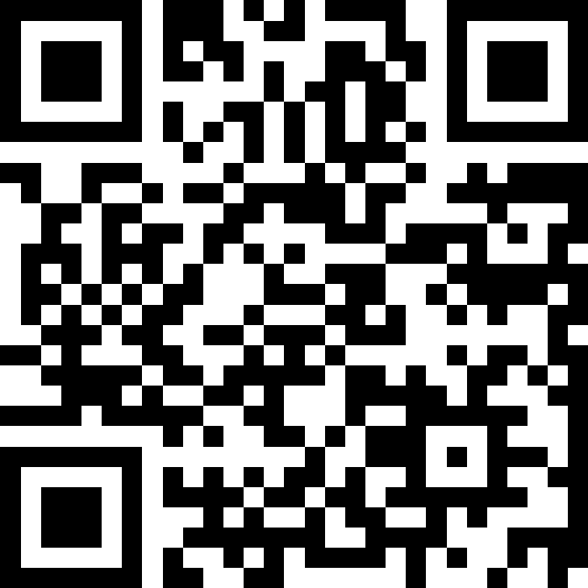
ArrayList Applications
BEFORE WE START
Talk to your neighbors:
Any weekend plans?

Slide 2
Lecture Outline
Announcements
Warm Up
ArrayList Extended Application

Slide 3
Announcements
C0 grades and R0 out yesterday
  Now that you have your first set of grades, review the Course Grades section of the syllabus to understand how they factor into your grade at the end of the quarter!
  See Resubmission page and Ed post for R0 logistics
Creative Assignment 1 (C1) out later today!
  Focused on ArrayLists
  Due next Thursday, Oct 16th by 11:59pm PT
First quiz in section on Tuesday Oct 14th
  Practice Quiz 0 released!
Reminder: Section participation in 11+ sections → Extra resub!
  No need to do anything; TAs will track on Gradescope

Slide 4
Lecture Outline
Announcements
Warm Up
ArrayList Extended Application

Slide 5
Edge Cases! (And Testing)
When writing a method, especially one that takes input of some kind (e.g., parameters, user input, a Scanner with input) it’s good to think carefully about what assumptions you can make (or cannot make) about this input.
Edge case: A scenario that is uncommon but possible, especially at the “edge” of a parameter’s valid range.
❓ What happens if the user passes a negative number to moveDown?
❓ What happens if the user passes a number larger than the length of the list to moveDown?
More testing tips on the course website’s Resources page!

Slide 6
ArrayList Methods
Method | Description
add(type element) | Adds element to the end of the ArrayList
add(int index, type element) | Adds element to the specified index in the ArrayList
size() | Returns the number of elements in the ArrayList
contains(type element) | Returns true if element is contained in the ArrayList, false otherwise
get(int index) | Returns the element at index in the ArrayList
remove(int index) | Removes the element at index from the ArrayList and returns the removed element.
indexOf(type element) | Returns the index of element in the ArrayList; returns -1 if the element doesn’t exist in the ArrayList
set(int index, type element) | Sets the element at index to the given element and returns the old value

Slide 7
addAll
Write a method called addAll that accepts two ArrayLists of Characters, list1 and list2 , and an integer location as parameters and inserts all of the elements from list2 into list1 at the specified location.

Slide 8
Lecture Outline
Announcements
Warm Up
ArrayList Extended Application

Slide 9
Bakery Favorites
We will write a program called BakeryFavorites.java that manages a list of favorite bakeries for a user (using an ArrayList) and allows the user to perform various different operations on their stored list of favorite bakeries.
Key skills used:
User Interaction (UI) loop
Iterative development strategies
Functional decomposition
Practice with ArrayList methods!

Slide 10
Bakery Favorites: Operations
Load a list of favorites in from a file provided by the user.
Compare the stored list of favorites to another list of favorites provided by the user in another file.
Report the top n favorites according to the list, where the user can specify n.
Move a specific favorite down in the list.
Add a list of favorites in a user-provided file to the stored list of favorites at a specified location.
Save the current list of favorites to a file provided by the user.

Slide 11
Bakery Favorites: Development Strategy
Set up the main scaffold code
Menu loop
Develop each operation, one at a time
You’ll see a similar development strategy in Creative Project 1’s specification — we recommend you follow it!

Slide 12
Bakery Favorites: Operations
Load a list of favorites in from a file provided by the user.
Compare the stored list of favorites to another list of favorites provided by the user in another file.
Report the top n favorites according to the list, where the user can specify n.
Move a specific favorite down in the list.
Add a list of favorites in a user-provided file to the stored list of favorites at a specified location.
Save the current list of favorites to a file provided by the user.
ALREADY DONE!
See In-Class 4

