Slide 1
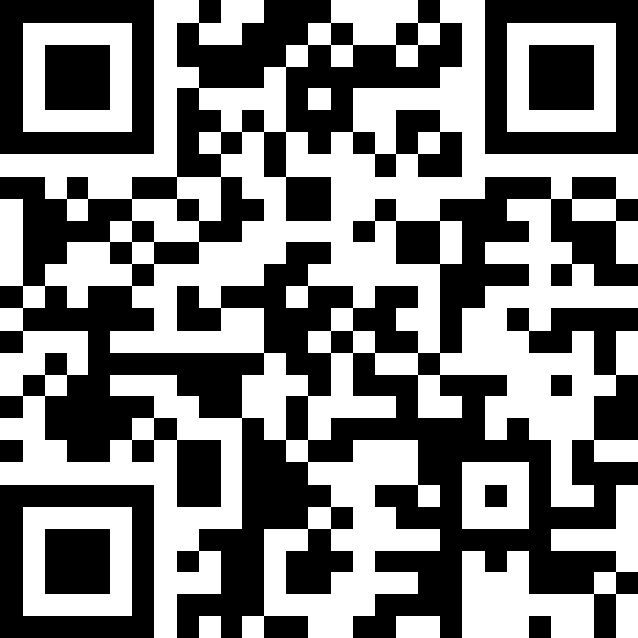
File I/O – Token and line-based processing
BEFORE WE START
Talk to your neighbors:
Slido Poll: Apple pie or pumpkin pie?

Slide 2
Lecture Outline
Announcements/Reminders
Review Java
Scanners for User Input and Files
  Token-based & Line-based processing
File I/O Examples

Slide 3
Announcements
The IPL is open!
  MGH 334, Schedule is on the course website; staffed by our awesome TAs!
  Open 12:30 to 9:30pm most days, but check the schedule…
Creative Project 0 due Thursday, October 2nd at 11:59pm PT
  Make sure to complete the “Final Submission” slide and submit!
  Submit as many times as you’d like—we will only grade the latest submission made before the deadline
Just joined CSE 122? That’s okay; look at Ed & course website and catch up!
  Freaking out that C0 is due tomorrow? It’s ok! Resubmission cycles allow you to submit it later.
Go to your designated quiz sections!
Quiz dates:
Quiz 0: October 14th Quiz 1: November 4th Quiz 2: November 20th

Slide 4
Lecture Outline
Announcements/Reminders
Review Java
Scanners for user input and Files
  Token-based & Line-based Processing
File I/O Examples

Slide 5
Reminders: Review Java Syntax
Java Tutorial reviews all the relevant programming features you should familiar with (even if you don’t know them in Java).
  Printing and comments
  Variables, types, expressions
  Conditionals (if/else if/ else)
  Loops (for and while)
  Strings
  Methods
  Arrays & 2D arrays
Recordings of both sessions are now available on the course website in the course calendar!

Slide 6
Lecture Outline
Announcements/Reminders
Review Java
Scanner for User Input and Files
  Token-based & Line-based Processing
File I/O Examples

Slide 7
(Review) Scanner for User input
Scanner is defined in the java.util package
import java.util.*;
Scanner console = new Scanner(System.in);
Scanner Methods | Description
nextInt() | Reads the next token from the user as an int and returns it
nextDouble() | Reads the next token from the user as a double and returns it
next() | Reads the next token from the user as a String and returns it
nextLine() | Reads an entire line from the user as a String and returns it
hasNextInt() | Returns true if the next token can be read as an int, false otherwise
hasNextDouble() | Returns true if the next token can be read as a double, false otherwise
hasNext() | Returns true if there is another token of input to be read in, false otherwise
hasNextLine() | Returns true if there is another line of input to be read in, false otherwise

Slide 8

(PCM) Token vs. Line-based Scanning
The quick, brown fox
Jumped over the
Lazy dog.
Token are units of input (as defined by the Scanner) that are separated by whitespace (spaces, tabs, new lines)

Slide 9
(PCM) Token vs. Line-based Scanning
The quick, brown fox
Jumped over the
Lazy dog.
The

Slide 10
(PCM) Token vs. Line-based Scanning
The quick, brown fox
Jumped over the
Lazy dog.
quick,

Slide 11
(PCM) Token vs. Line-based Scanning
The quick, brown fox
Jumped over the
Lazy dog.
brown

Slide 12
(PCM) Token vs. Line-based Scanning
The quick, brown fox
Jumped over the
Lazy dog.
fox

Slide 13
(PCM) Token vs. Line-based Scanning
The quick, brown fox
Jumped over the
Lazy dog.
etc.

Slide 14
(PCM) Token vs. Line-based Scanning
The quick, brown fox
Jumped over the
Lazy dog.

Slide 15
(PCM) Token vs. Line-based Scanning
The quick, brown fox
Jumped over the
Lazy dog.
The quick, brown fox

Slide 16
How many tokens are in the following line?
“Hello world !” my-name is Elba
A) Four
B) Five
C) Six
D) Seven
Notes:
public class Temperatures {
public static void main(String[] args) {
int[] nums = {1, 4, 4, 8, 13};
int totalDiff = 0;
for (int i = 1; i <= nums.length-1; i++) {
totalDiff += (nums[i] - nums[i - 1]);
}
System.out.println("Total Diff = " + totalDiff);
}
}

Slide 17
How many tokens are in the following line?
“Hello world !” my-name is Elba
A) Four
B) Five
C) Six
D) Seven
Notes:
public class Temperatures {
public static void main(String[] args) {
int[] nums = {1, 4, 4, 8, 13};
int totalDiff = 0;
for (int i = 1; i <= nums.length-1; i++) {
totalDiff += (nums[i] - nums[i - 1]);
}
System.out.println("Total Diff = " + totalDiff);
}
}

Slide 18
(PCM) Scanner for File I/O
Scanner is defined in the java.util package
import java.util.*;
File file = new File("Example.txt");
Scanner fileScan = new Scanner(file);
File is defined in the java.io package
import java.io.*;
Scanner Methods | Description
nextInt() | Reads the next token from the user as an int and returns it
nextDouble() | Reads the next token from the user as a double and returns it
next() | Reads the next token from the user as a String and returns it
nextLine() | Reads an entire line from the user as a String and returns it
hasNextInt() | Returns true if the next token can be read as an int, false otherwise
hasNextDouble() | Returns true if the next token can be read as a double, false otherwise
hasNext() | Returns true if there is another token of input to be read in, false otherwise
hasNextLine() | Returns true if there is another line of input to be read in, false otherwise

Slide 19
(PCM) Checked Exceptions
If you try to compile a program working with file scanners, you may encounter this error message:
  error: unreported exception FileNotFoundException; must be caught or declared to be thrown
To resolve this, you need to be throws FileNotFoundException at the end of the header of any method containing file Scanner creation code, or any method that calls that method!
  This is like signing a waiver and telling Java – "Hey, I hereby promise to not get mad at you when you bug and crash my program if I give you a file that doesn't actually exist."

Slide 20
(PCM) Typical Line-Processing Pattern
while (scan.hasNextLine()) {
String nextLine = scan.nextLine();
// do something with nextLine
}

Slide 21
(PCM) Typical Token-Processing Pattern
while (scan.hasNext______()) {
_______ nextToken = scan.next_______();
// do something with nextToken
}

Slide 22
What is the output of this Java program?
import java.util.*;
import java.io.*;
public class Demo {
public static void main(String[] args) throws
FileNotFoundException {
File f = new File("Example.txt");
Scanner fileScan = new Scanner(f);
while (fileScan.hasNextLine()) {
System.out.print(fileScan.nextLine() + ", ");
}
}
}
A) One, Two, Three,
B) One,
Two,
Three,
D) One Two, Three,
E) Error / Exception
C) One Two,
Three,
Example.txt:
One Two
Three
Notes:
public class Temperatures {
public static void main(String[] args) {
int[] nums = {1, 4, 4, 8, 13};
int totalDiff = 0;
for (int i = 1; i <= nums.length-1; i++) {
totalDiff += (nums[i] - nums[i - 1]);
}
System.out.println("Total Diff = " + totalDiff);
}
}

Slide 23
What is the output of this Java program?
import java.util.*;
import java.io.*;
public class Demo {
public static void main(String[] args) throws
FileNotFoundException {
File f = new File("Example.txt");
Scanner fileScan = new Scanner(f);
while (fileScan.hasNextLine()) {
System.out.print(fileScan.nextLine() + ", ");
}
}
}
A) One, Two, Three,
B) One,
Two,
Three,
D) One Two, Three,
E) Error / Exception
C) One Two,
Three,
Example.txt:
One Two
Three
Notes:
public class Temperatures {
public static void main(String[] args) {
int[] nums = {1, 4, 4, 8, 13};
int totalDiff = 0;
for (int i = 1; i <= nums.length-1; i++) {
totalDiff += (nums[i] - nums[i - 1]);
}
System.out.println("Total Diff = " + totalDiff);
}
}

Slide 24
Lecture Outline
Announcements/Reminders
Review Java
Scanner for User Input and Files
  Token-based & Line-based Processing
File I/O Examples

Slide 25
(Friday's PCM) Typical Hybrid Pattern
while (fileScan.hasNextLine()) {
String line = fileScan.nextLine();
Scanner lineScan = new Scanner(line);
while (lineScan.hasNext__()) {
__ nextToken = lineScan.next__();
// do something with nextToken
}
}

