Slide 1

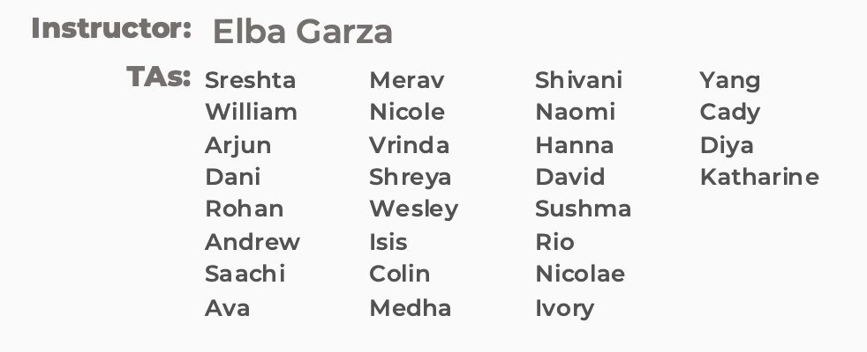
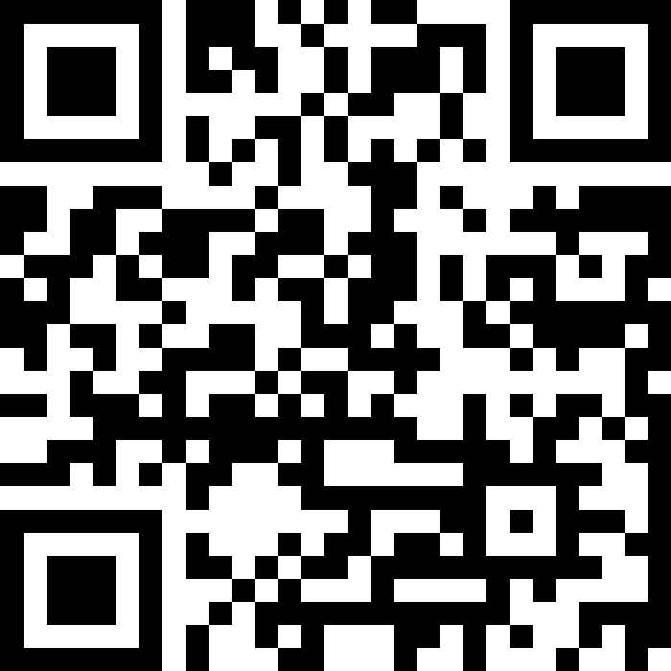
Interfaces
BEFORE WE START
Chat with neighbors:
What is your favorite
fast food chain?
LEC 14
Music: 122 25au Lecture Tunes
1 & Elba Garza2
#cse122b

Slide 2
Lecture Outline
Announcements
Interface Review
More Shapes!
Comparable

Slide 3
Announcements
Creative Project 2 (C2) due Thursday, November 13th
Resubmission Cycle 5 (R5) out Thursday, November 13th
  - Eligible: P1, P2
Programming Assignment 3 (P3) out Friday!
  Due November 20th by 11:59 PM
Quiz 2 Thursday, November 20th
  Practice Quiz coming out before then!
Reminder on Final Exam: Monday, December 8th 12:30 PM - 2:20 PM

Slide 4
Lecture Outline
Announcements
Interfaces Review
More Shapes!
Comparable

Slide 5
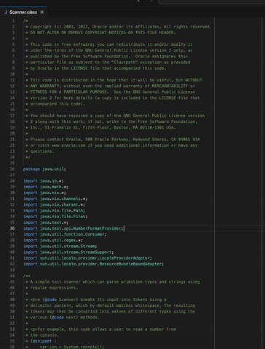
Recall: Abstraction
A Scanner gets text input and turns it into data.
VS

Slide 6
Recall from L6: Wait, ADT? Interfaces?
Abstract Data Type (ADT): A description of the idea of a data structure including what operations are available on it and how those operations should behave. For example, the English explanation of what a list should be.
Interface: Java construct that lets programmers specify what methods a class should have. For example the List interface in java.
Implementation: Concrete code that meets the specified interface. For example, the ArrayList and LinkedList classes that implement the List interface.
List<String> myList = new ArrayList<>();

Slide 7
Interfaces
Interfaces serve as a sort of “contract”– in order for a class to implement an interface, it must fulfill the contract requirements.
The contract requirements are certain methods that the class must implement.

Slide 8
Lists
One ADT we’ve talked a lot about in this course is a list.
Within Java, there exists a List interface – its contract includes methods like:
add, clear, contains, get, isEmpty, size
There’s also an ArrayList class (implementation)
To get the certificate, it must include all these
methods (and any others the List interface specifies)

Slide 9
Interfaces vs. Implementation
Interfaces require certain methods, but they do not say anything about how those methods should be implemented – that’s up to the class! 🏅
List is an interface
  ArrayList is a class that implements the List interface
  LinkedList is a class that implements the List interface
  …

Slide 10
Why interfaces?
public static void fill(WaterBottle w) {…}
This method only accepts a WaterBottle!

Slide 11
Why interfaces?
Flexibility
public static void fill(Container c) {…}
This method can accept either a:
WaterBottle
Brita
Tub or
Any other class that implements Container!

Slide 12
Why interfaces?
Flexibility
public static void method(Set<String> s) {…}
This method can accept either a:
HashSet<String> or
TreeSet<String> or
Any other class that implements Set and whose element type is String!

Slide 13


Why interfaces?
Abstraction
Interfaces also support abstraction
  (the separation of ideas from details)

Slide 14
Lecture Outline
Announcements
Interfaces Review
More Shapes!
Comparable

Slide 15
Classes can Implement Multiple Interfaces
A class can implement multiple interfaces – it’s like one person signing multiple contracts!
If a class implements an interface A and an interface B, it’ll just have to include all of A’s required methods along with all of B’s required methods

Slide 16
Classes can Implement Multiple Interfaces
public interface UWMerch {
public String getTypeOfMerch();
}
public class WaterBottle implements Container, UWMerch {
...
public String getTypeOfMerch() {
return “bottle”;
}
}
But WaterBottle would have to implement:
fill from Container AND getTypeOfMerch from UWMerch

Slide 17
An interface can extend another
You can have one interface extend another
So if public interface A extends B, then any class that implements A must include all the methods in A’s interface and all the methods in B’s interface

Slide 18
An interface can extend another
We can write another interface:
Polygon that extends Shape
“Polygon is a Shape”
Make modifications such that:
- Square is a Polygon (and Shape)
Triangle is a Polygon (and Shape)
Circle is a Shape (but not a Polygon)

Slide 19
Lecture Outline
Announcements
Interfaces Review
More Shapes!
Comparable

Slide 20
Recall the Student / Course Example from Wed
Course stored a field
private List<Student> roster;
Why not use a Set to store the students?…
Seems like a great idea (no duplicates, not worried about keeping a specific order or indexing into it) but … Java reasons:
  HashSet won’t work because of lack of hashCode() implementation
  TreeSet won’t work because… what does it mean to “sort” Students?

Slide 21
Comparable
TreeSet uses an interface called Comparable<E> to know how to sort its elements!
Only has one required method:
  public int compareTo(E other)
Its return value is:
  < 0 if this is “less than” other
  0 if this is equal to other
  > 0 if this is “greater than” other

