Slide 1

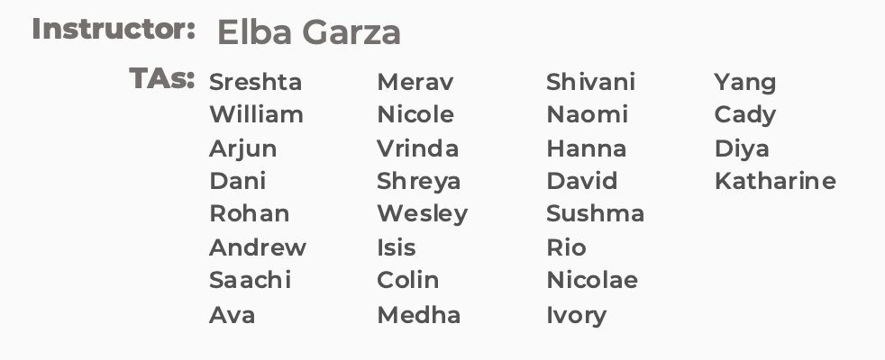
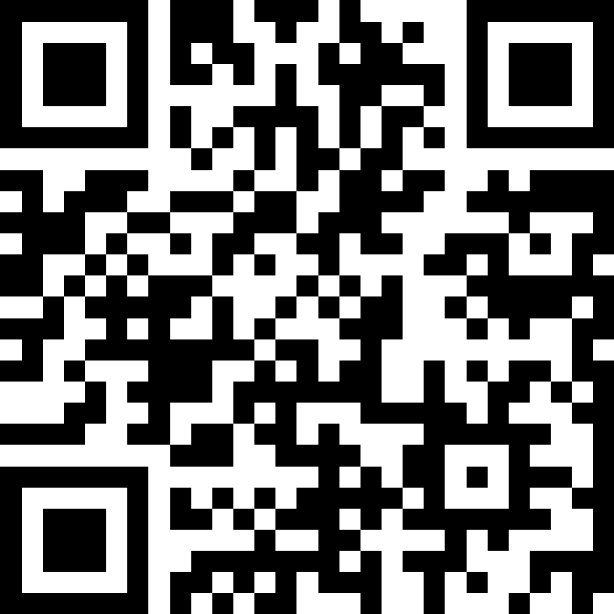
Interfaces
BEFORE WE START
Chat with neighbors:
If you could be an inanimate object, which one would you be and why?
LEC 14
Music: 122 25au Lecture Tunes
Katharine
a

Slide 2
Lecture Outline
Announcements
Interface Review
More Shapes!
Comparable

Slide 3
Announcements
Creative Project 2 (C2) due Thursday, November 13th
Resubmission Cycle 5 (R5) out Thursday, November 13th
- Eligible: P1, P2
Programming Assignment 3 (P3) out Friday!
Due November 20th by 11:59 PM
Quiz 2 Thursday, November 20th
Practice Quiz coming out before then!
Reminder on Final Exam: Monday, December 8th 12:30 PM - 2:20 PM

Slide 4
Lecture Outline
Announcements
Interfaces Review
More Shapes!
Comparable

Slide 5
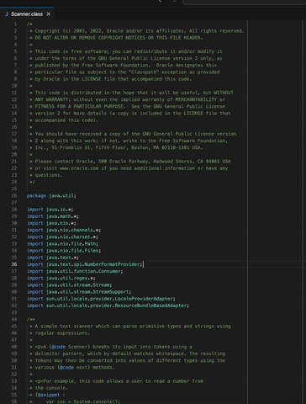
Recall: Abstraction
A Scanner gets text input and turns it into data.
VS
Notes:
Abstraction: the process of simplifying complex stuff by removing unnecessary details and focusing on essentials. AKA. a summary
We’ve seen this in:
our comments where we want to avoid implementation details in the behavior and class comment!
Making classes of reusable functionalities and “things” (objects). Ex: Scanners
ADTs

Slide 6
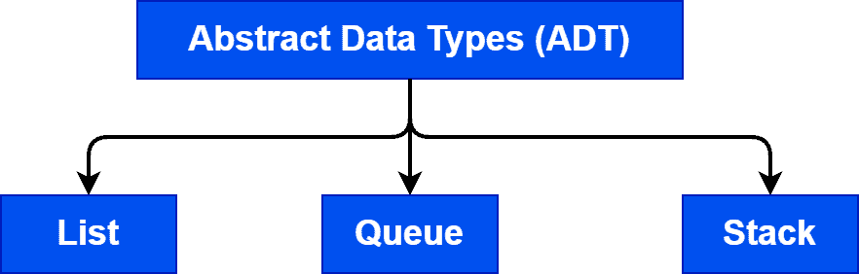
Remember ADTs?

Slide 7
Recall from L6: Wait, ADT? Interfaces?
Abstract Data Type (ADT): A description of the idea of a data structure including what operations are available on it and how those operations should behave. For example, the English explanation of what a list should be.
Interface: Java construct that lets programmers specify what methods a class should have. For example the List interface in java.
Implementation: Concrete code that meets the specified interface. For example, the ArrayList and LinkedList classes that implement the List interface.
List<String> myList = new ArrayList<>();

Slide 8
Interfaces
Interfaces serve as a sort of “contract”– in order for a class to implement an interface, it must fulfill the contract requirements.
The contract requirements are certain methods that the class must implement.

Slide 9
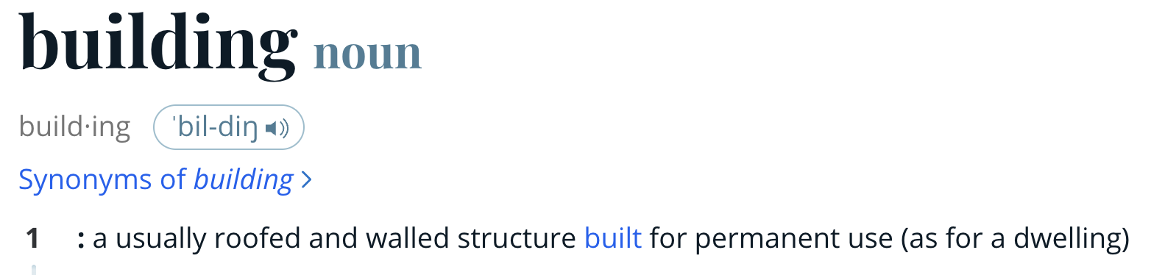


Our “ADT”
Our “Interface”
Our “Implementation”

Slide 10
Lists
One ADT we’ve talked a lot about in this course is a list.
Within Java, there exists a List interface – its contract includes methods like:
add, clear, contains, get, isEmpty, size
There’s also an ArrayList class (implementation)
To get the certificate, it must include all these
methods (and any others the List interface specifies)

Slide 11
Interfaces vs. Implementation
Interfaces require certain methods, but they do not say anything about how those methods should be implemented – that’s up to the class! 🏅

Slide 12
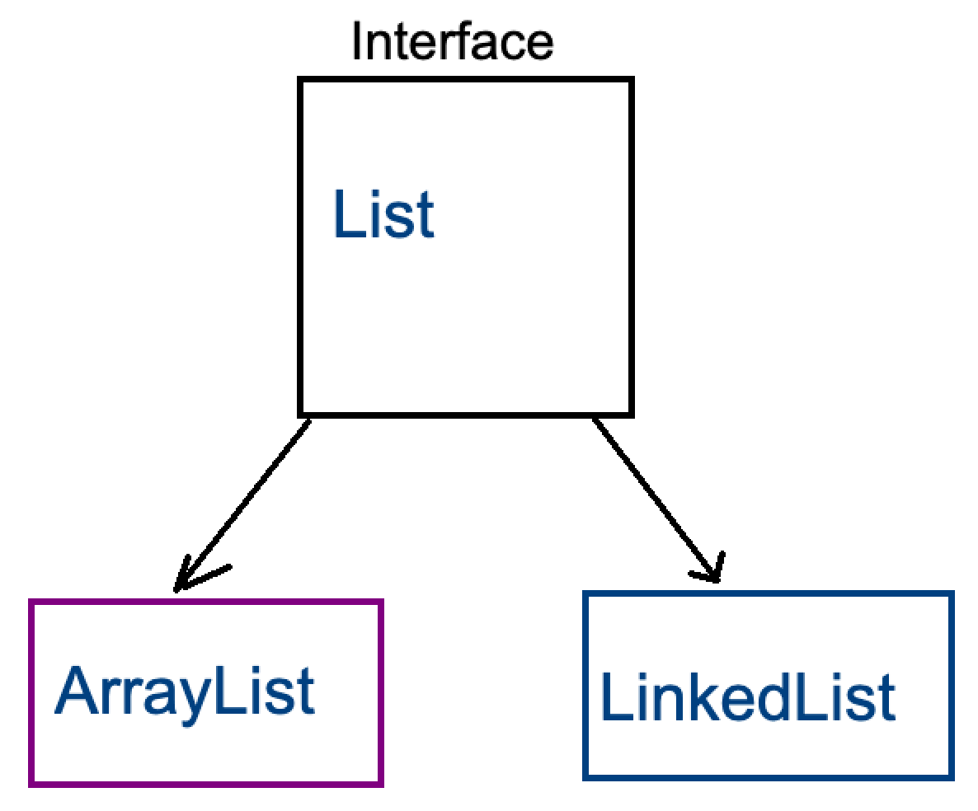
Interfaces vs. Implementation
List is an interface
ArrayList is a class that implements the List interface
LinkedList is a class that implements the List interface
…

Slide 13
Why interfaces?
public static void fill(WaterBottle w) {…}
This method only accepts a WaterBottle!

Slide 14
Why interfaces?
Flexibility
public static void fill(Container c) {…}
This method can accept either a:
WaterBottle
Brita
Tub or
Any other class that implements Container!

Slide 15
Why interfaces?
Flexibility
public static void method(Set<String> s) {…}
This method can accept either a:
HashSet<String> or
TreeSet<String> or
Any other class that implements Set and whose element type is String!

Slide 16


Why interfaces?
Abstraction
Interfaces also support abstraction
(the separation of ideas from details)
Notes:
referring back to the idea of Abstraction…
We talked a lot about interfaces, how they bridge the ADT and implementation, and ADT’s are a form of abstraction… So are interfaces! They are just another level of abstraction!

Slide 17
Lecture Outline
Announcements
Interfaces Review
More Shapes!
Comparable
Ed lesson link
Notes:
Head to Ed.

Slide 18
Classes can Implement Multiple Interfaces
A class can implement multiple interfaces – it’s like one person signing multiple contracts!
If a class implements an interface A and an interface B, it’ll just have to include all of A’s required methods along with all of B’s required methods

Slide 19
Classes can Implement Multiple Interfaces
public interface UWMerch {
public String getMaterial();
}
public class WaterBottle implements Container, UWMerch {
...
public String getMaterial() {
return this.material;
}
}
But WaterBottle would have to implement:
fill from Container AND getMaterial from UWMerch

Slide 20
An interface can extend another
You can have one interface extend another
So if public interface A extends B, then any class that implements A must include all the methods in A’s interface and all the methods in B’s interface

Slide 21
An interface can extend another
We can write another interface: Polygon that extends Shape
“Polygon is a Shape”
Make modifications such that:
- Square is a Polygon (and Shape)
Triangle is a Polygon (and Shape)
Circle is a Shape (but not a Polygon)
SHAPE
POLYGON
Tri
angle
Square

Slide 22
Lecture Outline
Announcements
Interfaces Review
More Shapes!
Comparable

Slide 23
Recall the Student / Course Example from Wed
Course stored a field
private List<Student> roster;
Why not use a Set to store the students?…
Seems like a great idea (no duplicates, not worried about keeping a specific order or indexing into it) but … Java reasons:
HashSet won’t work because of lack of hashCode() implementation
TreeSet won’t work because… what does it mean to “sort” Students?

Slide 24
Comparable
TreeSet uses an interface called Comparable<E> to know how to sort its elements!
Only has one required method:
public int compareTo(E other)
Its return value is:
< 0 if this is “less than” other
0 if this is equal to other
> 0 if this is “greater than” other

