Slide 1

Encapsulation, Constructors, More Instance Methods
BEFORE WE START
Slido vote & chat with neighbors:
What is your favorite Ed announcement pet photo?

Slide 2
Lecture Outline
Announcements
Warm Up
More Instance Methods
Encapsulation
Constructors

Slide 3
Announcements
Creative Project 2 will be released later today!
Focused on OOP
You have a week and a half—.peek() at it early!
Resubmission Cycle 4 (R4) out soon!
C1, P1, P2 eligible for resub
Quiz 1 was yesterday; grades will be released just before Quiz 2!

Slide 4
Lecture Outline
Announcements
Warm Up
More Instance Methods
Encapsulation
Constructors

Slide 5
What do p and p2 hold after the following code is executed?
p: (3, 10) p2: (3, 10)
p: (3, -99) p2: (3, 100)
p: (0, -99) p2: (3, 100)
p: (3, -99) p2: (0, 100)
p: (0, -99) p2: (3, 10)
Point p = new Point();
p.x = 3;
p.y = 10;
Point p2 = p;
p2.y = 100;
p = new Point();
p.y = -99;

Slide 6

What do p and p2 hold after the following code is executed?
p: (3, 10) p2: (3, 10)
p: (3, -99) p2: (3, 100)
p: (0, -99) p2: (3, 100)
p: (3, -99) p2: (0, 100)
p: (0, -99) p2: (3, 10)
Point p = new Point();
p.x = 3;
p.y = 10;
Point p2 = p;
p2.y = 100;
p = new Point();
p.y = -99;

Slide 7
What do p and p2 hold after the following code is executed?
p: (3, 10) p2: (3, 10)
p: (3, -99) p2: (3, 100)
p: (0, -99) p2: (3, 100)
p: (3, -99) p2: (0, 100)
p: (0, -99) p2: (3, 10)
Point p = new Point();
p.x = 3;
p.y = 10;
Point p2 = p;
p2.y = 100;
p = new Point();
p.y =-99;
0, -99
3, 100
0, 0
3, 0
3, 10
p2:
p
p:
0, 0
old p i.e. (3, 100)

Slide 8
Lecture Outline
Announcements
Warm Up
More Instance Methods
Encapsulation
Constructors

Slide 9
Abstraction
The separation of ideas from details, meaning that we can use something without knowing exactly how it works.
You were able use the Scanner class without understanding how it works internally!

Slide 10
Client v. Implementor
We have been the clients of many objects this quarter!
Now we will become the implementors of our own objects!

Slide 11
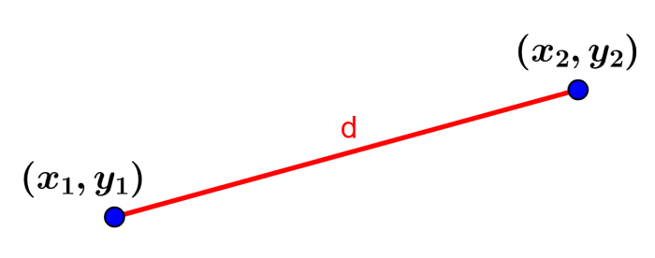
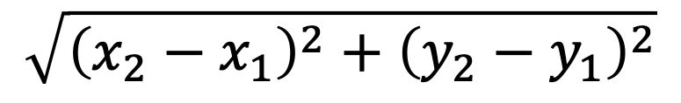
What is the correct implementation of the distanceFrom instance method?
$$\sqrt{{\left(x_{2}−x_{1}\right)}^{2}+{\left(y_{2}−y_{1}\right)}^{2}}$$
(A)
(B)
public double distanceFrom() {
double xTerm = Math.pow(x - x, 2);
double yTerm = Math.pow(y - y, 2);
return Math.sqrt(xTerm + yTerm);
}
public static double distanceFrom(Point otherPoint) {
double xTerm = Math.pow(otherPoint.x - x, 2);
double yTerm = Math.pow(otherPoint.y - y, 2);
return Math.sqrt(xTerm + yTerm);
}
(C)
(D)
public double distanceFrom(Point otherPoint) {
double xTerm = Math.pow(otherPoint.x - x, 2);
double yTerm = Math.pow(otherPoint.y - y, 2);
return Math.sqrt(xTerm + yTerm);
}
public double distanceFrom(int otherX, int otherY) {
double xTerm = Math.pow(otherX - x, 2);
double yTerm = Math.pow(otherY - y, 2);
return Math.sqrt(xTerm + yTerm);
}

Slide 12
What is the correct implementation of the distanceFrom instance method?
$$\sqrt{{\left(x_{2}−x_{1}\right)}^{2}+{\left(y_{2}−y_{1}\right)}^{2}}$$
(A)
(B)
public double distanceFrom() {
double xTerm = Math.pow(x - x, 2);
double yTerm = Math.pow(y - y, 2);
return Math.sqrt(xTerm + yTerm);
}
public static double distanceFrom(Point otherPoint) {
double xTerm = Math.pow(otherPoint.x - x, 2);
double yTerm = Math.pow(otherPoint.y - y, 2);
return Math.sqrt(xTerm + yTerm);
}
(C)
(D)
public double distanceFrom(Point otherPoint) {
double xTerm = Math.pow(otherPoint.x - x, 2);
double yTerm = Math.pow(otherPoint.y - y, 2);
return Math.sqrt(xTerm + yTerm);
}
public double distanceFrom(int otherX, int otherY) {
double xTerm = Math.pow(otherX - x, 2);
double yTerm = Math.pow(otherY - y, 2);
return Math.sqrt(xTerm + yTerm);
}

Slide 13
toString
public String toString() {
return "String representation of object";
}
The toString() method is automatically called whenever an object is treated like a String!

Slide 14
toString
public String toString() {
return "String representation of object";
}
The toString() method is automatically called whenever an object is treated like a String!
Wait: Why not write a print() method that prints out the String representation to the console? All toString() does is return a String!

Slide 15
Lecture Outline
Announcements
Warm Up
More Instance Methods
Encapsulation
Constructors

Slide 16
Encapsulation
Objects encapsulate state and expose behavior.
Encapsulation is hiding implementation details of an object from its clients. (Clients = chaos, y’all.)
Encapsulation provides abstraction.

Slide 17
private
The private keyword is an access modifier (like public)
Fields declared private cannot be accessed by any code outside of the class.
We always want to encapsulate our objects’ fields by declaring them private.

Slide 18
Accessors and Mutators
Declaring fields as private removes all access from the user.
If we want to give some back, we can define instance methods.
Accessors (“getters”) | Mutators (“setters”)
getX() | setX(int newX)
getY() | setY(int newY)
 | setLocation(int newX, int newY)

Slide 19
Encapsulation
Objects encapsulate state and expose behavior.
Encapsulation is hiding implementation details of an object from its clients.
Encapsulation provides abstraction.
Encapsulation also gives the implementor flexibility!

Slide 20
Encapsulation
While users can still access and modify our Point’s fields with the instance methods we defined, we have control of how they do so.
Example: Can only accept positive coordinate values
Another Example: Can swap out our underlying implementation to use polar coordinates instead!

Slide 21
Lecture Outline
Announcements
Warm Up
More Instance Methods
Encapsulation
Constructors

Slide 22
Constructors
Constructors are called when we first create a new instance of a class.
Point p = new Point();
If we don’t write any constructors, Java provides one that takes no parameters and just sets each field to its default value.

Slide 23
Constructor Syntax
public Point(int initialX, int initialY) {
x = initialX;
y = initialY;
}

Slide 24
this keyword
The this keyword refers to the current object in a method or constructor.
You can use it to refer to an object’s fields
this.x, this.y
You can use it to refer to an object’s instance methods
this.setX(newX)

Slide 25
Constructor Syntax
public Point(int initialX, int initialY) {
x = initialX;
y = initialY;
}
If we write any constructors, Java no longer provides one for us.

Slide 26
this keyword
The this keyword refers to the current object in a method or constructor.
You can use it to refer to an object’s fields
this.x, this.y
You can use it to refer to an object’s instance methods
this.setX(newX)
You can use it to call one constructor from another
this(0, 0)

