Slide 1
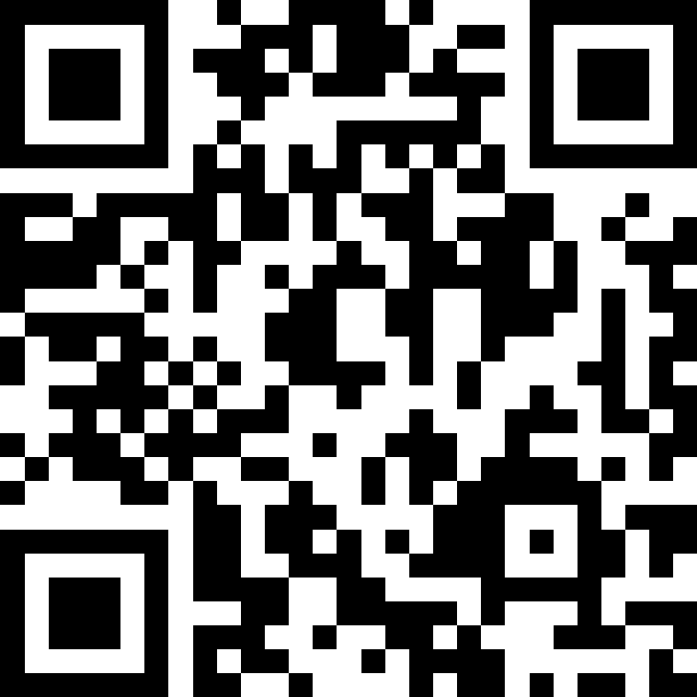
Introduction to Objects
BEFORE WE START
Slido vote & chat with your neighbors:
What are your favorite places to study on/near campus?

Slide 2
Lecture Outline
Announcements
OOP Review
Example
Abstraction

Slide 3
Announcements
Programming Assignment 2 (P2) out
Due Tuesday, Nov 4th by 11:59pm PT
Quiz 1 on Tuesday, Nov 4th in your registered quiz section
Practice quiz out tonight—Solutions Sunday!
Resubmission Cycle 3 (R3) out
Due Tuesday, Nov 4th by 11:59pm PT
Eligible assignments: P0, C1, P1

Slide 4
Mid-Quarter Evaluation
Sustain:
Pre-class work
Lectures
Section
IPL
Improve:
More practice quizzes!
Showing more code quality... in class!
Gradebook please!

Slide 5
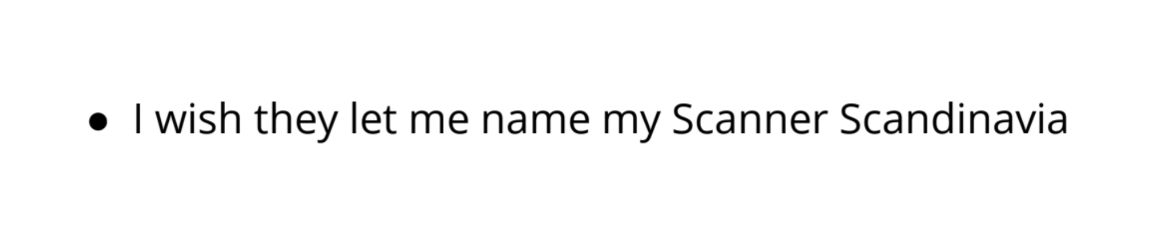
Mid-Quarter Evaluation

Slide 6
Lecture Outline
Announcements
OOP Review
Example
Abstraction

Slide 7
Object Oriented Programming (OOP)
Procedural programming: Programs that perform their behavior as a series of steps to be carried out
Classes that do things
Object-oriented programming (OOP): Programs that perform their behavior as interactions between objects
Classes that represent things
We’re going to start writing our own objects!

Slide 8
Classes & Objects
Classes can define the template for an object
📰 Like the blueprint for a house!
“What does it mean to be this thing?”
Objects are the actual instances of the class
🏠 Like the actual house built from the blueprint!
“It is an example of this thing!”
We create a new instance of a class with the new keyword
e.g., Scanner console = new Scanner(System.in);

Slide 9
State & Behavior
Objects can tie related state and behavior together
State is defined by the object’s fields or instance variables
Scanner’s state may include what it’s scanning, where it is in the input, etc.
Behavior is defined by the object’s instance methods
Scanner’s behavior includes “getting the next token and returning it as an int”, “returning whether there is a next token or not”, etc.

Slide 10
Syntax
public class MyObject {
// fields (or instance variables)
type1 fieldName1;
type2 fieldName2;
...
// instance methods
public returnType methodName(...) {
...
}
}

Slide 11
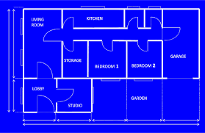






Instance Variables
Fields are also referred to as instance variables
Fields are defined in a class
Each instance of the class has their own copy of the fields
Hence instance variable! It’s a variable tied to a specific instance of the class!

Slide 12






Instance Methods
Instance methods are defined in a class
Calling an instance method on a particular instance of the class will have effects only on that instance

Slide 13
Lecture Outline
Announcements
OOP Review
Example
Abstraction

Slide 14
Representing a Coordinate Point
How would we do this given what we knew last week?
Maybe int x, int y?
Maybe int[]?

Slide 15
Representing a point
int x, int y
Easy to mix up x, y
Just two random ints floating around – easy to make mistakes!
int[]
Not really what an array is for
Again, just two ints – just have to “trust” that we’ll remember to treat it like a point
Let’s make a class instead!

Slide 16
Instance Methods
Instance methods are defined in a class
Calling an instance method on a particular instance of the class will have effects on that instance

Slide 17
Instance Methods
Instance methods are defined in a class
Calling an instance method on a particular instance of the class will have effects only on that instance

Slide 18
Lecture Outline
Announcements
OOP Review
Example
Abstraction

Slide 19
Abstraction
The separation of ideas from details, meaning that we can use something without knowing exactly how it works.
You were able use the Scanner class without understanding how it works internally!

Slide 20
Client v. Implementor
We have been the clients of many objects this quarter!
Now we will become the implementors of our own objects!

