Slide 1

Nested Collections
Slido vote & chat with neighbors:
What are you doing for Halloween?

Slide 2
Agenda
Announcements
Review: mostFrequentStart
Recap: Nested Collections
Practice: Social Network

Slide 3
Announcements
Programming Assignment 2 (P2) was released on Friday!
Seriously, start early! This assignment is much more involved…
Due Nov 4th by 11:59 PM
Quiz 1 on Nov 4th in your registered Quiz Section
Topics: (Reference Semantics), Stacks and Queues, Sets, Maps
Practice Quiz 1 available Friday; solutions on Sunday
Quiz 0 grades to be released this weekend!
Tomorrow, Resubmission Cycle 3 (R3) form out, due Nov 4th by 11:59 PM
Available assignments: P0, C1, P1
Reminder: to use a resubmission cycle you need to
(1) submit your work (big blue "Submit" button on Ed)
AND (2) fill out the resubmission form (linked from Ed + course calendar)

Slide 4
Mid-Quarter Evaluation
Feedback coming soon. Meeting with ET&L tomorrow!

Slide 5
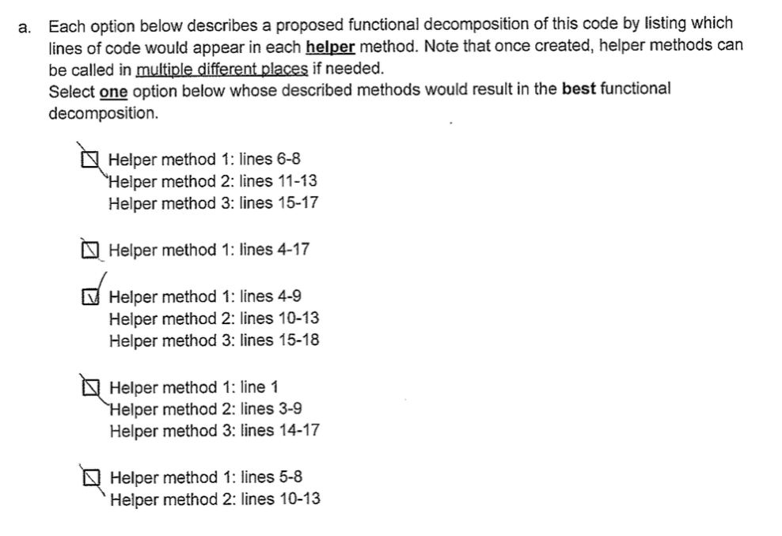
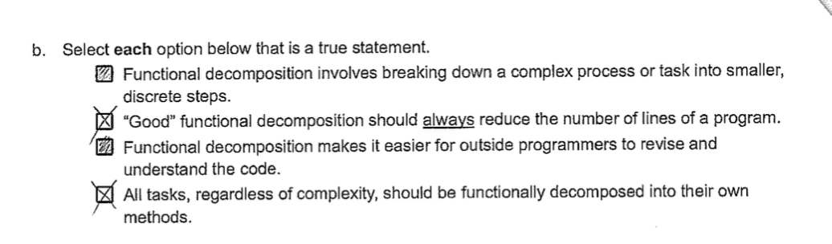
An aside for quizzes…
Please be legible and clear on your written answers 🥴

Slide 6
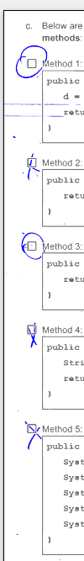
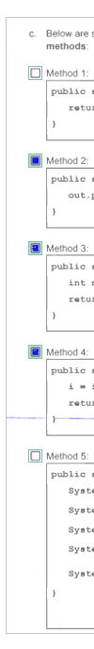
An aside for quizzes…
Please be legible and clear on your written answers 🥴

Slide 7
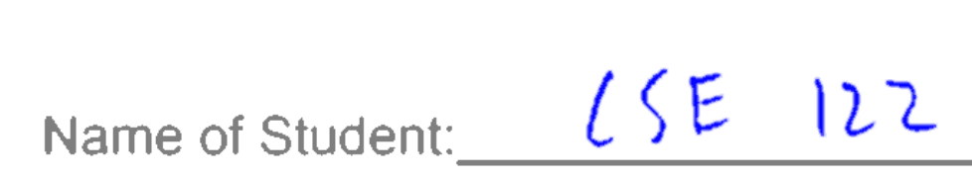

An aside for quizzes…
Please write your name legibly!

Slide 8
Agenda
Announcements
Review: mostFrequentStart
Recap: Nested Collections
Practice: Social Network

Slide 9
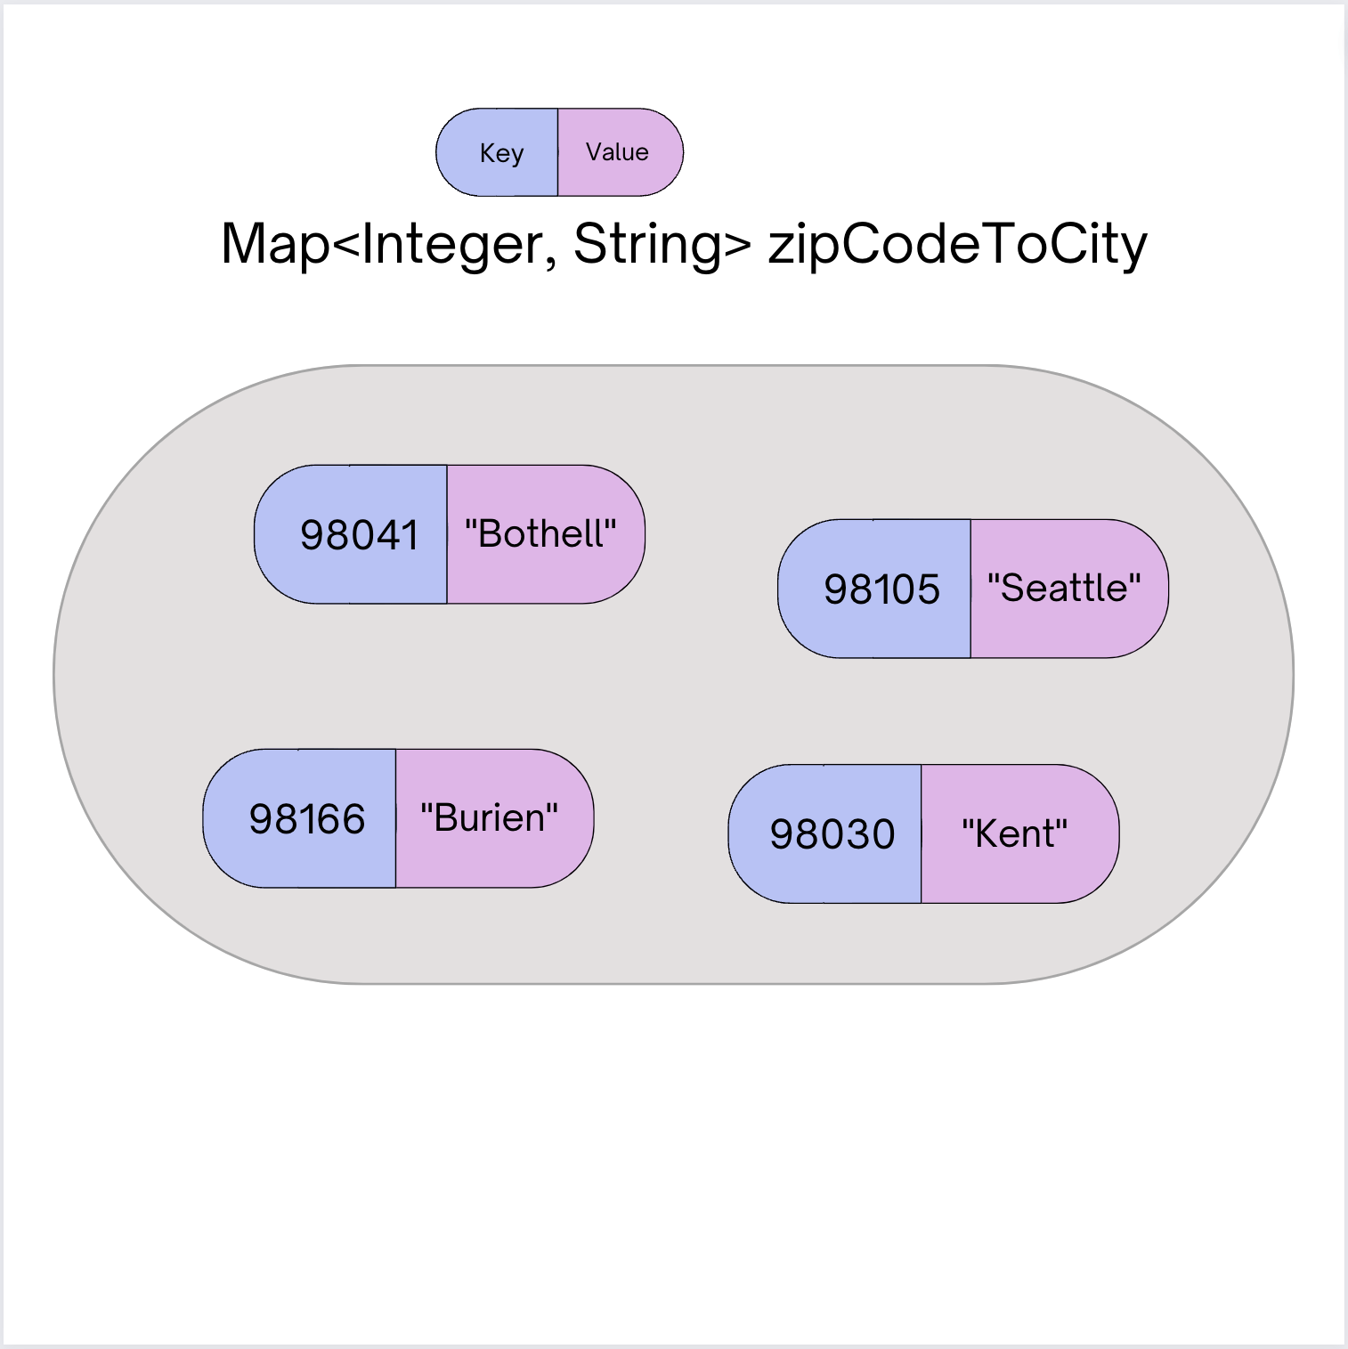
Map ADT
Data structure to map keys to values
Keys can be any* type; Keys must be unique
Values can be any type
Example: Mapping ticker to stock price in P0
Operations
put(key, value): Associate key to value
Overwrites duplicate keys
get(key): Get value for key
remove(key): Remove key/value pair
Same as Python’s dict

Slide 10
mostFrequentStart
Write a method called mostFrequentStart that takes a Set of words and does the following steps:
Organizes words into “word families” based on which letter they start with
Selects the largest “word family” as defined as the family with the most words in it
Returns the starting letter of the largest word family (and should update the Set of words to only have words from the selected family).

Slide 11
mostFrequentStart
For example, if the Set words stored the values:
["hello", "goodbye", "library", "literary", "little", "repel"]
The word families produced would be:
'h' -> 1 word ("hello")
'g' -> 1 word ("goodbye")
'l' -> 3 words ("library", "literary", "little")
'r' -> 1 word ("repel")
Since 'l' has the largest word family, we modify the Set to only contain Strings starting with 'l' and finally return 'l'.

Slide 12
Agenda
Announcements
Review: mostFrequentStart
Recap: Nested Collections
Practice: Social Network

Slide 13
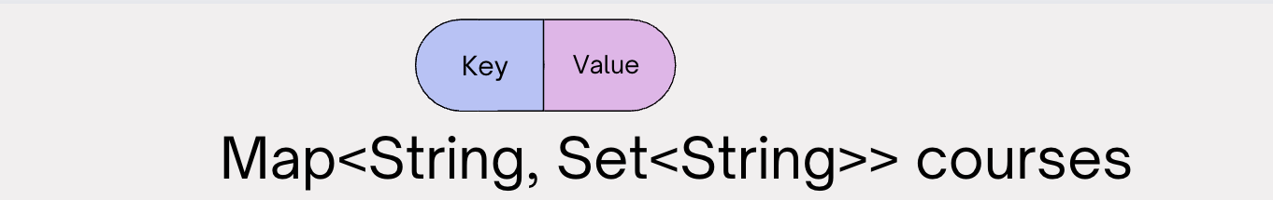
Nested Collections
The values inside a Map can be any type, including data structures
Common examples:
Mapping: Section ➔ Set of students in that section
Mapping: Recipe ➔ Set of ingredients in that recipe (Or even Map<String, Map<String, Double>> for units!)
["Brett", "James"]
["Miya"]
“CSE 121”
“CSE 390HB”
“CSE 122”
“CSE 197”
["Adrian","Matt"]
["Elba"]

Slide 14
Updating Nested Collections
The “value” inside the Map is a reference to the data structure!
Think carefully about number of references to a particular object
["Brett", "James"]
["Miya"]
cse123
“CSE 123”
“CSE 121”
“CSE 390HB”
[ ]
["James"]
["James","Gigi"]
courses.put("CSE 123", new HashSet<String>()); courses.get("CSE 123").add("James"); Set<String> cse123 = courses.get("CSE 123"); cse123.add("Gigi");
“CSE 122”
“CSE 197”
["Adrian","Matt"]
["Elba"]

Slide 15
Suppose map had the following items. What would its items be after running this code?
map: {"KeyA"=[1, 2], "KeyB"=[3], "KeyC"=[4, 5, 6]}
Set<Integer> nums = map.get("KeyA"); nums.add(7); map.put("KeyB", nums); map.get("KeyA").add(8); map.get("KeyB").add(9);
{"KeyA"=[1, 2], "KeyB"=[1, 2, 7], "KeyC"=[4, 5, 6]}
{"KeyA"=[1, 2, 8], "KeyB"=[1, 2, 7, 9], "KeyC"=[4, 5, 6]}
{"KeyA"=[1, 2, 7, 8], "KeyB"=[1, 2, 7, 9], "KeyC"=[4, 5, 6]}
{"KeyA"=[1, 2, 7, 8, 9], "KeyB"=[1, 2, 7, 8, 9], "KeyC"=[4, 5, 6]}

Slide 16
Suppose map had the following items. What would its items be after running this code?
nums
map: {”KeyA"=[1, 2], ”KeyB"=[3], ”KeyC"=[4, 5, 6]}
[1, 2]
[1, 2, 7, 8]
KeyA:
[1, 2, 7]
Set<Integer> nums = map.get("KeyA"); nums.add(7); map.put("KeyB", nums); map.get("KeyA").add(8); map.get("KeyB").add(9);
[1, 2, 7, 8, 9]
KeyB:
[3]
KeyC:
[4, 5, 6]
{"KeyA"=[1, 2], "KeyB"=[1, 2, 7], "KeyC"=[4, 5, 6]}
{"KeyA"=[1, 2, 8], "KeyB"=[1, 2, 7, 9], "KeyC"=[4, 5, 6]}
{"KeyA"=[1, 2, 7, 8], "KeyB"=[1, 2, 7, 9], "KeyC"=[4, 5, 6]}
{"KeyA"=[1, 2, 7, 8, 9], "KeyB"=[1, 2, 7, 8, 9], "KeyC"=[4, 5, 6]}

Slide 17
Agenda
Announcements
Review: mostFrequentStart
Recap: Nested Collections
Practice: Social Network

Slide 18
Background: Search Engines
A search engine receives a query and returns a set of relevant documents. Examples: Google.com, Mac Finder, more.
Queries often can have more
A search engine involves two main components
An index to efficiently find the set of documents for a query
Will focus on “single word queries” for today’s example
A ranking algorithm to order the documents from most to least relevant
Not the focus of this example
Goal: Precompute a data structure that helps find the relevant documents for a given query

Slide 19
Inverted Index
An inverted index is a Mapping from possible query words to the set of documents that contain that word
Answers the question: “What documents contain the word ‘burritos’?”
Inverted Index
Document 1
I
Document 1
Document 2
Document 3
I love tacos
love
Document 1
Document 2
Document 3
Document 2
I love burritos
tacos
Document 1
Document 3
burritos
Document 2
I love tlayudas
tlayudas
Document 3

Slide 20
Ranking Results
There is no one right way to define which documents are “most relevant” There are approximations, but make decisions about what relevance means
Idea 1: Documents that have more hits of the query should come first
Pro: Simple
Con: Favors longer documents (query: “the dogs” will favor long documents with lots of “the”s)
Idea 2: Weight query terms based on their “uniqueness”. Often use some sort of score for “Term Frequency – Inverse Document Frequency (TF-IDF)
Pro: Doesn’t put much weight on common words like “the”
Cons: Complex, many choices in how to compute that yield pretty different rankings
Idea 3: Much more! Most companies keep their ranking algorithms very very secret ☺

