Slide 1
JUnit Testing
BEFORE WE START
Talk to your neighbors:
What is your favorite thing to cook? If you don’t cook, what’s your favorite thing to eat :P
Music: 122 24wi Lecture Tunes ❄️

Slide 2
Lecture Outline
Announcements
Importance of Testing
JUnit
How Much Testing is Enough?
Example: Brainstorm Test Cases (Card & BattleManager)
Challenge: Floating Point Precision

Slide 3
Announcements
Quiz 2 tomorrow in quiz section (Thurs, Feb 29)
Review Quiz Logistics for rules and policies
Programming Assignment 3 (P3) due tomorrow (Thurs, Feb 29)
Creative Project 3 (C3) will be released Friday, Mar 1
Last assignment!
Final Exam: Wednesday, March 13th 12:30 – 2:20 PM
Left-handed seating request form on EdStem
Exam page posted with details (read through and bring questions on Friday)

Slide 4
Lecture Outline
Announcements
Importance of Testing
JUnit
How Much Testing is Enough?
Example: Brainstorm Test Cases (Card & BattleManager)
Challenge: Floating Point Precision

Slide 5
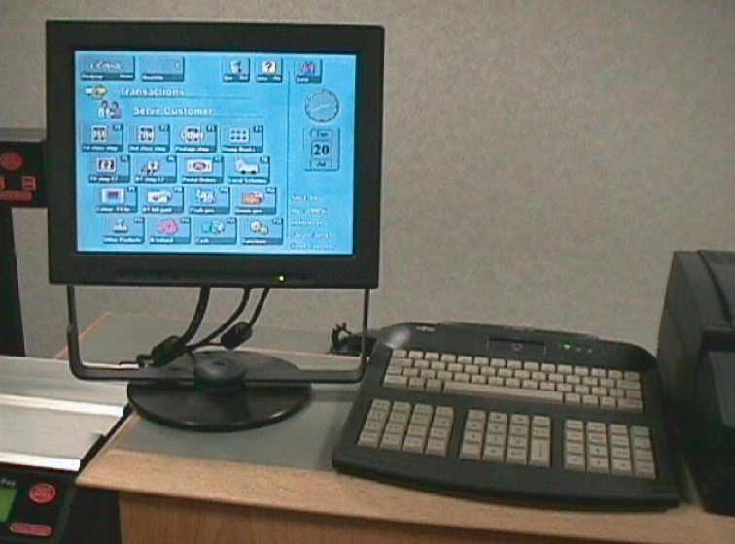
Importance of Testing
Software, written by people, controls more and more of our day-to-day lives.
Bugs (just like the ones we all write) are just as easy to write in this software.
Stakes can be quite high so bugs can have catastrophic effects
Source: Hackaday
The Horizon IT System for The UK Post Office Source: Fujitsu.com

Slide 6
Importance of Testing
“The Horizon scandal, described as ‘the most widespread miscarriage of justice in UK history’, resulted in more than 700 post office operators being prosecuted between 1999 and 2015 for theft, fraud and false accounting because of faulty accounting software installed in the late 1990s… Some spent time in prison, and the scandal has been linked to four suicides.”
Source: The Guardian

Slide 7
Bugs you’ve experienced
Can you think of a bug(s) you’ve experienced or heard of that have had serious effects?
If you can’t, can you think of any absurd bugs you’ve seen?

Slide 8
Lecture Outline
Announcements
Importance of Testing
JUnit
How Much Testing is Enough?
Example: Brainstorm Test Cases (Card & BattleManager)
Challenge: Floating Point Precision

Slide 9
JUnit Basics
import statements to give you access to JUnit method annotations and assertion methods!
Method Annotations
@Test
@DisplayName
…
Assertion Methods
assertEquals
assertTrue
assertFalse
…

Slide 10
JUnit Testing
import org.junit.jupiter.api.*;
import static org.junit.jupiter.api.Assertions.*;
import java.util.*; public class ArrayListTest { @Test public void testAddAndGet() { List<String> list = new ArrayList<>(); list.add("Joe Spaniac"); list.add("Miya Natsuhara"); list.add("CSE 122"); assertEquals("Joe Spaniac", list.get(0)); } }

Slide 11
JUnit Testing
import org.junit.jupiter.api.*;
import static org.junit.jupiter.api.Assertions.*;
import java.util.*; public class ArrayListTest { @Test public void testAddAndGet() { List<String> list = new ArrayList<>(); list.add("Joe Spaniac"); list.add("Miya Natsuhara"); list.add("CSE 122"); assertEquals("Joe Spaniac", list.get(0)); // TRUE!! } }

Slide 12
JUnit Testing
import org.junit.jupiter.api.*;
import static org.junit.jupiter.api.Assertions.*;
import java.util.*; public class ArrayListTest { @Test public void testAddAndGet() { List<String> list = new ArrayList<>(); list.add("Joe Spaniac"); list.add("Miya Natsuhara"); list.add("CSE 122"); assertEquals("Joe Spaniac", list.get(0)); assertEquals("Miya Natsuhara", list.get(2)); } }

Slide 13
JUnit Testing
import org.junit.jupiter.api.*;
import static org.junit.jupiter.api.Assertions.*;
import java.util.*; public class ArrayListTest { @Test public void testAddAndGet() { List<String> list = new ArrayList<>(); list.add("Joe Spaniac"); list.add("Miya Natsuhara"); list.add("CSE 122"); assertEquals("Joe Spaniac", list.get(0)); assertEquals("Miya Natsuhara", list.get(2)); // FALSE!! } }

Slide 14
JUnit Testing
import org.junit.jupiter.api.*;
import static org.junit.jupiter.api.Assertions.*;
import java.util.*; public class ArrayListTest { @Test public void testAddAndGet() { List<String> list = new ArrayList<>(); list.add("Joe Spaniac"); list.add("Miya Natsuhara"); list.add("CSE 122"); assertEquals("Joe Spaniac", list.get(0)); assertEquals("CSE 122", list.get(2)); } }

Slide 15
JUnit Testing
import org.junit.jupiter.api.*;
import static org.junit.jupiter.api.Assertions.*;
import java.util.*; public class ArrayListTest { @Test public void testAddAndGet() { List<String> list = new ArrayList<>(); list.add("Joe Spaniac"); list.add("Miya Natsuhara"); list.add("CSE 122"); assertEquals("Joe Spaniac", list.get(0)); assertEquals("CSE 122", list.get(2)); // TRUE!!! } }

Slide 16
JUnit Testing
import org.junit.jupiter.api.*;
import static org.junit.jupiter.api.Assertions.*;
import java.util.*; public class ArrayListTest { @Test public void testAddAndGet() { List<String> list = new ArrayList<>(); list.add("Joe Spaniac"); list.add("Miya Natsuhara"); list.add("CSE 122"); assertEquals("Joe Spaniac", list.get(0)); assertEquals("CSE 122", list.get(2)); assertTrue(list.size() == 3); } }

Slide 17
JUnit Testing
import org.junit.jupiter.api.*;
import static org.junit.jupiter.api.Assertions.*;
import java.util.*; public class ArrayListTest { @Test public void testAddAndGet() { List<String> list = new ArrayList<>(); list.add("Joe Spaniac"); list.add("Miya Natsuhara"); list.add("CSE 122"); assertEquals("Joe Spaniac", list.get(0)); assertEquals("CSE 122", list.get(2)); assertTrue(list.size() == 3); // TRUE!! } }

Slide 18
JUnit Tips
Write a test method for individual methods and test methods that combine different method calls in different combinations!
Write a test method per distinct case (i.e., empty case, one element, even, odd, some edge case, …)
Use assertEquals(expected, actual, message) to provide a description of what case that line is testing
Testing code is just code. Use good coding practices (e.g., helper methods to reduce redundancy) to help you write code.
It can take time, but if you do it well, developing your solution can be a breeze!

Slide 19
In-Class: Remix – Courses Taught

Slide 20
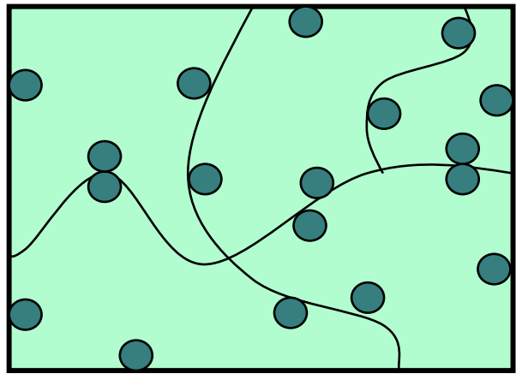
How Many Test Cases Is Enough?
In general, more diverse tests –> more confidence!
Try to think adversarially and try to break your own code with tests
Specification Testing (based on the spec) vs. Clear-box Testing (based on how you know your implementation works)
Specification Testing you can do before writing your solution!
Clear-box Testing you do after you've written your solution.
Test a wide variety of different cases
Think about boundary or "edge" cases in particular, where the behavior should change

Slide 21
Lecture Outline
Announcements
Importance of Testing
JUnit
How Much Testing is Enough?
Example: Brainstorm Test Cases (Card & BattleManager)
Challenge: Floating Point Precision

Slide 22
Card Class
Each card has a suit (♠️♣️♦️❤️) and a value (e.g., 2, 3, 10, J, Q, K)
Note: value represented as an int
For example, for the Queen of Hearts card
The suit is hearts ❤️
The value is Queen (represented as 12)
Ace | 2 | 3 | 4 | 5 | 6 | 7 | 8 | 9 | 10 | Jack | Queen | King
1 | 2 | 3 | 4 | 5 | 6 | 7 | 8 | 9 | 10 | 11 | 12 | 13

Slide 23
Card Class
public Card(int value, String suit)
Throws an IllegalArgumentException if value or suit is invalid
public String getSuit()
public int getValue()
public String toString()
public boolean equals(Object other)

Slide 24
BattleManager Class
Assumes two players
Setup: 52-card deck is split between the two players evenly
Each round:
Each player flips their top card
The player with the higher value card takes both cards
Aces are considered "high" – they beat all other values
If the cards have the same value, "battle"
Each player places 3 cards face down, then flips a new card, and the player with the higher value card takes all cards
(If this is another battle, repeat previous process)
Goal: one player has all 52 cards

Slide 25
BattleManager Class
public BattleManager()
public BattleManager(Queue<Card> deck1, Queue<Card> deck2)
public void deal()
public boolean gameOver()
public int getPlayer1DeckSize()
public int getPlayer2DeckSize()
public void play()

Slide 26
What test cases can you test for the Card class? What about the BattleManager class?
Spend 2 minutes brainstorming specification testing
Then 2 minutes brainstorming clear-box testing

Slide 27
Lecture Outline
Announcements
Importance of Testing
JUnit
How Much Testing is Enough?
Example: Brainstorm Test Cases (Card & BattleManager)
Challenge: Floating Point Precision

Slide 28
Challenge: Floating Point Numbers
Another name for doubles are floating point numbers
Floating point numbers are nice, but imprecise
Computers can only store a certain amount of precision (can’t store 0.3333333333 repeating forever)
Finite precision can lead to slightly incorrect calculations with floating point numbers
Take-away: Essentially can never rely on == for doubles. Instead, must define some notion of how far away they can be to be tolerated as the same
JUnit: assertEquals(expected, actual, delta)

