Slide 1
Maps
BEFORE WE START
Talk to your neighbors:
What is your favorite form of potato?

Slide 2
Lecture Outline
Announcements
Map Review
Debrief PCM: Count Words
Practice: joinRosters
Practice: mostFrequentStart

Slide 3
Announcements
Reminder; Quiz 1 is Thursday, July 25th
Resubmission Cycle 2 (R2) form open now
Due Tuesday, April 30 by 11:59 PM
Eligible Assignments: P0
Programming Assignment 2 (P2) released later today!

Slide 4
Lecture Outline
Announcements
Map Review
Debrief PCM: Count Words
Practice: joinRosters
Practice: mostFrequentStart

Slide 5
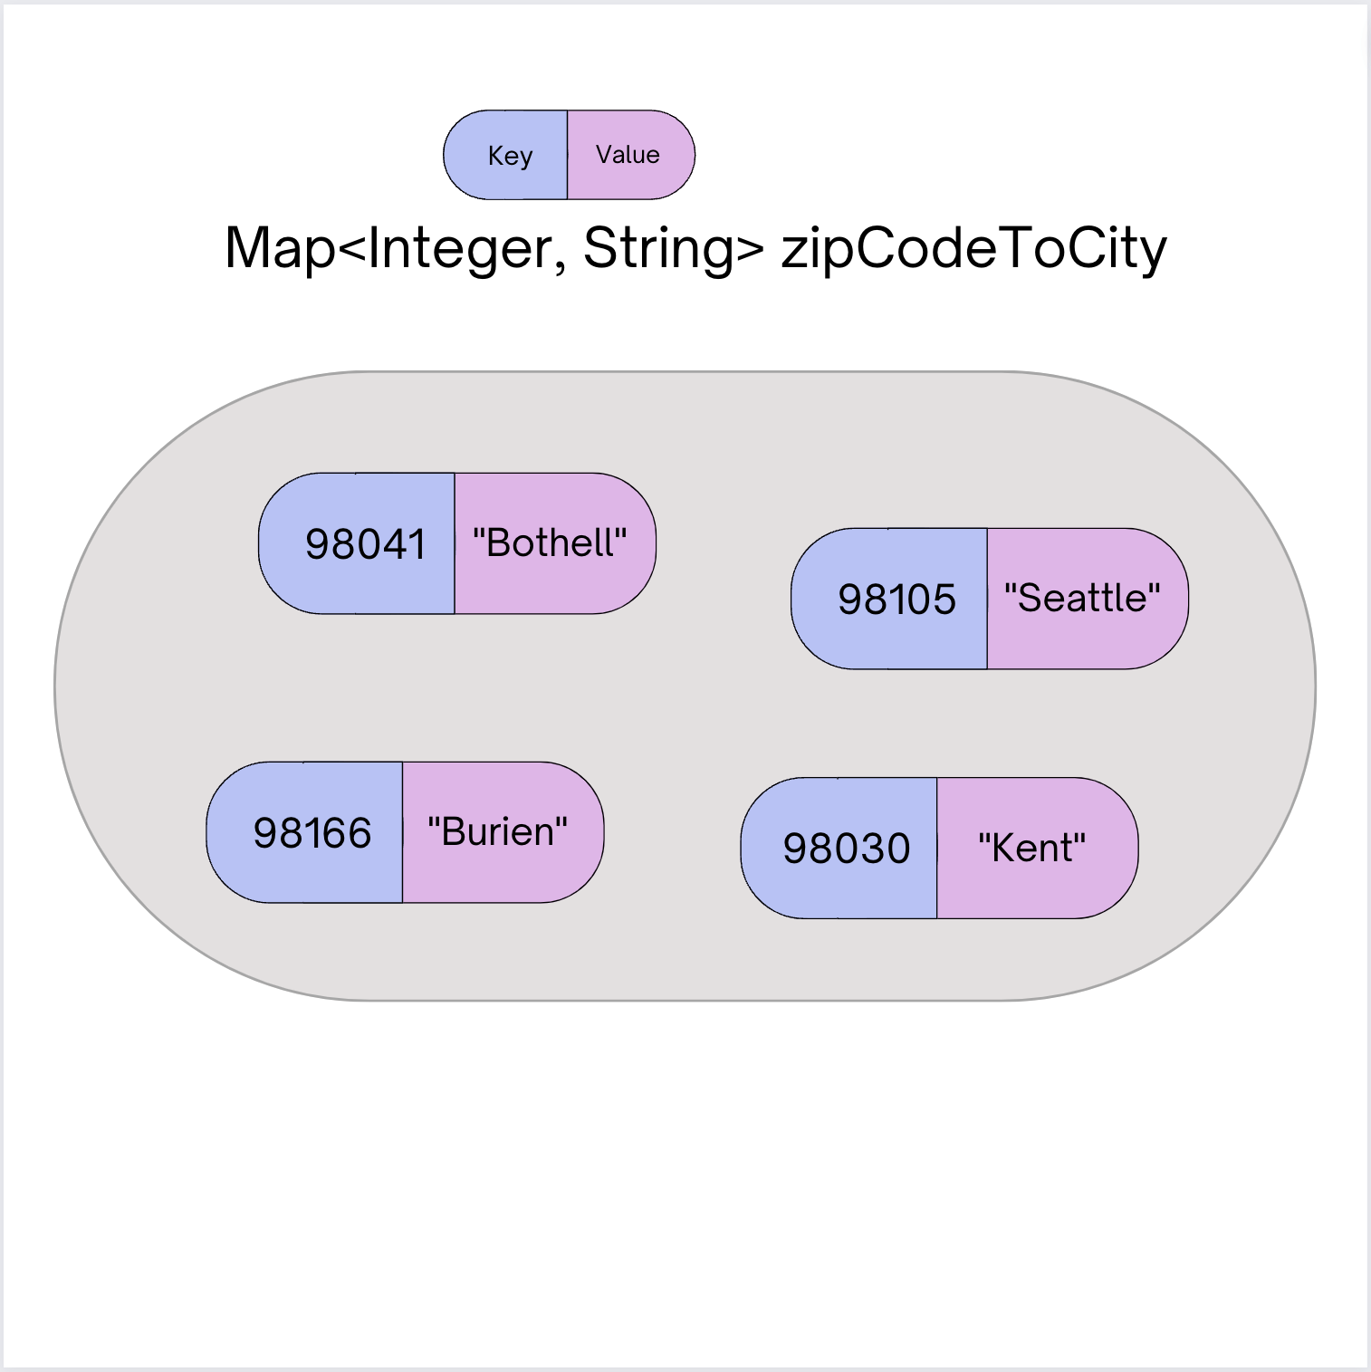
Map ADT
Data structure to map keys to values
Keys can be any type; Keys must be unique
Values can be any type
Example: Mapping nucleotides to counts in P0!
Operations
put(key, value): Associate key to value
Overwrites duplicate keys
get(key): Get value for key
remove(key): Remove key/value pair
Also called a “dictionary”
Same as Python’s dict

Slide 6
Programming with Maps in Java
Methods | Description
put(key, value) | adds a mapping from the given key to the given value; if the key already exists, replaces its value with the given one
get(key) | returns the value mapped to the given key (null if not found)
containsKey(key) | returns true if the map contains a mapping for the given key
remove(key) | removes any existing mapping for the given key
clear() | removes all key/value pairs from the map
size() | returns the number of key/value pairs in the map
isEmpty() | returns true if the map's size is 0
toString() | returns a string such as "{a=90, d=60, c=70}"
keySet() | returns a set of all keys in the map
values() | returns a collection of all values in the map

Slide 7
Programming with Maps in Java
Interface: Map
Implementations: TreeMap, HashMap
// Making a Map Map<String, String> favArtistToSong = new TreeMap<>(); // adding elements to the above Map favArtistToSong.put("Iron Maiden", "Wasted Years"); favArtistToSong.put("Foxes", "Body Talk"); favArtistToSong.put("Vampire Weekend", "Campus"); // Getting a value for a key String song = favArtistToSong.get(”Vampire Weekend"); System.out.println(song);

Slide 8
Map Implementations
Our first data structures with marked differences in how their implementations behave
One Map ADT / Interface
Two Map implementations
TreeMap – Pretty fast, but sorted keys
HashMap – Extremely fast, unsorted keys
Map<String, Integer> map1 = new TreeMap<>(); Map<String, Integer> map2 = new HashMap<>();
...

Slide 9
Select the method calls required to modify the given map m as follows:
Assume m’s contents are
98030="Kent"
98178="Seattle"
98166="Burien"
98041="Bothell"
We want to modify m so that its contents are
98030="Kent"
98178="Tukwila"
98166="Burien"
98041="Bothell"
98101="Seattle"
98126="Seattle"
m.put(98178, "Tukwila");
m.remove(98178);
m.put(98126, "Seattle");
m.get(98178, "Seattle");
m.put(98101, "Seattle");

Slide 10
Select the method calls required to modify the given map m as follows:
Assume m’s contents are
98030="Kent"
98178="Seattle"
98166="Burien"
98041="Bothell"
We want to modify m so that its contents are
98030="Kent"
98178="Tukwila"
98166="Burien"
98041="Bothell"
98101="Seattle"
98126="Seattle"
m.put(98178, "Tukwila");
m.remove(98178);
m.put(98126, "Seattle");
m.get(98178, "Seattle");
m.put(98101, "Seattle");

Slide 11
Lecture Outline
Announcements
Map Review
Debrief PCM: Count Words
Practice: joinRosters
Practice: mostFrequentStart

Slide 12
Lecture Outline
Announcements
Map Review
Debrief PCM: Count Words
Practice: joinRosters
Practice: mostFrequentStart

Slide 13
joinRosters
Write a method joinRosters that combines a Map from student name to quiz section, and a Map from TA name to quiz section and prints all pairs of students/TAs.
For example, if studentSections stores the following map:
{Alan=AC, Jerry=AB, Yueying=AA, Sharon=AB, Steven=AB, Zewditu=BA}
And taSections stores the following map
{Ayush=BA, Marcus=AA, Rohini=AB, Colin=AC}
AC: Alan - Colin AB: Jerry - Rohini AB: Sharon - Rohini AB: Steven - Rohini AA: Yueying – Marcus BA: Zewditu – Ayush

Slide 14
Lecture Outline
Announcements
Map Review
Debrief PCM: Count Words
Practice: joinRosters
Practice: mostFrequentStart

Slide 15
mostFrequentStart
Write a method called mostFrequentStart that takes a Set of words and does the following steps:
Organizes words into “word families” based on which letter they start with
Selects the largest “word family” as defined as the family with the most words in it
Returns the starting letter of the largest word family and update the Set of words to only have words from the selected family.

Slide 16
mostFrequentStart
For example, if the Set words stored the values
["hello", "goodbye", "library", "literary", "little", "repel"]
The word families produced would be
'h' -> 1 word ("hello")
'g' -> 1 word ("goodbye")
'l' -> 3 words ("library", "literary", "little")
'r' -> 1 word ("repel")
Since 'l' has the largest word family, we return 3 and modify the Set to only contain Strings starting with 'l'.

