Slide 1
Advanced OOP
BEFORE WE START
Talk to your neighbors:
What are your plans over the summer?
Abby Williams
Chloë Mi Cartier
Connor Sun
Cynthia Pan
Katharine Zhang
Marcus Sanches
Rohini Arangam

Slide 2
Lecture Outline
Announcements
Constructors Recap
Equals
Bigger Example
Interfaces Review
Shapes!
Comparable

Slide 3
Announcements
Programming Assignment 3 (P3) releasing later tonight
  Focused on OOP and interfaces!
Quiz 2 (LAST ONE) in section Thursday 8/8
Finals week coming up! Prep materials coming next week

Slide 4
Lecture Outline
Announcements
Equals
Bigger Example
Interfaces Review
Shapes!
Comparable

Slide 5

Equals (PCM Review)
The equals() method returns true if the given parameter is considered equal to this object, and false otherwise.
  Used by lots of library methods! e.g. contains, remove for specific elements, etc.
Each class has one provided by Java, but it checks for reference equality. (Thanks?)
If you want equals to check for value equality, you need to write this method yourself.

Slide 6
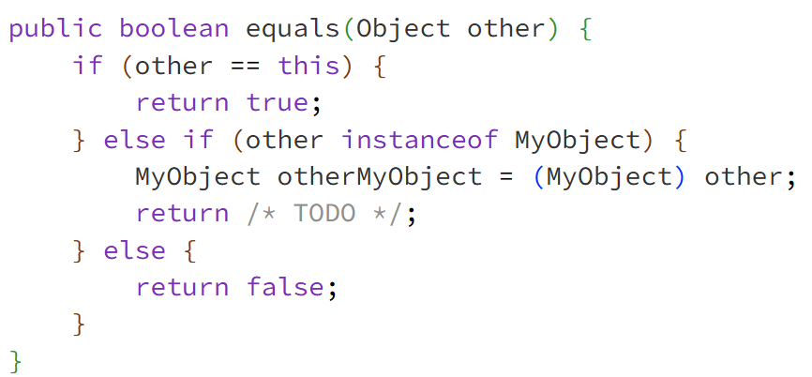
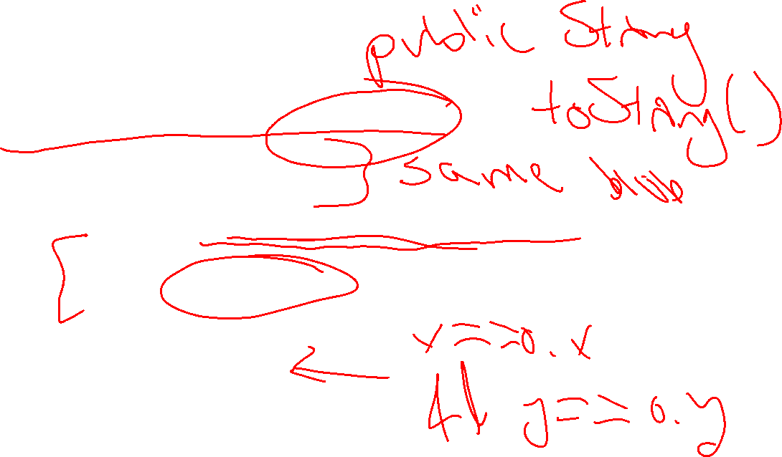
Equals (PCM Review)

Slide 7
Object
By taking a parameter of type Object, the equals method can be passed any type of object.
More to come in CSE 123 on the Java mechanisms that make this work!
We can use the instanceof keyword in Java to determine if the parameter is actually a Point

Slide 8
Almost there…
This is actually still an imperfect implementation because we would also need to write a hashCode() method for our object to work with HashSet, HashMap, etc. but more to come on that in CSE 331 and beyond ☺

Slide 9
Lecture Outline
Announcements
Equals
Bigger Example
Interfaces Review
Shapes!
Comparable

Slide 10
Student class
Write a Student class that you can construct by saying:
new Student(1234567, "Miya")
where the first parameter is their student number and the second parameter is their name. Your Student class should also implement the following methods:
getName() returns the student's name
getStudentNumber() returns the student's number
setName(String newName) sets the student’s name to the given newname
toString() returns a String representation of the student formatted as "name (studentNumber)"
equals(Object other) that returns true if the given parameter is considered equal to this object

Slide 11
Student class
What if we added a field to the Student class:
private boolean isMale;
Yikes—You are the designer now. Think carefully about what assumptions you are making!
Also…
Why shouldn’t we include a setStudentNumber method?

Slide 12
Course class
Write a Course class that represents a course at UW. Implement the following methods and constructors:
Constructors
Write a constructor so that you can construct a Course by saying new Course(23213, "CSE 122", 4) where the first parameter is the course's SLN, the second parameter is the code for the course, and the third parameter is the number of credits.
Write another constructor so that you can construct a Course by saying new Course(23239, "CSE 122", 4, enrollment) where the first parameter is the course's SLN, the second parameter is the code for the course, the third parameter is the number of credits, and the fourth parameter is a Student[] containing a Student for each student enrolled in the course.

Slide 13
Course class
Instance Methods
updateRoster(Student[] students) replaces the current roster with the content of the given students
addStudent(Student s) adds the given student to the roster if they are not already on it
dropStudent(Student s) removes the given student from the roster if they are on it
checkStudentEnrolled(Student s) returns true if the given student is on the current roster, and false otherwise
getSLN() returns the course's SLN
getCourseCode() returns the course's code
getCredits() returns the number of credits for the course
getRoster() returns a copy of the course's roster

Slide 14
Lecture Outline
Announcements
Equals
Bigger Example
Interfaces Review
Shapes!
Comparable

Slide 15
Recall from L6: Wait, ADT? Interfaces?
Abstract Data Type (ADT): A description of the idea of a data structure including what operations are available on it and how those operations should behave. For example, the English explanation of what a list should be.
Interface: Java construct that lets programmers specify what methods a class should have. For example the List interface in java.
Implementation: Concrete code that meets the specified interface. For example, the ArrayList and LinkedList classes that implement the List interface.

Slide 16
Interfaces
Interfaces serve as a sort of “certificate”– in order for a class to implement an interface, it must fulfill the certificates requirements.
The certificates requirements are certain methods that the class must implement.

Slide 17
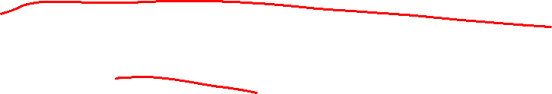
Lists
One ADT we’ve talked a lot about in this course is a list.
Within Java, there exists a List interface – its contract includes methods like:
add, clear, contains, get, isEmpty, size
There’s also an ArrayList class (implementation)
To get the certificate, it must include all these
methods (and any others the List interface specifies)

Slide 18
Interfaces vs. Implementation
Interfaces require certain methods, but they do not say anything about how those methods should be implemented – that’s up to the class! 🏅
List is an interface
  ArrayList is a class that implements the List interface
  LinkedList is a class that implements the List interface
  …

Slide 19
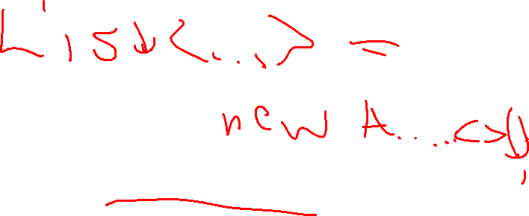
Why interfaces?
Flexibility
public static void method(Set<String> s) {…}
This method can accept either a:
HashSet<String> or
TreeSet<String> or
Any other class that implements Set and whose element type is String!

Slide 20


Why interfaces?
Abstraction
Interfaces also support abstraction
  (the separation of ideas from details)

Slide 21
Lecture Outline
Announcements
Equals
Bigger Example
Interfaces Review
Shapes!
Comparable

Slide 22
Classes can Implement Multiple Interfaces
A class can implement multiple interfaces – it’s like one person getting multiple certificates!
If a class implements an interface A and an interface B, it’ll just have to include all of A’s required methods along with all of B’s required methods

Slide 23
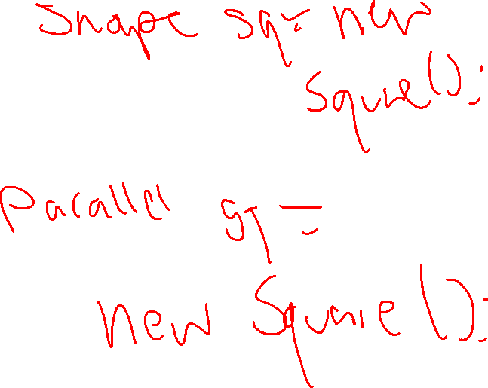
Classes can Implement Multiple Interfaces
public interface Parallel {
public int numParallelPairs();
}
public class Square implements Shape, Parallel {
...
public int numParallelPairs() {
return 2;
}
}
But Square would have to implement:
getPerimeter, getArea from Shape
AND
numParallelPairs from Parallel

Slide 24
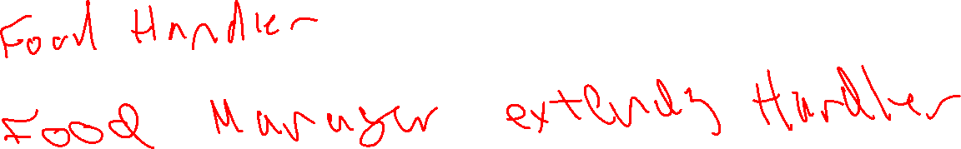
An interface can extend another
You can have one interface extend another
So if public interface A extends B, then any class that implements A must include all the methods in A’s interface and all the methods in B’s interface

Slide 25
An interface can extend another
We can write another interface
Polygon that extends Shape
Make modifications such that:
- Square is a Polygon (and Shape)
Triangle is a Polygon (and Shape)
Circle is a Shape (but not a Polygon)

Slide 26
Lecture Outline
Announcements
Equals
Bigger Example
Interfaces Review
More Shapes!
Comparable

Slide 27
Comparable
TreeSet uses an interface called Comparable<E> to know how to sort its elements!
Only has one required method:
  public int compareTo(E other)
Its return value is:
  < 0 if this is “less than” other
  0 if this is equal to other
  > 0 if this is “greater than” other

