Slide 1
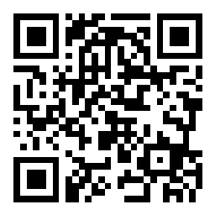
JUnit Testing
BEFORE WE START
Talk to your neighbors:
What is your favorite thing to cook? If you don’t cook, what’s your favorite thing to eat :P
Music: 122 24sp Lecture Tunes 🌼

Slide 2
Lecture Outline
Announcements
Importance of Testing
JUnit
How Much Testing is Enough?
Example: Brainstorm Test Cases (Card & BattleManager)
Challenge: Floating Point Precision

Slide 3
Announcements
Programming Assignment 3 (P3) due tomorrow (Thurs, May 23)
Creative Project 3 (C3) will be released Friday, May 24
Last assignment!
R4 feedback released yesterday!
Friendly reminder: if you receive a lower score on a resub than your initial submission because of a grading mistake please make an Ed post and we’ll fix it!
Final Exam: Thursday, June 6th 8:30 – 10:20 PM
Left-handed seating request form on EdStem
JUnit “virtual section” for today’s content, linked from this Ed module

Slide 4
Lecture Outline
Announcements
Importance of Testing
JUnit
How Much Testing is Enough?
Example: Brainstorm Test Cases (Card & BattleManager)
Challenge: Floating Point Precision

Slide 5
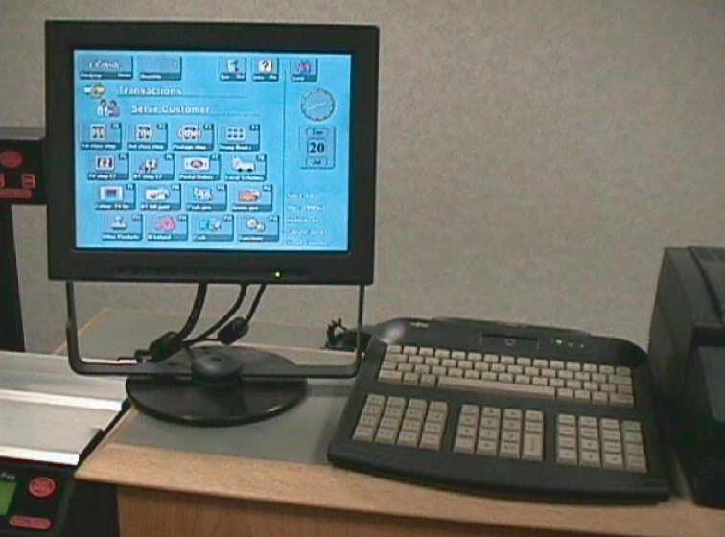
Importance of Testing
Software, written by people, controls more and more of our day-to-day lives.
Bugs (just like the ones we all write) are just as easy to write in this software.
Stakes can be quite high so bugs can have catastrophic effects
Source: Hackaday
The Horizon IT System for The UK Post Office Source: Fujitsu.com

Slide 6
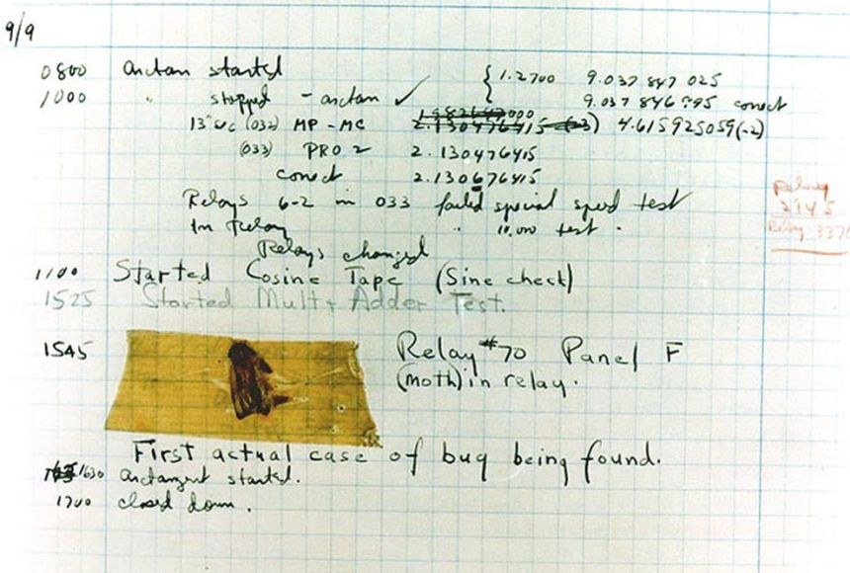
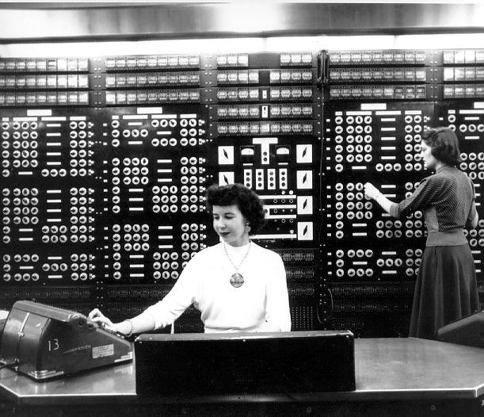
Fun Aside – what was the first computer bug?
1947 Harvard “computers” find moth trapped in the Mark II

Slide 7
Importance of Testing
“The Horizon scandal, described as ‘the most widespread miscarriage of justice in UK history’, resulted in more than 700 post office operators being prosecuted between 1999 and 2015 for theft, fraud and false accounting because of faulty accounting software installed in the late 1990s… Some spent time in prison, and the scandal has been linked to four suicides.”
Source: The Guardian

Slide 8
Bugs you’ve experienced
Can you think of a bug(s) you’ve experienced or heard of that have had serious effects?
If you can’t, can you think of any absurd bugs you’ve seen?

Slide 9
Lecture Outline
Announcements
Importance of Testing
JUnit
How Much Testing is Enough?
Example: Brainstorm Test Cases (Card & BattleManager)
Challenge: Floating Point Precision

Slide 10
Using a Testing Framework
Unit Test – a method that compares what your codes does against what you expect it to do
Testing Framework – a library of code that gives you special tags and key words for your unit tests so that you can click the “test” button instead of the “run” button and you get a list of tests with info like green check mark passes or error messages
Like a music tuner! Technology specifically built to compare what your instrument sounds like against what it’s expected to sound like

Slide 11
JUnit Basics
JUnit – a unit testing framework for the Java language
import statements to give you access to JUnit method annotations and assertion methods!
Method Annotations
@Test
@DisplayName
…
Assertion Methods
assertEquals
assertTrue
assertFalse
…
import org.junit.jupiter.api.*;
import static org.junit.jupiter.api.Assertions.*;
import java.util.*; public class ArrayListTest { @Test public void testAddAndGet() { List<String> list = new ArrayList<>(); list.add("Joe Spaniac"); list.add("Miya Natsuhara"); list.add("CSE 122"); assertEquals("Joe Spaniac", list.get(0)); } }

Slide 12
JUnit Testing
import org.junit.jupiter.api.*;
import static org.junit.jupiter.api.Assertions.*;
import java.util.*; public class ArrayListTest { @Test public void testAddAndGet() { List<String> list = new ArrayList<>(); list.add("Joe Spaniac"); list.add("Miya Natsuhara"); list.add("CSE 122"); assertEquals("Joe Spaniac", list.get(0)); } }

Slide 13
JUnit Testing
import org.junit.jupiter.api.*;
import static org.junit.jupiter.api.Assertions.*;
import java.util.*; public class ArrayListTest { @Test public void testAddAndGet() { List<String> list = new ArrayList<>(); list.add("Joe Spaniac"); list.add("Miya Natsuhara"); list.add("CSE 122"); assertEquals("Joe Spaniac", list.get(0)); // TRUE!! } }

Slide 14
JUnit Testing
import org.junit.jupiter.api.*;
import static org.junit.jupiter.api.Assertions.*;
import java.util.*; public class ArrayListTest { @Test public void testAddAndGet() { List<String> list = new ArrayList<>(); list.add("Joe Spaniac"); list.add("Miya Natsuhara"); list.add("CSE 122"); assertEquals("Joe Spaniac", list.get(0)); assertEquals("Miya Natsuhara", list.get(2)); } }

Slide 15
JUnit Testing
import org.junit.jupiter.api.*;
import static org.junit.jupiter.api.Assertions.*;
import java.util.*; public class ArrayListTest { @Test public void testAddAndGet() { List<String> list = new ArrayList<>(); list.add("Joe Spaniac"); list.add("Miya Natsuhara"); list.add("CSE 122"); assertEquals("Joe Spaniac", list.get(0)); assertEquals("Miya Natsuhara", list.get(2)); // FALSE!! } }

Slide 16
JUnit Testing
import org.junit.jupiter.api.*;
import static org.junit.jupiter.api.Assertions.*;
import java.util.*; public class ArrayListTest { @Test public void testAddAndGet() { List<String> list = new ArrayList<>(); list.add("Joe Spaniac"); list.add("Miya Natsuhara"); list.add("CSE 122"); assertEquals("Joe Spaniac", list.get(0)); assertEquals("CSE 122", list.get(2)); } }

Slide 17
JUnit Testing
import org.junit.jupiter.api.*;
import static org.junit.jupiter.api.Assertions.*;
import java.util.*; public class ArrayListTest { @Test public void testAddAndGet() { List<String> list = new ArrayList<>(); list.add("Joe Spaniac"); list.add("Miya Natsuhara"); list.add("CSE 122"); assertEquals("Joe Spaniac", list.get(0)); assertEquals("CSE 122", list.get(2)); // TRUE!!! } }

Slide 18
JUnit Testing
import org.junit.jupiter.api.*;
import static org.junit.jupiter.api.Assertions.*;
import java.util.*; public class ArrayListTest { @Test public void testAddAndGet() { List<String> list = new ArrayList<>(); list.add("Joe Spaniac"); list.add("Miya Natsuhara"); list.add("CSE 122"); assertEquals("Joe Spaniac", list.get(0)); assertEquals("CSE 122", list.get(2)); assertTrue(list.size() == 3); } }

Slide 19
JUnit Testing
import org.junit.jupiter.api.*;
import static org.junit.jupiter.api.Assertions.*;
import java.util.*; public class ArrayListTest { @Test public void testAddAndGet() { List<String> list = new ArrayList<>(); list.add("Joe Spaniac"); list.add("Miya Natsuhara"); list.add("CSE 122"); assertEquals("Joe Spaniac", list.get(0)); assertEquals("CSE 122", list.get(2)); assertTrue(list.size() == 3); // TRUE!! } }

Slide 20
Testing Tips
Write many tests for each method
Test that your method does what you want it to do
Test combinations of your method being used with other methods
Write a test method per distinct case
Test that different states of input don’t break your code (empty or null params)
Test that code correctly enters all boolean checks (loops, if/else)
Use assertEquals(expected, actual, message) to provide a description of what case that line is testing
Testing code is just code. Use good coding practices (e.g., helper methods to reduce redundancy) to help you write code.
It can take time, but if you do it well, developing your solution can be a breeze!

Slide 21
In-Class: Remix – Courses Taught

Slide 22
How Many Test Cases Is Enough?
In general, more diverse tests –> more confidence!
Try to think adversarially and try to break your own code with tests, How do you “user-proof” your code?
Specification Testing (based on the spec) vs. Clear-box Testing (based on how you know your implementation works)
Specification Testing you can do before writing your solution! (Test Driven Development)
Clear-box Testing you do after you've written your solution.
Test a wide variety of different cases
Think about boundary or "edge" cases in particular, where the behavior should change

Slide 23
Lecture Outline
Announcements
Importance of Testing
JUnit
How Much Testing is Enough?
Example: Brainstorm Test Cases (Card & BattleManager)
Challenge: Floating Point Precision

Slide 24
Card Class
Each card has a suit (♠️♣️♦️❤️) and a value (e.g., 2, 3, 10, J, Q, K)
Note: value represented as an int
For example, for the Queen of Hearts card
The suit is hearts ❤️
The value is Queen (represented as 12)
Ace | 2 | 3 | 4 | 5 | 6 | 7 | 8 | 9 | 10 | Jack | Queen | King
1 | 2 | 3 | 4 | 5 | 6 | 7 | 8 | 9 | 10 | 11 | 12 | 13

Slide 25
Card Class
public Card(int value, String suit)
Throws an IllegalArgumentException if value or suit is invalid
public String getSuit()
public int getValue()
public String toString()
public boolean equals(Object other)

Slide 26
BattleManager Class
Assumes two players
Setup: 52-card deck is split between the two players evenly
Each round:
Each player flips their top card
The player with the higher value card takes both cards
Aces are considered "high" – they beat all other values
If the cards have the same value, "battle"
Each player places 3 cards face down, then flips a new card, and the player with the higher value card takes all cards
(If this is another battle, repeat previous process)
Goal: one player has all 52 cards

Slide 27
BattleManager Class
public BattleManager()
public BattleManager(Queue<Card> deck1, Queue<Card> deck2)
public void deal()
public boolean gameOver()
public int getPlayer1DeckSize()
public int getPlayer2DeckSize()
public void play()

Slide 28
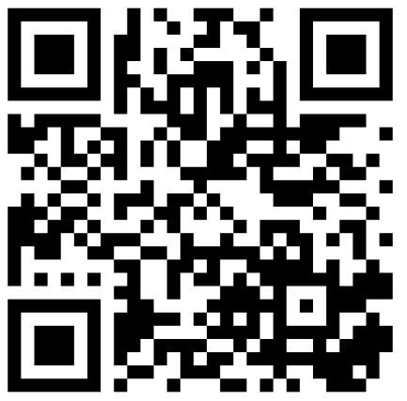
What test cases can you test for the Card class? What about the BattleManager class?
Spend 2 minutes brainstorming specification testing
Then 2 minutes brainstorming clear-box testing

Slide 29
Lecture Outline
Announcements
Importance of Testing
JUnit
How Much Testing is Enough?
Example: Brainstorm Test Cases (Card & BattleManager)
Challenge: Floating Point Precision

Slide 30
Challenge: Floating Point Numbers
Another name for doubles are floating point numbers
Floating point numbers are nice, but imprecise
Computers can only store a certain amount of precision (can’t store 0.3333333333 repeating forever)
Finite precision can lead to slightly incorrect calculations with floating point numbers
Take-away: Essentially can never rely on == for doubles. Instead, must define some notion of how far away they can be to be tolerated as the same
JUnit: assertEquals(expected, actual, delta)

