Slide 1
Introduction to Objects
BEFORE WE START
Talk to your neighbors:
Best places to study on campus?
Music: 122 24sp Lecture Tunes 🌼

Slide 2
Lecture Outline
Announcements
SearchEngine Recap
OOP Review
Example
Abstraction

Slide 3
Announcements
Programming Assignment 2 (P2) out
Due Thursday, May 9th by 11:59 PM
Which means… no assignment releasing tonight!
Quiz 0 grades released yesterday
Check them out and use results to calibrate how you should study over the weekend!
Quiz 1 on Tuesday, May 7th in your registered quiz section
Resubmission Cycle 3 (R3) out
Due Tuesday, May 7th by 11:59 PM
Eligible assignments: P0, C1, P1

Slide 4
Lecture Outline
Announcements
SearchEngine Recap
OOP Review
Example
Abstraction

Slide 5
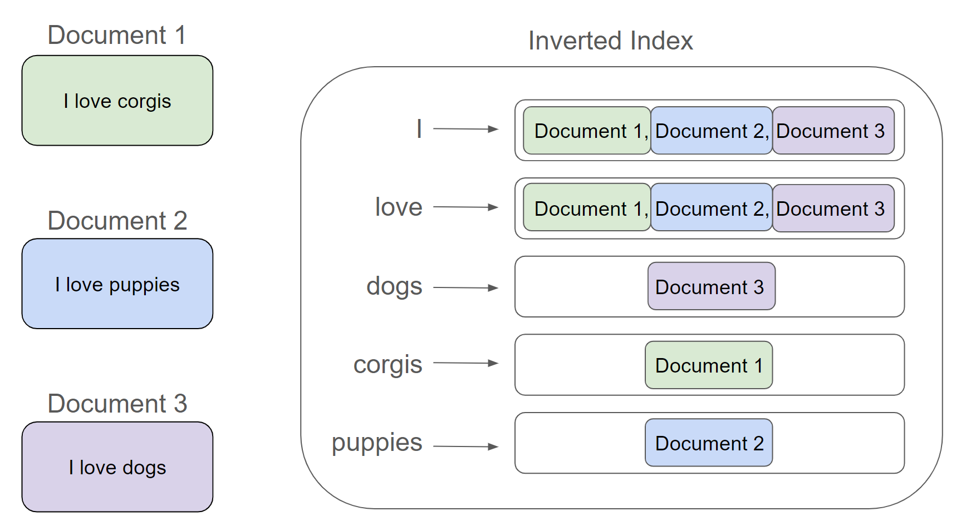
searchEngine & Inverted Index
An inverted index is a Mapping from possible query words to the set of documents that contain that word
Answers the question: “What documents contain the word ‘corgis’?”

Slide 6
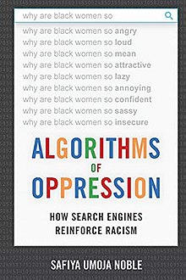
Data Bias
Google’s autocomplete recommendations used to actually look like this
Fix: Don’t display autocomplete results for phrases like “why are [group] ____”
Are these changes fixing the right thing?
Btw, this is a great book that you should check out if you’re interested ->

Slide 7
What to do?
Obviously, ideal to have datasets that aren’t biased in the first place.
But might not always be possible if we can’t fix the sources of bias in the real world…
AI/Models aren’t “neutral” or “more objective”, they just quicky and automatically codify the status quo (and perpetuate biases)
Garbage in -> Garbage out
Lots of work going into how to de-bias models even if they are trained on biased data. Active area of research!
Key take-away: None of this comes “for free”, requires hard word to fight bias
Ask ourselves:
What biases might be present in my data?
What assumption might I be making about who is using my program?
How can I write code to be more inclusive?
What happens when (not if) mistakes happen? Who potentially benefits and who is potentially harmed?

Slide 8
Lecture Outline
Announcements
SearchEngine Recap
OOP Review
Example
Abstraction

Slide 9
Object Oriented Programming (OOP)
Procedural programming: Programs that perform their behavior as a series of steps to be carried out
Classes that do things
Object-oriented programming (OOP): Programs that perform their behavior as interactions between objects
Classes that represent things
We’re going to start writing our own objects!

Slide 10
Classes & Objects
Classes can define the template for an object
📰 Like the blueprint for a house!
“What does it mean to be this thing?”
Objects are the actual instances of the class
🏠 Like the actual house built from the blueprint!
“It is an example of this thing!”
We create a new instance of a class with the new keyword
e.g., Scanner console = new Scanner(System.in);

Slide 11
State & Behavior
Objects can tie related state and behavior together
State is defined by the object’s fields or instance variables
Scanner’s state may include what it’s scanning, where it is in the input, etc.
Behavior is defined by the object’s instance methods
Scanner’s behavior includes “getting the next token and returning it as an int”, “returning whether there is a next token or not”, etc.

Slide 12
Syntax
public class MyObject {
// fields
type1 fieldName1;
type2 fieldName2;
...
// instance methods
public returnType methodName(...) {
...
}
}

Slide 13
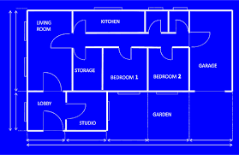
Instance Variables
Fields are also referred to as instance variables
Fields are defined in a class
Each instance of the class has their own copy of the fields
Hence instance variable! It’s a variable tied to a specific instance of the class!

Slide 14
Instance Methods
Instance methods are defined in a class
Calling an instance method on a particular instance of the class will have effects on that instance

Slide 15
Lecture Outline
Announcements
SearchEngine Recap
OOP Review
Example
Abstraction

Slide 16
Representing a Coordinate Point
How would we do this given what we knew last week?
Maybe int x, int y?
Maybe int[]?

Slide 17
Representing a point
int x, int y
Easy to mix up x, y
Just two random ints floating around – easy to make mistakes!
int[]
Not really what an array is for
Again, just two ints – just have to “trust” that we’ll remember to treat it like a point
Let’s make a class instead!

Slide 18
Instance Methods
Instance methods are defined in a class
Calling an instance method on a particular instance of the class will have effects on that instance

Slide 19
Instance Methods
Instance methods are defined in a class
Calling an instance method on a particular instance of the class will have effects on that instance

Slide 20
Lecture Outline
Announcements
SearchEngine Recap
OOP Review
Example
Abstraction

Slide 21
Abstraction
The separation of ideas from details, meaning that we can use something without knowing exactly how it works.
You were able use the Scanner class without understanding how it works internally!

Slide 22
Client v. Implementor
We have been the clients of many objects this quarter!
Now we will become the implementors of our own objects!

