Slide 1
ArrayList Applications
BEFORE WE START
Talk to your neighbors:
Any weekend plans?

Slide 2
Lecture Outline
Announcements
Warm Up
ArrayList Extended Application

Slide 3
Announcements
C0 grades and R0 out yesterday
  Now that you have your first set of grades, review the Course Grades section of the syllabus to understand how they factor into your grade at the end of the quarter!
  Grade Checker spreadsheet also linked from the syllabus to help track your grades throughout the quarter.
  See Resubmission page and Ed post for R0 logistics
Creative Assignment 1 (C1) out later today!
  Focused on ArrayLists
  Due next Thursday, Oct 17th by 11:59 PM
First quiz in section on Tuesday Oct 15th

Slide 4
Lecture Outline
Announcements
Warm Up
ArrayList Extended Application

Slide 5
addAll
Write a method called addAll that accepts two ArrayLists of Characters, list1 and list2 , and an integer location as parameters and inserts all of the elements from list2 into list1 at the specified location.

Slide 6
Lecture Outline
Announcements
Warm Up
ArrayList Extended Application

Slide 7
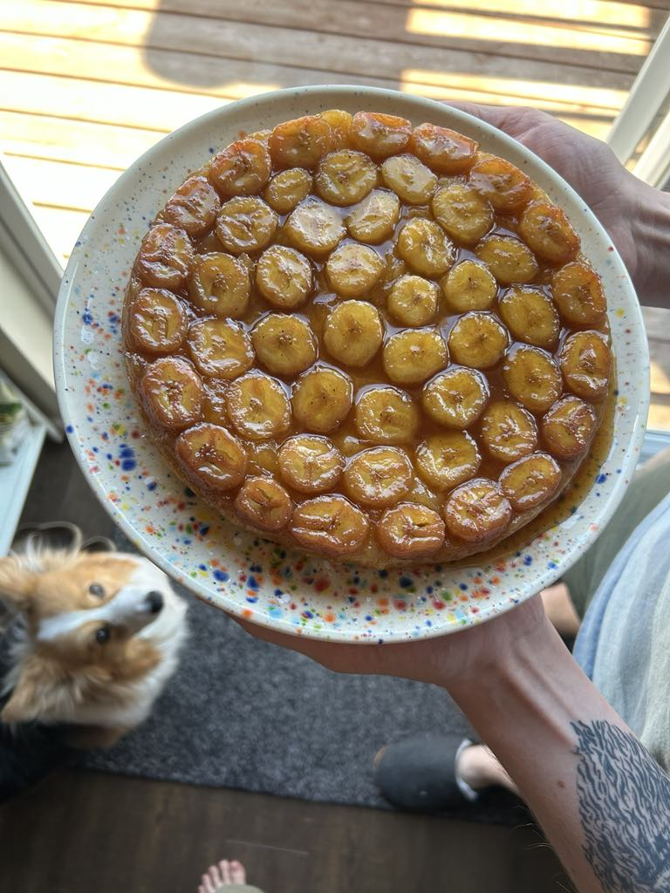
Bakery Favorites
We will write a program called BakeryFavorites.java that manages a list of favorite bakeries for a user (using an ArrayList) and allows the user to perform various different operations on their stored list of favorite bakeries.
Key skills used:
User Interaction (UI) loop
Iterative development strategies
Functional decomposition
Practice with ArrayList methods!

Slide 8
Bakery Favorites: Operations
Load a list of favorites in from a file provided by the user.
Compare the stored list of favorites to another list of favorites provided by the user in another file.
Report the top n favorites according to the list, where the user can specify n.
Move a specific favorite down in the list.
Add a list of favorites in a user-provided file to the stored list of favorites at a specified location.
Save the current list of favorites to a file provided by the user.

Slide 9
Bakery Favorites: Development Strategy
Set up the main scaffold code
Menu loop
Develop each operation, one at a time
You’ll see a similar development strategy in Creative Project 1’s specification — we recommend you follow it!

Slide 10
Bakery Favorites: Operations
Load a list of favorites in from a file provided by the user.
Compare the stored list of favorites to another list of favorites provided by the user in another file.
Report the top n favorites according to the list, where the user can specify n.
Move a specific favorite down in the list.
Add a list of favorites in a user-provided file to the stored list of favorites at a specified location.
Save the current list of favorites to a file provided by the user.
ALREADY DONE!
See In-Class 4

