Slide 1
Putting It All Together (Review)
BEFORE WE START
Talk to your neighbors:
What’s the first thing you’ll do after finals are over? (Sleep is obvious…)

Slide 2
Lecture Outline
Announcements
Exam Logistics
Review
How to Study
Mind Maps

Slide 3
Announcements
Last couple sessions of classes!
Quick overview of class today!
Victory lap + AMA on Friday
Creative Project 3 (C3) currently out
Due Tomorrow, Thursday, December 5th by 11:59 PM PT
Resubmission Cycle 7 (R7) opens tomorrow, Thurs Dec 5
Due Tuesday, Dec 10 by 11:59 PM PT
Open to all previous assignments
Provide feedback!
Course evaluations:
Section A: https://uw.iasystem.org/survey/297869
Section B: https://uw.iasystem.org/survey/297870
TA evaluations: https://tinyurl.com/24au-12x-evals
Gumball & Gigi visit on Monday, Dec 9 1:00pm – 3:00pm
Hanging out around Drumheller fountain + Rainier Vista

Slide 4
Announcements
Final Exam Review: Tuesday, December 10 4:30 – 6:50 PM
Led by TAs
First half: time to work on practice exam with TAs in room
Second half: TAs going over exam, giving tips
Likely recorded, we’ll update if this isn’t the case!
Final Exam: Thursday, December 12 12:30 – 2:20 PM
Preliminary details are up on the course website!
Seating chart will be posted soon!
Already up:
Final Exam Study Guide
Past & Practice Exams

Slide 5
Lecture Outline
Announcements
Exam Logistics
Review
How to Study
Mind Maps

Slide 6
Exam Format
6 questions in total, each will receive one ESN grade
Some questions might have sub-parts
Reminder: Quiz and Exam grades are all mixed into the same bucket
General format
3 Questions: Mix of Conceptual, Mechanical/Tracing, Debugging Problems
3 Questions: Programming Problems
See sections for the last 2 weeks for practice handwriting problems

Slide 7
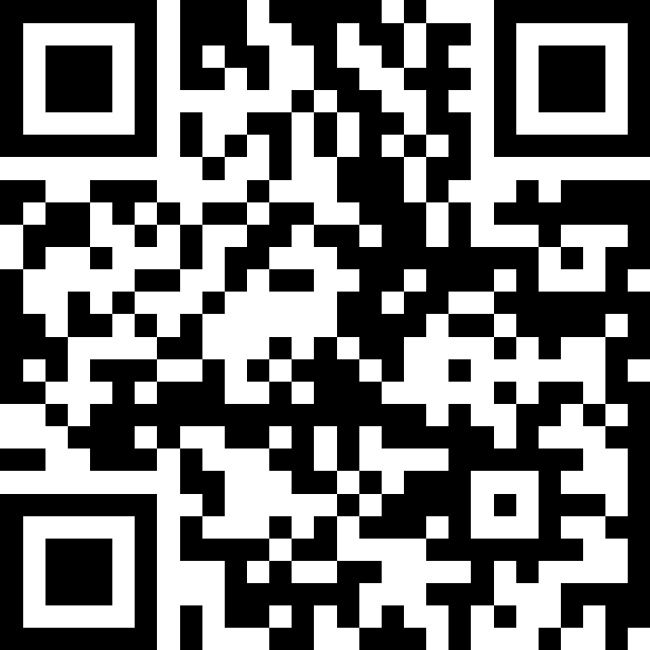
Exam Logistics
Most important bits
Thursday June 6 from 8:30 – 10:20 AM in KNE 120 & KNE 130
Seat assignments to be posted on the course website
Don’t cheat
Only have the exam open during the time (don’t start early; don’t work after)
No electronic devices
You can bring one 8.5x11 inch (or A4) paper with notes (front and back)
Will also provide a reference sheet (see course website)
Questions? Raise hand or as on sli.do (cse122)

Slide 8
Review So Far
CS Concepts
Problem Solving
Functional Decomposition
Debugging
Testing
Third Party Libraries*
Java Language
File I/O
Iterators and For-each Loops
Exceptions
Reference Semantics
JUnit*
Data Structures
ADTs
Lists
Stacks
Queues
Sets
Maps
Java Collections
Arrays / 2D Arrays
ArrayList
LinkedList
Stack
TreeSet / TreeMap
HashSet / HashMap
Interfaces for Collections
Object Oriented
Instance variables
Instance methods
Interfaces
Abstraction
Encapsulation
Client/Implementer

Slide 9
Review Resources
Pre-Class Materials + Lectures
Section Handouts
Quizzes
Your Notes!
Helpful for contextualizing what you learned
Practice final exams
Practice it

Slide 10
Lecture Outline
Announcements
Exam Logistics
Review
How to Study
Mind Maps

Slide 11
Study Strategies
Study Early and Often
Stay Healthy
Study Like you Test
Connect Problems: How is one problem similar/different to another?
Mixed Practice vs. Massed Practice
Embrace Difficulty
Reference Sheet: Iterative Refining

Slide 12
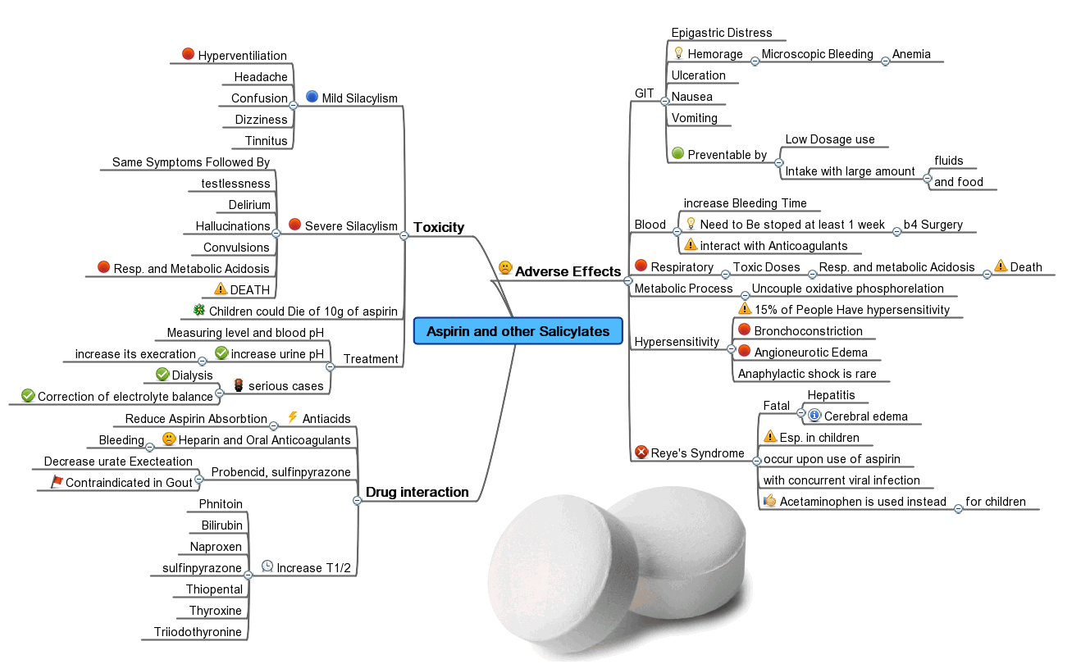
Mind Maps
One of the most important parts of learning is relating concepts to each other
Almost all learning is contextual: based on relating one thing to another
Transfer is challenging!
Mind Maps empower you to write out how topics relate to each other. Concretizing relations.
Can be incredibly helpful when reviewing and can be a great resource for looking back at this class

Slide 13
Lecture Outline
Announcements
Exam Logistics
Review
How to Study
Mind Maps

