Slide 1
Third Party Libraries
BEFORE WE START
Talk to your neighbors:
What has been your favorite assignment so far this quarter? Could be for CSE 122 or other class!

Slide 2
Lecture Outline
Announcements
  Final Exam Logistics
Third Party Libraries
Open-Source Software
Intro Creative Project 3

Slide 3
Announcements
Programming Assignment 3 due tonight, Fri Nov 22
Creative Project 3 will be released tonight!
Thanksgiving Week (Nov 25 – Nov 29)
  Mon (Nov 25): Reduced staffing at the IPL
  Tues (Nov 26): Reduced staffing at the IPL; TA's choice quiz sections!
  Wed (Nov 27): IPL closed; Optional Lectures by Tas!
    Lecture A and Lecture B will have different topics
  Thurs – Fri (Nov 28 – 29): University Holidays (campus closed)
Reminder: Gumball & Gigi campus visit 🐶🐾
  Mon Dec 9 1:00pm – 3:00pm
Final Exam details posted on the course website

Slide 4
Final Exam Logistics
Final Exam Logistics posted on the course website. You should read the whole thing, but we’ll talk about highlights today.
Important points:
Thursday Dec 12 from 12:30 – 2:20 pm
There will be assigned seats (posted soon)
  If you would like a left-handed seat, you will be able to request one (form forthcoming).
Don’t cheat!
  Do not start early or work after time is called
  No electronic devices or communicating with others during the test
You will be able to bring in one reference sheet of your own notes (like quizzes)
  Additionally, we will provide a reference sheet during exam (posted on website soon)
Topic list
See website for details about policies w.r.t. what we expect of your answers

Slide 5
Lecture Outline
Announcements
  Final Exam Logistics
Third Party Libraries
Open-Source Software
Intro Creative Project 3

Slide 6
Library
The term library or third party library is used broadly to refer to a collection of code someone has written, packaged up, and shared for others to use
  Example: JUnit is a library!
There are a lot of libraries out there!
  Here is just one person’s list of favorites with only 687 different libraries 😅
Example: JFugue a Java library for making music

Slide 7
Lecture Outline
Announcements
  Final Exam Logistics
Third Party Libraries
Open-Source Software
Intro Creative Project 3

Slide 8

Open-Source Software
Libraries are just code that people write! You can make your own if you want! Or contribute to one that wants help!
Open-Source Code are projects where all the code is visible to the world.
Many Open-Source projects are also run by teams of individuals all working on the same code base. Need collaboration tools to make it easy for many people to work on one piece of code.
  Wanna try? Check out https://www.firsttimersonly.com/
Collaboration Tools
  git to manage the process of collaborating on code
  Websites such as GitHub or GitLab to host and share the code
    Do not post solutions to your assignments publicly on these (or other) sites
Won’t focus on collaboration tools in the intro sequence
  CSE Majors: CSE 391 Other Majors: CSE 374
Linus Torvalds
inventor of Git and Linux

Slide 9
Public != Free to Use
Just because some code is publicly available to look at, doesn’t mean you have permission to download, run, copy, or edit that code.
All code should have a License or Software License, a legal set of permissions given by the code authors to users of the code
  You need to make sure you are abiding by any licenses in code repositories you are interested in using (they are legally binding)
  If you make public repositories and you want people to use it, you need to include some license.
    The default license means nobody can use/copy/modify your code (and this gets very messy when you have other people working on the project)
    How to choose a license (a common default is the MIT License)

Slide 10
Lecture Outline
Announcements
  Final Exam Logistics
Third Party Libraries
Open-Source Software
Intro Creative Project 3

Slide 11
Design Patterns
There are often common patterns / principles for the good design of code to make it
  Easier to understand
  Easier to write new features
  Easier to test and spot bugs
One of the most universal patterns is abstraction or separation of concerns
  Non-programming Example: Running a restaurant would be much harder if every employee had to constantly switch being wait staff, chefs, bartenders, cleaners. Separating roles makes the whole job easier and efficient.
  Programming Example: We’ve talked about the importance helper methods add to readability
Optional Further Reading: Model-View-Control Design Pattern

Slide 12
Separation of Concerns
Most applications separate the following things:
  How the user views and interacts with an application
  The “core logic” behind how the application works
Example: Snapchat released a browser app a few years ago
  Very unlikely they wrote the entire code base from scratch.
  Instead, probably already had separated:
    The “core logic” of sending/receiving pictures, marking them as viewed, etc.
    A view on that controller that displays buttons, pictures, on an iPhone for the user to interact with
  Now, adding a browser app doesn’t require any changes to the first system, just making a new version of the view to work on browsers instead of iPhones (and they probably have a different version for Android)
Common theme: Separate the “logic” of an app from how the user interacts with it

Slide 13
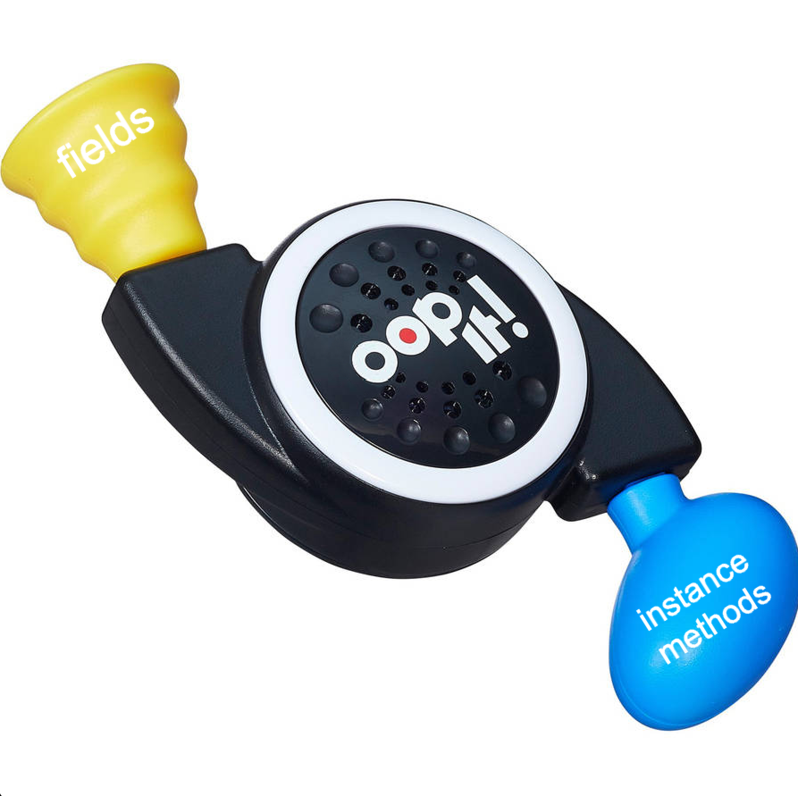
Separation of Concerns in CSE 122
With the introduction of Objects and Object-Oriented Programming, we can do this much more easily
  If you wanted to make a visual app for Program Linting, you don’t have to change most of the files! Just make a new LinterMain
However, most of our previous assignments do this quite poorly
  Example: For TODO List, you had code that interacted with the user mixed up with the logic for managing the TODO list! Concerns not separated!
So Creative Project 3 is you deciding how to fix that!

Slide 14
Creative Project 3 – OOP It!
Take one of our earlier assignments and rewrite it to use Object Oriented Programming to better separate the concerns of interaction and managing the state of the application
You pick one of the assignments
  P0: Stonks
  C1: TODO List
  P1: Music Playlist
  P2: Absurdle
You get to choose which assignment you want to make OOP’ed, and how to design that object!
  Externally it should have the same behavior as original assignment

