Slide 1
Introduction to Objects
BEFORE WE START
Talk to your neighbors:
Favorite study spot on campus?
Music: Miya’s 23wi CSE 122 Playlist

Slide 2
Lecture Outline
Announcements
SearchEngine Recap
Bias in Data Discussion
OOP Review
Example
Abstraction

Slide 3
Announcements
Programming Assignment 2 due date pushed one week!
Due Thursday, Feb 16
No assignment released on Friday!
Quiz 1 Retakes starting next week
Quiz 1 and Quiz 0 Retake grades coming out soon

Slide 4
Lecture Outline
Announcements
SearchEngine Recap
Bias in Data Discussion
OOP Review
Example
Abstraction

Slide 5
Lecture Outline
Announcements
SearchEngine Recap
Bias in Data Discussion
OOP Review
Example
Abstraction

Slide 6
Data Bias
Common Misconception: Models or Artificial Intelligence (AI) are somehow “less biased” or “more objective” than humans. Not true.
The programs we use operate on real-world data, and will often reflect the biases that data contains
Have to carefully consider the context and limitations of the data we gather. If the data an algorithm is built on is vastly different than the context in which it’s used, some pretty awful outcomes can happen

Slide 7
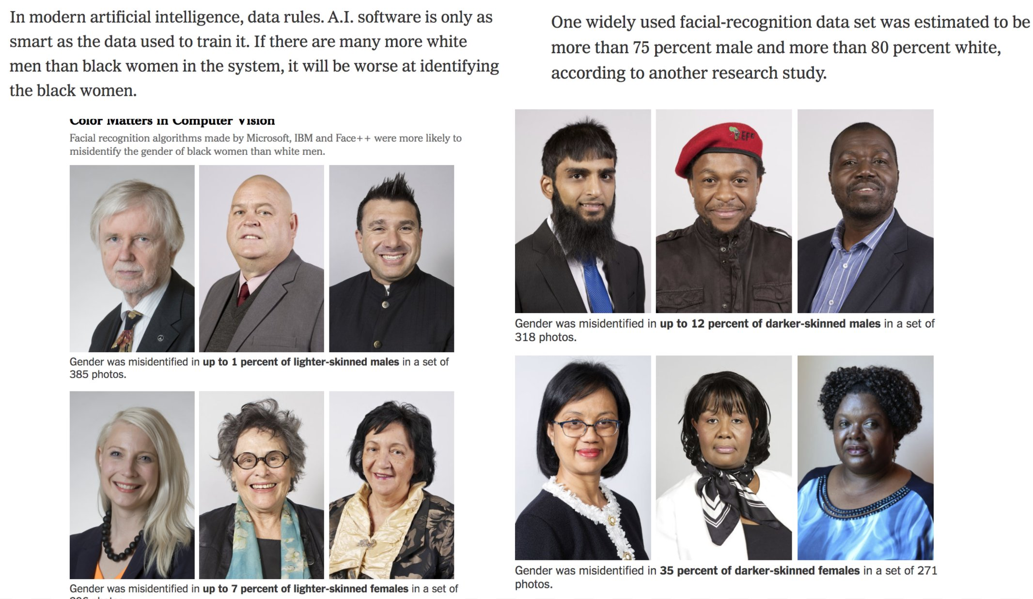
Data Bias

Slide 8
What to do?
Obviously, ideal to have datasets that aren’t biased in the first place.
But might not always be possible if we can’t fix the sources of the bias in the real world...
AI/Models aren’t “neutral” or “more objective”, they just quickly and automatically codify the status quo (and perpetuate biases)
Garbage in → Garbage out
Lots of work going into how to de-bias models even if they are trained on biased data. Active area of research!
Key take-away: None of this comes “for free”, requires hard work to fight bias
Ask ourselves:
What biases might be present in my data?
What assumptions might I be making about who is using my program?
How can I write code to be more inclusive?
What happens when (not if) mistakes happen? Who potentially benefits and who is potentially harmed?

Slide 9
Lecture Outline
Announcements
SearchEngine Recap
Bias in Data Discussion
OOP Review
Example
Abstraction

Slide 10
(PCM) Object Oriented Programming (OOP)
procedural programming: Programs that perform their behavior as a series of steps to be carried out
Classes that do things
object-oriented programming (OOP): Programs that perform their behavior as interactions between objects
Classes that represent things
We’re going to start writing our own objects!

Slide 11
(PCM) Classes & Objects
Classes can define the template for an object
📰 Like the blueprint for a house!
Objects are the actual instances of the class
🏠 Like the actual house built from the blueprint!
We create a new instance of a class with the new keyword
e.g., Scanner console = new Scanner(System.in);

Slide 12
(PCM) State & Behavior
Objects can tie related state and behavior together
State is defined by the object’s fields or instance variables
Scanner’s state may include what it’s scanning, where it is in the input, etc.
Behavior is defined by the object’s instance methods
Scanner’s behavior includes “getting the next token and returning it as an int”, “returning whether there is a next token or not”, etc.

Slide 13
(PCM) Syntax
public class MyObject {
// fields
type1 fieldName1;
type2 fieldName2;
...
// instance methods
public returnType methodName(...) {
...
}
}

Slide 14
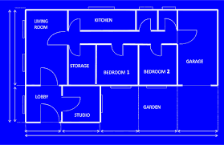
(PCM) Instance Variables
Fields are also referred to as instance variables
Fields are defined in a class
Each instance of the class has their own copy of the fields
Hence instance variable! It’s a variable tied to a specific instance of the class!

Slide 15
(PCM) Instance Methods
Instance methods are defined in a class
Calling an instance method on a particular instance of the class will have effects on that instance

Slide 16
Lecture Outline
Announcements
SearchEngine Recap
Bias in Data Discussion
OOP Review
Example
Abstraction

Slide 17
Representing a point
How would we do this given what we knew last week?
Maybe int x, int y?
Maybe int[]?

Slide 18
Representing a point
Let’s make a class instead!
int x, int y
Easy to mix up x, y
Just two random ints floating around – easy to make mistakes!
int[]
Not really what an array is for
Again, just two ints – just have to “trust” that we’ll remember to treat it like a point

Slide 19
(PCM) Instance Methods
Instance methods are defined in a class
Calling an instance method on a particular instance of the class will have effects on that instance

Slide 20
(PCM) Instance Methods
Instance methods are defined in a class
Calling an instance method on a particular instance of the class will have effects on that instance

Slide 21
Lecture Outline
Announcements
SearchEngine Recap
Bias in Data Discussion
OOP Review
Example
Abstraction

Slide 22
(PCM) Abstraction
The separation of ideas from details, meaning that we can use something without knowing exactly how it works.
You could use the Scanner class without understanding how it worked internally!

Slide 23
(PCM) Client v. Implementor
We have been the clients of many objects this quarter!
Now we will become the implementors of our own objects!

