Slide 1
Nested Collections
BEFORE WE START
Talk to your neighbors:
What was the example you found for Creative Project 1 about how data set bias has caused harm to people?

Slide 2
Agenda
Announcements
Recap: Nested Collections
Practice: Barbenheimer
Practice: Search Engine
Images Debrief

Slide 3
Announcements
Resub 3 Form posted after lecture
Due Tuesday 7/25 @ 11:59 pm
Quiz 1 is Monday (7/24)
- Topics: Reference Semantics, 2D Arrays, Sets, Maps
Programming Assignment 2 released after lecture
Due next Thursday!

Slide 4
Agenda
Announcements
Recap: Nested Collections
Practice: Barbenheimer
Practice: Search Engine
Images Debrief

Slide 5
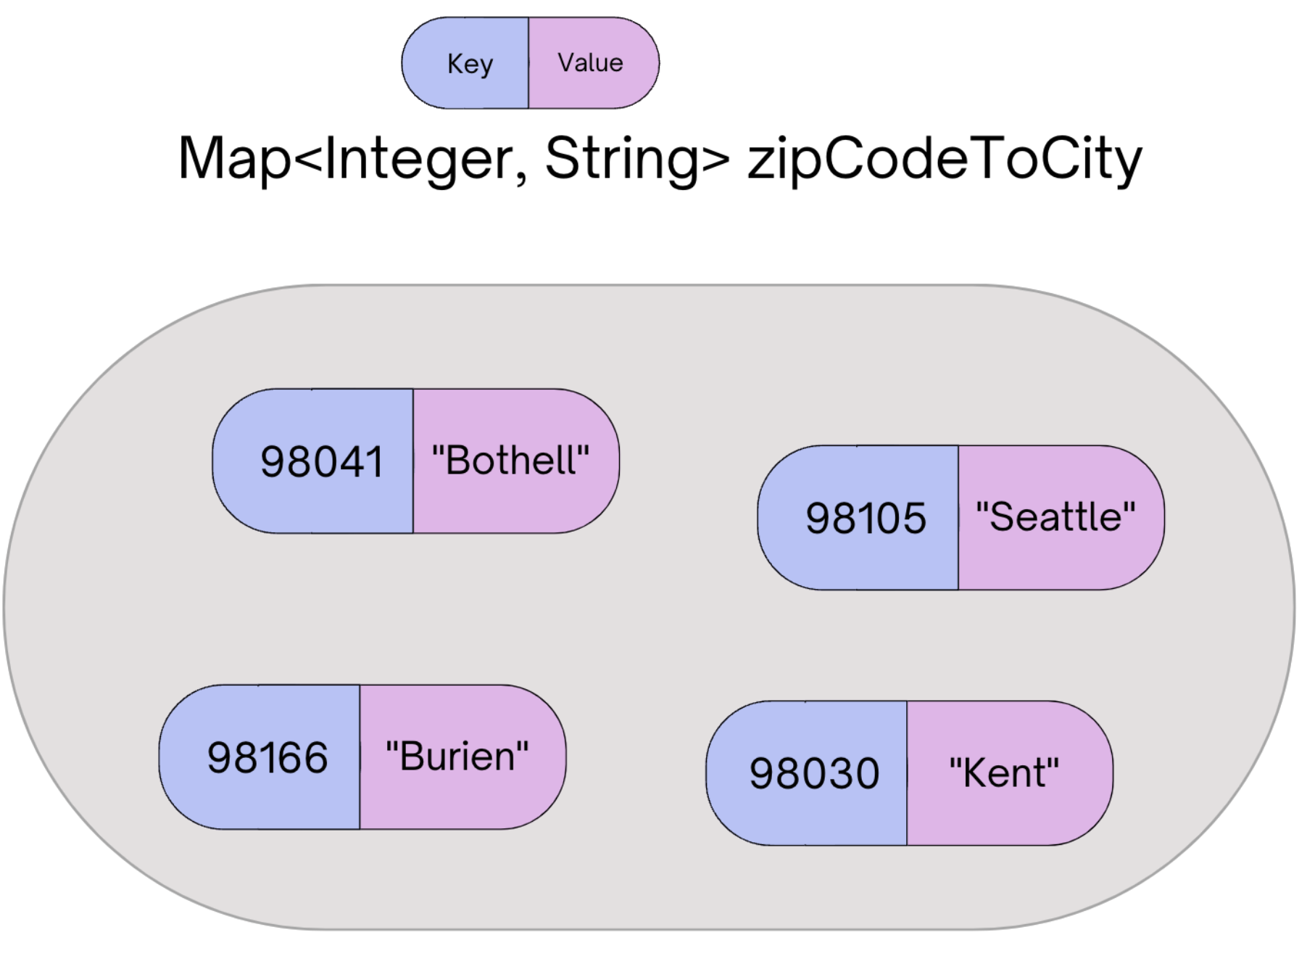
(Review) Map ADT
Data structure to map keys to values
Keys can be any* type; Keys are unique
Values can be any type
Example: Mapping nucleotides to counts!
Operations
put(key, value): Associate key to value
Overwrites duplicate keys
get(key): Get value for key
remove(key): Remove key/value pair
Same as Python’s dict

Slide 6
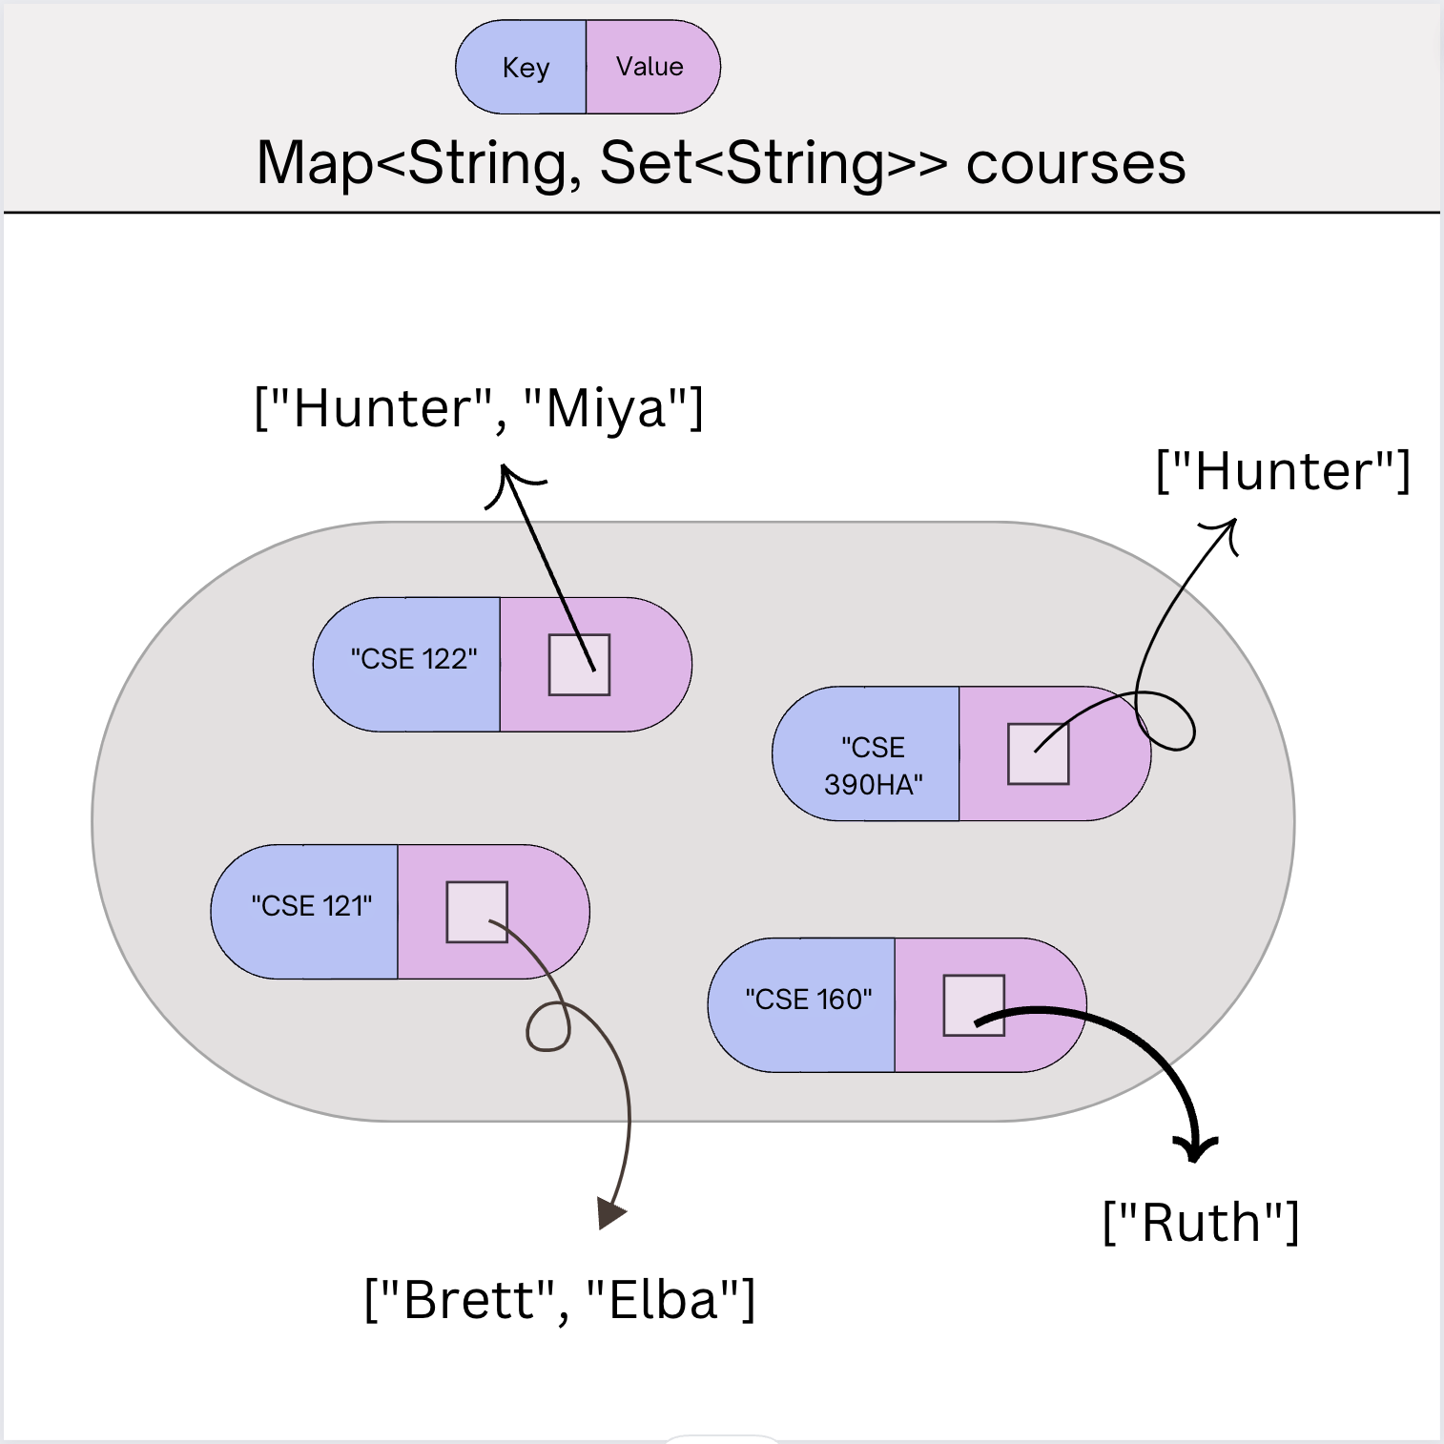
(PCM) Nested Collections
The values inside a Map can be any type, including data structures
Common examples:
Mapping Section -> Set of students in that section
Mapping Recipe -> Set of ingredients in that recipe
Or even Map<String, Map<String, Double>> for units!

Slide 7
Map Type Examples
Count of A, T, C, Gs in a DNA sequence
Map<Character, Integer>
A, T, C, or G
occurrence count
Look up all students in each section based on their TA name…
Map<String, Set<String>>
TA name
Student names
Represent people in line at a grocery store grouped by the cashier they’re waiting for
Map<Integer, Queue<String>>
Lane Number
Customer names in a queue

Slide 8
Agenda
Announcements
Recap: Nested Collections
Practice: Barbenheimer
Practice: Search Engine
Images Debrief

Slide 9
(PCM) Updating Nested Collections
The value inside the Map is a reference to the data structure!
Think carefully about number of references to a particular object
courses.put("CSE 123", new HashSet<String>()); courses.get("CSE 123").add("Kasey"); Set<String> cse123 = courses.get("CSE 123"); cse123.add("Brett");

Slide 10
Suppose map had the following state. What would its state be after running this code?
map: {”KeyA"=[1, 2], ”KeyB"=[3], ”KeyC"=[4, 5, 6]}
Set<Integer> nums = map.get("KeyA"); nums.add(7); map.put("KeyB", nums); map.get("KeyA").add(8); map.get("KeyB").add(9);
{"KeyA"=[1, 2], "KeyB"=[1, 2, 7], "KeyC"=[4, 5, 6]}
{"KeyA"=[1, 2, 8], "KeyB"=[1, 2, 7, 9], "KeyC"=[4, 5, 6]}
{"KeyA"=[1, 2, 7, 8], "KeyB"=[1, 2, 7, 9], "KeyC"=[4, 5, 6]}
{"KeyA"=[1, 2, 7, 8, 9], "KeyB"=[1, 2, 7, 8, 9], "KeyC"=[4, 5, 6]}

Slide 11
Suppose map had the following state. What would its state be after running this code?
map: {”KeyA"=[1, 2], ”KeyB"=[3], ”KeyC"=[4, 5, 6]}
Set<Integer> nums = map.get("KeyA"); nums.add(7); map.put("KeyB", nums); map.get("KeyA").add(8); map.get("KeyB").add(9);
{"KeyA"=[1, 2], "KeyB"=[1, 2, 7], "KeyC"=[4, 5, 6]}
{"KeyA"=[1, 2, 8], "KeyB"=[1, 2, 7, 9], "KeyC"=[4, 5, 6]}
{"KeyA"=[1, 2, 7, 8], "KeyB"=[1, 2, 7, 9], "KeyC"=[4, 5, 6]}
{"KeyA"=[1, 2, 7, 8, 9], "KeyB"=[1, 2, 7, 8, 9], "KeyC"=[4, 5, 6]}

Slide 12
Agenda
Announcements
Recap: Nested Collections
Practice: Barbenheimer
Practice: Search Engine
Images Debrief

Slide 13
Background: Search Engines
A search engine receives a query and returns a set of relevant documents. Examples: Google.com, Mac Finder, more.
Queries often can have more
A search engine involves two main components
An index to efficiently find the set of documents for a query
Will focus on “single word queries” for today’s example
A ranking algorithm to order the documents from most to least relevant
Not the focus of this example
Goal: Precompute a data structure that helps find the relevant documents for a given query

Slide 14
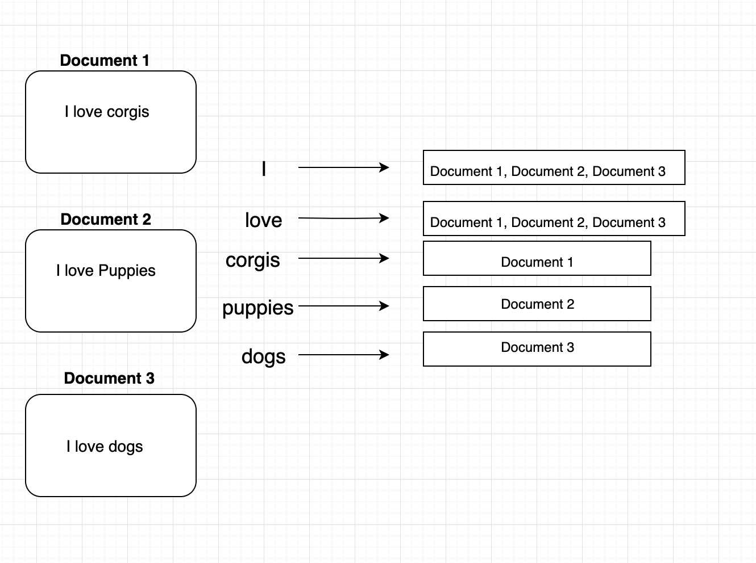
Inverted Index
An inverted index is a Mapping from possible query words to the set of documents that contain that word
Answers the question: “What documents contain the word ‘corgis’?”

Slide 15
(Optional) Ranking Results
There is no one right way to define which documents are “most relevant” There are approximations, but make decisions about what relevance means
Idea 1: Documents that have more hits of the query should come first
Pro: Simple
Con: Favors longer documents (query: “the dogs” will favor long documents with lots of “the”s)
Idea 2: Weight query terms based on their “uniqueness”. Often use some sort of score for “Term Frequency – Inverse Document Frequency (TF-IDF)
Pro: Doesn’t put much weight on common words like “the”
Cons: Complex, many choices in how to compute that yield pretty different rankings
Idea 3: Much more! Most companies keep their ranking algorithms very very secret ☺

Slide 16
Agenda
Announcements
Review/Finish: mostFrequentStart
Recap: Nested Collections
Practice: Search Engine
Images Debrief

Slide 17
Data Bias
Common Misconception: Models or Artificial Intelligence (AI) are somehow “less biased” or “more objective” than humans. Not true.
The programs we use operate on real-world data, and will often reflect the biases that data contains
Have to carefully consider the context and limitations of the data we gather. If the data an algorithm is built on is vastly different than the context in which it’s used, some pretty awful outcomes can happen

Slide 18
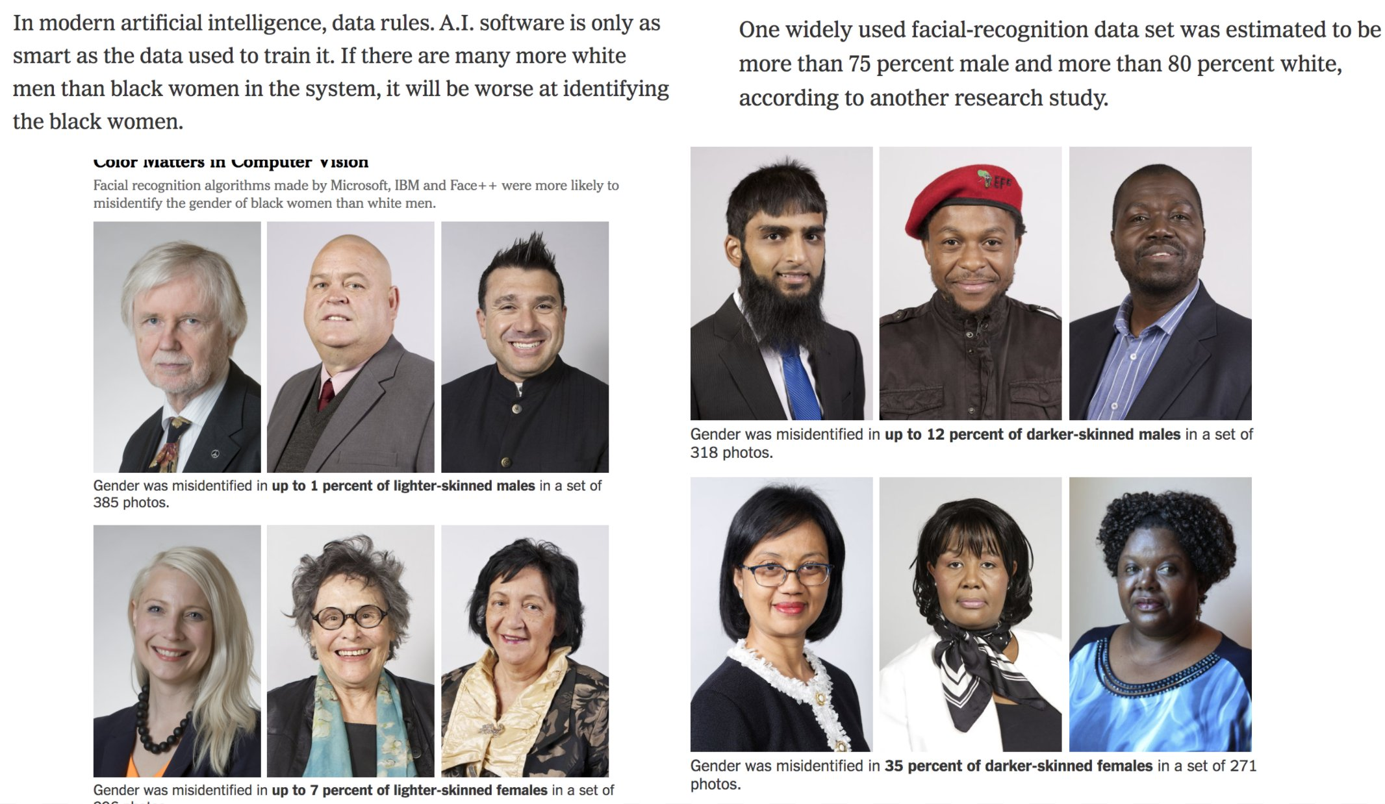
Data Bias

Slide 19
What to do?
Obviously, ideal to have datasets that aren’t biased in the first place.
But might not always be possible if we can’t fix the sources of the bias in the real world...
AI/Models aren’t “neutral” or “more objective”, they just quickly and automatically codify the status quo (and perpetuate biases)
Garbage in → Garbage out
Lots of work going into how to de-bias models even if they are trained on biased data. Active area of research!
Key take-away: None of this comes “for free”, requires hard work to fight bias
Ask ourselves:
What biases might be present in my data?
What assumptions might I be making about who is using my program?
How can I write code to be more inclusive?
What happens when (not if) mistakes happen? Who potentially benefits and who is potentially harmed?

