Slide 1
Maps
BEFORE WE START
Talk to your neighbors:
What’s your favorite movie genre?

Slide 2
Lecture Outline
Announcements
Map Review
Debrief PCM: Count Words
Practice: joinRosters
Practice: mostFrequentStart

Slide 3
Announcements
Quiz 0 grades were released
- Regrade Request form
C1 due tomorrow
P2 released Friday
Quiz 1 is Monday, July 24
Topics: Reference Semantics, 2D Arrays, Sets, Maps

Slide 4
Lecture Outline
Announcements
Map Review
Debrief PCM: Count Words
Practice: joinRosters
Practice: mostFrequentStart

Slide 5
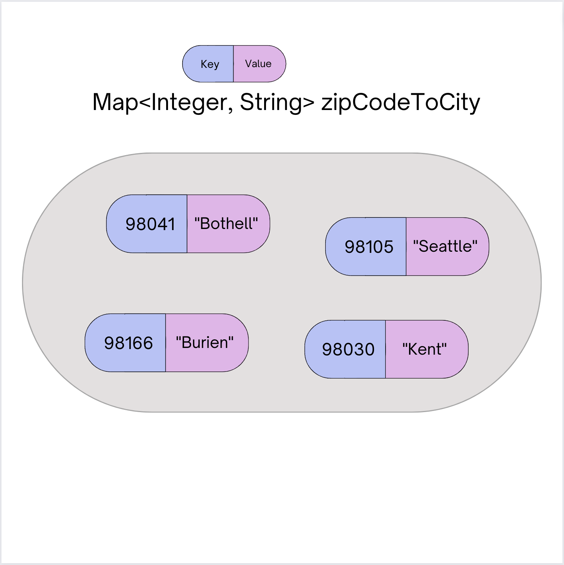
(PCM) Map - What is it good for?
What is it?
Keeps associations between unique keys and (non-unique) values
All keys are one type. All values are one type
But a keys might be a different type from values
Dynamically sized
What is Map particularly good at?
put(key, value) - associates key with a value
get(key) - returns the value associated with a key (if any)
remove(key) – remove key/value pair

Slide 6
(PCM) Abstract Data Types
more
abstract
ADT
Examples: queue, stack, list,
set, map (aka dictionary)
Language agnostic
Language specific
Interface
Examples: Queue<>, List<>
Set<>, Map<>
more
specific
Implementation
Examples: ArrayList, LinkedList, array, Stack, 2D array,
HashSet, TreeSet, HashMap, TreeMap

Slide 7
(PCM) Maps in Java
Interface: Map
Implementations: TreeMap, HashMap
TreeMap – Pretty fast, sorted keys
HashMap – Extremely fast, unsorted keys
Map<String, Integer> map1 = new TreeMap<>(); Map<String, Integer> map2 = new HashMap<>();
...

Slide 8
(PCM) Programming with Maps
Methods | Description
put(key, value) | adds a mapping from the given key to the given value; if the key already exists, replaces its value with the given one
get(key) | returns the value mapped to the given key (null if not found)
containsKey(key) | returns true if the map contains a mapping for the given key
remove(key) | removes any existing mapping for the given key
keySet() | returns a set of all keys in the map
values() | returns a collection of all values in the map
clear() | removes all key/value pairs from the map
size() | returns the number of key/value pairs in the map
isEmpty() | returns true if the map's size is 0
toString() | returns a string such as "{a=90, d=60, c=70}"

Slide 9
(PCM) Programming with Maps
// Making a Map Map<String, String> musicalToFavSong = new TreeMap<>(); // adding elements to the above Map musicalToFavSong.put(”Hamilton", ”Wait for It"); musicalToFavSong.put(”Les Miserables", ”Stars"); musicalToFavSong.put(”Waitress", ”She Used to Be Mine"); // Getting a value for a key String song = musicalToFavSong.get(”Hamilton"); System.out.println(song); // “Wait for It”

Slide 10
What does the map store after the following code?
Map<String, String> musicalToFavSong = new TreeMap<>(); musicalToFavSong.put("Hamilton", "Non-Stop");
musicalToFavSong.put("Hamilton", "Wait for It"); musicalToFavSong.put("Les Miserables", "Stars"); musicalToFavSong.put("Waitress", "She Used to Be Mine"); musicalToFavSong.remove(”Les Miserables");
musicalToFavSong.put(”Hairspray", ”Without Love");
Error
D
Hamilton -> Non-Stop Hamilton -> Wait for It Waitress -> She Used to Be Mine Hairspray -> Without Love
Waitress -> She Used to Be Mine
Hamilton -> Wait for It Hairspray -> Without Love
Hairspray -> Without Love Hamilton -> Wait for It Waitress -> She Used to Be Mine
A
B
C

Slide 11
What does the map store after the following code?
Map<String, String> musicalToFavSong = new TreeMap<>(); musicalToFavSong.put("Hamilton", "Non-Stop");
musicalToFavSong.put("Hamilton", "Wait for It"); musicalToFavSong.put("Les Miserables", "Stars"); musicalToFavSong.put("Waitress", "She Used to Be Mine"); musicalToFavSong.remove(”Les Miserables");
musicalToFavSong.put(”Hairspray", ”Without Love");
Error
Hamilton -> Non-Stop Hamilton -> Wait for It Waitress -> She Used to Be Mine Hairspray -> Without Love
Waitress -> She Used to Be Mine
Hamilton -> Wait for It Hairspray -> Without Love
Hairspray -> Without Love Hamilton -> Wait for It Waitress -> She Used to Be Mine
A
B
C

Slide 12
Lecture Outline
Announcements
Map Review
Debrief PCM: Count Words
Practice: joinRosters
Practice: mostFrequentStart

Slide 13
Lecture Outline
Announcements
Map Review
Debrief PCM: Count Words
Practice: joinRosters
Practice: mostFrequentStart

Slide 14
joinRosters
Write a method joinRosters that combines a Map from student name to quiz section, and a Map from TA name to quiz section and prints all pairs of students/TAs.
For example, if studentSections stores the following map:
{Alan=AD, Jerry=AB, Nina=AA, Sharon=AB, Tanya=AD}
And taSections stores the following map
{Jaylyn=AB, Darel=AD, Atharva=AA}
AD: Alan - Darel AB: Jerry - Jaylyn AA: Nina - Atharva AB: Sharon - Jaylyn AD: Tanya - Darel

Slide 15
Lecture Outline
Announcements
Map Review
Debrief PCM: Count Words
Practice: joinRosters
Practice: mostFrequentStart

Slide 16
mostFrequentStart
Write a method called mostFrequentStart that takes a Set of words and does the following steps:
Organizes words into “word families” based on which letter they start with
Selects the largest “word family” as defined as the family with the most words in it
Returns the starting letter of the largest word family (and if time, should update the Set of words to only have words from the selected family).

Slide 17
mostFrequentStart
For example, if the Set words stored the values
["hello", "goodbye", "library", "literary", "little", "repel"]
The word families produced would be
'h' -> 1 word ("hello")
'g' -> 1 word ("goodbye")
'l' -> 3 words ("library", "literary", "little")
'r' -> 1 word ("repel")
Since 'l' has the largest word family, we return 3 and modify the Set to only contain Strings starting with 'l'.

