Slide 1
Stacks & Queues
BEFORE WE START
Talk to your neighbors:
Dogs or cats?

Slide 2
Lecture Outline
Announcements
Review: ADTs, Stacks & Queues
Queue Manipulation
Stack Manipulation
Problem Solving

Slide 3
Announcements
Quiz 0 next Monday (July 10th)
Resub 0 (R0) due tonight
P0 grades will be released today, so you technically can resubmit
Creative Project (C0) due tomorrow
Programming Assignment 1 (P1) will be released Friday
It will be due next Thursday (July 13)

Slide 4
Lecture Outline
Announcements
Review
Queue Manipulation
Stack Manipulation
Problem Solving

Slide 5
(PCM) Abstract Data Types
Abstract Data Type (ADT): A specification of a collection of data and the operations that can be performed on it.
Describes what a collection does, not how it does it
We don't know exactly how a stack or queue is implemented, and we don't need to!
Only need to understand high-level idea of what a collection does and its operations in order to use them
Stack: retrieves elements in reverse order as added. Operations: push, pop, peek, …
Queue: retrieves elements in same order as added. Operations: add, remove, peek, …

Slide 6
(PCM) Abstract Data Types
more
abstract
ADT
Examples: queue, stack, list
Language agnostic
Language specific
Interface
Examples: Queue<>, List<>
more
specific
Implementation
Examples: ArrayList, LinkedList, array, Stack

Slide 7
Stack - What is it good for?
What is it?
A Last-in-First-out (LIFO) data structure
Elements are removed in the reverse order to how they were added
All elements must be of same type*
Dynamically sized
push
pop, peek
What is Stack particularly good at?
push - add element to top
pop - remove element from top
Supported operations are few but very efficient
top | 3
 | 2
bottom | 1
stack

Slide 8
(PCM) Stacks
top
push
pop
bottom

Slide 9
Stacks in Computer Science
Programming languages and compilers:
method calls are placed onto a stack (call=push, return=pop)
compilers use stacks to evaluate expressions
Matching up related pairs of things:
find out whether a string is a palindrome
examine a file to see if its braces { } match
convert "infix" expressions to pre/postfix
Sophisticated algorithms:
searching through a maze with "backtracking”
many programs use an "undo stack" of previous operations

Slide 10
(PCM) Programming with Stacks
Stack<E>() | constructs a new stack with elements of type E
push(value) | places given value on top of stack
pop() | removes top value from stack and returns it; throws EmptyStackException if stack is empty
peek() | returns top value from stack without removing it; throws EmptyStackException if stack is empty
size() | returns number of elements in stack
isEmpty() | returns true if stack has no elements
Stack<String> s = new Stack<String>();
s.push("a");
s.push("b");
s.push("c"); // bottom ["a", "b", "c"] top
System.out.println(s.pop()); // "c"
Stack has other methods that we will ask you not to use

Slide 11
Queue - What is it good for?
What is it?
A First-in-First-out (FIFO) data structure
Elements are removed in the same order to how they were added
All elements must be of same type*
Dynamically sized
front |  | back
1 | 2 | 3
What is Queue particularly good at?
add - add element to back
remove - remove element from front
Supported operations are few but very efficient
remove, peek
add
queue

Slide 12
(PCM) Queue
remove
front
back
add

Slide 13
Queues in Computer Science
Operating systems:
queue of print jobs to send to the printer
queue of programs / processes to be run
queue of network data packets to send
Programming:
modeling a line of customers or clients
storing a queue of computations to be performed in order
Real world examples:
people on an escalator or waiting in a line
cars at a gas station (or on an assembly line)

Slide 14
(PCM) Programming with Queues
add(value) | places given value at back of queue
remove() | removes value from front of queue and returns it; throws a NoSuchElementException if queue is empty
peek() | returns front value from queue without removing it; returns null if queue is empty
size() | returns number of elements in queue
isEmpty() | returns true if queue has no elements
Queue<Integer> q = new LinkedList<Integer>();
q.add(42);
q.add(-3);
q.add(17); // front [42, -3, 17] back
System.out.println(q.remove()); // 42
IMPORTANT: When constructing a queue you must use a new LinkedList object instead of a new Queue object.

Slide 15
Lecture Outline
Announcements
Review
Queue Manipulation
Stack Manipulation
Problem Solving

Slide 16
Lecture Outline
Announcements
Review
Queue Manipulation
Stack Manipulation
Problem Solving

Slide 17
What is the return of this method?
// numbers: bottom [1, 2, 3, 4, 5] top
public static int sum(Stack<Integer> numbers) { int total = 0; for (int i = 0; i < numbers.size(); i++) { int number = numbers.pop(); total += number; numbers.push(number); } return total; }
0
1
5
15
25
Throws an error

Slide 18
What is the return of this method?
// numbers: bottom [1, 2, 3, 4, 5] top
public static int sum(Stack<Integer> numbers) { int total = 0; for (int i = 0; i < numbers.size(); i++) { int number = numbers.pop(); total += number; numbers.push(number); } return total; }
0
1
5
15
25
Throws an error

Slide 19
What is the return of this method?
// numbers: bottom [1, 2, 3, 4, 5] top
public static int sum(Stack<Integer> numbers) { Queue<Integer> q = new LinkedList<>(); int total = 0; for (int i = 0; i < numbers.size(); i++) { int number = numbers.pop(); total += number; q.add(number); } return total; }
0
1
5
12
15
Throws an error

Slide 20
What is the return of this method?
// numbers: bottom [1, 2, 3, 4, 5] top
public static int sum(Stack<Integer> numbers) { Queue<Integer> q = new LinkedList<>(); int total = 0; for (int i = 0; i < numbers.size(); i++) { int number = numbers.pop(); total += number; q.add(number); } return total; }
0
1
5
12
15
Throws an error

Slide 21
Stack Sum bug
Loop Table
// numbers: bottom [1, 2, 3, 4, 5] top
public static int sum(Stack<Integer> numbers) { Queue<Integer> q = new LinkedList<>(); int total = 0; for (int i = 0; i < numbers.size(); i++) { int number = numbers.pop(); total += number; q.add(number); } // Still need to move back to the stack! return total; }
i | total | numbers | numbers.size()
0
5
[4, 3, 2, 1]
1
9
[3, 2, 1]
4
2
12
[2, 1]
3
3
2
Exit the loop!!

Slide 22
Lecture Outline
Announcements
Review
Queue Manipulation
Stack Manipulation
Problem Solving

Slide 23
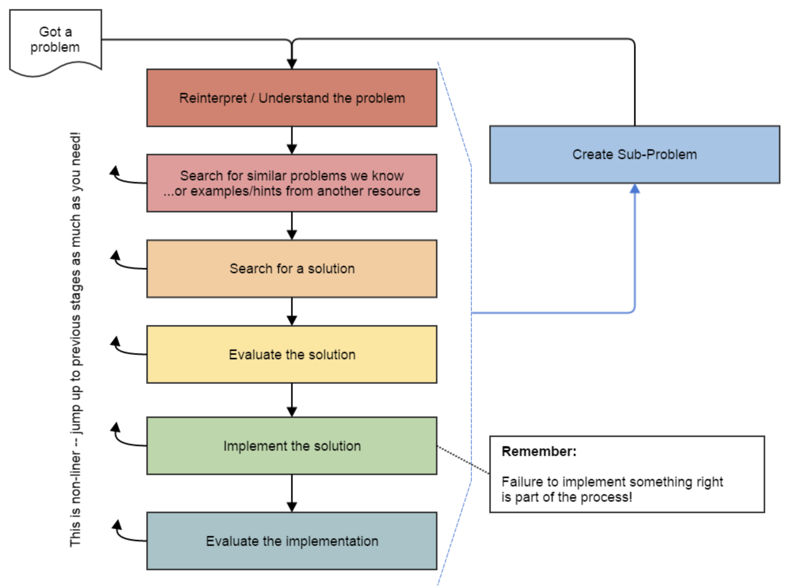
Problem Solving
On their own, Stacks & Queues are quite simple with practice (few methods, simple model)
Some of the problems we ask are complex because the tools you have to solve them are restrictive
sum(Stack) is hard with a Queue as the auxiliary structure
We challenge you on purpose here to practice problem solving
Source: Oleson, Ko (2016) - Programming, Problem Solving, and Self-Awareness: Effects of Explicit Guidance

Slide 24
Common Problem-Solving Strategies
Analogy – Is this similar to a problem you’ve seen?
sum(Stack) is probably a lot like sum(Queue), start there!
Brainstorming – Consider steps to solve problem before writing code
Try to do an example “by hand” → outline steps
Solve Sub-Problems – Is there a smaller part of the problem to solve?
Move to queue first
Debugging – Does your solution behave correctly on the example input.
Test on input from specification
Test edge cases (“What if the Stack is empty?”)
Iterative Development – Can we start by solving a different problem that is easier?
Just looping over a queue and printing elements

Slide 25
Common Stack & Queue Patterns
Stack → Queue and Queue → Stack
We give you helper methods for this on problems
Reverse a Stack with a S→Q + Q→S
“Cycling” a queue: Inspect each element by repeatedly removing and adding to back size times
Careful: Watch your loop bounds when queue’s size changes
A ”splitting” loop that moves some values to the Stack and others to the Queue

Slide 26
See you Friday!
Practice with Stacks & Queues in Section
Quiz on Monday (July 10th)
Challenge problem in lecture on Friday
P1, released Friday, will use Stacks & Queues
Remember to do the PCM for Friday!

