Slide 1
Collections
BEFORE WE START
Talk to your neighbors:
Favorite 122 data structure?

Slide 2
Lecture Outline
Announcements
Classes + Interfaces Recap
Dumb Data Structures
Collections
Final Exam Review

Slide 3
Announcements
P3 due on Sunday at 11:59pm
Resub 6 due Tuesday
Quiz 2 grades will be released Monday
Final Exam is next week!
Wednesday + Friday @ 10:50am – 11:50am in PCAR 192
Final Review Session Monday @ 11:00am – 1:30pm
11am – 12:15pm : Work on a practice final
12:15pm – 1:30pm : TAs walk through solutions
IPL will be open through Thursday, Aug 17

Slide 4
Lecture Outline
Announcements
Classes + Interfaces Recap
Dumb Data Structures
Collections
Final Exam Review

Slide 5
Goal for Today
Review some of the data structures we’ve talked about this quarter
Understand how Java organizes them with interfaces

Slide 6
Collections: What classes have we seen so far?

Slide 7
Collections: What interfaces have we seen so far?

Slide 8
Lecture Outline
Announcements
Classes + Interfaces Recap
Dumb Data Structures
Collections
Final Exam Review

Slide 9
Dumb Data Structures
We’re going to create our own versions of these classes so we can dig into how they all relate to each other!
BUT they’re going to be real dumb.
If you want to get a sense of how they’re actually implemented, go take CSE 123!

Slide 10
DumbArrayIntList
DumbArrayIntList()
add(int value)
add(int index, int value)
contains(int value)
isEmpty()
get(int index)
set(int index, int value)
remove(int index)
size()
indexOf(int value)
toString()

Slide 11
Lecture Outline
Announcements
Classes + Interfaces Recap
Dumb Data Structures
Collections
Final Exam Review

Slide 12
IntCollection Relationships
IntCollection
extends
extends
extends
IntList
IntSet
IntQueue
implements
implements
implements
implements
class DumbLinkedIntList
class DumbArrayIntList
class DumbHashIntSet
class DumbTreeIntSet

Slide 13
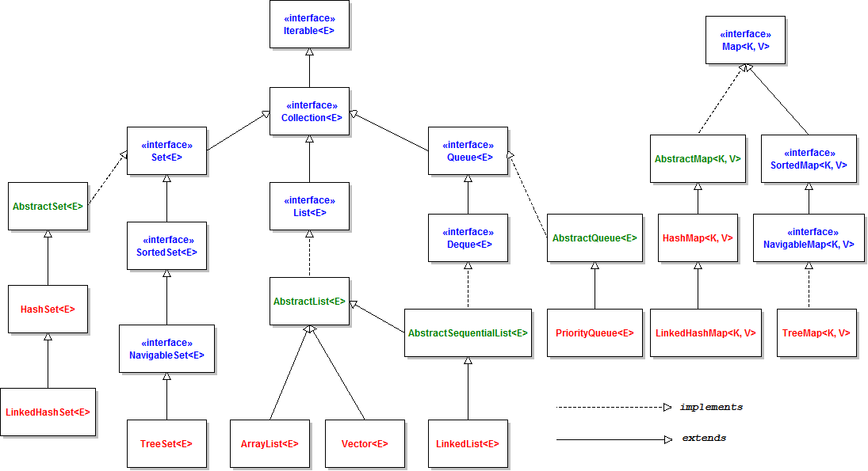

Slide 14
Lecture Outline
Announcements
Classes + Interfaces Recap
Dumb Data Structures
Collections
Final Exam Review

Slide 15
Exam Format
6 questions in total, each will receive one ESN grade
Some questions might have sub-parts
Reminder: Quiz and Exam grades are all mixed into the same bucket
General format
3 Questions: Mix of Conceptual, Mechanical/Tracing, Debugging Problems
3 Questions: Programming Problems
Wednesday – 3 questions
Friday – 3 questions
See sections 11, 13, and 14 for practice handwriting problems
Practice finals posted on course website

Slide 16
Exam Logistics
Most important bits
Wednesday and Friday @ 10:50am – 11:50am in PCAR 192
Seat assignments
Don’t cheat
Only have the exam open during the time (don’t’ start early; don’t work after)
No electronic devices
You can bring one 8.5x11 inch paper with notes (front and back)
Will also provide a reference sheet (see course website)
Bring husky card + pencil
Questions? Raise hand or ask on sli.do (#cse122)

Slide 17
Review Resources
Pre-Class Materials + Lectures
Section Handouts (Especially sections 11, 13, and 14)
Quizzes
Sample Finals
Your Notes!
Helpful for contextualizing what you learned

Slide 18
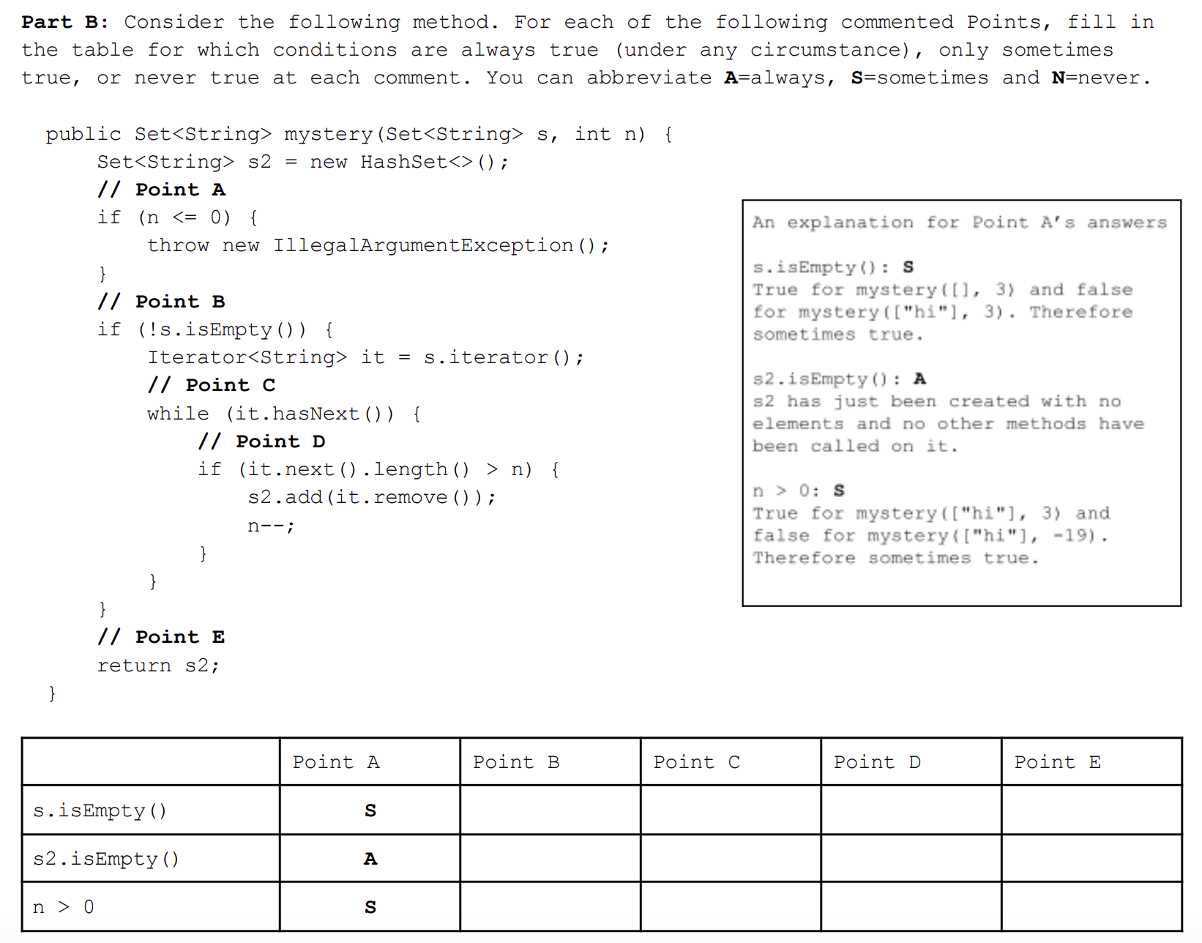

Slide 19
What topic do you feel the most confident about? Least confident? How do you plan on studying for the final? What questions do you have about the final?

