Slide 1
JUnit Testing
BEFORE WE START
Talk to your neighbors:
What is your favorite “classic” mobile game?
(e.g. candy crush, temple run, fruit ninja, 2048, etc)

Slide 2
Lecture Outline
Announcements
Optional
Importance of Testing
JUnit
Example: Tic Tac Toe

Slide 3
Announcements
Final Exam on Wed + Fri @ 10:50 – 11:50am PCAR 192
Review session on Monday Aug 14
More resources/policies on course website
Programming Assignment 3 due Sunday, Aug 13
Resub 6 due Tuesday, Aug 15

Slide 4
Exam Format
6 questions in total, each will receive one ESN grade
Some questions might have sub-parts
Reminder: Quiz and Exam grades are all mixed into the same bucket
General format
3 Questions: Mix of Conceptual, Mechanical/Tracing, Debugging Problems
3 Questions: Programming Problems
Wednesday – 3 questions
Friday – 3 questions
See sections 11, 13, and 14 for practice handwriting problems
Practice finals posted on course website

Slide 5
Exam Logistics
Most important bits
Wednesday and Friday @ 10:50am – 11:50am in PCAR 192
Seat assignments
Don’t cheat
Only have the exam open during the time (don’t’ start early; don’t work after)
No electronic devices
You can bring one 8.5x11 inch paper with notes (front and back)
Will also provide a reference sheet (see course website)
Bring husky card + pencil
Questions? Raise hand or ask on sli.do (#cse122)

Slide 6
Lecture Outline
Announcements
Optional
Importance of Testing
JUnit
Example: Tic Tac Toe

Slide 7
Optional
Optional is a Java class that is used to handle situations where a value is sometimes there.
You give Optional a type to hold (or potentially not hold) when you are referring to its type.
e.g., Optional<String>, Optional<Integer>, Optional<Point>

Slide 8
Optional Methods
Method | Description
Optional.empty() | Creates an empty Optional object
Optional.of(…) | Creates an Optional object holding the object it’s given
isEmpty() | Returns true if there is no value stored, and false otherwise
isPresent() | Returns true if there is a value stored, and false otherwise
get() | Returns the stored object from the Optional (if one is stored; otherwise throws a NoSuchElementException)
The Optional class has more than just these methods, but these are what you’ll need to focus on for this class!

Slide 9
Optional Methods
isEmpty(), isPresent(), and get() are called like normal instance methods (on an actual instance of Optional).
Optional.of(…) and Optional.empty() are called differently
(Like the Math class methods)

Slide 10
Lecture Outline
Announcements
Optional
Importance of Testing
JUnit
Example: Tic Tac Toe

Slide 11
(PCM) Importance of Testing
Software, written by people, controls more and more of our day-to-day lives.
Bugs (just like the ones we all write) are just as easy to write in this software.
Stakes can be quite high so bugs can have catastrophic effects
Source: Hackaday

Slide 12
Bugs you’ve experienced
Can you think of a bug(s) you’ve experienced or heard of that have had serious effects?
If you can’t, can you think of any absurd bugs you’ve seen?

Slide 13
Lecture Outline
Announcements
Optional
Importance of Testing
JUnit
Example: Tic Tac Toe

Slide 14
JUnit Basics
import statements to give you access to JUnit method annotations and assertion methods!
Method Annotations
@Test
@DisplayName
…
Assertion Methods
assertEquals(expected, actual)
assertTrue(boolean)
assertFalse(boolean)
…

Slide 15
JUnit Testing
import org.junit.jupiter.api.*;
import static org.junit.jupiter.api.Assertions.*;
import java.util.*; public class ArrayListTest { @Test public void testAddAndGet() { List<String> list = new ArrayList<>(); list.add("Hunter Schafer"); list.add("Miya Natsuhara"); list.add("CSE 122"); assertEquals("Hunter Schafer", list.get(0)); assertEquals("Miya Natsuhara", list.get(1)); assertEquals("CSE 122", list.get(2)); assertTrue(list.size() == 3); } }
put object into some expected state
Use assert statements to check if observed state is what we expect

Slide 16
Using JUnit
Each @test method should be independent
ie. set up its own state, make all relevant assertions
An @test fails if any assert statement fails
JUnit executes @test methods in an arbitrary order

Slide 17
Using JUnit - Tips
one @test method per distinct case (i.e., empty case, one element, even, odd, some edge case, …)
Might also want to test calling multiple methods to check that they work together as expected
assertEquals(expected, actual, message) can provide a description of what the line is testing
Good coding practices still apply
Eg. you can write helper methods in your test file

Slide 18
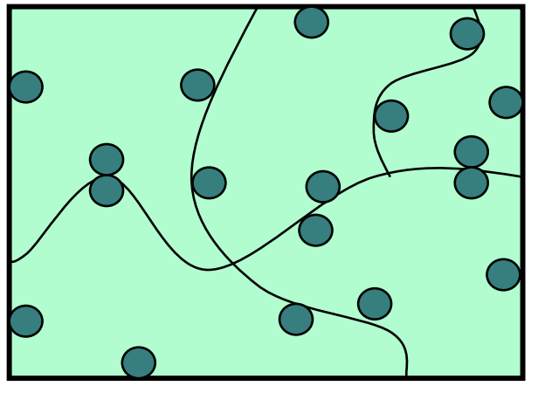
(PCM) How Many Test Cases Is Enough?
In general, more tests –> more confidence!
Try to think adversarially and try to break your own code with tests
Specification Testing (based on the spec) vs. Clear-box Testing (based on how you know your implementation works)
Specification Testing you can do before writing your solution!
Clear-box Testing you do after you've written your solution.
Test a wide variety of different cases
Think about boundary or "edge" cases in particular, where the behavior should change

Slide 19
Lecture Outline
Announcements
Optional
Importance of Testing
JUnit
Example: Tic Tac Toe

Slide 20
What test cases can you think of for the TicTacToe spec?

Slide 21
Closed or open box tests?
Closed box testing - write tests based on a specification independent of any implementation.
Open box testing - write tests for a particular implementation.
Test Driven Development - write tests before the
implementation

Slide 22
Bonus Topic: Floating Point Numbers
Another name for doubles are floating point numbers
Floating point numbers are nice, but imprecise
Computers can only store a certain amount of precision (can’t store 0.3333333333 repeating forever)
Finite precision can lead to slightly incorrect calculations with floating point numbers
Take-away: Essentially can never rely on == for doubles. Instead, must define some notion of how far away they can be to be tolerated as the same
JUnit: assertEquals(expected, actual, delta)

Slide 23
