Slide 1
Advanced OOP
BEFORE WE START
Talk to your neighbors:
Do you listen to any podcasts? If so, what are your favorites?

Slide 2
Lecture Outline
Announcements
Constructors (cont.)
Equals
Larger Example (cont.)

Slide 3
Announcements
C2 due tomorrow
P3 released Friday
The last part of the assignment involves Junit Testing (we will talk about this in Wednesday’s lecture!)
Due August 13
No resubmissions
Final exam reminders
Aug 16 and 18 at the normal lecture time and location
More logistics on course website
Sections from now on are focused on preparing you for the final!

Slide 4
Lecture Outline
Announcements
Constructors (cont.)
Equals
Larger Example (cont.)

Slide 5
(PCM) Constructor Syntax
public Point(int initialX, int initialY) {
x = initialX;
y = initialY;
}
All fields should be initialized in the constructor(s)!
If we write any constructors, Java no longer provides one for us.

Slide 6
(PCM) this keyword
The this keyword refers to the current object in a method or constructor.
You can use it to refer to an object’s fields
this.x, this.y
You can use it to refer to an object’s instance methods
this.setX(newX)
You can use it to call one constructor from another
this(0, 0)

Slide 7
Lecture Outline
Announcements
Constructors (cont.)
Equals
Larger Example (cont.)

Slide 8
(PCM) Equals
The equals() method returns true if the given parameter is considered equal to this object, and false otherwise.
Used by lots of library methods! (contains, remove for specific elements, etc.)
Each class has one provided by Java, but it checks for reference equality.
If you want equals to check for value equality, you need to write this method yourself.

Slide 9
Object
By taking a parameter of type Object, the equals method can be passed any type of object.
More to come in CSE 123 on the Java mechanisms that make this work!
We can use the instanceof keyword in Java to determine if the parameter is actually a Point

Slide 10
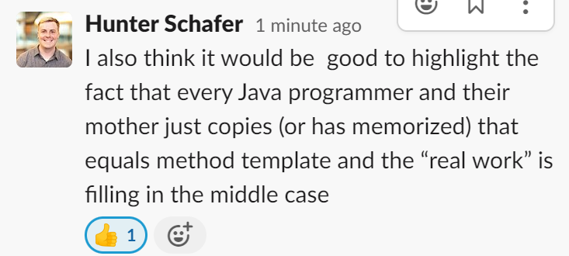
(PCM) Point’s equals()
public boolean equals(Object o) {
if (this == o) {
return true;
} else if (o instanceof Point) {
Point other = (Point) o;
return other.x == this.x && other.y == this.y;
} else {
false;
}
}

Slide 11
Almost there…
This is actually still an imperfect implementation because we would also need to write a hashCode() method for our object to work with HashSet, HashMap, etc. but more to come on that in CSE 331 and beyond ☺

Slide 12
Lecture Outline
Announcements
Constructors (cont.)
Equals
Larger Example (cont.)

Slide 13
What is the best method comment for getNewestSong()?
Returns the last song by this Artist that was added to the list
Returns the newest song by this artist, or null if the artist has no songs
Returns the newest song by this artist
Loops through the list of songs by this Artist to find which one has the largest year and returns it
Returns the newest song by this artist, with ties being broken by which song was added earlier, or null if the artist has no songs.

Slide 14
What is the best method comment for getNewestSong()?
Returns the last song by this Artist that was added to the list
Returns the newest song by this artist, or null if the artist has no songs
Returns the newest song by this artist
Loops through the list of songs by this Artist to find which one has the largest year and returns it
Returns the newest song by this artist, with ties being broken by which song was added earlier, or null if the artist has no songs.

Slide 15
Think about the design of the Song and Artist classes. Here are guiding questions, but you are welcome to (and encouraged to) deviate from these topics!
What are “valid” values for each of the fields?
Song: name, year
Artist: name, songs
What are additional fields that we could include?
Would it make sense to include additional constructors? If so, what constructors?
Example: a Song constructor that accepts only a name
What would happen if we used a different data structure to store an Artist’s songs?
How would it affect the client perspective of an Artist?
What would we need to change about our code?

Slide 16
Design decisions
It’s up to you!
Think carefully about the decisions you make when designing your classes
What assumptions are you making?
How does this affect users?

