Slide 1
Introduction to Objects
BEFORE WE START
Talk to your neighbors:
What did you do last weekend?

Slide 2
Lecture Outline
Announcements
OOP Review
Example
Abstraction
Encapsulation

Slide 3
Announcements
Quiz 1 was on Monday
grades released next week
Resub 3 form due last night
P2 Absurdle due tomorrow
C2 released Friday

Slide 4
Lecture Outline
Announcements
OOP Review
Example
Abstraction
Encapsulation

Slide 5
(PCM) Object Oriented Programming (OOP)
procedural programming: Program that does things by carrying out a series of steps
Classes that do things
object-oriented programming (OOP): Program that does things using interactions between things (ie. objects)
Classes that represent things

Slide 6
(PCM) Classes & Objects
Classes can define the template for an object
📰 Like the blueprint for a house!
Objects are the actual instances of the class
🏠 Like the actual house built from the blueprint!
We create a new instance of a class with the new keyword
e.g., Scanner console = new Scanner(System.in);

Slide 7
(PCM) State & Behavior
Objects can tie related state and behavior together
State is defined by the object’s fields or instance variables
Scanner’s state may include what it’s scanning, where it is in the input, etc.
Behavior is defined by the object’s instance methods
Scanner’s behavior includes “getting the next token and returning it as an int”, “returning whether there is a next token or not”, etc.

Slide 8
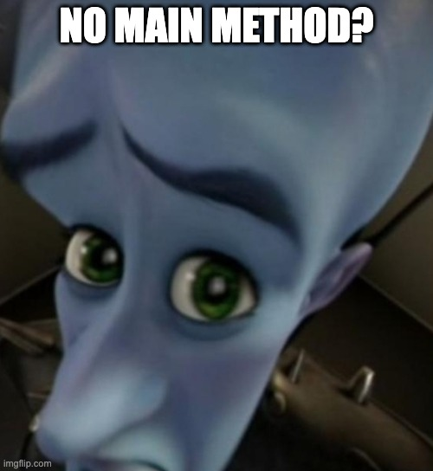
(PCM) Syntax
public class MyObject {
// fields
type1 fieldName1;
type2 fieldName2;
...
// instance methods
public returnType methodName(...) {
...
}
}

Slide 9
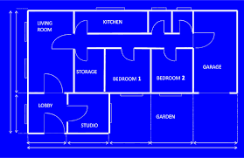
(PCM) Instance Variables
Fields are also referred to as instance variables
Fields are defined in a class
Each instance of the class has their own copy of the fields
Hence instance variable! It’s a variable tied to a specific instance of the class!

Slide 10
(PCM) Instance Methods
Instance methods are defined in a class
Calling an instance method on a particular instance of the class will have effects on that instance

Slide 11
Lecture Outline
Announcements
OOP Review
Example
Abstraction
Encapsulation

Slide 12
Representing a point
How would we do this given what we knew last week?
Maybe int x, int y?
Maybe int[]?

Slide 13
Representing a point
Let’s make a class instead!
int x, int y
Easy to mix up x, y
Just two random ints floating around – easy to make mistakes!
int[]
Not really what an array is for
Again, just two ints – just have to “trust” that we’ll remember to treat it like a point

Slide 14
Lecture Outline
Announcements
OOP Review
Example
Abstraction
Encapsulation

Slide 15
(PCM) Abstraction
The separation of ideas from details, meaning that we can use something without knowing exactly how it works.
You could use the Scanner class without understanding how it worked internally!

Slide 16
(PCM) Client v. Implementor
We have been the clients of many objects this quarter!
Now we will become the implementors of our own objects!

Slide 17
Lecture Outline
Announcements
OOP Review
Example
Abstraction
Encapsulation

Slide 18
Encapsulation
Objects encapsulate state and expose behavior.
Encapsulation is hiding implementation details of an object from its clients.
Encapsulation provides abstraction.

Slide 19
private
The private keyword is an access modifier (like public)
Fields declared private cannot be accessed by any code outside of the object.
We always want to encapsulate our objects’ fields by declaring them private.

Slide 20
Accessors and Mutators
Declaring fields as private removes all access from the user.
If we want to give some back, we can define instance methods.
Accessors (“getters”) | Mutators (“setters”)
getX() | setX(int newX)
getY() | setY(int newY)
 | setLocation(int newX, int newY)

