Slide 1
Welcome!
BEFORE WE START
Music: cse 122 su 23 tunes

Slide 2
Lecture Outline
Introductions
About this Course
Course Components & Tools
Policies
Making the Most of this Class
Intro/Review Java

Slide 3
Course Staff
Instructor: Melissa Lin
Teaching Assistants:
Available in section, office hours, and discussion board
Invaluable source of information & help in this course
We’re excited to get to know you!
Our goal is to help you succeed ☺

Slide 4
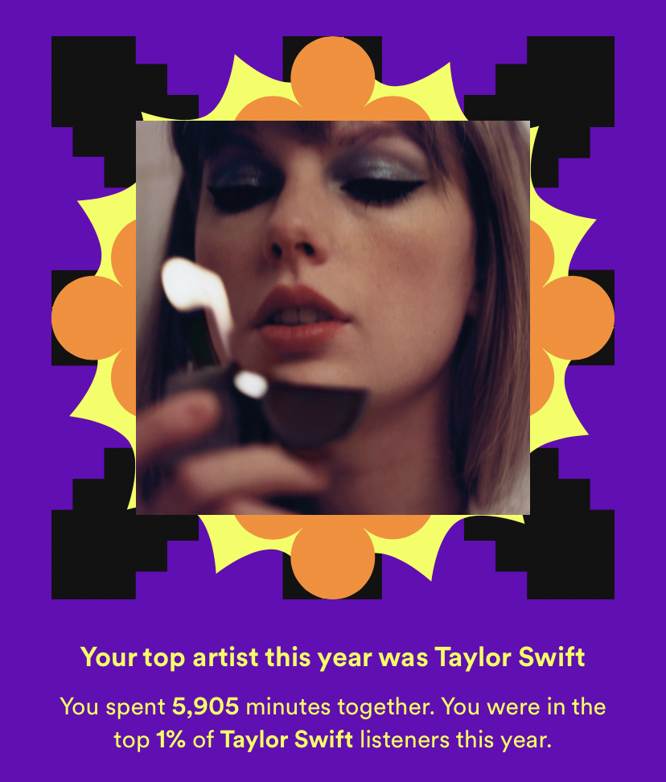
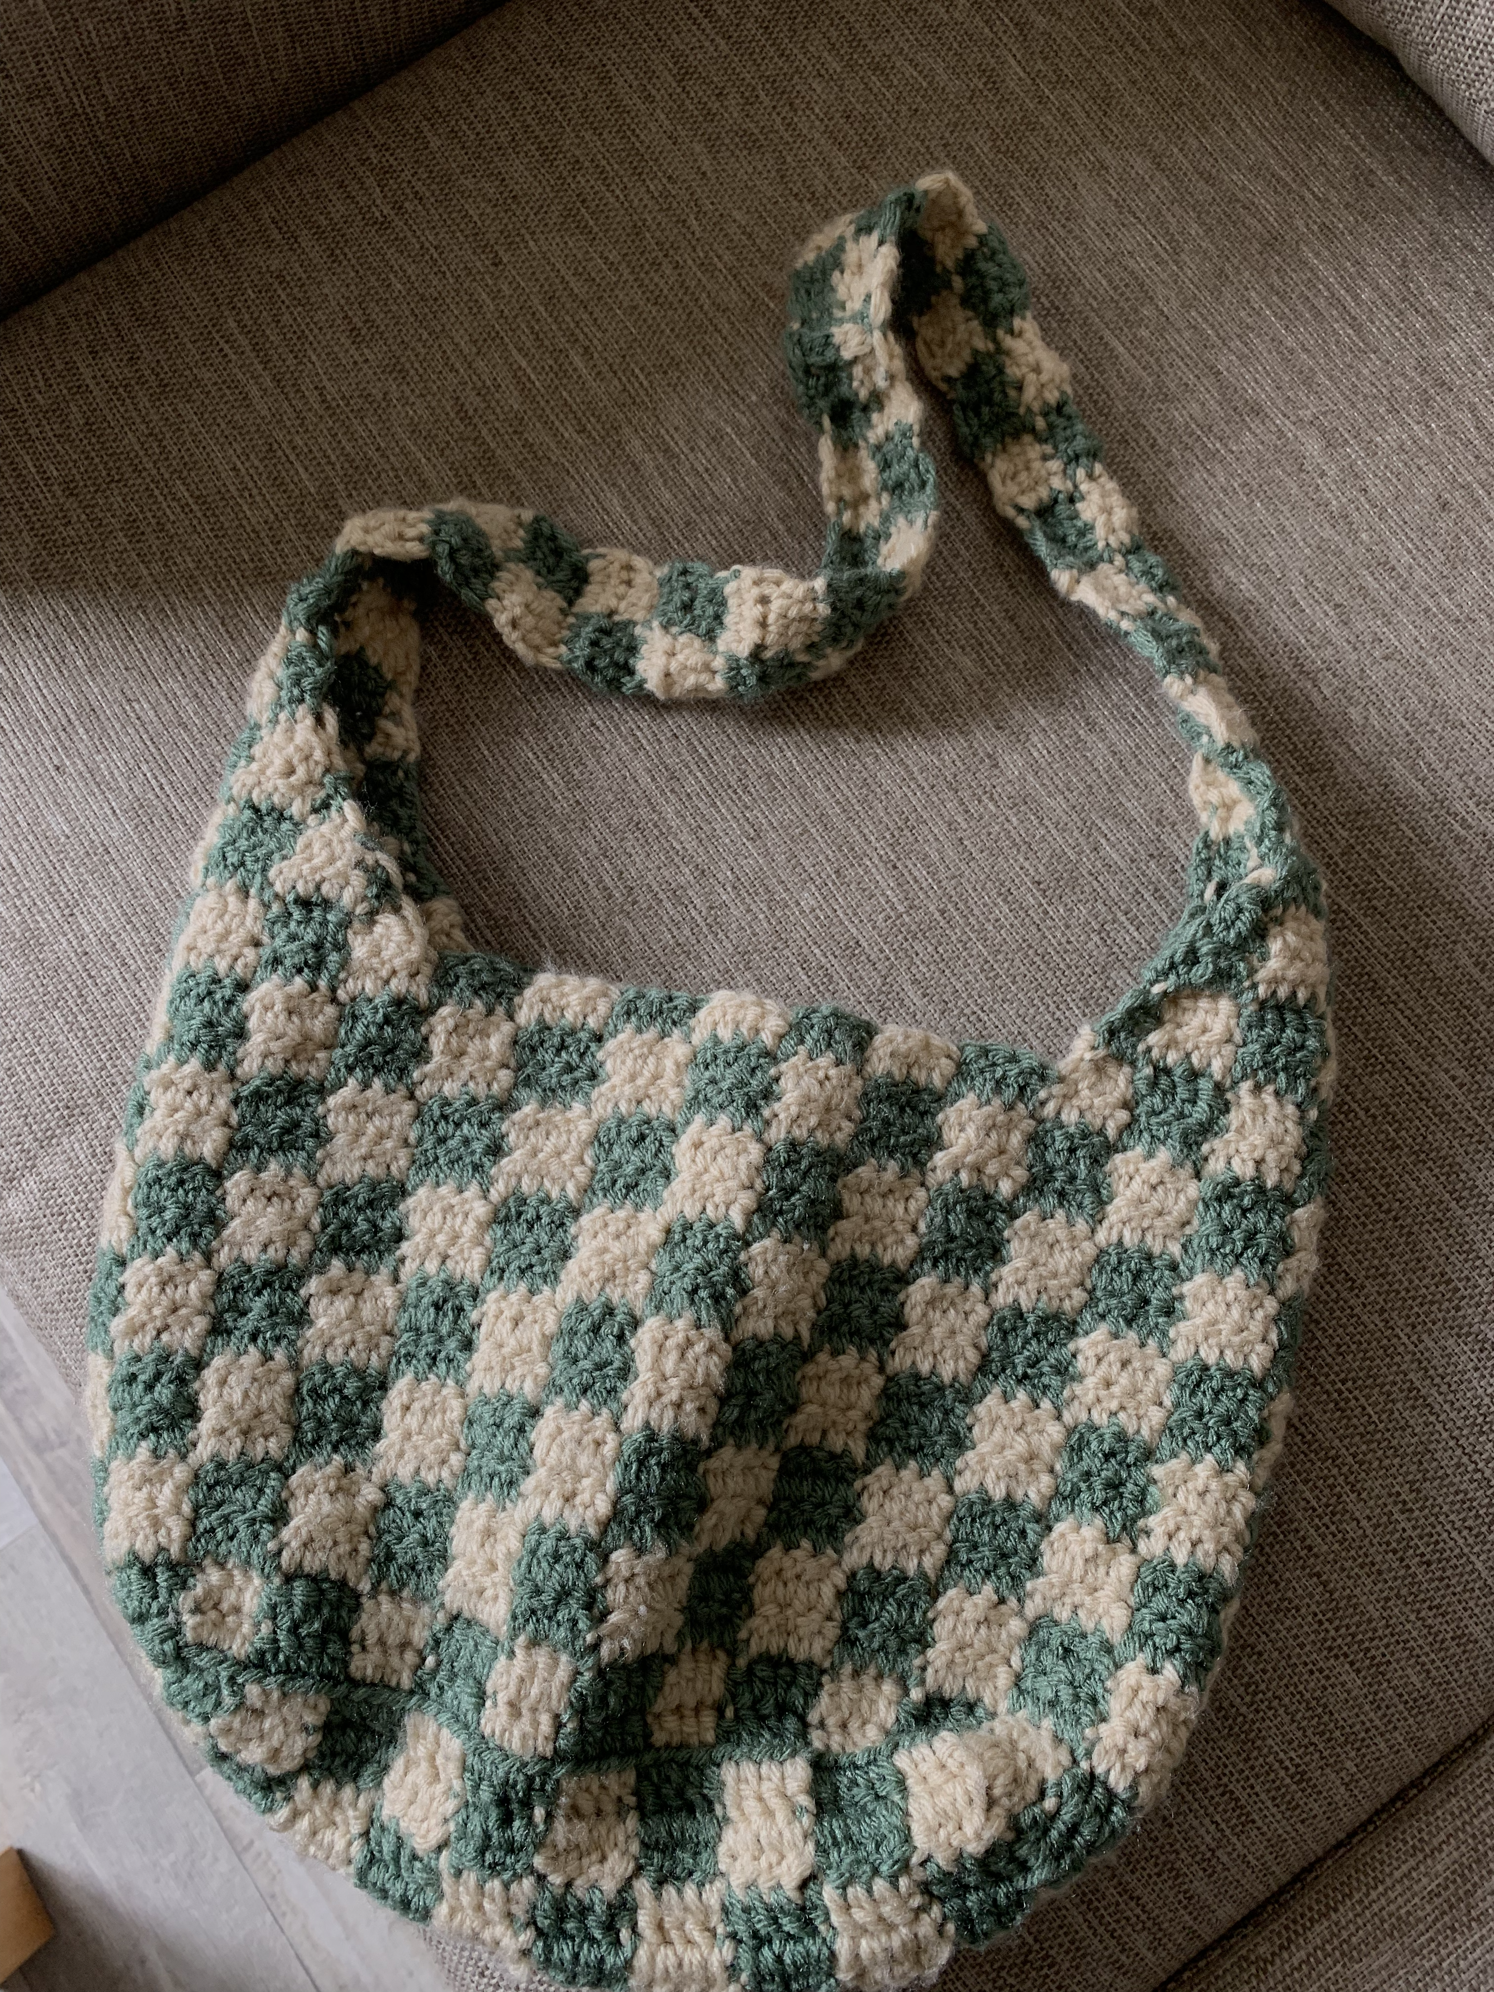
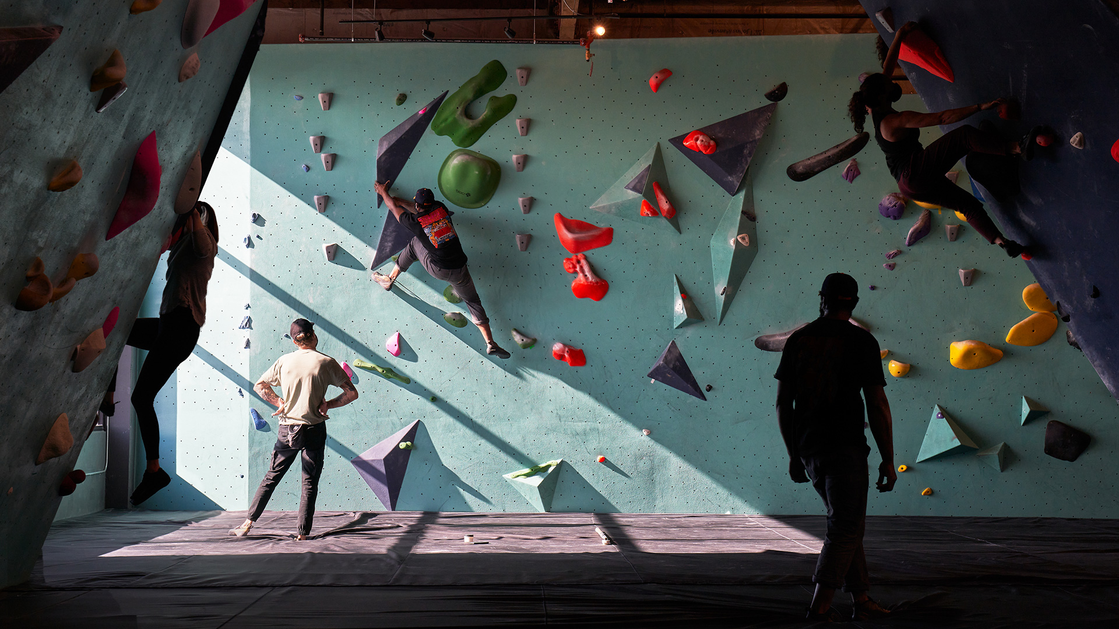
About me
me

Slide 5
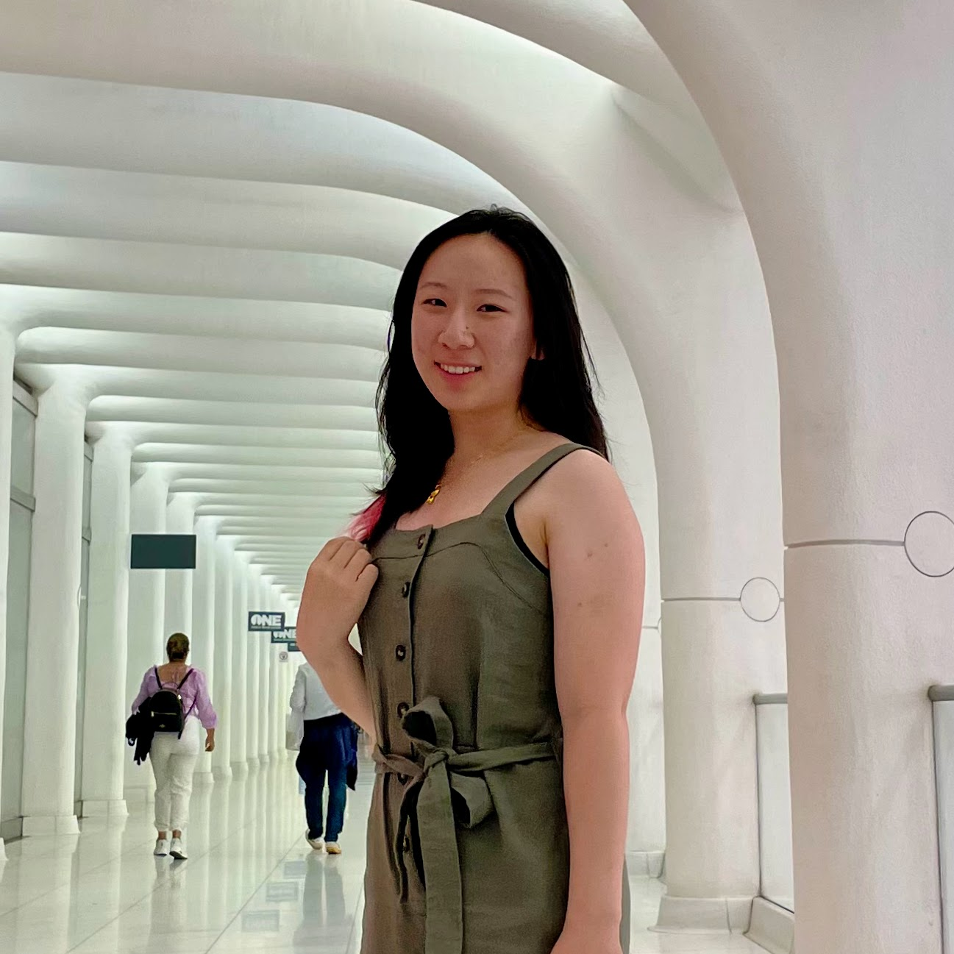
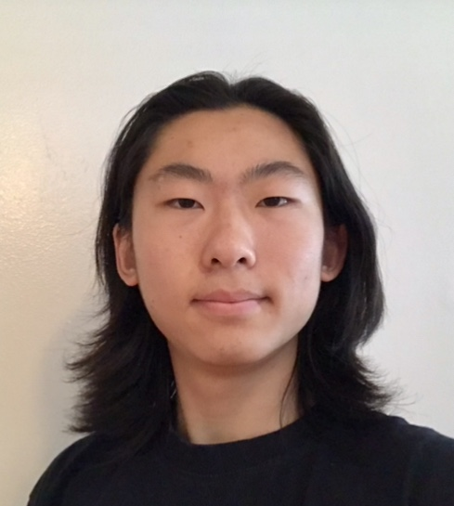
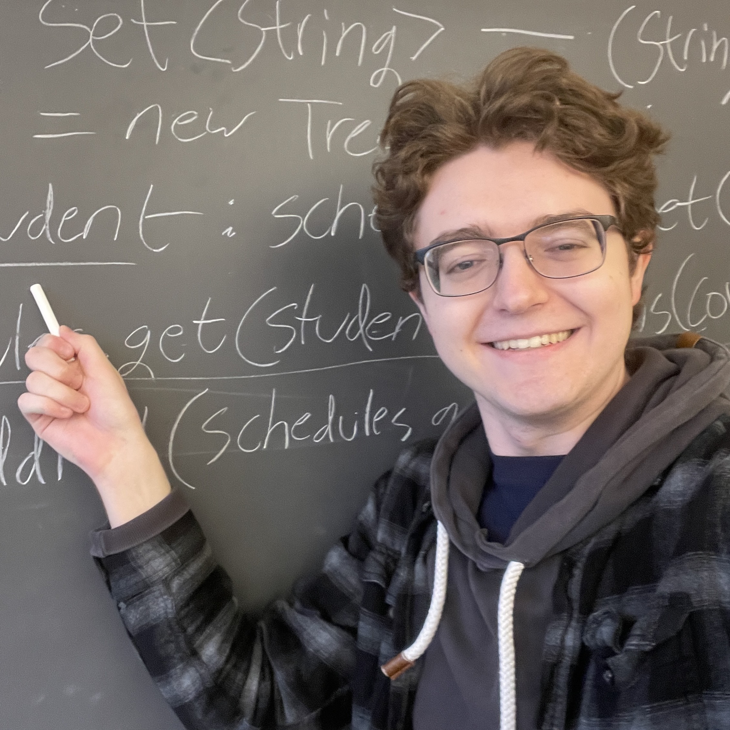
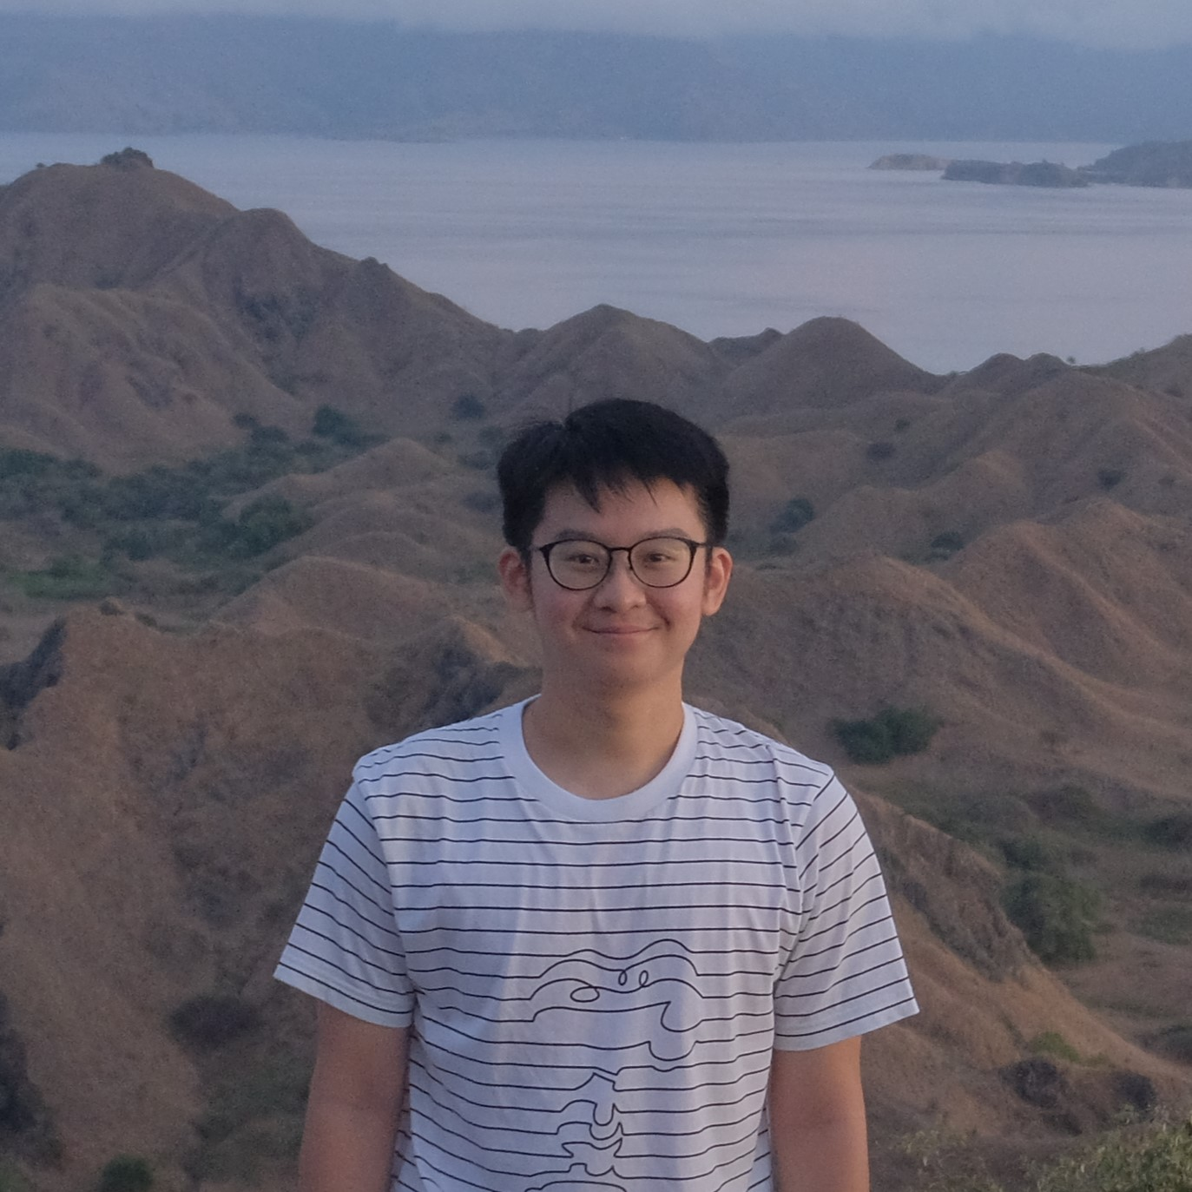
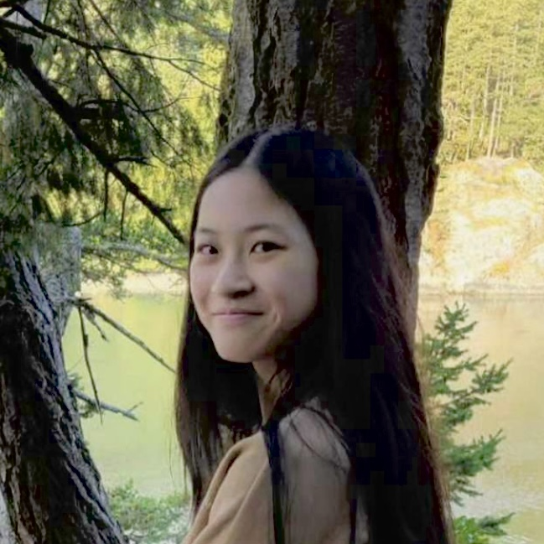
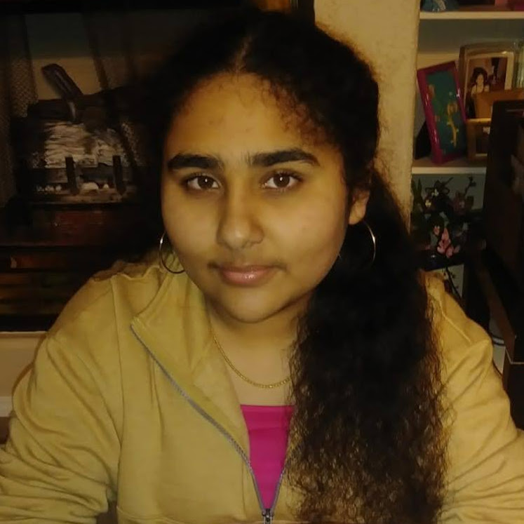
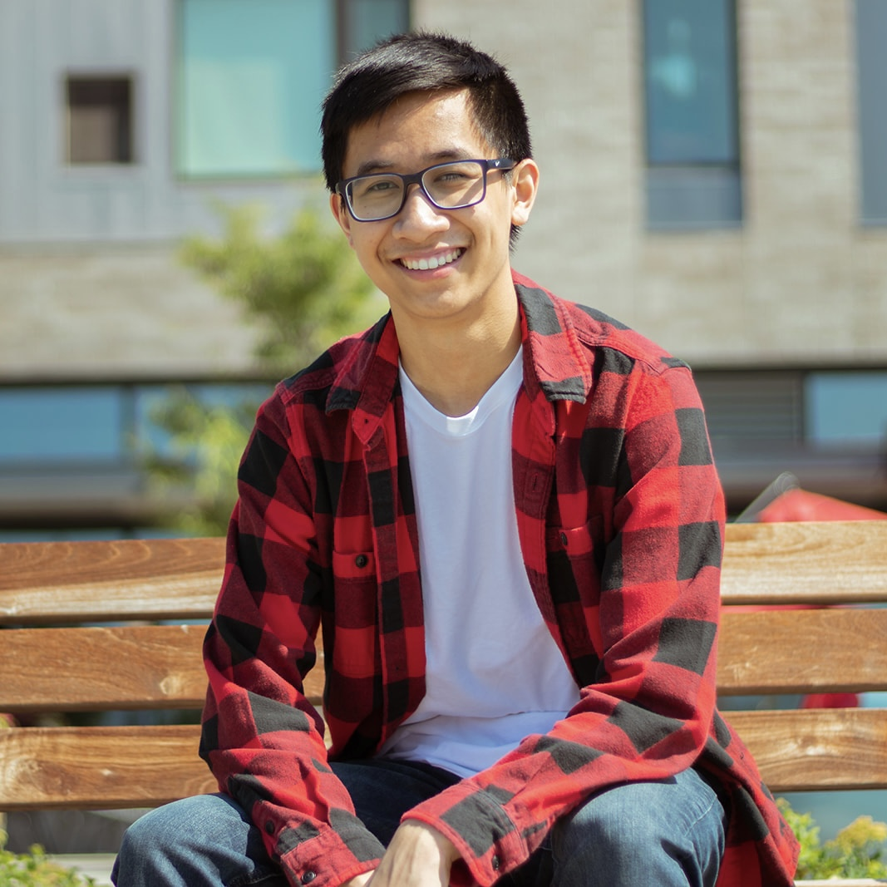
Tas <3

Slide 6
Students
79 of you!
Strength in numbers
If you’re confused about something, I guarantee someone else is too!
Students come from all different backgrounds & majors & interests in future career goals
Focus on us trying to help you build community
Meet others in the class to form study groups or have people you can work with.

Slide 7
What is this Class?
CSE 121 – Computer Programming I or Other Programming Experience
CSE 122 – Computer Programming II
Print statements
Data types (int, String, boolean)
Methods / Functions
Parameters
Returns
Control structures
Loops
Conditionals
File I/O
Arrays
Computational Thinking (language agnostic)
Decomposing large problems into smaller, manageable, subproblems
Using data structures
List
Stacks / Queues
Sets
Maps
Object Oriented Programming
Interfaces

Slide 8
Prerequisite Knowledge
Students entering CSE 122 are coming from many of different backgrounds
UW: CSE 121 or other intro programming course
Community College: Intro Programming Course
High School Programming Course (e.g., UWHS, AP CS, IB CS, etc.)
Self-taught or other previous experience
Importantly: CSE 122 is in Java, but we do not expect prior experience in Java! Do expect knowing the list of CSE 121 topics in some language.
Students who do not have experience in Java will be focusing on practicing the programming skills you know in a new language!
You will find the Java Tutorial and Programming Assignment 0 very helpful!
If you want to know if this class is the right fit for you, take the Allen School Self-Placement Test

Slide 9
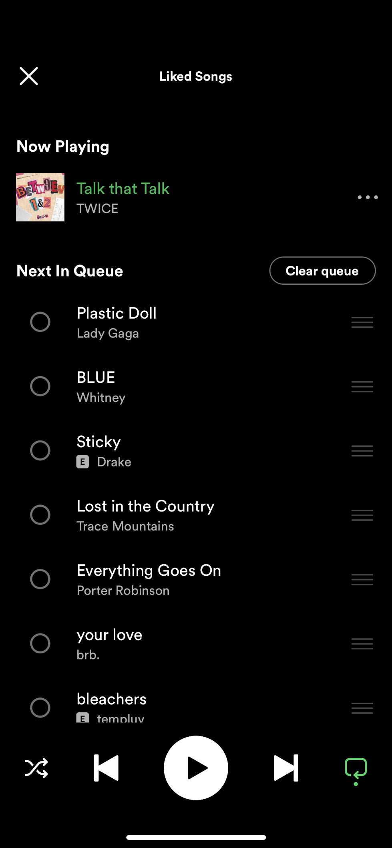
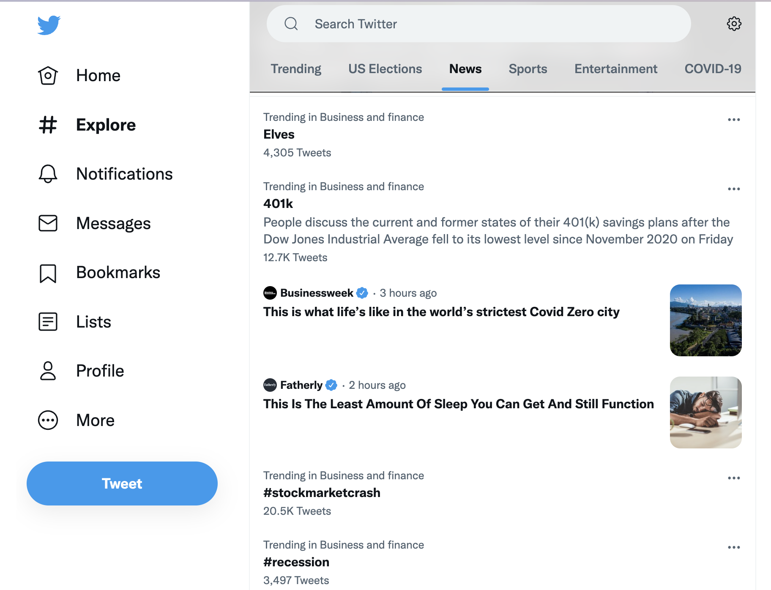
Why 122?
1. Build a strong foundation of data structures that will let you tackle the biggest problems in computing
122 Data Structures
Source: Twitter 9/23
Source: Hunter’s Spotify
Source: Ethical CS

Slide 10
Why 122?
2. Learn an important structural pattern for representing objects in code to make our code more reusable and maintainable and easier to understand.
Java is designed around this idea of objects. We haven’t been leveraging that yet!
Used in almost every real-world software project.

Slide 11
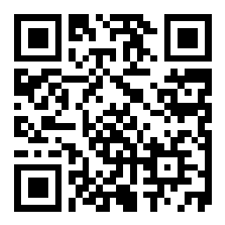
Poll: Why are you taking this class?
Answer on sli.do #cse122 or using this QR code:

Slide 12
Lecture Outline
Introductions
About this Course
Course Components & Tools
Policies
Making the Most of this Class
Intro/Review Java

Slide 13
Course Components
Meetings
LECTURES
(x19)
SECTIONS
(x18)
We’re here!
Introduce concepts, practice ideas, discuss applications.
Pre-class materials to prepare for class each day. Due before class.
Held in person
More practice, reviews, applications
TA advice, how to be an effective student
Preparation for quizzes / exams
Assessments
PROGRAMMING ASSIGNMENTS
(x4)
CREATIVE PROJECTS
(x4)
QUIZZES
(x3)
EXAM
(x1)
Structured assignments
Programming in Java
Applying & implementing course concepts
More open-ended assignments
Explore new ideas and applications
Take home, open-note, open-internet
~45 minutes
Culminating exam
More details to come

Slide 14
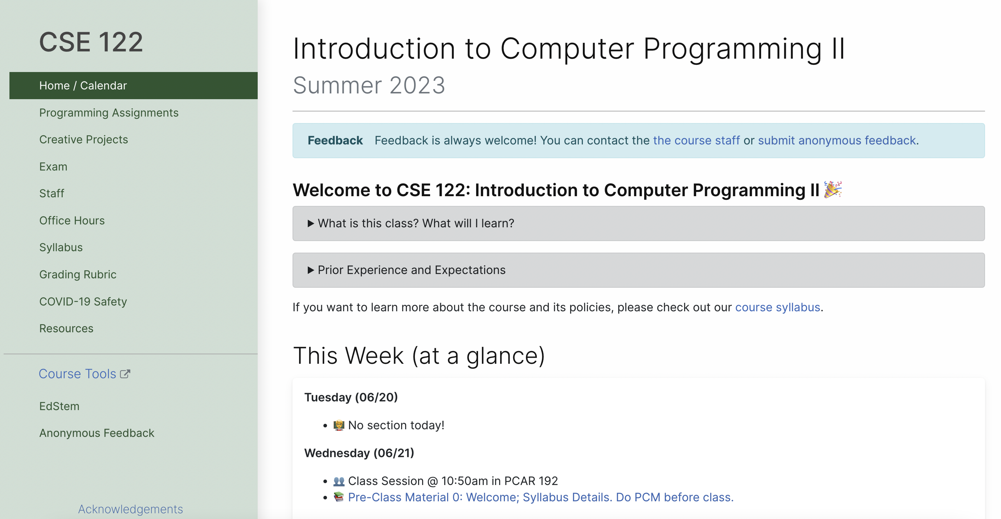
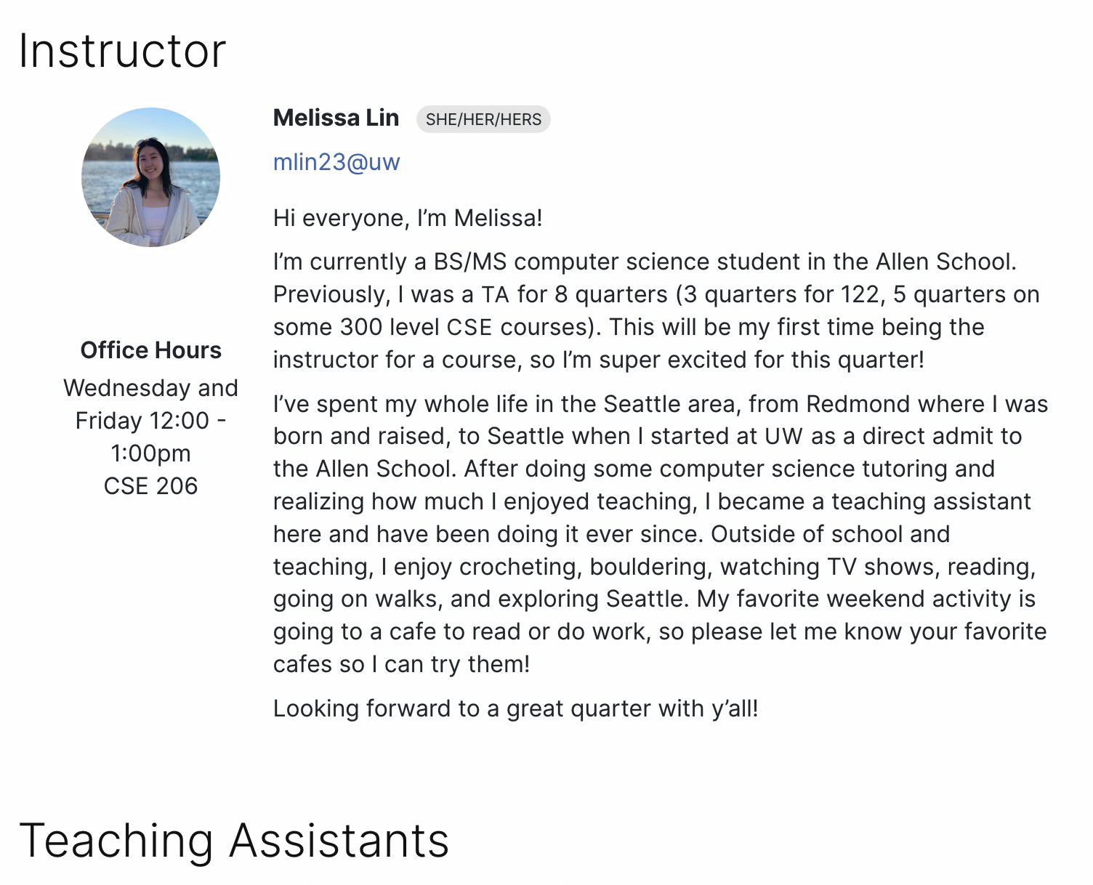
Course Website
cs.uw.edu/122
Get to know the staff
Contains most course info – check frequently!
Announcements, Calendar, Lecture Slides, Office Hours schedule, Staff Bios, Important Links

Slide 15
Other Course Tools
My Digital Hand
Queueing in office hours
IntelliJ
Develop offline
Visual debugger
Ed
Community & Information
Discussion Board (please ask & answer!; anonymous option)
Chat
Announcements
Pre-Class Materials / Section Handouts
Assignments
Online IDE
Submit assignments
View Feedback
Canvas
Gradebook
Lecture recordings
Sli.do
In-class activities (ungraded)
No account needed

Slide 16
Lecture Outline
Introductions
About this Course
Course Components & Tools
Policies
Making the Most of this Class
Intro/Review Java

Slide 17
Resubmissions
Learning is a challenging process that takes time, it doesn’t always happen on your first try.
Each week, one previous Programming Assignment or Creative Project can be resubmitted
Must be accompanied by a short write up explaining changes
Grade on resubmission completely replaces original grade.
See syllabus for more details

Slide 18
Collaboration
These concepts are challenging: we strongly encourage discussion + collaboration!
Don’t attempt to gain credit for something you didn’t do
In general, share ideas and work together, but don’t copy work. Never show someone else your code or solution write up.
For any ungraded work (e.g., pre-class materials) there is no concern about academic misconduct! You should be collaborating on those without reservation.
On graded assignments you should still collaborate, but the code you write should be of your own creation.
Always cite the help you receive on graded work
Withdrawal Policy
Read full policy in Syllabus

Slide 19
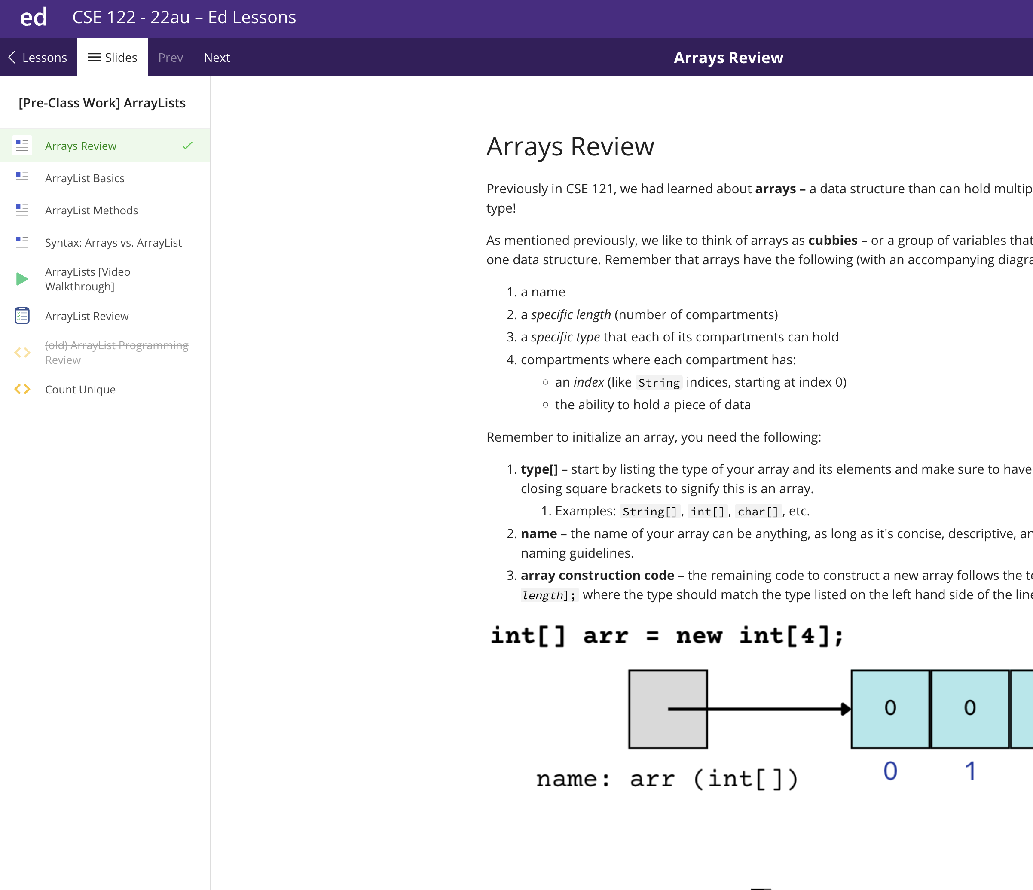
Textbook
Pre-class Materials
All required readings are available free on Ed!
Should be finished before class (not graded)
Optional Textbook
Building Java Programs by Reges and Stepp (5th Edition)
Not required but does add another perspective. Will reference relevant chapters.
Advice: only purchase if you learn best with a textbook, otherwise not recommended.

Slide 20
Lecture Outline
Introductions
About this Course
Course Components & Tools
Policies
Making the Most of this Class
Intro/Review Java

Slide 21
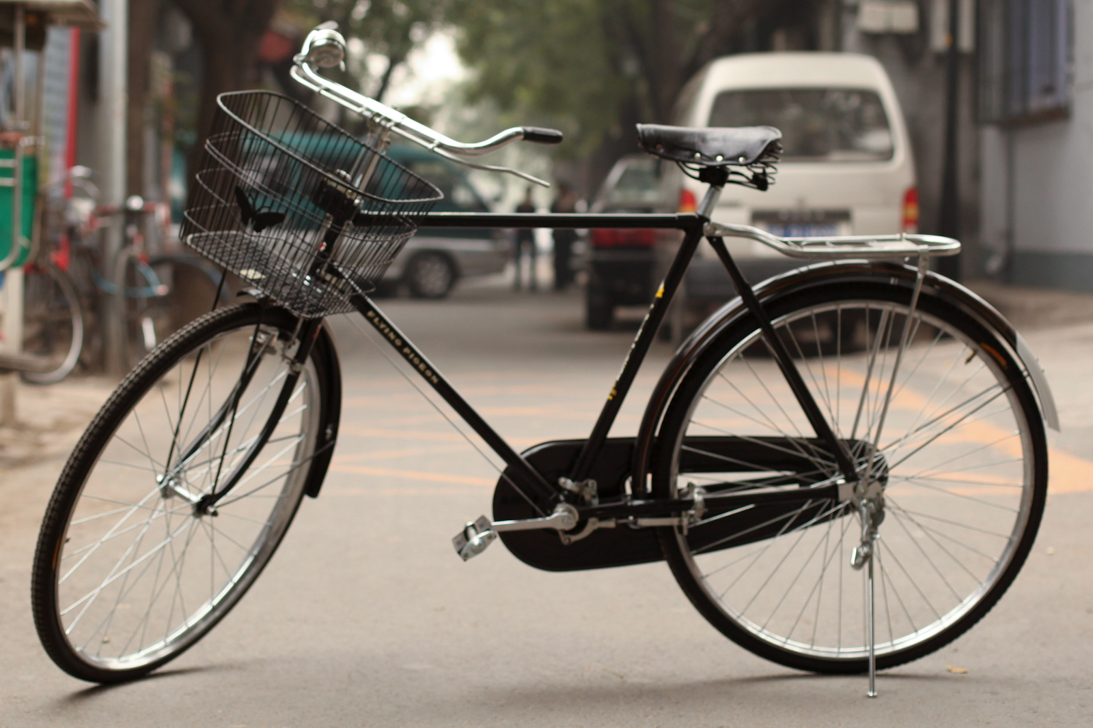
How Learning Works
Learning requires active participation in the process. It’s not as simple as sitting and listening to someone talk at you.
Requires deliberate practice in learning by doing
Benefits from collaborative learning
Hybrid classroom model
Asks you to do some preparation before class in the form of readings and practice problems.
Should take ~30 minutes a day
Class will start with brief recap, then pick up where the reading and practice problems leave off.
Attendance isn’t graded, but showing up and trying is the first step in succeeding in the class!
Pre-class materials are ungraded, but
It’s okay if you find them challenging! That means you are learning!

Slide 22
Metacognition
Metacognition: asking questions about your solution process.
Examples:
While debugging: explain to yourself why you’re making this change to your program.
Before running your program: make a prediction of what you expect to see.
When coding: be aware when you’re not making progress, so you can take a break or try a different strategy.
When designing:
Explain the tradeoffs with using a different data structure or algorithm.
Reflect on how you ruled out alternative ideas along the way to a solution.
When studying: what is the relationship of this topic to other ideas in the course?
After coding: reflect on the process – what were the challenges?

Slide 23
Getting Help
Discussion Board
Feel free to make a public or private post on Ed
We encourage you to answer other peoples’ questions! A great way to learn
Introductory Programming Lab (Office Hours)
TAs can help you face to face in office hours, and look at your code
You can go to the IPL with any course questions, not just assignments
Section
Work through related problems, get to know your TA who is here to support you
Your Peers
We encourage you to form study groups! Discord or Ed are great places to do that
Email
We prefer that all content and logistic questions go on the Ed discussion board (even if you make them private).
For serious personal circumstances, you can email me directly. It never hurts to email me, but if it’s a common logistic question, I may politely ask you to post on the discussion board.

Slide 24
Help Us Improve!
This is a very new course! We are always looking for feedback on how to improve the class for you and for future students! Thank you in advance for your patience and understanding as we develop everything. ☺
We really value your feedback!
Let us know what’s working and what isn’t working for you
Something that went well in another course? Tell us about it!
Post on the discussion board (can be public/private).
Note: Anonymous here is anonymous to other students, not to the staff.
Submit feedback via the Anonymous Feedback Tool (linked under “Course Tools” on the website)

Slide 25
The World Around CSE 122
Our goal is to give you a great CSE 122 experience
But CSE 122 does not exist in a vacuum – there’s a lot going on in the world right now that can impact your education
We’ve designed course policies for maximum flexibility
But we cannot cover every individual situation
Please reach out if you need accommodations of any kind to deal with these unfamiliar situations

Slide 26
Lecture Outline
Introductions
About this Course
Course Components & Tools
Policies
Making the Most of this Class
Intro/Review Java

Slide 27
Hello World
Java Specifics
Every program needs a class
Runnable programs need a main method (signature must exactly match)
System.out.println to print
"Hello world" is a String
Running on Ed
Run runs your program
Mark submits and runs autograder
Submit as many times as you like
“Shotgun submission” = Unhelpful habit
Solution shows solution (if applicable)
public class HelloWorld { public static void main(String[] args) { System.out.println("Hello world"); } }

Slide 28
“Homework” for Next Time
First assignment will be released Friday, but there are some things to do in the meantime.
TODOs this week
Go meet your TA and classmates in Thursday’s quiz section
⭐️ Complete the pre-class material for Friday (see calendar)
Read over syllabus

