Slide 1
Maps
BEFORE WE START
Talk to your neighbors:
What is your least favorite root vegetable?
Music: Miya’s 23wi CSE 122 Playlist

Slide 2
Lecture Outline
Announcements
Map Review
Debrief PCM: Count Words
Practice: joinRosters
Practice: mostFrequentStart

Slide 3
Announcements
Quiz 1 is Tuesday, Feb 7
Retake and Resubmission forms for next week will be posted later today
C1 due tomorrow (Thurs, Feb 2)
P2 released Fri, Feb 3

Slide 4
Lecture Outline
Announcements
Map Review
Debrief PCM: Count Words
Practice: joinRosters
Practice: mostFrequentStart

Slide 5
🎉 NEW DATA STRUCTURE DAY!! 🎉
Map

Slide 6
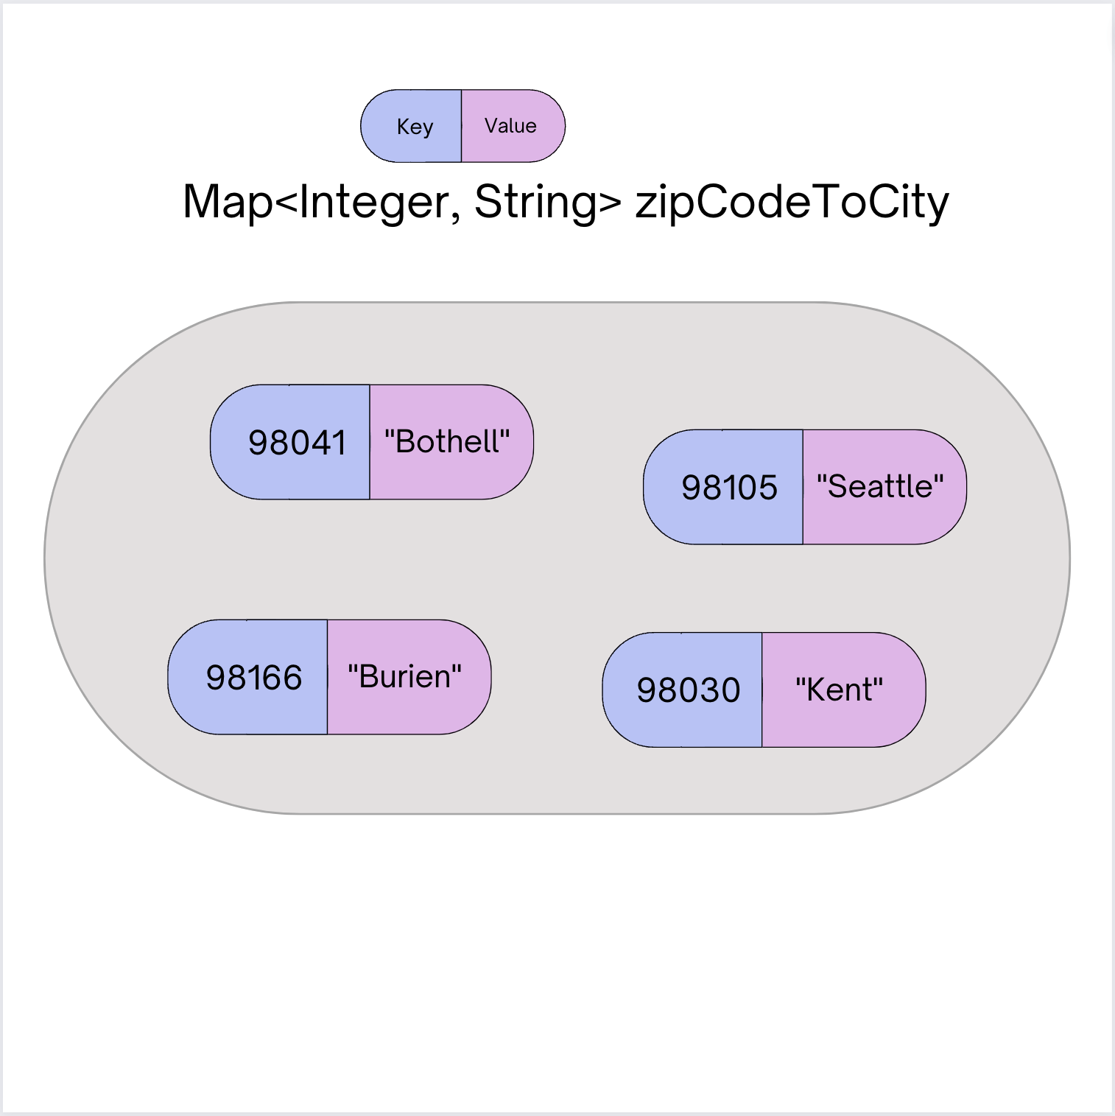
(PCM) Map - What is it good for?
What is it?
Keeps associations between unique keys and (non-unique) values
All keys are one type. All values are one type
But a keys might be a different type from values
Dynamically sized
What is Map particularly good at?
put(key, value) - associates key with a value
get(key) - returns the value associated with a key (if any)
put and get are either super fast (HashMap) or quite fast (TreeMap)

Slide 7
(PCM) Abstract Data Types
more
abstract
ADT
Examples: queue, stack, list,
set, map (aka dictionary)
Language agnostic
Language specific
Interface
Examples: Queue<>, List<>
Set<>, Map<>
more
specific
Implementation
Examples: ArrayList, LinkedList, array, Stack, 2D array,
HashSet, TreeSet, HashMap, TreeMap

Slide 8
(PCM) Programming with Maps
Interface: Map
Implementations: TreeMap, HashMap
// Making a Map Map<String, String> favArtistToSong = new TreeMap<>(); // adding elements to the above Map favArtistToSong.put("Steve Lacy", "Dark Red"); favArtistToSong.put("The Cranberries", "Linger"); favArtistToSong.put("Umi", "Bet"); // Getting a value for a key String song = favArtistToSong.get("Umi"); System.out.println(song);

Slide 9
(PCM) Programming with Maps
Methods | Description
put(key, value) | adds a mapping from the given key to the given value; if the key already exists, replaces its value with the given one
get(key) | returns the value mapped to the given key (null if not found)
containsKey(key) | returns true if the map contains a mapping for the given key
remove(key) | removes any existing mapping for the given key
keySet() | returns a set of all keys in the map
values() | returns a collection of all values in the map
clear() | removes all key/value pairs from the map
size() | returns the number of key/value pairs in the map
isEmpty() | returns true if the map's size is 0
toString() | returns a string such as "{a=90, d=60, c=70}"

Slide 10
(PCM) Map Implementations
One Map Interface
Two Map implementations*
TreeMap – Pretty fast, sorted keys
HashMap – Extremely fast, unsorted keys
*similar to the TreeSet and HashSet implementations
Map<String, Integer> map1 = new TreeMap<>(); Map<String, Integer> map2 = new HashMap<>();
...

Slide 11
Select the method calls required to modify the given map m as follows:
Assume m’s contents are
98030="Kent"
98178="Seattle"
98166="Burien"
98041="Bothell"
We want to modify m so that its contents are
98030="Kent"
98178="Tukwila"
98166="Burien"
98041="Bothell"
98101="Seattle"
98126="Seattle"
m.put(98178, "Tukwila");
m.remove(98178);
m.put(98126, "Seattle");
m.get(98178, "Seattle");
m.put(98101, "Seattle");

Slide 12
Select the method calls required to modify the given map m as follows:
Assume m’s contents are
98030="Kent"
98178="Seattle"
98166="Burien"
98041="Bothell"
We want to modify m so that its contents are:
98030="Kent"
98178="Tukwila"
98166="Burien"
98041="Bothell"
98101="Seattle"
98126="Seattle"
m.put(98178, "Tukwila");
m.remove(98178);
m.put(98126, "Seattle");
m.get(98178, "Seattle");
m.put(98101, "Seattle");

Slide 13
Select the method calls required to modify the given map m as follows:
Assume m’s contents are
98030="Kent"
98178="Seattle"
98166="Burien"
98041="Bothell"
We want to modify m so that its contents are:
98030="Kent"
98178="Tukwila"
98166="Burien"
98041="Bothell"
98101="Seattle"
98126="Seattle"
m.put(98178, "Tukwila");
m.remove(98178);
m.put(98126, "Seattle");
m.get(98178, "Seattle");
m.put(98101, "Seattle");

Slide 14
Lecture Outline
Announcements
Map Review
Debrief PCM: Count Words
Practice: joinRosters
Practice: mostFrequentStart

Slide 15
Lecture Outline
Announcements
Map Review
Debrief PCM: Count Words
Practice: joinRosters
Practice: mostFrequentStart

Slide 16
joinRosters
Write a method joinRosters that combines a Map from student name to quiz section, and a Map from TA name to quiz section and prints all pairs of students/TAs.
For example, if studentSections stores the following map:
{Alan=AC, Jerry=AB, Nina=AA, Sharon=AB, Steven=AB, Tanya=BA}
And taSections stores the following map
{Ben=BA, Melissa=AA, Andrew=AB, Atharva=AC}
AC: Alan – Atharva
AB: Jerry – Andrew
AA: Nina - Melissa
AB: Sharon – Andrew
AB: Steven – Andrew
BA: Tanya - Ben

Slide 17
Lecture Outline
Announcements
Map Review
Debrief PCM: Count Words
Practice: joinRosters
Practice: mostFrequentStart

Slide 18
mostFrequentStart
Write a method called mostFrequentStart that takes a Set of words and does the following steps:
Organizes words into “word families” based on which letter they start with
Selects the largest “word family” as defined as the family with the most words in it
Returns the starting letter of the largest word family (and if time, should update the Set of words to only have words from the selected family).

Slide 19
mostFrequentStart
For example, if the Set words stored the values
["hello", "goodbye", "library", "literary", "little", "repel"]
The word families produced would be
'h' -> 1 word ("hello")
'g' -> 1 word ("goodbye")
'l' -> 3 words ("library", "literary", "little")
'r' -> 1 word ("repel")
Since 'l' has the largest word family, we return 3 and modify the Set to only contain Strings starting with 'l'.

