Slide 1
Introduction to Objects
BEFORE WE START
Talk to your neighbors:
Favorite study spot on campus?

Slide 2
Lecture Outline
Announcements
Nested Collection Practice
Bias in Data Discussion
OOP Review
Example
Abstraction

Slide 3
Announcements
Quiz 1 yesterday
Retakes starting next week
Quiz 1 grades & Quiz 0 Retake grades out soon
P2 Absurdle out
get started early!
due 5/11

Slide 4
Lecture Outline
Announcements
SearchEngine Recap
Bias in Data Discussion
OOP Review
Example
Abstraction

Slide 5
Lecture Outline
Announcements
SearchEngine Recap
Bias in Data Discussion
OOP Review
Example
Abstraction

Slide 6
Data Bias
Common Misconception: Models or Artificial Intelligence (AI) are somehow “less biased” or “more objective” than humans. Not true.
The programs we use operate on real-world data, and will often reflect the biases that data contains
Have to carefully consider the context and limitations of the data we gather. If the data an algorithm is built on is vastly different than the context in which it’s used, some pretty awful outcomes can happen

Slide 7
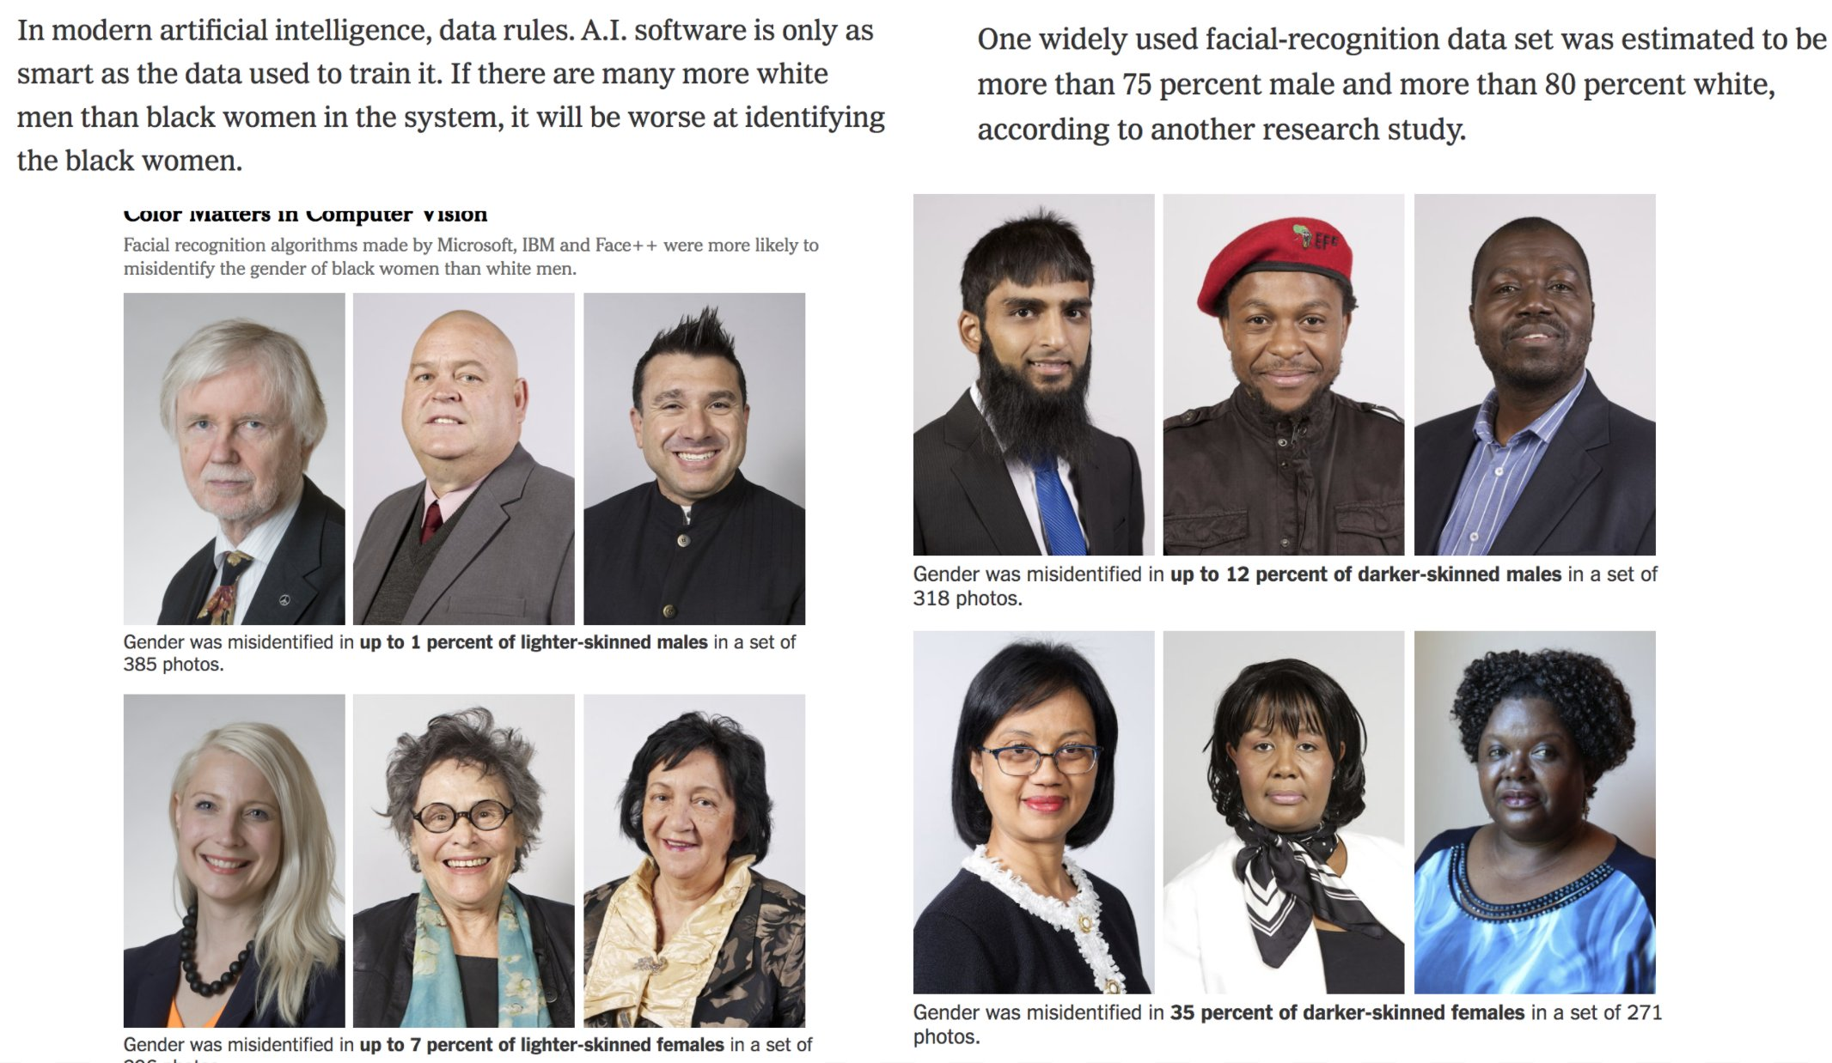
Data Bias
citation:
http://gendershades.org/

Slide 8
What to do?
Obviously, ideal to have datasets that aren’t biased in the first place.
But might not always be possible if we can’t fix the sources of the bias in the real world...
AI/Models aren’t “neutral” or “more objective”, they just quickly and automatically codify the status quo (and perpetuate biases)
Garbage in → Garbage out
Lots of work going into how to de-bias models even if they are trained on biased data. Active area of research!
Key take-away: None of this comes “for free”, requires hard work to fight bias
Ask ourselves:
What biases might be present in my data?
What assumptions might I be making about who is using my program?
How can I write code to be more inclusive?
What happens when (not if) mistakes happen? Who potentially benefits and who is potentially harmed?

Slide 9
Lecture Outline
Announcements
SearchEngine Recap
Bias in Data Discussion
OOP Review
Example
Abstraction

Slide 10
(PCM) Object Oriented Programming (OOP)
object-oriented programming (OOP): Program as interaction between things (ie. objects)
Code that represent things
We’re going to start writing our own objects!
compare to:
procedural programming: Program as a list of steps
Code that does things

Slide 11
(PCM) State & Behavior
Object - a grouping of related state and behavior
State - information the object holds
ArrayList state:
Behavior - things the object can do
ArrayList behavior:
elements, size
add an element, remove an element, get size, etc

Slide 12
(PCM) Syntax
public class MyObject {
// fields (aka instance variables)
type1 fieldName1;
type2 fieldName2;
...
// instance methods
public returnType methodName(...) {
...
}
}
State
Behavior

Slide 13
(PCM) Classes & Objects
Classes can define the template for an object
📰 Like the blueprint for a house!
Objects are the actual instances of the class
🏠 Like the actual house built from the blueprint!
Each instance has its own state
We create a new object of a class with the new keyword
e.g., Scanner console = new Scanner(System.in);

Slide 14
Lecture Outline
Announcements
SearchEngine Recap
Bias in Data Discussion
OOP Review
Example
Abstraction

Slide 15
Representing a point
How would we do this given what we knew last week?
Maybe int x, int y?
Maybe int[]?

Slide 16
Representing a point
Let’s make a class instead!
int x, int y
Easy to mix up x, y
Just two random ints floating around – easy to make mistakes!
int[]
Not really what an array is for
Again, just two ints – just have to “trust” that we’ll remember to treat it like a point

Slide 17
Lecture Outline
Announcements
SearchEngine Recap
Bias in Data Discussion
OOP Review
Example
Abstraction

Slide 18
(PCM) Abstraction
The separation of ideas from details, meaning that we can use something without knowing exactly how it works.
You could use the Scanner class without understanding how it worked internally!

Slide 19
(PCM) Client v. Implementor
We have been the clients of many objects this quarter!
Now we will become the implementors of our own objects!

