Slide 1
Maps
BEFORE WE START
Talk to your neighbors:
What is your least favorite root vegetable?
Music: Hunter/Miya’s Playlist

Slide 2
(Review) Choosing a Data Structure: Tradeoffs
You got a bit of practice with this in your quiz sections on Tuesday!
Solving the same problem with an ArrayList, a Stack, and a Queue
Things to consider:
Functionality
If you need duplicates or indexing, Sets are not for you!
Efficiency
Different data structures are “good at” different things!

Slide 3
Lecture Outline
Map Review
Debrief PCM: Count Words
Practice: Combine Rosters
Practice: mostFrequentStart

Slide 4
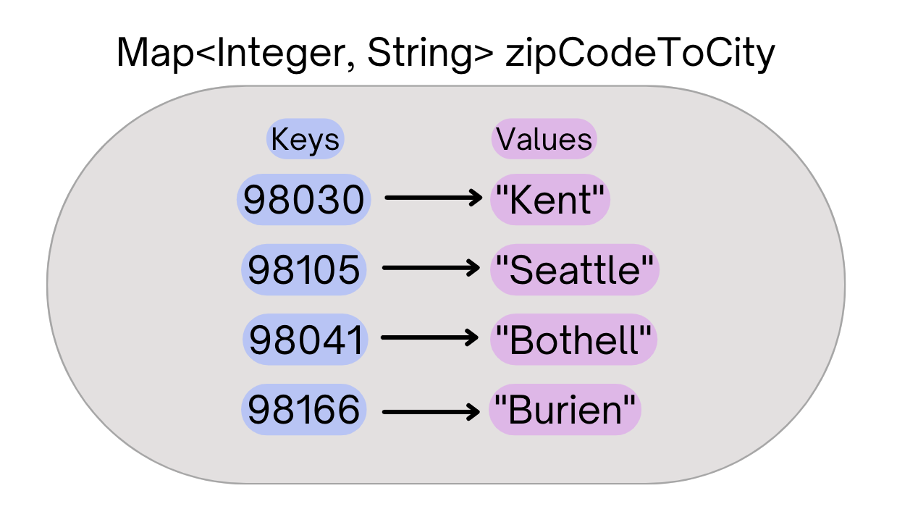
(PCM) Map ADT
Data structure to map keys to values
Keys can be any* type; Keys are unique
Values can be any type
Example: Mapping nucleotides to counts!
Operations
put(key, value): Associate key to value
Overwrites duplicate keys
get(key): Get value for key
remove(key): Remove key/value pair
Same as Python’s dict

Slide 5
(PCM) Programming with Maps
Interface: Map
Implementations: TreeMap, HashMap
// Making a Map Map<String, String> favArtistToSong = new TreeMap<>(); // adding elements to the above Map favArtistToSong.put("Steve Lacy", "Dark Red"); favArtistToSong.put("The Cranberries", "Linger"); favArtistToSong.put("Umi", "Bet"); // Getting a value for a key String song = favArtistToSong.get("Umi"); System.out.println(song);

Slide 6
(PCM) Programming with Maps
Methods | Description
put(key, value) | adds a mapping from the given key to the given value; if the key already exists, replaces its value with the given one
get(key) | returns the value mapped to the given key (null if not found)
containsKey(key) | returns true if the map contains a mapping for the given key
remove(key) | removes any existing mapping for the given key
clear() | removes all key/value pairs from the map
size() | returns the number of key/value pairs in the map
isEmpty() | returns true if the map's size is 0
toString() | returns a string such as "{a=90, d=60, c=70}"
keySet() | returns a set of all keys in the map
values() | returns a collection of all values in the map

Slide 7
(PCM) Map Implementations
Our first data structures with marked differences in how their implementations behave
One Map ADT / Interface
Two Map implementations
TreeMap – Pretty fast, sorted keys
HashMap – Extremely fast, unsorted keys
Map<String, Integer> map1 = new TreeMap<>(); Map<String, Integer> map2 = new HashMap<>();
...

