Slide 1
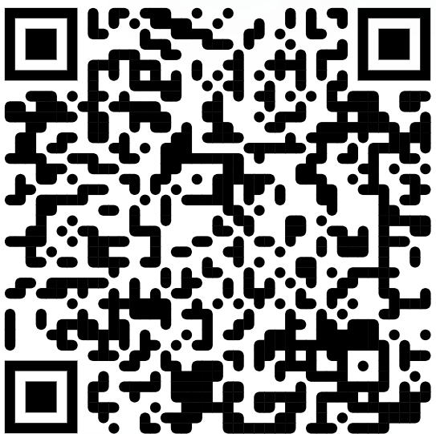
ArrayList Continued
BEFORE WE START
Talk to your neighbors:
Share a boring fact about yourself
Music: Hunter/Miya’s Playlist

Slide 2
Lecture Outline
Announcements
Warm Up
Large Example
Helpful for Creative Project 0

Slide 3
Announcements
Quiz 0 will be held in your quiz section on Tuesday (Oct 11)
Details and logistic information in announcement
Programming Assignment 0 (P0) was due on yesterday (Thursday, Oct 6)
You can expect grades and feedback to be released sometime around Thursday next week
Creative Project 0 will be released later today
It will be due next Thursday (Oct 13)

Slide 4
Lecture Outline
Announcements
Warm Up
Large Example
Helpful for Creative Project 0!

Slide 5
topN
Write a method called topN that accepts an ArrayList of characters list and an int n and returns a new ArrayList of characters that contains the first n elements of list.
For example, if list contained ['g', 'u', 'm', 'b', 'a', 'l', 'l’], a call to topN(list, 4) would return an ArrayList containing ['g', 'u', 'm', 'b']

Slide 6
Lecture Outline
Announcements
Warm Up
Large Example
Helpful for Creative Project 0!

Slide 7
Movie Favorites
We will write a program called MovieFavorites.java that manages a list of favorite movies for a user (using an ArrayList) and allows the user to perform various different operations on their stored list of favorite movies.

Slide 8
Movie Favorites Operations
Load a list of favorites in from a file provided by the user.
Compare the stored list of favorites to another list of favorites provided by the user in another file.
Report the top n favorites according to the list, where the user can specify n.
Move a specific favorite down in the list
Save the current list of favorites to a file provided by the user.
Add a list of favorites in a user-provided file to the stored list of favorites at a specified location.

Slide 9
Movie Favorites: Development Strategy
Set up main scaffold code
Menu loop
Each behavior, one at a time
You’ll see a similar development strategy in Creative Project 0’s specification – we recommend you follow it!

Slide 10
Movie Favorites Operations
Load a list of favorites in from a file provided by the user.
Compare the stored list of favorites to another list of favorites provided by the user in another file.
Report the top n favorites according to the list, where the user can specify n.
Move a specific favorite down in the list
Save the current list of favorites to a file provided by the user.
Add a list of favorites in a user-provided file to the stored list of favorites at a specified location.

Slide 11
Movie Favorites Operations
Load a list of favorites in from a file provided by the user.
Compare the stored list of favorites to another list of favorites provided by the user in another file.
Report the top n favorites according to the list, where the user can specify n.
Move a specific favorite down in the list
Save the current list of favorites to a file provided by the user.
Add a list of favorites in a user-provided file to the stored list of favorites at a specified location.
PrintStream!

Slide 12
PrintStream
Allows us to print to an output file.
PrintStream output = new PrintStream(new File("output.txt"));
output.print("hi");
output.println("hello");

Slide 13
addAll
Write a method called addAll that accepts two ArrayLists of Strings mainList and otherList and an integer location as parameters and inserts all of the elements from otherList into mainList at the specified location.

