Slide 1
Conditionals
BEFORE WE START
Talk to your neighbors:
How are you doing (like actually)?
LEC 09
Music: ♣️CSE 121 25su Lecture Tunes ♣️
Instructor:
Hannah Swoffer
TAs:
Abby
Hannah
Julia
Merav
Trey

Slide 2
Agenda
Announcements, Reminders
Conditionals PCM Review
Code Examples!
Conditionals Practice

Slide 3
Announcements, Reminders
C2 released, due Tuesday, July 29th
R3 released, due Tuesday, July 29th
  This is the last time P0 is eligible for resubmission
Quiz 1 on Thursday, July 31st
  Can’t make it? Email Hannah ASAP
Quiz 1 Practice Quizzes 1 will be released later today
  I highly recommend using these to study!
  There are while loops on the practice quizzes, but while loops will not be on Quiz 1

Slide 4
Agenda
Announcements, Reminders
Conditionals PCM Review
Code Examples!
Conditionals Practice

Slide 5
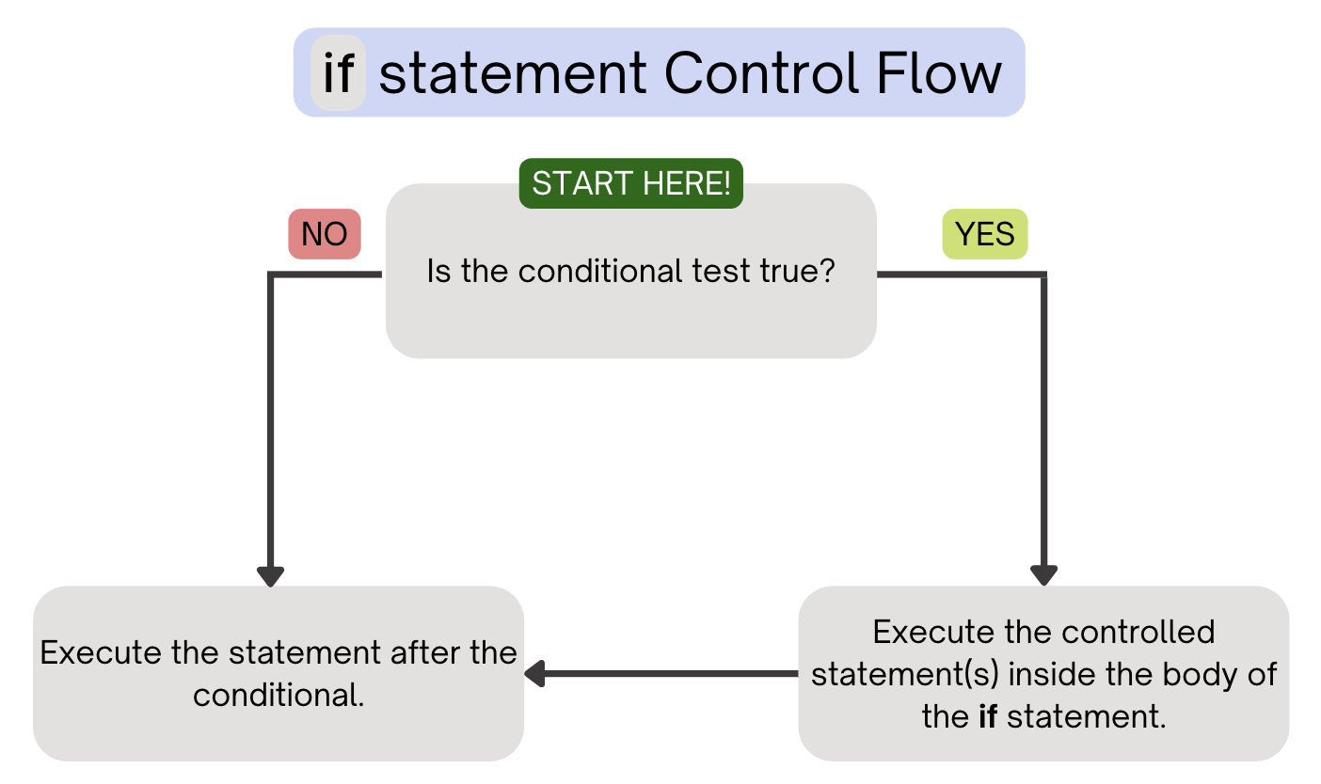
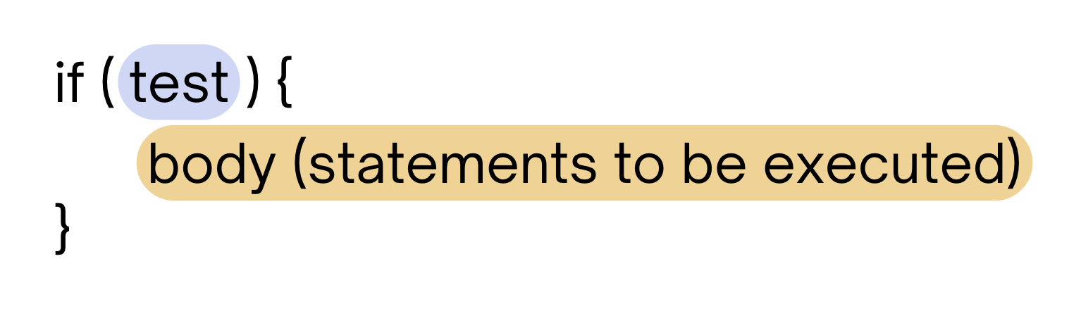
PCM Review: if statements
Executes a block of statements if and only if the test is true

Slide 6
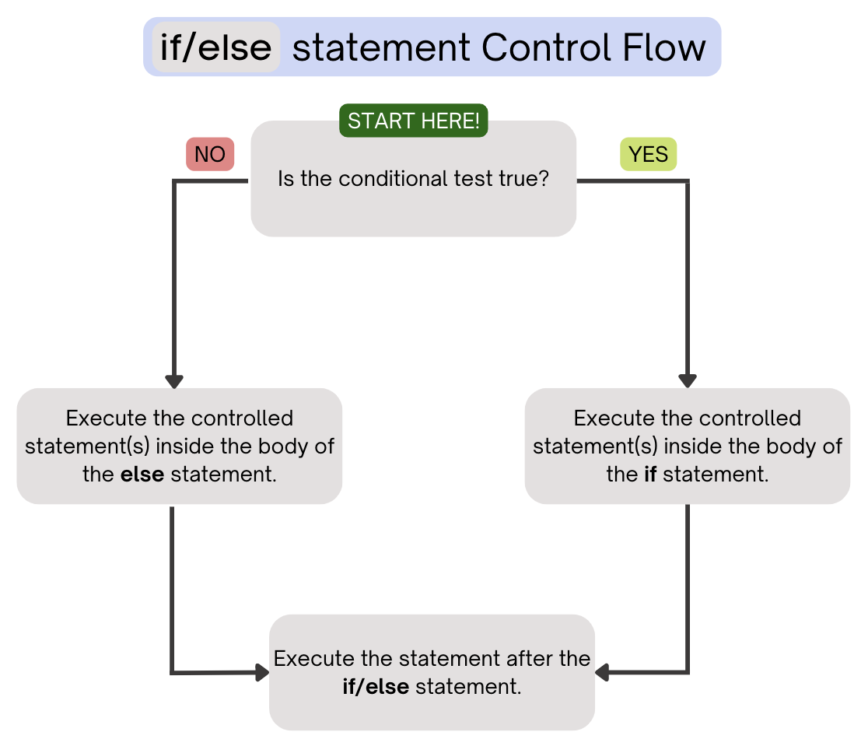
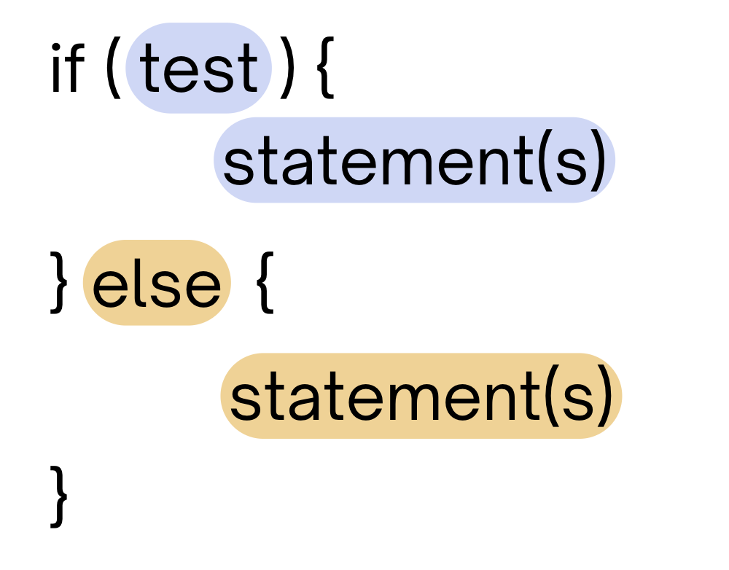
PCM Review: if-else
If the test is true: execute block of statements
If not, execute other block of statements

Slide 7
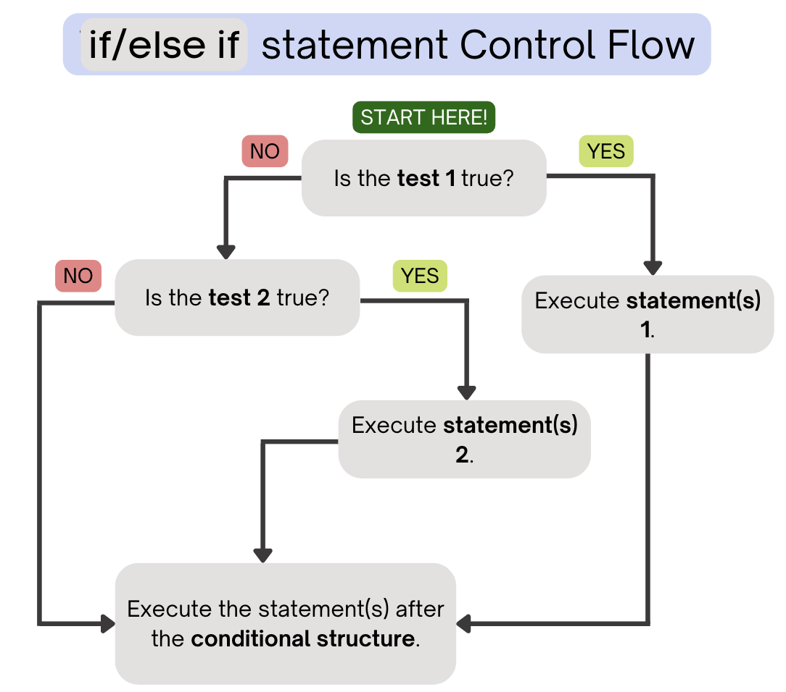
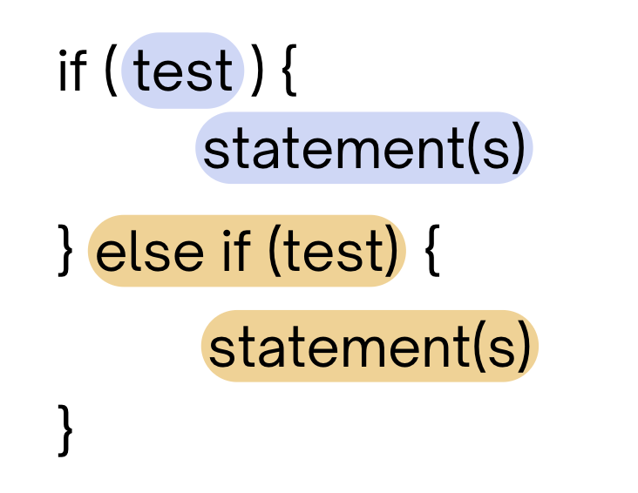
PCM Review: if-else-if
If the first test is true, execute that block
If not, proceed to the next test, and repeat
If none were true, don’t execute any blocks

Slide 8
Think Pair Share: odds and evens (think)
public static void main(String[] args) {
for (int i = 1; i <= 3; i++) {
System.out.print(mystery(i));
}
}
public static String mystery(int n) {
String response = "even ";
if (n % 2 == 1) {
response = "odd ";
} else if (n == 1) {
response = "one ";
}
return response;
}
What does this program output?
A. odd even odd
B. one even odd
C. one even even
D. even even even

Slide 9
Think Pair Share: odds and evens (pair)
public static void main(String[] args) {
for (int i = 1; i <= 3; i++) {
System.out.print(mystery(i));
}
}
public static String mystery(int n) {
String response = "even ";
if (n % 2 == 1) {
response = "odd ";
} else if (n == 1) {
response = "one ";
}
return response;
}
What does this program output?
A. odd even odd
B. one even odd
C. one even even
D. even even even

Slide 10
“Useless” Conditionals
public static void main(String[] args) {
for (int i = 1; i <= 3; i++) {
System.out.print(mystery(i));
}
}
public static String mystery(int n) {
String response = "even ";
if (n % 2 == 1) {
response = "odd ";
} else if (n == 1) {
response = "one ";
}
return response;
}
This else if statement never runs!

Slide 11
Agenda
Announcements, Reminders
Conditionals PCM Review
Code Examples!
Conditionals Practice

Slide 12
Agenda
Announcements, Reminders
Conditionals PCM Review
Code Examples!
Conditionals Practice

Slide 13
Think Pair Share: count (think)
public static int mystery(int num1, int num2) {
int count = 0;
if (num1 == 7) {
count++;
if (num2 < 4) {
count++;
}
}
if (num1 + num2 == 10) {
count++;
} else if (num1 - 2 + num2 == 8) {
count++;
} else {
count++;
}
return count;
}
If num1 is 7 and num2 is 3, what does this method return?
A. 2
B. 3
C. 4
D. 5

Slide 14
Think Pair Share: count (think)
public static int mystery(int num1, int num2) {
int count = 0;
if (num1 == 7) {
count++;
if (num2 < 4) {
count++;
}
}
if (num1 + num2 == 10) {
count++;
} else if (num1 - 2 + num2 == 8) {
count++;
} else {
count++;
}
return count;
}
If num1 is 7 and num2 is 3, what does this method return?
A. 2
B. 3
C. 4
D. 5

